Slide 1
Attribute-Aware Relationship-Based Access Control for Online Social Networks
Yuan Cheng, Jaehong Park and Ravi Sandhu
Institute for Cyber Security
University of Texas at San Antonio
7/14/2014
28th Annual IFIP WG 11.3 Working Conference on Data and Applications Security and Privacy (DBSec 2014)
World-Leading Research with Real-World Impact!

Slide 2
Outline
Relationship-based Access Control (ReBAC)
Motivation
UURAC_{A} Model
Algorithm
Conclusion
© Ravi Sandhu
World-Leading Research with Real-World Impact!
2

Slide 3
Relationship-based Access Control
Users in OSNs are connected by social relationships (user-to-user relationships)
Owner of the resource can control its release based on such relationships between the access requester and the owner
Access conditions are usually based on type, depth, or strength of relationships

Slide 4
Related Work
 | Fong 2009 | Fong 2011 | Carminati 2009a | Carminati 2009b | UURAC_{A}
Relationship Category
Multiple Relationship Types |  | √ | √ | √ | √
Directional Relationship |  | √ | √ |  | √
Model Characteristics
Policy Individualization | √ | √ | √ | √ | √
User & Resource as a Target |  |  |  | (partial) | √
Outgoing/Incoming Action Policy |  |  |  | (partial) | √
Relationship Composition
Relationship Depth | 0 to 2 | 0 to n | 1 to n | 1 to n | 0 to n
Relationship Composition | f, f of f | Exact type sequence | Path of same type | Exact type sequence | Path pattern of different types
Attribute-aware Access Control
Common-friends_{k} | √ |  |  |  | √
User Attributes |  | (partial) |  |  | √
Relationship Attributes |  |  | (partial) |  | √
Passive form of action allows outgoing and incoming action policy
Path pattern of different relationship types makes policy specification more expressive
Attribute-aware access control based on attributes of users and relationships

Slide 5
Motivation
ReBAC usually relies on type, depth, or strength of relationships, but cannot express more complicated topological information
ReBAC lacks support for attributes of users, resources, and relationships
Useful examples include common friends, duration of friendship, minimum age, etc.

Slide 6
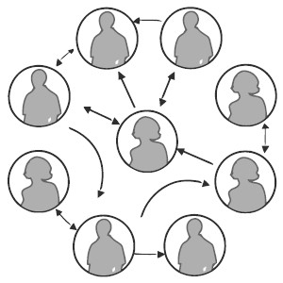
UURAC_{A} Model
Extended from the UURAC model (DBSec 12)
Social graph is modeled as a directed labeled simple graph G=<U, E, Σ>
Nodes U as users
Edges E as relationships
Σ={σ₁, σ₂, …,σ_{n}, σ₁⁻¹, σ₂⁻¹,…, σ_{n}⁻¹}
as relationship types supported

Slide 7
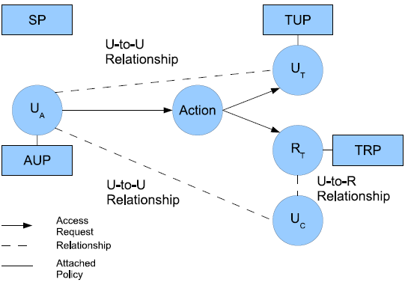
U2U Relationship-based Access Control (UURAC) Model
U_{A}: Accessing User
U_{T}: Target User
U_{C}: Controlling User
R_{T}: Target Resource
AUP: Accessing User Policy
TUP: Target User Policy
TRP: Target Resource Policy
SP: System Policy
Policy Individualization
User and Resource as a Target
Separation of user policies for incoming and outgoing actions
Regular Expression based path pattern w/ max hopcounts (e.g., <u_{a}, (f*c,3)>)

Slide 8
Access Request and Evaluation
Access Request <u_{a}, action, target>
u_{a} tries to perform action on target
Target can be either user u_{t} or resource r_{t}
Policies and Relationships used for Access Evaluation
When u_{a} requests to access a user u_{t}
u_{a}’s AUP, u_{t}’s TUP, SP
U2U relationships between u_{a} and u_{t}
When u_{a} requests to access a resource r_{t}
u_{a}’s AUP, r_{t}’s TRP, SP
U2U relationships between u_{a} and u_{c}

Slide 9
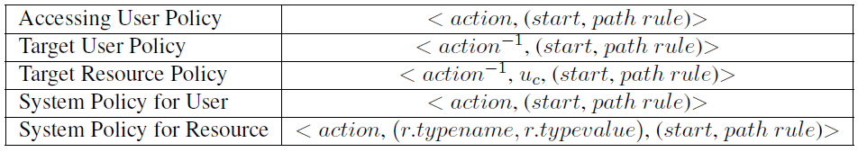
Policy Representation
action⁻¹ in TUP and TRP is the passive form since it applies to the recipient of action
TRP has an extra parameter u_{c} to specify the controlling user
U2U relationships between u_{a} and u_{c}
SP does not differentiate the active and passive forms
SP for resource needs r.typename, r.typevalue to refine the scope of the resource

Slide 10
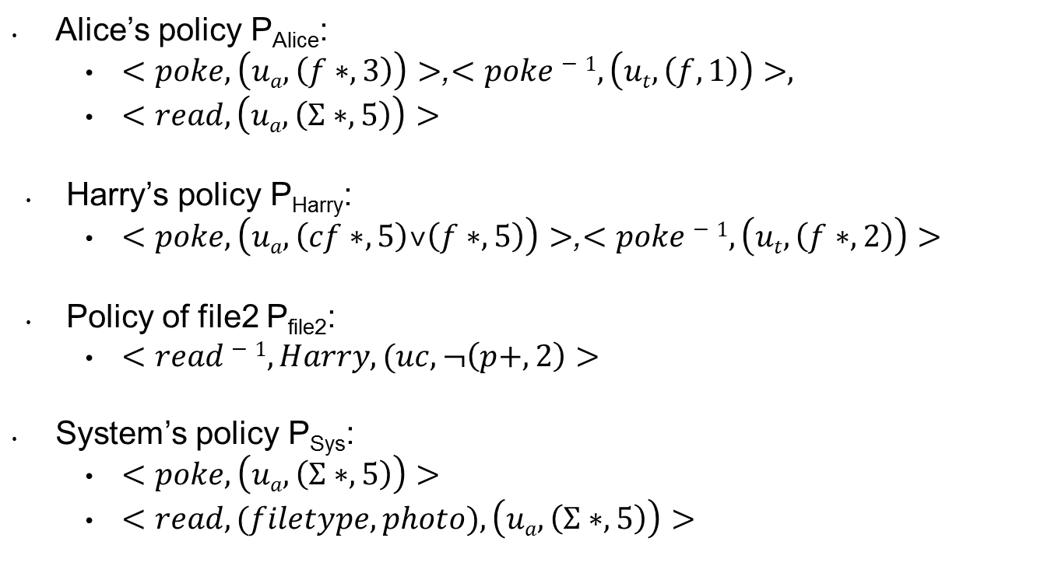
Example
Alice’s policy P_{Alice}:
$<poke,\left(ua,\left(f∗,3\right)\right)>$,$<poke−1,\left(ut,\left(f,1\right)\right)>,$
$<read, \left(ua,\left(Σ∗,5\right)\right)>$
Harry’s policy P_{Harry}:
$<poke,\left(ua,\left(cf∗,5\right)˅\left(f∗,5\right)\right)>$,$<poke−1,\left(ut,\left(f∗,2\right)\right)>$
Policy of file2 P_{file2}:
$<read−1,Harry,(uc,¬\left(p+,2\right)>$
System’s policy P_{Sys}:
$<poke,\left(ua,\left(Σ∗,5\right)\right)>$
$<read,(filetype, photo),\left(ua,\left(Σ∗,5\right)\right)>$

Slide 11
Attributes in OSNs
Node attributes
Define user’s identity and characteristics: e.g., name, age, gender, etc.
Edge attributes
Describe the characteristics of the relationship: e.g., weight, type, duration, etc.
Count attributes
Depict the occurrence requirements for the attribute-based path specification, specifying the lower bound of the occurrence of such path

Slide 12
Attribute-based Policy
<quantifier, f(ATTR(N), ATTR(E)), count ≥ i>
+1
+2
-2
-1
+0
+1
+2
-2
-2
-1
-0
∀[+1, -2], age(u) > 18
∃[+1, -1], weight(e) > 0.5
∃{+1, +2, -1}, gender = “male”
World-Leading Research with Real-World Impact!

Slide 13
Path-checking Algorithm
Strategy: DFS
Parameters: G, path, hopcount, s, t
Access Request: (Alice, read, r_{t})
f
Policy: (read⁻¹, r_{t}, (f*cf*, 3))
п₁
f
f
п₃
Path pattern: f*cf*
Hopcount: 3
п₀
c
c
f
п₂
DFA for f*cf*
World-Leading Research with Real-World Impact!

Slide 14
Path pattern: f*cf*
Hopcount: 3
f
Bob
Dave
Bob
Dave
п₁
f
п₁
f
f
f
f
п₃
п₀
п₃
c
п₀
c
Alice
c
c
Harry
c
f
Alice
f
Ed
Harry
п₂
п₂
f
Case 2: found a matching path and DFA reached an accepting state
Case 1: next node is already visited, thus creates a self loop
Case 3: currentPath matches the prefix of the pattern, but DFA not at an accepting state
f
Carol
Fred
George
f
c
f
f
d: 0
currentPath: Ø
stateHistory: 0
d: 1
currentPath: (H,D,f)
stateHistory: 01
d: 3
currentPath: (H,D,f)(D,B,c)(B,A,f)
stateHistory: 0123
d: 2
currentPath: (H,D,f)(D,B,f)
stateHistory: 011
d: 2
currentPath: (H,D,f)(D,B,c)
stateHistory: 012

Slide 15
Example: Node Attributes
+1
-1
Bob
f
Dave
f
f
Occupation = ‘student’
Occupation = ‘student’
+1
f
Alice
f
Ed
Harry
Occupation = ‘teacher’
f
+1
-1
f
Carol
Fred
George
f
Occupation = ‘student’
f
Occupation = ‘teacher’
f
Occupation = ‘student’
f
<access, (u_{a}, ((f*, 4): ∃[+1, -1], occupation = ‘student’, count ≥ 3)))>
World-Leading Research with Real-World Impact!

Slide 16
Example: Edge Attributes
Since = Feb, 2014
Bob
f
Dave
Since = June, 2013
f
f
Since = Aug, 2008
f
Alice
f
Ed
Since = May, 2009
Harry
Since = Aug, 2010
f
f
Carol
Fred
George
f
f
f
f
<read, Photo1, (u_{a}, ((f*, 3): ∀[+1, -1], duration ≥ 3 month, _)))>
World-Leading Research with Real-World Impact!

Slide 17
Complexity
Time complexity is bounded between [O(dmin^{Hopcount}),O(dmax^{Hopcount}) ], where dmax and dmin are maximum and minimum out-degree of node
Users in OSNs usually connect with a small group of users directly, the social graph is very sparse
Given the constraints on the relationship types and hopcount limit, the size of the graph to be explored can be dramatically reduced
Attribute-based check introduces overhead costs when it finds a possible qualified path, which are proportional to the amount of attributes as well as the type of attribute functions considered

Slide 18
Conclusion
Presented an extended UURAC model for OSNs
Formalized the attribute-based policies and the grammar for policy specifications
Enhanced the path checking algorithm with attribute-awareness

Slide 19

Questions

