Slide 1
A Provenance-based Access Control Model (PBAC)
Institute for Cyber Security
July 18, 2012
PST’12, Paris, France
Jaehong Park, Dang Nguyen and Ravi Sandhu
Institute for Cyber Security
University of Texas at San Antonio

Slide 2
Provenance Data
Information of operations/transactions performed against data objects and versions
  Actions that were performed against data
  Agents who performed actions on data
  Data used for actions
  Data generated from actions

Slide 3
Provenance-aware Systems
Capturing/expressing provenance data
Storing provenance data
Querying provenance data
Using provenance data
Securing provenance data
Access Control
Access Control

Slide 4
Access control in Provenance-aware Systems
Provenance Access Control (PAC)
  Controlling access to provenance data which could be more sensitive than the underlying data
  Needs access control models/mechanisms (e.g, RBAC)
  (Meaningful) control granularity? Right level of abstraction?
Provenance-based Access Control (PBAC)
  Using provenance data to control access to the underlying data
  Provenance-based policy specification
Meaningful granularity of provenance data?

Slide 5
Access Controls in Provenance-aware Systems
Access control
PBAC
PAC
Extended PBAC
Sanitization/Filtering/Redaction/….
Base PBAC
Role-based
PAC
Prov-based
PAC
……….
Prov Data Trust
Common Foundations:
Base Provenance Data,
DName (named abstraction) and
matching DPath (Dependency Path Pattern)

Slide 6
PAC & PBAC in Applications
Common Foundation
  Base provenance data
  Dependency list
    Dependency Name: meaningful, named abstraction
    matching regular expression-based causality dependency path pattern
PAC and PBAC are complementary
  In PAC, control decision can be based on provenance data (PB-PAC)
  In PBAC, PAC can be used for added trustworthiness on provenance data

Slide 7
Provenance Data
Directed Acyclic Graph (DAG)
Causality dependencies between entities (acting users, action processes and data objects)
Dependency graph can be traced for extracting Origin, usage, versioning information, etc.
    PBAC can support origin/usage-based control, Dynamic Separation of Duty (DSOD), workflow control, etc.

Slide 8
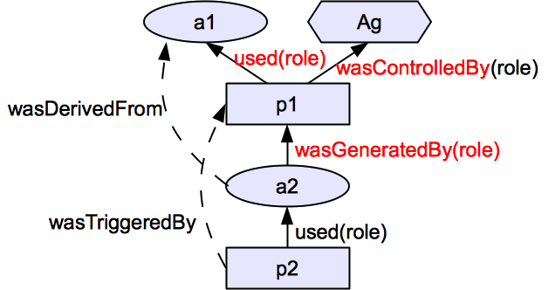
From Open Provenance Model (OPM)
3 Nodes
  Artifact (ellipse)
  Process (Rectangle)
  Agent (Hexagon)
5 Causality dependency edges (not dataflow)
Provenance data: a set of 2 entities & 1 dependency
  E.g., (ag,p1,a1,a2): <p1,ag,c>,<p1,a1,u>,<a2,p1,g>

Slide 9
Direct vs. Indirect Dependencies
Direct dependencies
  Used (u), wasGeneratedBy (g), wasControlledBy (c)
  Captured from transactions as base provenance data
Indirect dependencies
  System-computable dependencies
    using pre-defined dependency names and matching dependency path patterns
  User-declared dependencies
    using pre-defined dependency names

Slide 10
Object Dependency List (DL_{O})
A set of pairs of
  abstracted dependency names (DNAME) and
  regular expression-based object dependency path patterns (DPATH)
Examples
  < wasSubmittedVof, g_{submit}.u_{input} >
  < wasAuthoredBy, wasSubmittedVof?.wasReplacedVof ∗.g_{upload}.c >

Slide 11
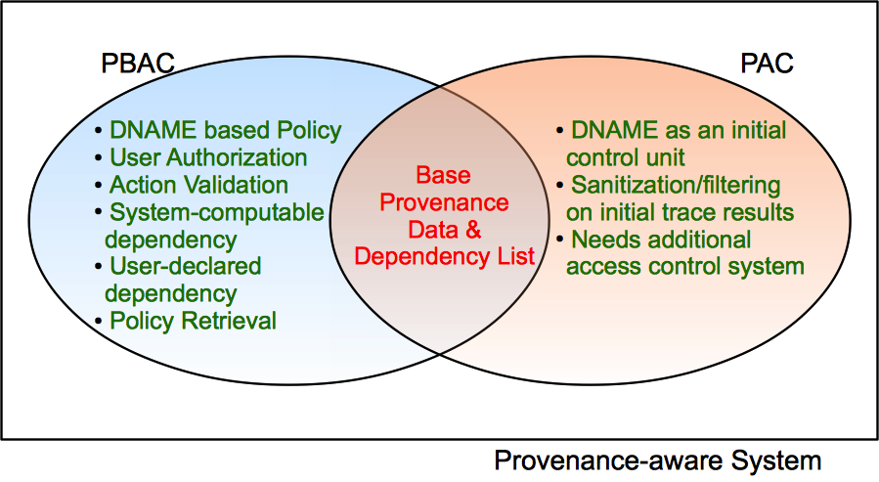
PBAC vs. PAC

Slide 12
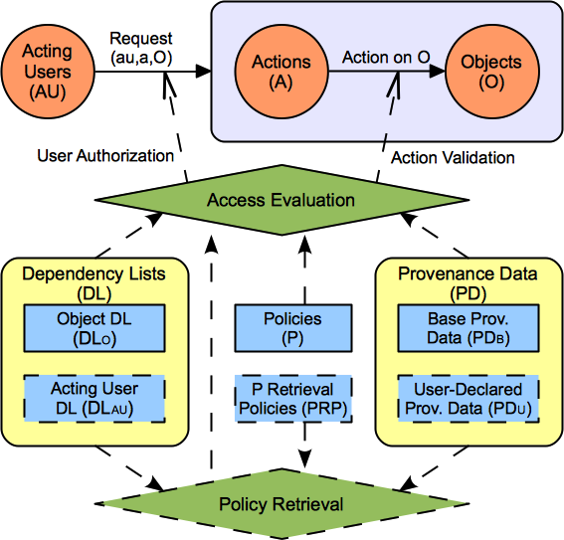

PBAC Model Components

Slide 13
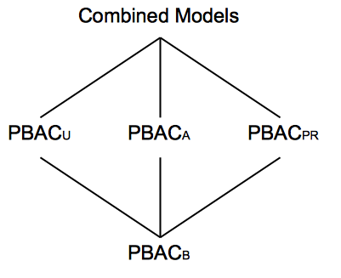
A Family of PBAC Models

Slide 14
PBAC_{B}: A Base Model
System-captured Base Provenance Data only
  Using only 3 direct dependencies (u, g, c)
  No user-declared provenance data
Object dependency only
Policy is readily available
  No policy retrieval required

Slide 15
Example: A Homework Grading System
Anyone can upload a homework.
A user can replace a homework if she uploaded it (origin-based control) and the homework is not submitted yet.
A user can submit a homework if she uploaded it and the homework is not submitted already. (workflow control)
A user can review a homework if she is not the author of the homework (DSOD), the user did not review the homework earlier, and the homework is submitted already but not graded yet.
A user can grade a homework if the homework is reviewed but not graded yet.

Slide 16
Sample Transactions &
Base Provenance Data
(au1, upload1, o_{1v1}): < upload1, au1, c >, <o_{1v1},upload1,g_{upload} >
(au1, replace1, o_{1v1}, o_{1v2}): < replace1, au1, c >,< replace1, o_{1v1}, u_{input}>, < o_{1v2}, replace1, g_{replace}>
(au1, submit1, o_{1v2}, o_{1v3}): < submit1, au1, c >, <submit1,o_{1v2}, u_{input} >,<o_{1v3},submit1,g_{submit} >
(au2, review1, o_{1v3}, o_{2v1}): < review1, au2, c >, <review1,o_{1v3}, u_{input} >,<o_{2v1},review1,g_{review} >
(au3, grade1, o_{1v3}, o_{3v1}): < grade1, au3, c >, < grade1,o_{1v3}, u_{input} >,< o_{3v1},grade1,g_{grade} >

Slide 17
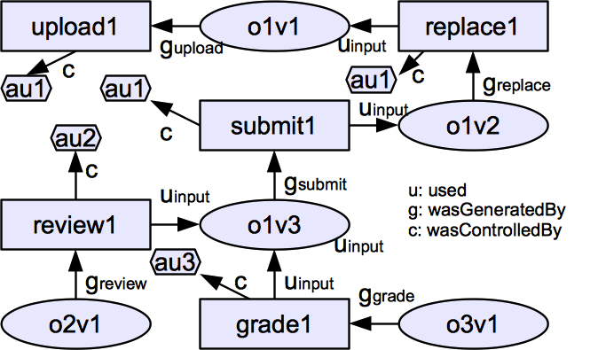
A Sample Base Provenance Data

Slide 18
A Sample Base Provenance Data
wasReviewedOby
wasReplacedVof
DL_{O}: < wasReplacedVof, g_{replace}.u_{input} >
wasSubmittedVof
wasReviewedOof
wasGradedOof

Slide 19
A Sample Base Provenance Data
wasAuthtoredBy
DL_{O}: <wasAuthoredBy, wasSubmittedVof?. wasReplacedVof ∗.g_{upload}.c >

Slide 20
A Sample Base Provenance Data
wasReviewedBy
DL_{O}: < wasReviewedBy, wasReviewedOof⁻¹. wasReviewedOby >

Slide 21
Sample Object Dependency List (DL_{O})
< wasReplacedVof, g_{replace}.u_{input} >
< wasSubmittedVof, g_{submit}.u_{input} >
< wasReviewedOof, g_{review}.u_{input} >
< wasReviewedOby, g_{review}.c >
< wasGradedOof, g_{grade}.u_{input} >
< wasAuthoredBy, wasSubmittedVof?.wasReplacedVof ∗.g_{upload}.c >
< wasReviewedBy, wasReviewedOof⁻¹. wasReviewedOby >

Slide 22
Sample Policies
Anyone can upload a homework.
A user can replace a homework if she uploaded it (origin-based control) and the homework is not submitted yet.
A user can submit a homework if she uploaded it and the homework is not submitted already. (workflow control)
allow(au, upload, o) ⇒ true
allow(au, replace, o) ⇒ au∈(o, wasAuthoredBy) ∧|(o,wasSubmittedVof)| = 0.
allow(au, submit, o) ⇒ au∈(o, wasAuthoredBy) ∧|(o,wasSubmittedVof)|=0.

Slide 23
Sample Policies (cont.)
A user can review a homework if she is not the author of the homework (DSOD), the user did not review the homework earlier, and the homework is submitted already but not graded yet.
A user can grade a homework if the homework is reviewed but not graded yet.
allow(au, review, o) ⇒ au ∉ (o, wasAuthoredBy) ∧au ∉ (o, wasReviewedBy) ∧ |(o, wasSubmittedV of)| ≠ 0 ∧ |(o,wasGradedOof⁻¹)| = 0.
allow(au, grade, o) ⇒ |(o, wasReviewedOof)| ≠ 0 ∧|(o,wasGradedOof⁻¹)| = 0).

Slide 24
Access Evaluation Procedure
Rule collecting phase
User authorization (UAuth) phase
Action validation (AVal) phase
conjunctive decision of UAuth and AVal

Slide 25
Access Evaluation Example
Policy: user can submit a homework if she uploaded it (origin-based control) and the homework is not submitted already. (workflow control)
au1
(au1, submit2, o_{1v3})

Slide 26
Rule Collecting Phase
Request: (au1, submit2, o_{1v3})
Action type: submit
Policy for submit
  allow(au, submit, o) ⇒ au∈(o, wasAuthoredBy) ∧|(o,wasSubmittedVof)| = 0.
User authorization rule
  au∈(o, wasAuthoredBy)
Action Validation rule
  |(o,wasSubmittedVof)| = 0

Slide 27
User Authorization Phase
  User Authorization Rule: au∈(o, wasAuthoredBy)
Dependency List (DL)
  < wasReplacedVof, g_{replace}.u_{input} >, < wasSubmittedVof, g_{submit}.u_{input} >
  < wasAuthoredBy, wasSubmittedVof?.wasReplacedVof ∗.g_{upload}.c >
au1 ∈ (o1v3, [g_{submit}.u_{input}]?.[g_{replace}.u_{input}]*.g_{upload}.c ) = {au1}
au1
(au1, submit2, o_{1v3})
27
World-leading research with real-world impact!

Slide 28
Action Validation Phase
  Action Validation Rule: |(o,wasSubmittedVof)| = 0
Dependency List (DL): < wasSubmittedVof, g_{submit}.u_{input} >
|(o1v3, g_{submit}.u_{input})| ≠ 0
au1
(au1, submit2, o_{1v3})
World-leading research with real-world impact!
World-leading research with real-world impact!

Slide 29
Summary
Proposed a foundation for PBAC and PAC
  the notion of named abstractions of causality dependency path patterns
  Regular expression-based dependency path pattern
Identified a Family of PBAC models
Developed a Base model for PBAC
  Supports Simple and effective policy specification and access control management
  Supports DSOD, workflow control, origin-based control, usage-based control, object versioning, etc.

Slide 30
What’s next?
Enhancing/extending PBAC model
Provenance Access Control Models
Provenance data sharing in multiple systems

Slide 31
Thank you!
Questions and Comments?

