Slide 1
Institute for Cyber Security
Risk-Aware RBAC Sessions
Khalid Zaman Bijon, Ram Krishnan and Ravi Sandhu
Institute for Cyber Security
University of Texas at San Antonio
Dec 17, 2012
ICISS 2012
IIT Guwahati, Assam, India
World-Leading Research with Real-World Impact!
1

Slide 2
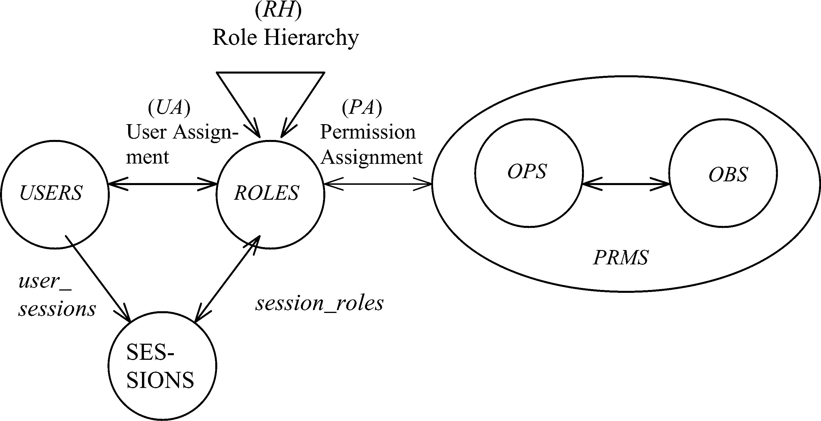
RBAC Sessions
Constraints
World-Leading Research with Real-World Impact!
2

Slide 3
RBAC Sessions
Motivation for Session in Classical RBAC
Least Privilege
Dynamic Separation of Duty
A major risk mitigation feature in RBAC
Functionalities:
Role Activation: Activate a role (Increase the session’s access capability)
Role Deactivation: Deactivate a role (Decrease the session’s access capability)
Concern:
1. User’s complete discretion on activation and deactivation
2. No differentiation of sessions
World-Leading Research with Real-World Impact!
3

Slide 4
Motivational Scenario
Policy
Decision Point
(PDP)
Policy Information
Point
(PIP)
User Environment 1
(Office computer)
User Environment 2
(Home computer)
Resources
Policy
Enforcement Point
(PEP)
Policy
Enforcement Point
(PEP)
A simple PDP/PEP based Access Control Enforcement Model
Environment 2 might be less secure than Environment 1
Thus, user sessions from them should not be equally secure
A user session can also be compromised
E.g. by malware running in user’s computer (environment)
Attacker could completely impersonate the user in a compromised session
Activating all the roles assigned to the user (role activation is entirely at user’s discretion in every session)
World-Leading Research with Real-World Impact!
4

Slide 5
Mitigation Strategy
A procedure to identify how risky a session is
risk-estimation of a session
Limit session’s access capability based on its estimated risk
a threshold on role activation based on estimated risk
session risk threshold vs combined risk of activated roles
Reduce User’s discretion on Role activation and deactivation
involve system to select a role to activate or deactivate
World-Leading Research with Real-World Impact!
5

Slide 6
Overview
Role level user-system Interaction
Permission level user-system Interaction
Session with Static
Risk-Threshold
Session with Dynamic
Risk-Threshold
Session with Adaptive
Risk-Threshold
Session with Static
Risk-Threshold
Session with Dynamic
Risk-Threshold
Session with Adaptive
Risk-Threshold
Role Activation
Role Deactivation
User
explicitly
identifies a role
System
automated or aided
role for user requested
permission
User
explicitly
Identifies a role
System
automated or aided
role for activating
another role
Risk adaptive
role deactivation
World-Leading Research with Real-World Impact!
6

Slide 7
Risk-Aware RBAC Session Characteristics
Risk-Aware RBAC sessions could be different types
when and how the risk-threshold is estimated
system and user properties that influences the calculation process
Session with static risk-threshold (SSR)
statically calculated
does not change across session
properties that does not change frequently (e.g. credential, assigned role-set)
Session with dynamic risk-threshold (SDR)
calculated before each user session
may vary across session
Some dynamic properties (e.g. time, place, currently activated roles)
Session with adaptive risk-threshold (SAR)
calculated before each user session
may vary across and within a session
affected by certain user activities during a session
need system functionalities to stop certain activities (e.g. system automated role deactivation)
World-Leading Research with Real-World Impact!
7

Slide 8
User Driven Role Activation
A User can activate a role in a session iff
the role is assigned to the user
activation of a role does not cross the risk-threshold of the session
individual risk of the role below the risk-threshold and
combined risk of activated roles is below the risk-threshold
Activation of a role might also lead to deactivate certain activated roles in a session
in order to satisfy session risk-threshold
system guided or system automated
Two different user-system interactions for role activation
role level (simply request a role to activate)
permission level (request a permission to access and system will activate the role)
World-Leading Research with Real-World Impact!
8

Slide 9
Role Activation Framework
(role level user-system interaction)
Strict Activation
activates if risk-threshold is satisfied
no deactivation of already activated roles in session
Activation with System Guided Deactivation
activates if risk-threshold is satisfied
if not, system suggests user to deactivate certain activated
roles in order to lower session risk
Activation with System Automated Deactivation
activates if risk-threshold is satisfied
if not, system automatically deactivates roles
need a specific role deactivation algorithm (e.g. LRU, heuristics)
World-Leading Research with Real-World Impact!
9

Slide 10
Role Activation Framework
(permission level interaction)
Permission level interaction process:
users simply try to access a permission in a session
system checks whether necessary role is activated in the session
if yes, allow the user access
otherwise, finds if there is a role for the permission
In the presence of multiple roles with the permission
system displays roles and user selects one, or
automatic role selection by the system
Automatic role selection
less risky role, role with minimum permission, etc.
Three different role activation models
strict activation (no deactivation)
activation with system guided deactivation
activation with system automated deactivation
World-Leading Research with Real-World Impact!
10

Slide 11
Risk-Adaptive Role Deactivation
Risk-threshold varies during a session in SAR
might need continuous monitoring of a session activities
could be lowered by user’s abnormal behavior or any detected malicious activities or other factors
further reduces the session’s access capability
Decrease of risk-threshold might cause deactivation of certain activated roles
roles that exceeds newly estimated threshold, roles that reduces the threshold, etc.
System automated role deactivation function
called by the system each time risk-threshold change
automatically deactivates affected roles, or
forces user to deactivate certain roles (provides some choices on what roles to be deactivated)
World-Leading Research with Real-World Impact!
11

Slide 12
Summary
Role level user-system Interaction
Permission level user-system Interaction
Session with Static
Risk-Threshold
Session with Dynamic
Risk-Threshold
Session with Adaptive
Risk-Threshold
Session with Static
Risk-Threshold
Session with Dynamic
Risk-Threshold
Session with Adaptive
Risk-Threshold
Role Activation
Role Deactivation
User
explicitly
mention a role
System
automated or aided
role for user requested
permission
User
explicitly
mention a role
System
automated or aided
role for activating
another role
Risk adaptive
role deactivation
World-Leading Research with Real-World Impact!
12

Slide 13
Formal Specification
Formally enhance NIST Core RBAC model
for a session with dynamic risk threshold
develop functionalities for a permission level user-system interaction (present NIST RBAC only supports role level interaction)
Three required information of a risk-aware session in NIST Core RBAC
assigned risk : a mapping of permission p to a positive real value, which gives the risk assigned to a permission.
risk threshold : a mapping of session s to a positive real number that gives the maximum risk the session could contain.
present risk : a mapping of session s to a positive real number that gives the present risk value of the session.
Necessary functions
AssignRisk: assigns a risk value to a permission
RoleRisk: returns estimated risk of a role
CreateSession: user creates a session and system calculate risk-threshold for the session
PerformTask: user tries to perform a task that might cause a role activation
CheckAccess: called by PerformTask function, it checks if user is authorized for a permission
AddActiveRole: called by CheckAccess, tries to activate if there is a role for the requested permission
Deactivation: called by AddActiveRole to deactivate some already activated roles in order to activate a role for the requested permission
World-Leading Research with Real-World Impact!
13

