Slide 1

Building Malware Infection Trees
Jose Andre Morales¹, Michael Main², Weilang Luo³,
Shouhuai Xu^{2,3}, Ravi Sandhu^{2,3}
¹Software Engineering Institute, Carnegie Mellon University*
²Institute for Cyber Security, University of Texas at San Antonio
³Department of Computer Science, University of Texas at San Antonio
*Research performed in the University of Texas at San Antonio

Slide 2
Introduction - 1
Present an abstract approach creating malware infection trees (MiT) effectively & efficiently
Capture relevant processes & files created/modified during execution
Construction primarily based on rules describing fundamental malware infection execution events
Gives meaningful understanding of malware infection & identifies involved processes
Implemented on Windows Vista OS
Useful in disinfection and analysis

Slide 3
Contributions
Propose an abstract approach to building malware infection trees (MiTs).
Define execution event rules describing essential components of infection strategies.
Describe implementation in the Windows Vista OS User and Kernel levels.

Slide 4
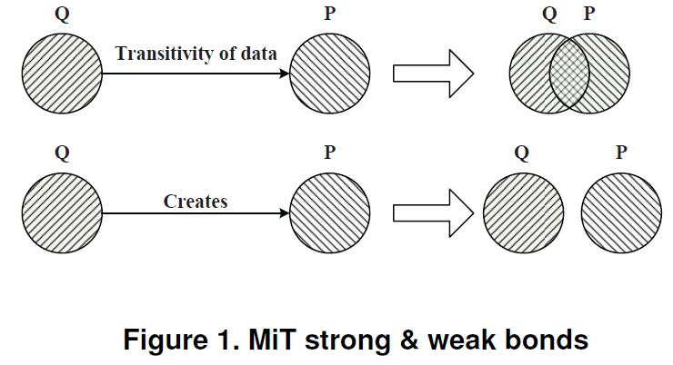
Strong & Weak Bonds
Based on observed interaction between processes and files during execution
Establishes meaningful relationship between nodes, justifying their addition to MiT
Strong Bond between Q & P:
  Transitivity (transfer) of data from Q to P, creates an intersection between Q & P where both have a subset of identical data
Weak Bond:
  Node Q creates a node P with no transfer of data, this becomes a creator/created relationship with no intersection of identical data between both
A strongly bonded tree
  Contains processes & files directly descending from original malware executable possibly essential to infection strategies
  Enhanced with weak bonds contains non-direct descendants and possibly non-essential files & process

Slide 5
Construction Rules
Set of rules defining when a node is added to a MiT primarily based on fundamental definitions of malware (cohen, adleman)
Rules facilitate strong & weak bonds resulting in highly relevant MiT with minimal non-essential items included
Generalized for use on multiple OS’s → not OS specific
New rules can be added
Node N is a file or currently running process
Edge E is an observed rule between nodes N1 and N2, where N2 is newly added to the MiT
Sample under analysis assumed Root of MiT
Assumption: Malware primarily infects through file & process manipulation
File system & Process rules

Slide 6
File System Rules
Captures malware self replication & arbitrary file creation
  Self replication considered essential to malware infection and propagation
  3 rules currently defined
F1:Infection via self replication, strong bond
F2:Infection via arbitrary file creation, weak bond
F3:Infection via arbitrary file write modification, weak bond

Slide 7
Process Rules
Capture malware’s manipulation of processes for nefarious uses
  Dynamic code injection
  Process Spawning
  2 rules currently defined
P1: Infection via dynamic code injection of a currently running process, strong bond
  Targets already running (benign) processes
P2: Infection via process spawning, weak bond
  Spawned from malware related (created or downloaded) executable file

Slide 8
Windows Vista Implementation
MiTCoN: tool which outputs MiT tables in real time using dynamic analysis
Command line with absolute path of file to analyze
Detects rule occurrence through SSDT hooking in the Windows Vista Kernel, runs as a kernel service.
Produces very robust MiT tables in under 5 minutes
Tables later converted to graphical tree representation

Slide 9
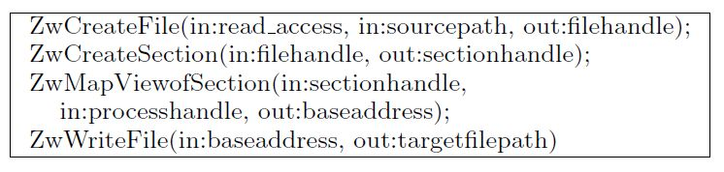

File System Rules - Implementation
1st set to detect F1 (self replication)
2nd set to detect F1
F2 (arb. File create)→ ZwCreateFile(sourcepath) != caller process
F3 (arb. File write/mod)→ 2nd Set, ZwReadFile(sourcepath) != caller process

Slide 10
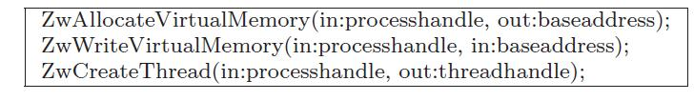

Process Rules - Implementation
P1: dynamic code injection
P2: Spawn process
  1st sequence
  2nd sequence (service creation)

Slide 11
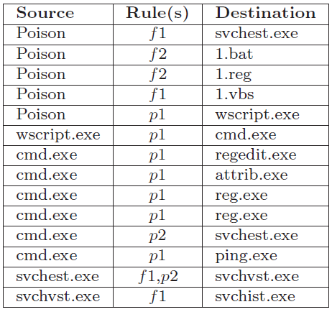
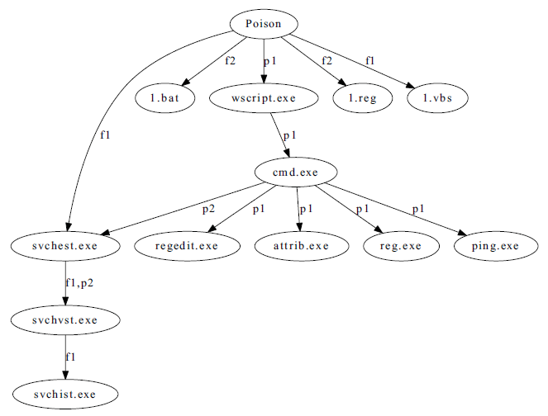
MiTCoN Example: BackDoor.Win32.Poison

Slide 12
Evaluation & Results
Built MiTs for 5800 diverse samples from GFI Sandbox Malware Repository
  3 min execution; max cpu: 3%, avg. cpu ~1%; max RAM: 14mb; MiT create max: ~7sec, avg. 3.1sec
  Rule occurrence – F1:662 , F2:14396 , F3:38629 , P1:647 , P2:3490
  Rule time occurrence max: 200ms, avg.: 12ms; f1 11ms avg; p1 14ms avg.
  Most common sequence: F1,P2

Slide 13
Evaluation & Results
120 samples analyzed by Anubis and GFI Sandbox compared to out MiTs
  114 had nodes in both not recorded in the MiT
  these nodes were files and/or processes belonging to standard Windows and not part of the malware infection → false positives
  Example: services.exe

Slide 14
Evaluation & Results
Attempted disinfection on the 120 samples
1. Each sample executed and MiT constructed, VM image scanned by Kaspersky
2. Each sample executed and files/processes appearing in MiT were erased from VM image then scanned by Kaspersky
100% success, in 2. Kaspersky did not detect any malware presence
  Implies our MiT sufficed to remove malware infection from system

Slide 15
Evaluation & Results
  Multiple occurrences of strong bonds, may suffice to understand essential infection strategy
  Efficient and Effective
MiT construction based on fundamental malware infection creates relevant MiTs excluding files and processes of standard Windows operations.
The high frequency, early occurrence and low false positives makes our rules for building MiTs highly effective in analyzing malware.
Our disinfection produce 100% success, MiTs may be useful in aiding disinfection efforts

Slide 16
Conclusions & Future Work
Abstract approach to create MiTs produce relevant meaningful description of infection strategy
Construction rules drawn from fundamental malware definitions focusing on infection strategies
Generalized and Extensible, OS independent
Highly efficient construction, very low resource usage, fast construction time
MiTs strong bonds included essential players of infection, minimized inclusion of non-infection related processes and files
Effective in disinfection, can aide other disinfection strategies
Future work involves expanding the rule set, testing sound and completeness, experiments in real and virtual environments

Slide 17
Questions?
¿Preguntas?
質問
ВопросыВопросы
Sawaal
Domande
Soru
ΕρωτήσειςΕρωτήσεις
問題

Slide 18
CMU copyright statement
NO WARRANTY
THIS MATERIAL OF CARNEGIE MELLON UNIVERSITY AND ITS SOFTWARE ENGINEERING INSTITUTE IS FURNISHED ON AN “AS-IS" BASIS. CARNEGIE MELLON UNIVERSITY MAKES NO WARRANTIES OF ANY KIND, EITHER EXPRESSED OR IMPLIED, AS TO ANY MATTER INCLUDING, BUT NOT LIMITED TO, WARRANTY OF FITNESS FOR PURPOSE OR MERCHANTABILITY, EXCLUSIVITY, OR RESULTS OBTAINED FROM USE OF THE MATERIAL. CARNEGIE MELLON UNIVERSITY DOES NOT MAKE ANY WARRANTY OF ANY KIND WITH RESPECT TO FREEDOM FROM PATENT, TRADEMARK, OR COPYRIGHT INFRINGEMENT.
Use of any trademarks in this presentation is not intended in any way to infringe on the rights of the trademark holder.
This Presentation may be reproduced in its entirety, without modification, and freely distributed in written or electronic form without requesting formal permission. Permission is required for any other use. Requests for permission should be directed to the Software Engineering Institute at permission@sei.cmu.edu.
This work was created in the performance of Federal Government Contract Number FA8721-05-C-0003 with Carnegie Mellon University for the operation of the Software Engineering Institute, a federally funded research and development center. The Government of the United States has a royalty-free government-purpose license to use, duplicate, or disclose the work, in whole or in part and in any manner, and to have or permit others to do so, for government purposes pursuant to the copyright license under the clause at 252.227-7013.

