Slide 1
Mitigating Multi-Tenancy Risks in IaaS Cloud Through
Constraints-Driven Virtual Resource Scheduling
Khalid Bijon, Ram Krishnan, and Ravi Sandhu
The University of Texas at San Antonio, USA
ACM Symposium on Access Control Models and Technologies
(SACMAT 2015)
Vienna, Austria
June 1-3, 2015

Slide 2










Cloud Service Models
Software as a Service (SaaS)
Network accessible software
Platform as a Service (PaaS)
App dev environment with cloud characteristics
Infrastructure as a Service (IaaS)
Virtualized hardware infrastructure

Slide 3
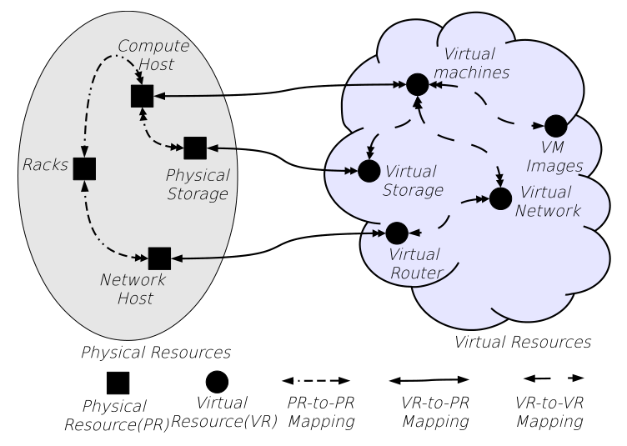
IaaS Cloud: Virtual to Physical Mappings

Slide 4
PUBLIC
CLOUD
$
HIGH RISK
$$$
LOW RISK
PRIVATE
CLOUD
Level of Physical Resource Sharing
HIGH
LOW
VM
VM
VM
VM
VM
VM
VM
VM
VM
VM
VM
VM
Hypervisor
Hypervisor
Hypervisor
Hypervisor
Physical Machine
Physical Machine
Physical Machine
Physical Machine
Tenant 1: Need 3 VMs
Multi-tenancy is unavoidable in cloud platforms
  Hypervisor provides isolation, albeit tricky
  E.g. Ristenpart et al
Tenant 2: Need 3 VMs
Tenant 3: Need 2 VMs
Tenant 2: Need 3 VMs
Tenant 4: Need 1 VM

Slide 5
Constraints-Driven Co-location
Toward a programmable cloud platform for resource isolation that can satisfy constraints such as:
  “Do not co-locate sensitive VMs with low-sensitive”
  “Do not co-locate high-availability VMs in the same rack”
  “Do not co-locate Exxon VMs with those of BP”
Must not co-locate vs. must co-locate
  Scheduling problems

Slide 6
Attribute-Based Conflict Specification for VM Co-location
Name-value pairs on VMs
  E.g. sensitivity(vm₁)=“high”, tenant(vm₂)=“Acme”
  Specified for VMs of each tenant
Intra-tenant (tenant-specified)
  Varies from tenant to tenant
  E.g. “sensitivity”, “group”, etc.
Inter-tenant (cloud service provider specified)
  Available to VMs of all tenants
  E.g. “tenant”, “flavor”, etc.

Slide 7
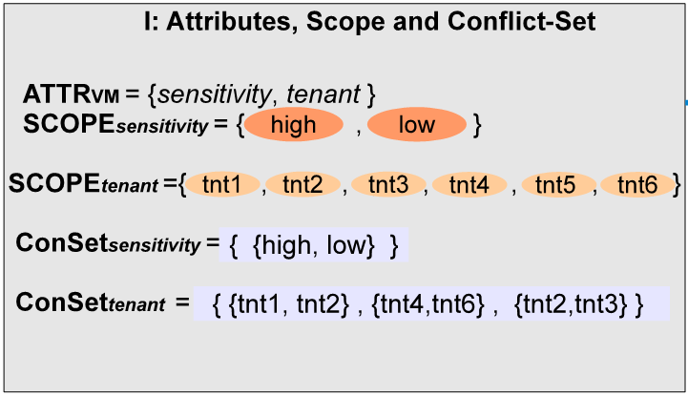
Sample Attributes for a Tenant

Slide 8
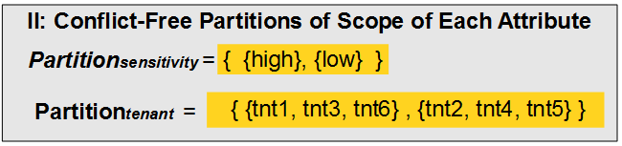
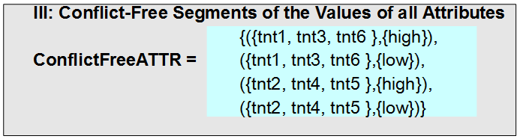
Conflict-Free Partitioning of Attributes
Step 1:
Finding MIN_PARTITION is similar to k-coloring: NP-Complete
Step 2:
O(|ATTR_{VM} | x |PARTITION_{att}|)

Slide 9
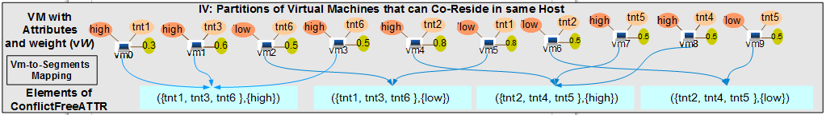
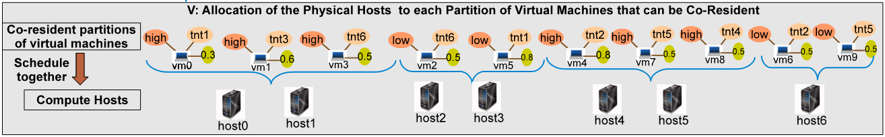
Co-Resident VM Scheduling
Step 3: Partitions of co-resident VMs
O(|VM| x |ConflictFreeATTR| x |ATTR_{VM}|)
Step 4: Scheduling of co-resident VMs into physical hosts
Similar to bin-packing: NP-Hard
Not a problem introduced by this work

Slide 10
Experimental Setup
OpenStack deployed on 5 physical machines
  Each is a Dell R710 with 16 cores, 2.53 GHz and 98GB RAM
  Each VM simulated as a physical host to simulate 100s of physical hosts

Slide 11
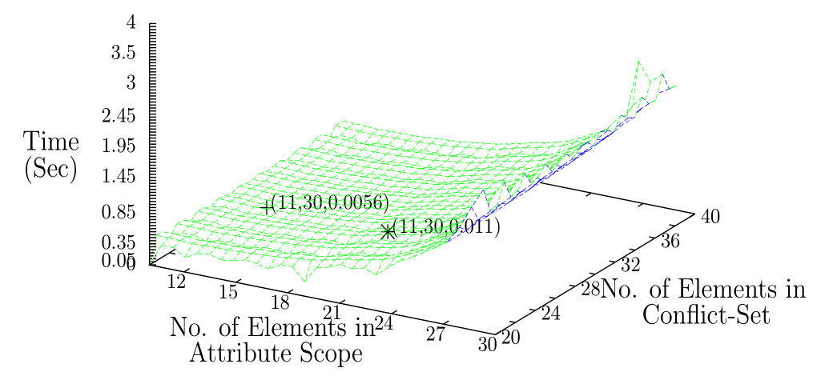
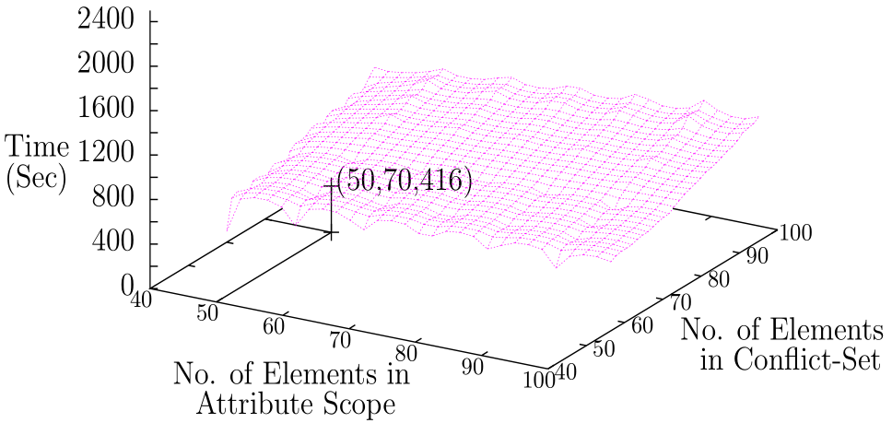
Conflict-Free Partition Using Backtracking
Small-ish scope and conflict set
Large scope and
conflict set

Slide 12
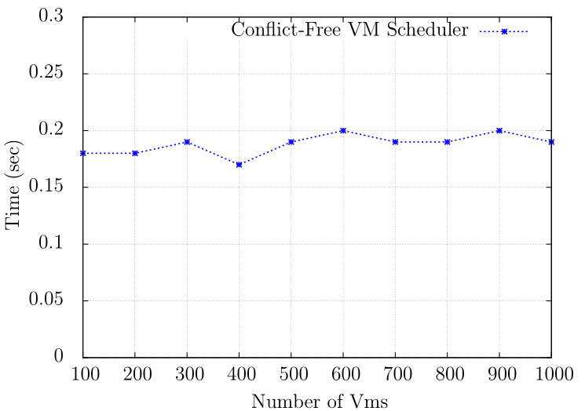
Scheduling Latency After Partitioning

Slide 13
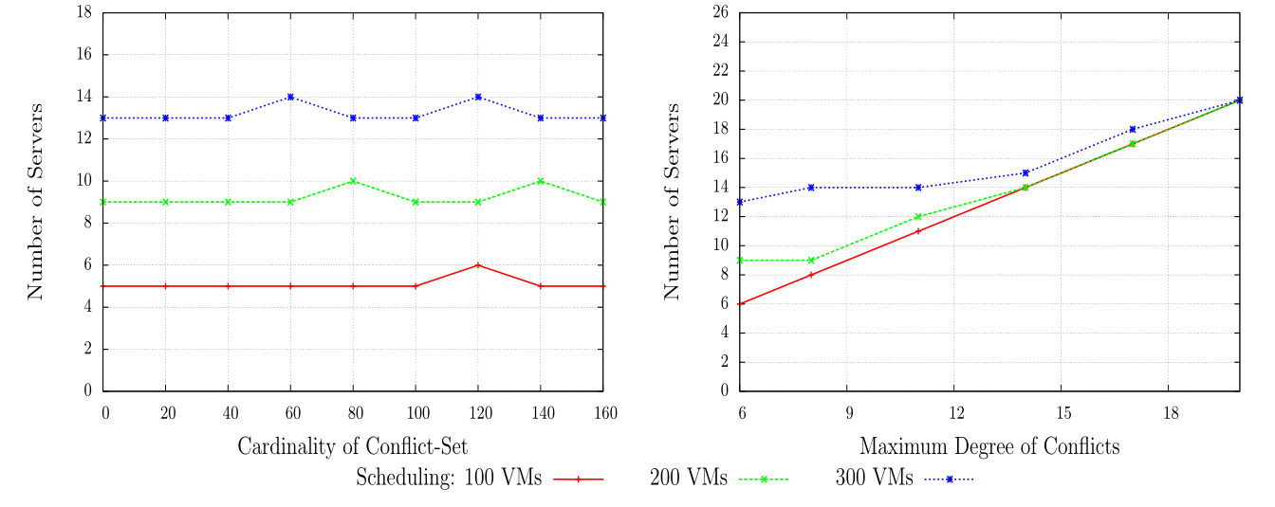
#Hosts
With varying number of elements in Conflict-Set
With varying number of maximum degree of conflicts

Slide 14
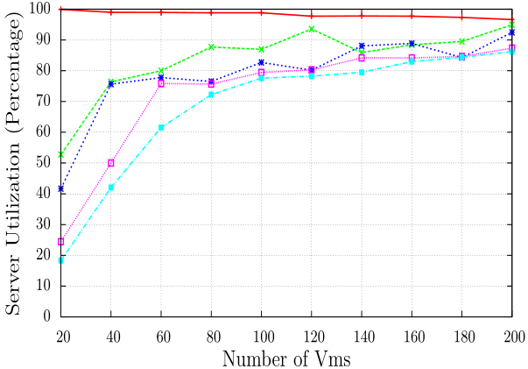

Host Utilization

Slide 15
Conflict Changes
Conflict specification can change over time!
Changes can be of different types
  Type 1: remove an element from the ConSet_{att}
  Type 2: add an element to ConSet_{att}
    PARTITION_{att} remains unchanged
  Type 3: add an element to ConSetatt
    PARTITION_{att} changes -> may need to migrate

Slide 16
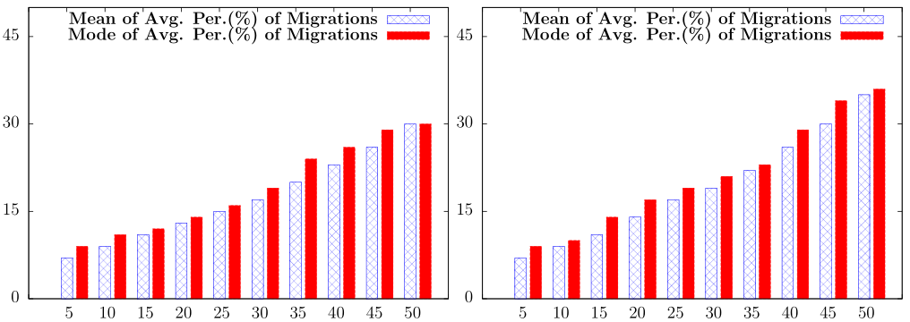
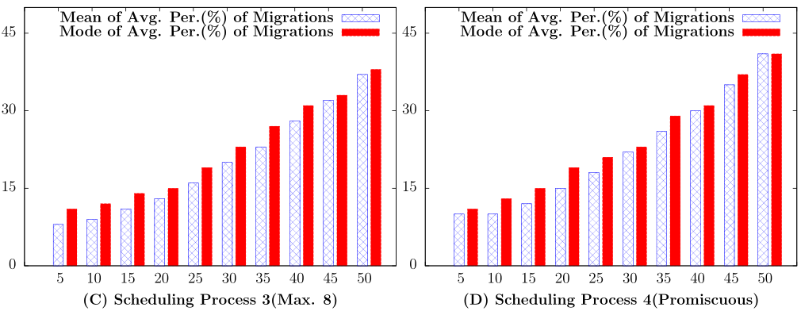
Migrations
% of Conflict for a Given Scope
% of Total VMs that Require Migration

Slide 17
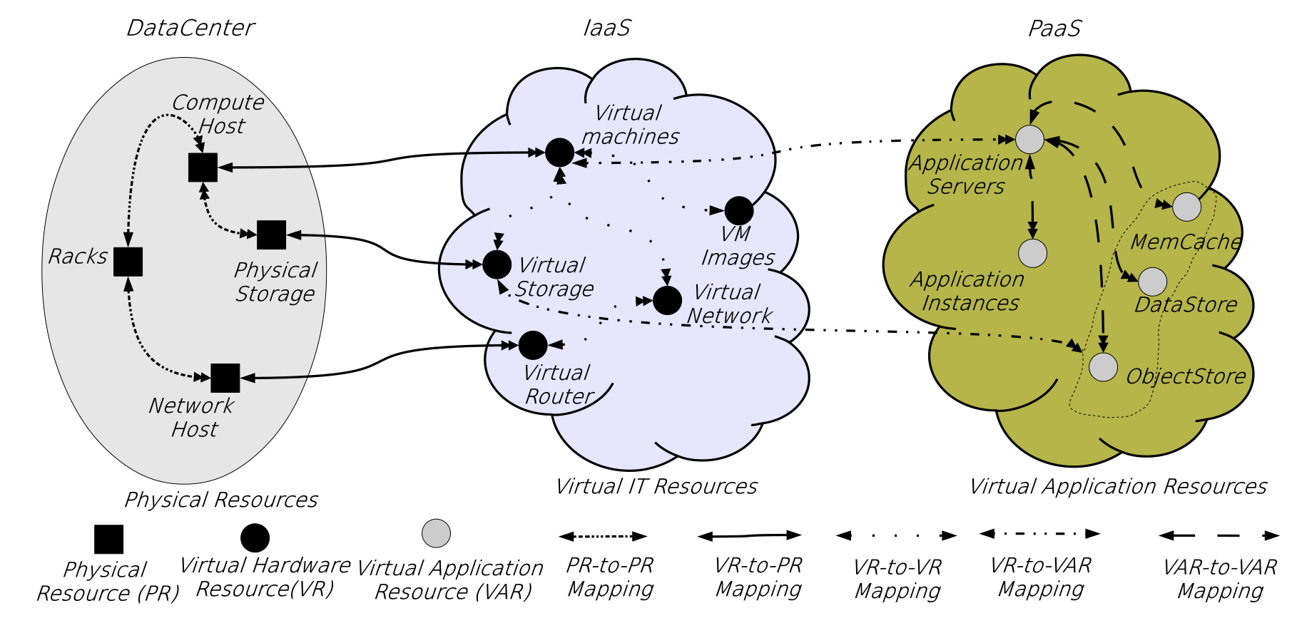
Ongoing/Future Directions
Constraints that span further levels of abstractions
  PaaS and SaaS

Slide 18
Ongoing/Future Directions (continued)
Constraints involving other virtual resources
  Storage, Network, etc.
Managing conflict changes over time
Incremental conflict specification
Attribute computation to inform conflict specification

Slide 19
Summary
A conflict specification framework for resources in IaaS
  Conflict-free partitioning is NP-Complete
Prototyped and experimented in OpenStack

Slide 20
Thank you!

