Slide 1



Ruledger: Ensuring Execution Integrity in Trigger-Action IoT Platforms
Jingwen Fan, Yi He, Bo Tang, Qi Li, Ravi Sandhu
March 04, 2021

Slide 2
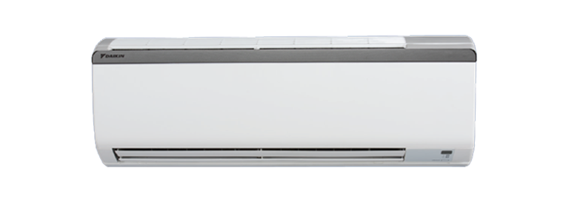
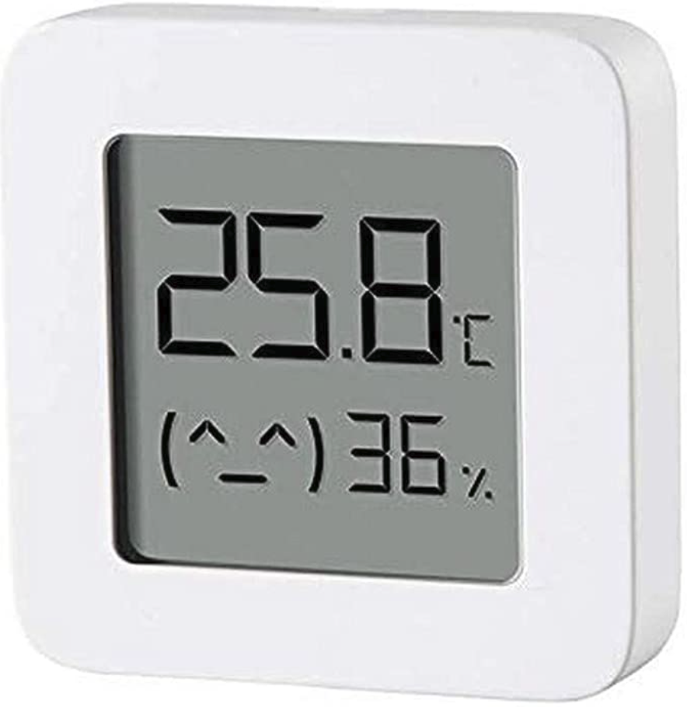





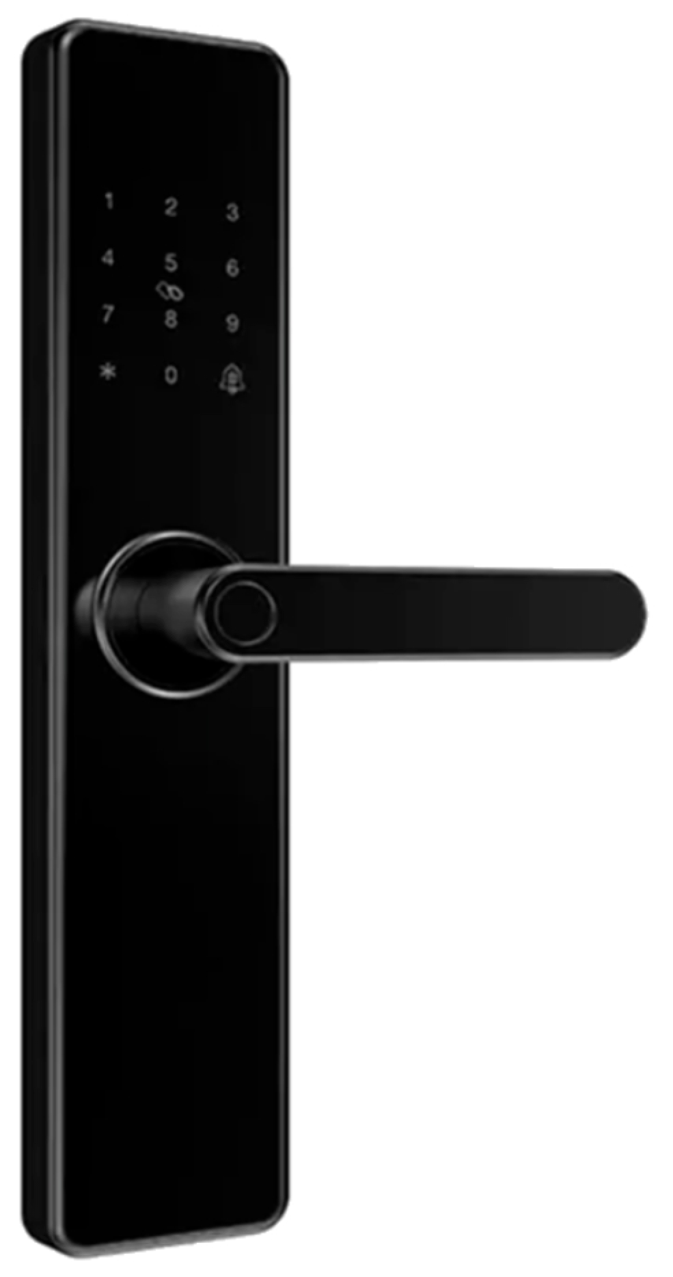

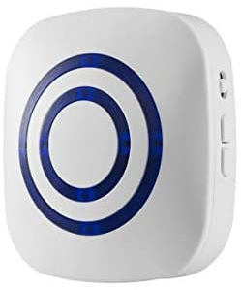


IoT Connections Are Growing Exponentially
Global IoT connections will reach 25 billion by 2025.*
IoT users need flexible and easy integrations.
* Gartner Research, IoT Security Primer: Challenges and Emerging Practices, refreshed 6 January 2020, ID G00355851-27.

Slide 3








Rule Executions in Trigger-Action IoT Platforms
Provides flexible and easy integrations using user-defined rules
Helps to achieve inter-device automation along the rule execution path.
“If user arrives home, then unlock the door and turn on the light.”
IoT Gateways
create
rules
Trigger-Action Platforms
Provided by
Device Vendor
IoT Edge Devices
IoT Platforms

Slide 4


Security Threats To The Rule Execution
Two types: API-level attacks, platform/device compromise attacks.
Platform Compromise Attacks
Trigger-Action Platforms
“If no one is at home, then unlock the door...”
Platform API Attacks
enter the
home mode
sensor: the user arrives home
IoT Platforms
Trigger-Action API Attacks
someone is at home
unlock the door
IoT Gateway
IoT Gateway
Event Spoof
Device API Attacks

Slide 5

Things Need To Be Done In Smart Home Systems
1. Protect rule configurations of the trigger-action platforms and IoT platforms.
2. Detect event spoofs generated from the devices.
3. Prevent malicious rule execution requests from the trigger-action platforms.
We cannot fix all the vulnerabilities.

Slide 6
There does not exist any verification mechanism to protect the integrity of rule execution among different IoT system components.

Slide 7


We Need A Novel IoT Platform
Verify: triggering event
Generate: id of next step
Bob's Rule =“If the user arrives home,
then unlock the door and turn on the light.”
1
2
Trigger-Action Platforms
Triggering Event
Triggering Event
IoT Gateways
4
3
Actions
Action Event
Distributed
Ledger
User's Rule: Bob
Verify: action event's id,
triggering event record,
record of Bob's rule
Triggering Event: User Arrives Home
Action Event: Unlock the door

Slide 8

Our Framework : Ruledger a distributed ledger-based IoT platform for event and rule verification
Wallet-based SDK
Device
Messages
Rule
Settings
Triggering
Events
Action
Execution
Smart Contract
Smart Home
App
Trigger-Action Platforms
User Agent
Ruledger Service
user
IoT Platforms
Rule Commits
IoT Edge
Devices
IoT Gateway
Execution
Agent
Triggering Event Verification
Task
Agent
sensor
Action Verification
IoT Gateway
Execution
Agent
Ledger
smart lock

Slide 9
Challenges and Solutions
Goal & Challenges | Solutions
Ensure the authenticity and integrity of rule configurations. Ensure rule executions on correct devices. Prevent privacy breaches. | Rule Commits Module: A set of prefab scripts that wrap device APIs of different vendors. Unified IoT events for the trigger-action platforms.
Check the trigger conditions and verify the triggering events. Make least changes to the current IoT platforms and device platforms. | Triggering Event Verification Module: Algorithm 1: Check Trigger Condition Algorithm 2: Triggering Event Verification
Ensure the integrity of rule executions. Develop a stateful verification framework. | Action Verification Module: Algorithm 3: Action Verification

Slide 10



Ruledger Design
“If the user's heart rate is abnormal, then unlock the front door and call the doctor.”
Set Rule
The Trigger
The Action
Fake Trigger
Events
Malicious
Action Requests
If heart rate alert event happens,
then unlock the door and call the doctor.
If the user is inactive and heart rate is above 120 BPM, submit heart rate alert event
Apple Smart Watch Cloud API
Trigger-Action Platform
SmartThings
Cloud API
Execution
Agent
Execution
Agent
Task Agent
Trigger Verification
Smart Contact
Task Record
Smart Contact
Action Verification
Smart Contact
Distributed Ledger
Notes:
To address those challenges, we propose a ledger-based IoT middleware to ensure the rule executing integrity.
Taking the heart-rate-alert rule as an example, trigger-action platforms such as IFTTT and Microsoft flow are used to execute the rule via the API providing by the IoT vendors. However, the authentication token may be leaked and attackers may trigger the rule maliciously via fake events or fake action requests. We provide verification mechanisms for both trigger events and action requests via three extra modules for state recording and verification.

Slide 11

Triggering Event Verification
Device Vendor Cloud Service
Wallet-based SDK
Smart Contract
Smart Watch
IoT Log Service
IoT Gateway
Execution Agent
Triggering Event
Verification Service
event id, log_key
event id, log_key
result_checksum
wirte event_log
submit event_log
verify event_log

Slide 12
Action Verification
Wallet-based SDK
Smart Contract
Wallet-based SDK
Trigger-Action Platform
Task Agent
Action Verification Service
Execution Agent
action_request
event_info, Cid
rule.actions
verify the messge, prevent reply attacks.
check the triggering event record, prevent event spoof attacks.
authenticity
correctness
3. check the rules in the ledger, prevent false triggering of the rules.

Slide 13

Evaluation
The deployment of Ruledger
We use 7 elastic cloud servers to deploy the ledger service.
We use real IFTTT platform and SmartThings Platform to measure the end-to-end latency.
Due to the rate-limit mechanism of these platforms, we need to implement simulating services to measure the throughput.
Execution
Agent
Ledger Service
Task
Agent
End-To-End Latency
Dummy
IFTTT Maker
Throughput
Elastic Cloud Server

Slide 14
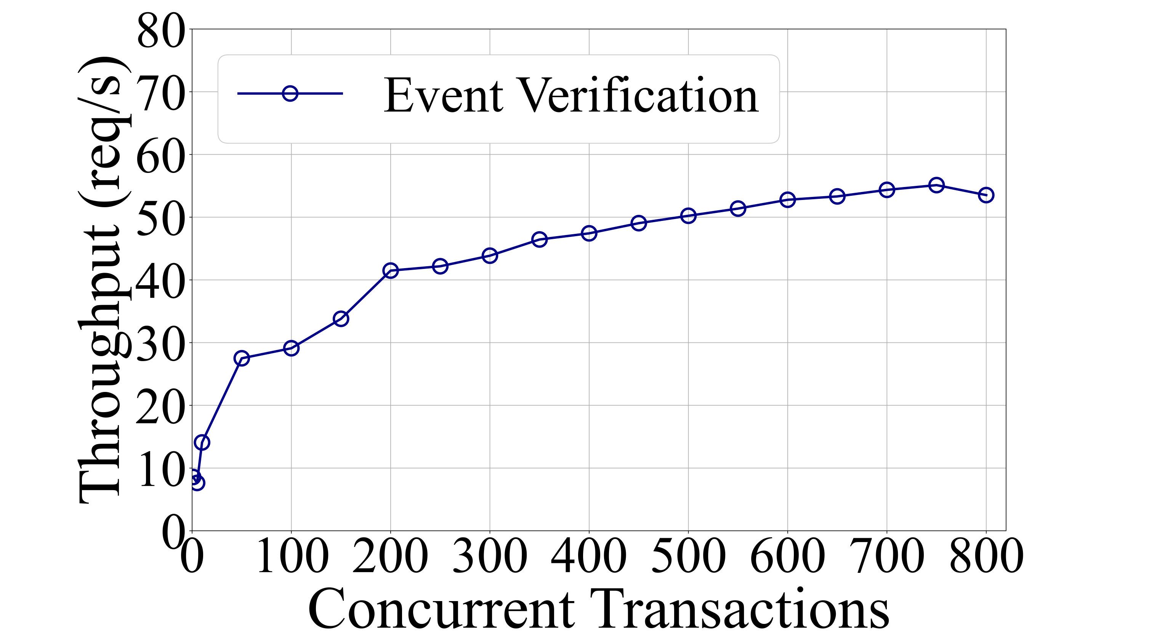
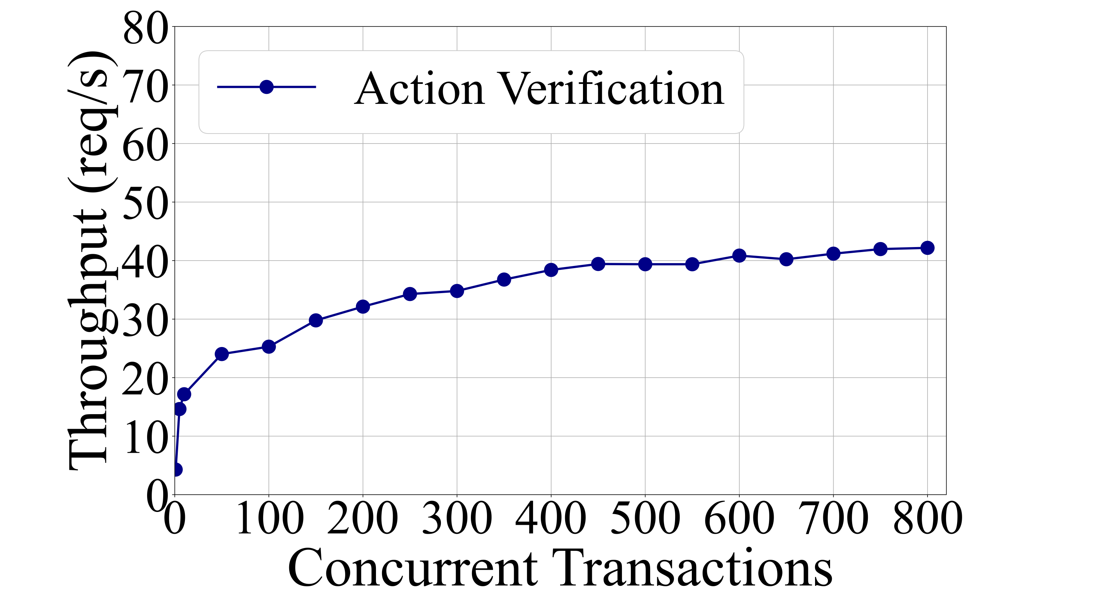
Performance Evaluation
rule =“If the user's heart rate is above 120 times per second, then unlock the door.”
Performance of Ruledger Modules
Latency
total latency of the smart contract modules <70ms
4.36% of the whole rule execution latency.
Throughput
use the execution agent and the task agent to submit different number of concurrent requests to the smart contract module.
Ruledger Module | Latency Incurred by Modules
trigger event verification | 32.45 ms
action verification | 32.83 ms

Slide 15
Performance Evaluation
2. Performance of The Entire System
End-to-End Latency
SmartThings: Baseline system that directly connects SmartThings and IFTTT.
Ruledger: Deploy Ruledger as a middleware between SmartThings and IFTTT.
Set simulated devices for a smart watch and a smart lock in SmartThings.
Throughput
implement a skeleton device simulator and a trigger-action service.
2000 concurrent requests using Apache JMeter.
Baseline: the execution agent sends the trigger event directly to the task agent.
 | SmartThings | Ruledger | Delay
End-to-end execution latency average of 30 trials | 1.403 s | 1.604 s | 12.53%
 | Baseline | Ruledger | Decrease
Throughput (req/s) | 43.37 | 40.57 | 6.5%

Slide 16
Summary
Ruledger : A ledger based IoT platform to protect the integrity of rule executions in trigger-action based smart home system.
wallet-based agents record stateful information generated by smart home systems in the ledger during rule executions.
smart contracts automatically verify the authenticity of the information according to the tamer-proof ledger records.
State generation and verification algorithm built upon ledgers and wallet-based agents to ensure the stateful information are properly submitted and verified.
check trigger conditions, triggering event verification
action verification
Prototype Ruledger with a real trigger-action platform and a real IoT system SmartThings.
acceptable overhead, feasible to be deployed in large scale.

Slide 17
Thank you for your time !

