Slide 1


Institute for Cyber Security
ABAC with Group Attributes and Attribute Hierarchies Utilizing the Policy Machine
2nd ACM Workshop on Attribute-Based Access Control (ABAC)
March 24, 2017
By
Smriti Bhatt, Farhan Patwa and Ravi Sandhu
Department of Computer Science
University of Texas at San Antonio

Slide 2
Outline
Introduction
Motivation
Background & Related Work
A Restricted HGABAC (rHGABAC) Model
Policy Machine (PM) and its Architecture
Authorization Architecture
rHGABAC Utilizing Policy Machine
Use Cases
Policy Evaluation in PM
Conclusion

Slide 3
Introduction
Attribute-Based Access Control (ABAC)
Access control based on attributes of users and objects
Flexible and fine grained access control model
Core Entities:
Users
Objects
Attributes (Users & Objects)
Permissions/Actions
Authorization Policy

Slide 4
Introduction
Many different ABAC models
Authorization policy specification in ABAC Models
Additional components and capabilities in ABAC
User and Object Groups
Group Attributes and Group Hierarchy
Attribute Hierarchy
ABAC Models
LAPs
EAPs
LAPs – Logical-Formula Authorization Policy
EAPs – Enumerated Authorization Policy
( ua_{i} , oa_{j} )

Slide 5
Motivation
ABAC models and policies in real-world applications
Enforcement of ABAC policies through existing ABAC frameworks and tools
XACML
Policy Machine
Ease of policy and attribute administration and management
LAP
EAP

Slide 6
Background & Related Work
HGABAC – A hierarchical attribute-based access control model
User and Object Groups
Group Attributes and Hierarchies
HABE – A hierarchical attribute-based encryption mechanism
LaBAC_{H} – Label-based access control model with hierarchy
Hierarchical relationship among attribute values

Slide 7
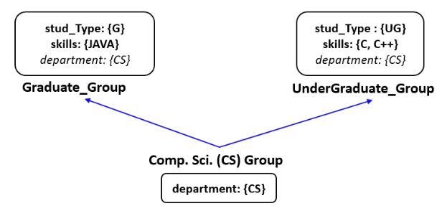
Group Attributes and Hierarchies
Group attributes
Hierarchy among groups
Senior
Group
Group Attribute Inheritance
Junior Group
Fig 1. An Example of User Group Hierarchy Adapted from [*]
* Gupta, Maanak, and Ravi Sandhu. "The GURA_G Administrative Model for User and Group Attribute Assignment." International Conference on Network and System Security. Springer International Publishing, 2016.

Slide 8
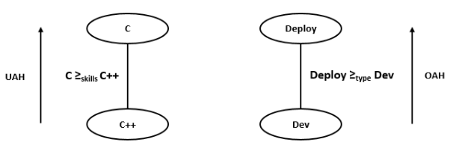
Attribute Hierarchy
A partial ordering of Range of attribute values
a. User Attribute-value Hierarchy
b. Object Attribute-value Hierarchy
Fig 2. An Example of Attribute Hierarchy

Slide 9
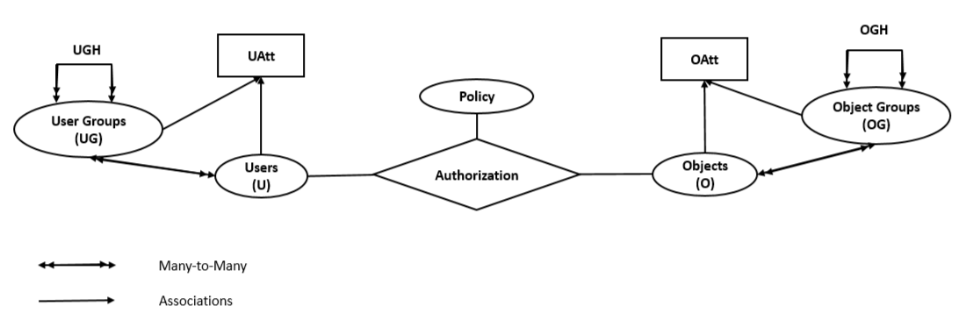
A Restricted HGABAC (rHGABAC) Model
→ Formalized as Single-Value EAP
e.g. Policy_{read} = (Manager, Private)
uav
oav
Fig 3. rHGABAC Model Adapted from [1,2]
Servos, Daniel, and Sylvia L. Osborn. "HGABAC: Towards a formal model of hierarchical attribute-based access control." International Symposium on Foundations and Practice of Security. Springer International Publishing, 2014.
Gupta, Maanak, and Ravi Sandhu. "The GURA_G Administrative Model for User and Group Attribute Assignment." International Conference on Network and System Security. Springer International Publishing, 2016.

Slide 10
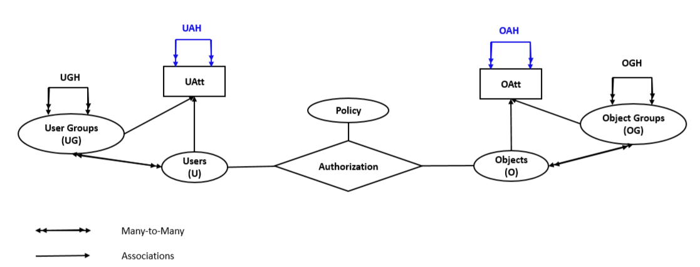
rHGABAC Model with Attribute Hierarchy
Attribute-Value Hierarchy
Fig 4. rHGABAC Model with Attribute Hierarchy

Slide 11
Policy Machine (PM)
Unified attribute-based access control framework
Express and enforce variety of access control policies utilizing PM Policy Configuration Points
Commonly known and implemented access control policies (DAC, MAC, RBAC)
Combinations of policies
New access control policies
PM Core Elements
Users
Objects
User Attributes
Object Attributes
Operations, Access Rights
Processes
Policy Classes
PM Relations
Assignment
Association
Prohibition
Obligation
assignment—for specifying relationships between policies, users, and user attributes, objects and object attributes
association – for defining policies through associations between user attributes and object attributes or objects through some operations

Slide 12
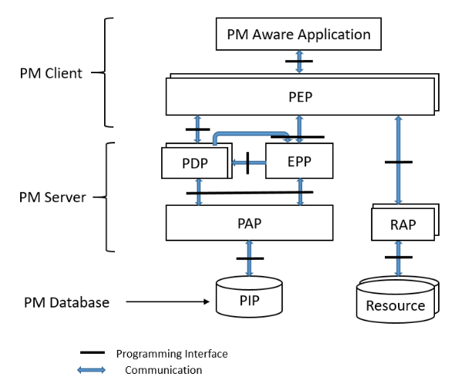
PM Architectural Components
Fig 5. Architectural Components of PM Adapted from [*]
* D. Ferraiolo, S. Gavrila, and W. Jansen, “Policy Machine: Features, architecture, and specification,” National Institute of Standards and Technology Internal Report 7987, 2014.

Slide 13
PM Architectural Components
Applications
Fig 5. Architectural Components of PM Adapted from [*]
* D. Ferraiolo, S. Gavrila, and W. Jansen, “Policy Machine: Features, architecture, and specification,” National Institute of Standards and Technology Internal Report 7987, 2014.

Slide 14
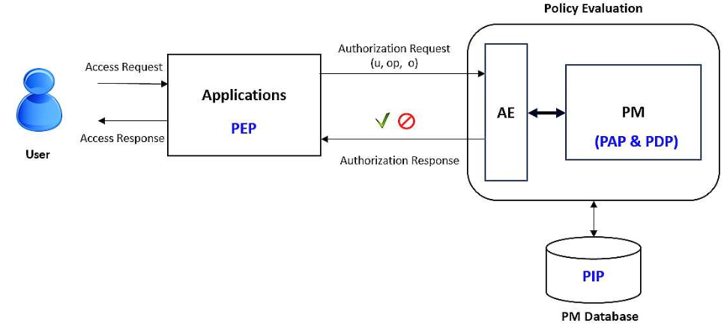
Authorization Architecture
Fig 6. Authorization Architecture Utilizing PM and AE

Slide 15
rHGABAC Utilizing Policy Machine
Implementation
PM Version 1.5
Utilized PM Server (PAP + PDP) and PM Database (Active Directory)
PM Agnostic Applications
Need support for RESTful API in order to communicate to our Authorization Engine (AE)*
Resources and their access points are abstracted within applications
* S. Bhatt, F. Patwa, and R. Sandhu, “An attribute-based access control extension for OpenStack and its enforcement utilizing the Policy Machine,” in IEEE 2nd International Conference on Collaboration and Internet Computing (CIC). IEEE, 2016, pp. 37–45.

Slide 16
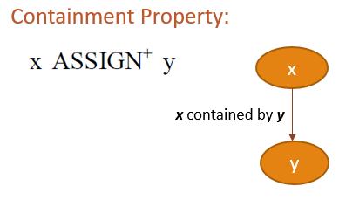
rHGABAC Utilizing Policy Machine
rHGABAC Policy Configuration in PM
User groups, user attributes and their values modeled as PM User Attributes
Object groups, object attributes and their values modeled as PM Object Attributes
Hierarchical relationships represented using PM’s assignment relation and containment property
Notes:
both oa1 and oa2 are contained by oa20 and acquire the properties of oa20, and oa1, oa2, and oa20 are contained by oa21 and likewise acquire its properties.
Inverted inheritance

Slide 17
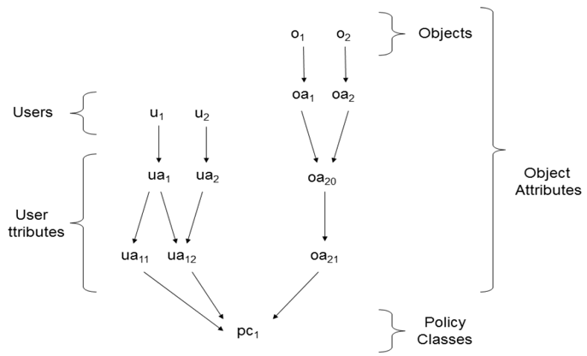
rHGABAC Utilizing Policy Machine
A simplified Policy Element Diagram in Policy Machine
read
A
Notes:
both oa1 and oa2 are contained by oa20 and acquire the properties of oa20, and oa1, oa2, and oa20 are contained by oa21 and likewise acquire its properties.
Inverted inheritance

Slide 18
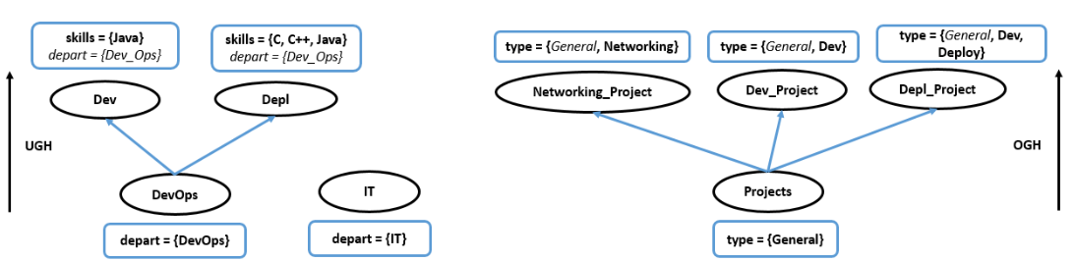
Use Case – Group Attributes and Hierarchy
a. User Groups and their assigned user attributes and values
b. Object Groups and their assigned object attributes and values

Slide 19
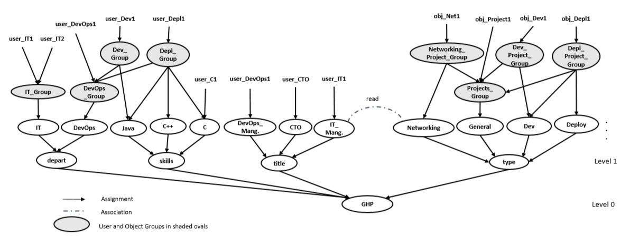
Use Case – PM Graph
Fig 7. Group Hierarchy Policy Graph (Based on PM Graph Structure)

Slide 20
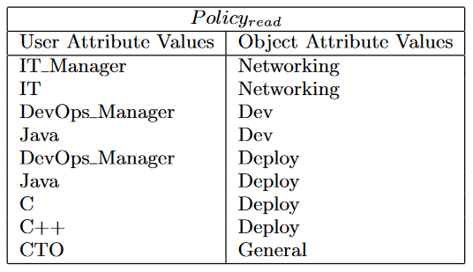
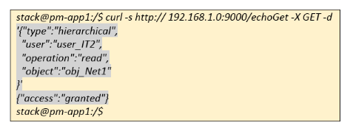
Use Case – Policy
Authorization Policy Request and Response

Slide 21
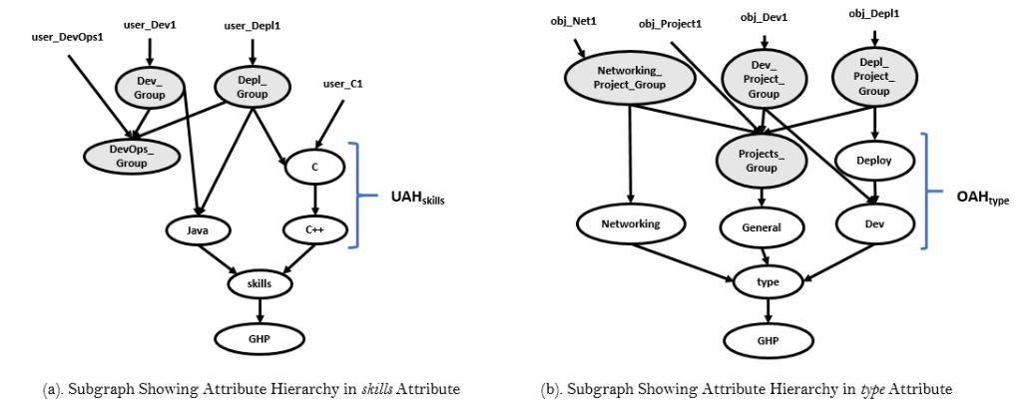
Use Case Extended with Attribute Hierarchy
Subgraph Showing Attribute Hierarchy in
skills Attribute
b. Subgraph Showing Attribute Hierarchy in
type Attribute

Slide 22
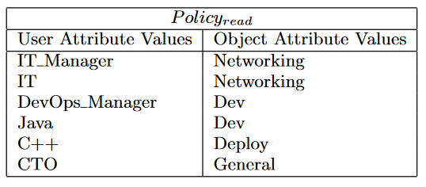
Use Case Extended with Attribute Hierarchy
Policy Without Attribute Hierarchy
Policy With Attribute Hierarchy

Slide 23
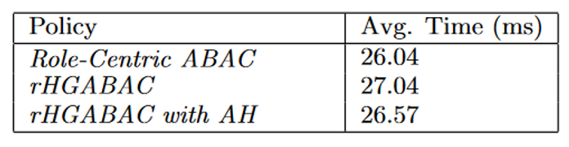
Policy Evaluation in PM
Comparison of policy evaluation times for different ABAC policies in PM using our authorization architecture with AE
Average Policy Evaluation Time for ABAC Policies

Slide 24
Conclusion
A restricted HGABAC model (rHGABAC) presented and formalized as a single-value EAP
Employed group attributes and group hierarchies, as well as attribute hierarchies in an ABAC model
Presented a generalized authorization architecture for enforcement of ABAC policies
rHGABAC simplifies Policy and Attribute management and administration in ABAC policies
New versions of PM tool would provide better insights in new ways of expressing and enforcing ABAC policies

Slide 25
Institute for Cyber Security
Thank you!!!
Questions???

