Slide 1
An Attribute-Based Access Control Model for
Secure Big Data Processing in Hadoop Ecosystem
Maanak Gupta, Farhan Patwa, and Ravi Sandhu
Institute for Cyber Security,
Center for Security and Privacy Enhanced Cloud Computing,
Department of Computer Science
University of Texas at San Antonio
3rd ACM Workshop on Attribute-Based Access Control (ABAC’18)
Tempe, Arizona, USA, March 19-21, 2018

Slide 2
Outline
Introduction and Motivation
Multi-layer Hadoop Authorization Framework
Object Tagged - RBAC Model
HeABAC Model
Implementation Approach
Use Case

Slide 3
Big Data and Big Challenges
IDC 2025 :
  global “Datasphere” – 163 zettabytes
  10x than 2016
Security:
  Privacy Concerns (eg: HIPPA)
  Fine granular access requirements
Hadoop Ecosystem = Hadoop core + Open-Source Projects
Hadoop Data Lake

Slide 4
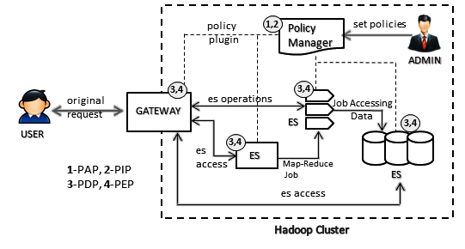
Hadoop Ecosystem
Authorization Architecture
Policy Manager : Apache Ranger, Apache Sentry
Gateway : Apache Knox
Ecosystem Service (ES) : Apache Hive, HDFS, Apache Storm, Apache Kafka, YARN

Slide 5
Multi-Layer Access Control
Data and Service Objects
Services
Cluster Resources and Applications
HDFS NameNode,
YARN ResourceManager
Apache Hive
HDFS Files,
Hive Tables
Kafka Topics
YARN Queues,
Cluster Nodes

Slide 6
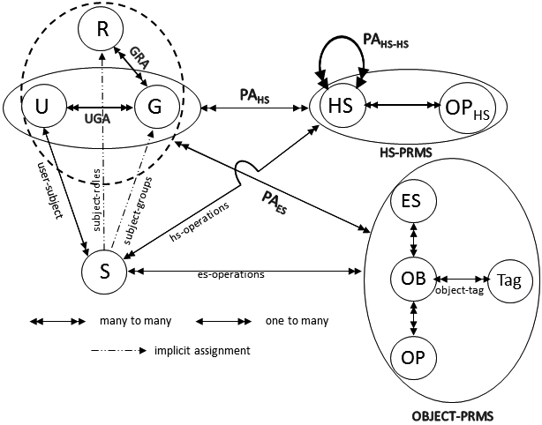
HeAC Model: Consolidated View
Hadoop Ecosystem
Access Control Model
Users (U), Groups (G) , Subjects (S)
Hadoop Services (HS)
Hadoop Service Operations (OP_{HS})
Objects (OB), Operations (OP)
Ecosystem Service (ES), Objects (OB)
Operations (OP), Tag

Slide 7
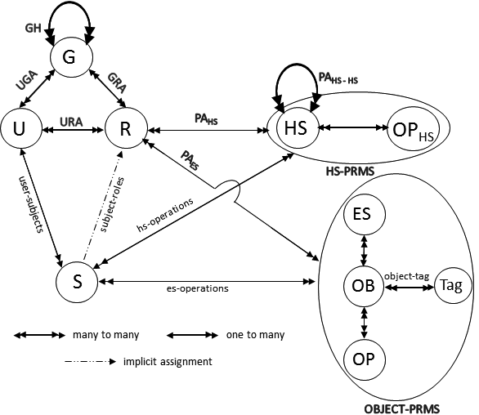
OT-RBAC Model
Object-Tagged RBAC

Slide 8
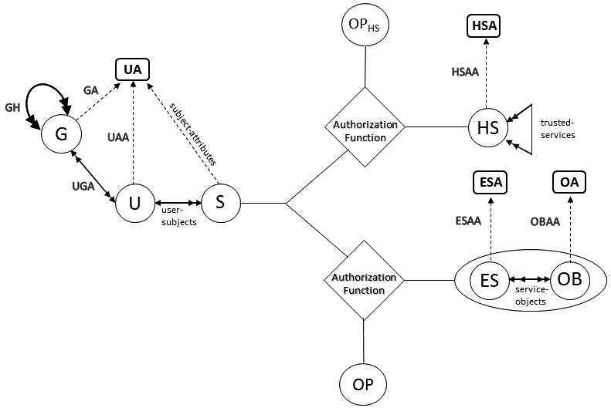
HeABAC Model
Hadoop Ecosystem Attribute-Based
Access Control Model
User Attributes (UA),
Hadoop Services Attributes (HSA)
Objects Attributes (OA),
Ecosystem Service Attributes (ESA)

Slide 9


Group Based Attribute Inheritance
Roles: {Staff, Grader, TA}
Roles: {student}
Roles: {student, Staff,
Grader, TA}
UGA
Direct & effective membership
URA
Effective Roles
Bob
G₁
Bob
Effective
membership
inheritance
Effective
membership
Roles: {Grader}
Roles: {TA}
G₂
G₃
Group Hierarchy
Major Benefits: Easy Administration where multiple roles can be assigned to user with single administrative operation.

Slide 10
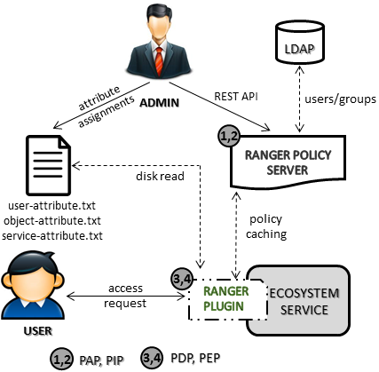
Implementation Approach

Slide 11
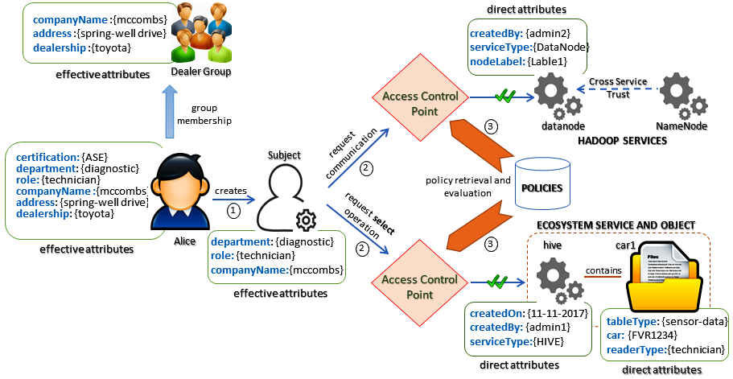
HeABAC Use-Case

Slide 12
HeABAC Example Policies
Authorization_{access}(s:S, es:ES) ≡ diagnostic ∈ effective_{department}(s) ∧ technician ∈ effective_{role}(s) ∧ serviceType(es) = HIVE ∧ createdBy(es) = admin1.
Authorization_{select}(s:S, es:ES, ob:OB) ≡ Authorization_{access}(s:S, es:ES) = True ∧ diagnostic ∈ effective_{department}(s) ∧ effective_{role}(s) ∈ readerType(ob) ∧ tableType(ob) = sensor-data ∧ car(ob) = FVR1234.
Authorization_{access}(s:S, hs:HS) ≡ diagnostic ∈ effective_{department}(s) ∧ technician ∈ effective_{role}(s) ∧ serviceType(hs) = DataNode ∧ createdBy(hs) = admin2

Slide 13
HeABAC Administrative Realms

Slide 14
HeABAC Administrative Realms
ARBAC inspired GURA, GURA_{G} models are required.

Slide 15
Conclusion and Future Work
Hadoop Authorization Layers
Object-Tagged-RBAC Model
Formalized Attributes based HeABAC Model
Some Future Goals:
Introduce Data ingestion security
Privacy concerns and finer grained approaches in multi-tenant Hadoop Lake

