Slide 1
Extended ReBAC Administrative Models with Cascading Revocation and Provenance Support
Yuan Cheng^{1，2}, Khalid Bijon², and Ravi Sandhu¹
Institute for Cyber Security, UTSA¹
MosaixSoft, Inc.²
21st ACM Symposium on Access Control Models and Technologies
June 6-8, 2016, Shanghai, China
World-Leading Research with Real-World Impact!

Slide 2
ReBAC
“… a new paradigm of access control needs to be developed that is based on interpersonal relationships …” -- [Gates 2007]
Relationship-based Access Control (ReBAC) determines access in terms of the relationships among users and resources
Inspired by the rapid emergence of online social networks
Exemplary work includes:
  [Carminati 2009a, 2009b]
  [Fong 2009]
  [Fong 2011a, 2011b, Bruns 2012]
  [Cheng 2012a, 2012b, 2014]
  [Crampton 2014, Stoller 2015, Rizvi 2015, Crampton 2016]
World-Leading Research with Real-World Impact!

Slide 3
Administrative ReBAC
Demand for an appropriate administrative model
  Dynamic and decentralized nature of OSNs
  Multiple owners and administrators
  Proper control on adding and removing of entities, relationships, and policies
Use ReBAC itself to manage ReBAC
  Economy of mechanism
  Prior success of using Role-based Access Control (RBAC) to manage RBAC
World-Leading Research with Real-World Impact!

Slide 4
RPPM [Crampton 2014]
J. Crampton and J. Sellwood, Path Conditions and Principal Matching: A New Approach to Access Control, SACMAT 2014.
RPPM: relationships, paths, and principal-matching
Combines UNIX access control model, ReBAC, and RBAC
Path Condition
  Bind requests to principals
Principal Matching
  Replace a path between entities with a single edge labelled by a principal
World-Leading Research with Real-World Impact!

Slide 5
RPPM² [Stoller 2015]
S. Stoller, An Administrative Model for Relationship-Based Access Control, DBSec 2015.
RPPM²: RPPM Modified
Administrative Model
  Add and Delete Edges/Entities/Authorization Rules
    The administration of authorization rules is considered the most challenging
  Economy of mechanism
World-Leading Research with Real-World Impact!

Slide 6
ReBAC for OpenMRS [Rizvi 2015]
S. Rizvi, P. Fong, J. Crampton and J. Sellwood, Relationship-Based Access Control for OpenMRS, SACMAT 2015.
Enforce ReBAC in a production-scale system
Administrative Model
  Add and remove access control relationships
  Enabling precondition and applicability precondition
World-Leading Research with Real-World Impact!

Slide 7
Motivation
Extend Administrative ReBAC
Use Case: Configure MT-RBAC
  RBAC extension with multi-tenancy authorization
Three motivating problems:
  Enforce Global Integrity Policy Checks
  Address Cascading Revocation
  Resolve Multiple-ownership Issue
World-Leading Research with Real-World Impact!

Slide 8
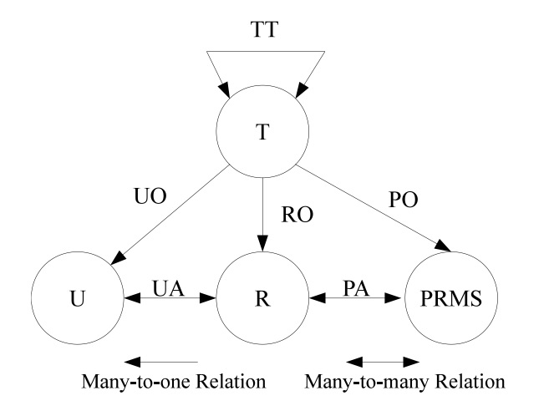
MT-RBAC
Multi-tenant RBAC Model Structure
World-Leading Research with Real-World Impact!

Slide 9
Outline
Introduction and Motivation
AReBAC Models 1, 2 and 3
Experiments
Conclusion
World-Leading Research with Real-World Impact!

Slide 10
AReBAC₁
Supports two operations: Add or Remove Edges (a.k.a. Relationships)
Consistency Policies:
  The system graph G = (V; E) is always well-formed after allowing admin operation.
Global Integrity Constraints:
  Constraints based on certain conditions for participants.
World-Leading Research with Real-World Impact!

Slide 11
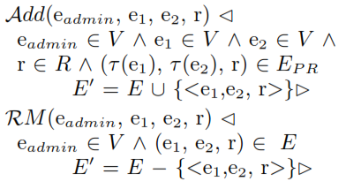
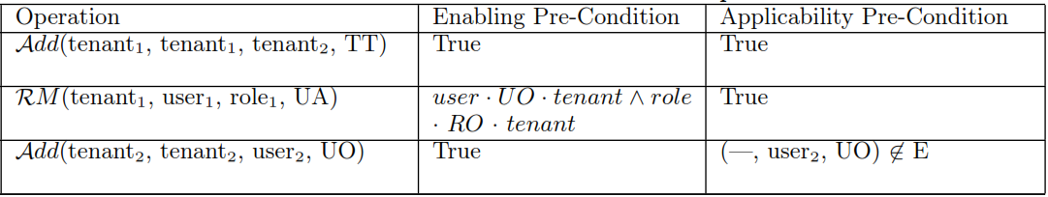
AReBAC₁ (cont.)
Operations
Policy
Examples
World-Leading Research with Real-World Impact!

Slide 12
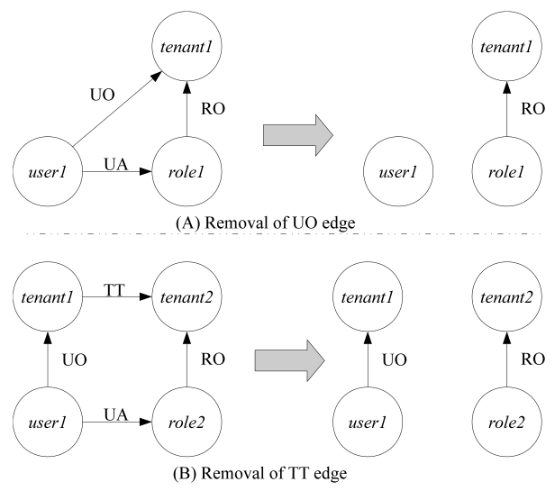
Cascading Revocation
The operation will trigger a series of recursive removal of edges on the graph in addition to the direct consequence of the operation.
World-Leading Research with Real-World Impact!

Slide 13
AReBAC₂
Policy:
Crevoke(e₁, e₂, r) returns a set of edges that needs to be removed (possibly empty) when the policy p is used to authorize the edge removal operation.
World-Leading Research with Real-World Impact!

Slide 14
Dependent-Edge Discovery
Identification of dependent edges is non-trivial
  Maintaining dependency relations could be costly
Dependent-edge Discovery Algorithm
  Depth-first search (O(V+E))
  Dependency mapping function (O(1))
    Maps the dependency edge (e₁, e₂, label) to an ordered set of relationship labels Path, and a set of dependent relationship labels R_{d}
  Overall complexity is O(V+E)
World-Leading Research with Real-World Impact!

Slide 15
Provenance
The provenance of a piece of data is the process that led to that piece of data
Causality dependencies record the flow of transactions in the system
The Open Provenance Model (OPM) captures such causality dependencies and expresses them in the provenance graph
We can use provenance to address the multi-ownership issue
World-Leading Research with Real-World Impact!

Slide 16
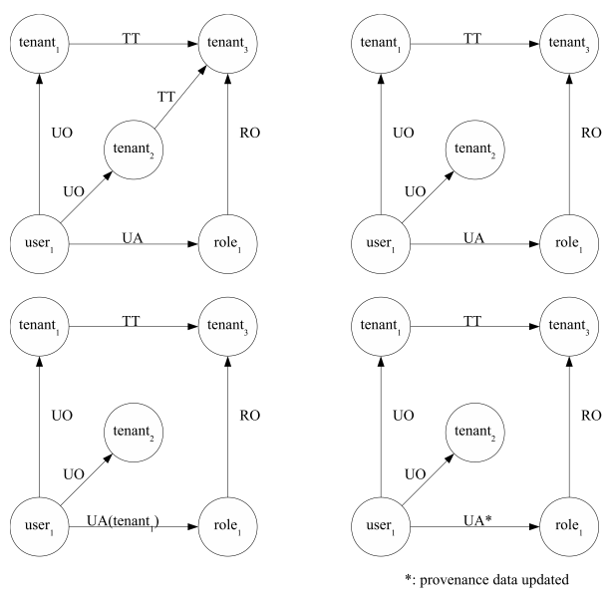
Edges with Multiple Ownership
World-Leading Research with Real-World Impact!

Slide 17
AReBAC₃
Use provenance information to capture and express causality dependencies for assisting authorization.
  Independent from ReBAC formalization
  Extensible to enable Provenance-based Access Control (PBAC)
  Potentially facilitate multi-level cascading revocation
  Provenance vs typed parameters
    More complicated and costly
    More expressive power and richer information
World-Leading Research with Real-World Impact!

Slide 18
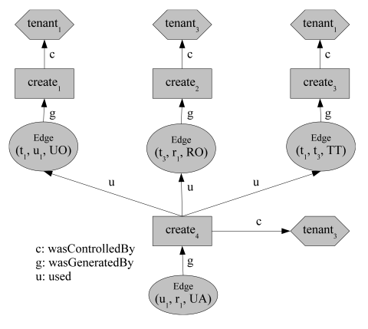
OPM Graph for Adding UA Edge
World-Leading Research with Real-World Impact!

Slide 19
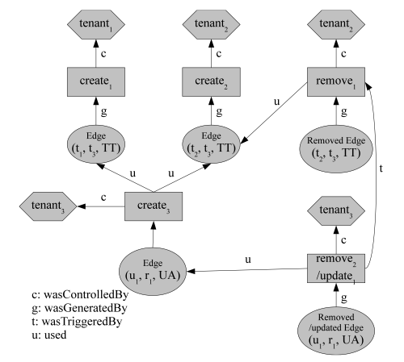
OPM Graph for Removing UA Edge
World-Leading Research with Real-World Impact!

Slide 20
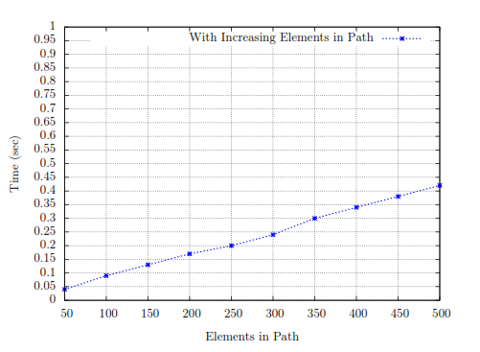
Experiments
Experiment 1: Varied size of Path, fixed size of rSet
World-Leading Research with Real-World Impact!

Slide 21
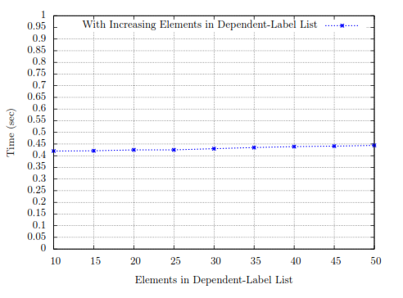
Experiments (cont.)
Experiment 2: Fixed size of Path, varied size of rSet
World-Leading Research with Real-World Impact!

Slide 22
Conclusion
Proposed a family of three administrative ReBAC models based on RPPM² policy language
Identified and addressed three problems
  Integrity constraints
  Cascading revocation
  Multi-ownership of edges
Provided a dependent-edge discovery algorithm
Used the proposed models to capture MT-RBAC
Next:
  Investigate new problems about ReBAC administration
    Policy administration
    Synthesize ReBAC and PBAC, etc.
World-Leading Research with Real-World Impact!

Slide 23

Questions? Comments?
World-Leading Research with Real-World Impact!

