Slide 1
ACON: Activity-Centric Access Control for Social Computing
Institute for Cyber Security
Aug. 25, 2011
International Conference on Availability, Reliability and Security
Jaehong Park, Ravi Sandhu, Yuan Cheng
Institute for Cyber Security
University of Texas at San Antonio

Slide 2
Social Computing
Characteristics
Social computing systems (SCS) provide services to promote information sharing by utilizing user activity information and shared contents
Best seller, friends recommendation, friend activity notification, location-based service
Both user and SCS provide/access information to be shared
A user wants to control other user’s or SCS’s activities against shared information or users related to her
User wants to protect their privacy
Both resource and user as a target of activity
Alice pokes bob, a buyer rates sellers
A user’s activity influences access control decisions
Rating based popularity

Slide 3
Activities in SCS
No traditional access control can cover all the controls necessary for SCS
Activity as a key concept for access control
Why Activity-centric?
Multiple kinds of activities (in addition to user’s general usage activity against resource) that have to be controlled.
User’s usage/control activity on user/resource, SCS’s service/control activities
A user’s usage/control activity influences SCS’s control decision on own and other users’ activities as well as SCS activities.
Once Alice invites Bob as a friend, Bob is allowed to see Alice’s information
If Alice is a friend of Bob and Bob become a friend of Chris, 1) if Chris allows friends of friends to his contents, Alice can access Chris’s contents; 2) SCS can recommend Chris and Alice as a friend
Buyers’ ratings on a seller may collectively used to control the seller’s sale activity.

Slide 4
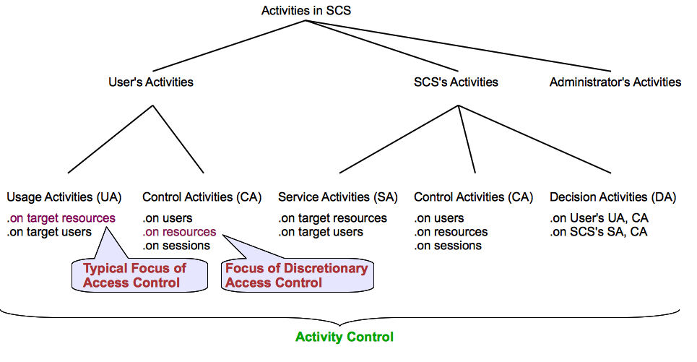
Activity Taxonomy in SCS

Slide 5
User’s Usage Activities
Usage Activity on Resources
Read/view shared comments/photos
Typical Focus of Access Control
Usage Activity on Users
Poke, recommend friends

Slide 6
User’s Control Activities
Control Activity on Resources
By changing attributes and policies of resources
set a resource as a violent content (attribute), accessible only by direct friends (policy)
Parents can set attributes and policies of children’s resources
Focus of Discretionary Access Control
Control Activity on Users
By changing user attributes and policies
To control activity performed by/against a particular user (self or other related users) without knowing a particular resource
Control Activity on Sessions
By controlling session attributes and policies that are inherited from a user

Slide 7
SCS’s (Automated) Activities
Service Activities
To promote users’ social interactions and information sharing
Friends recommendation, friend activity notification, location-based coupons, most-viewed videos
Control Activities
Through managing policies and attributes of users, resources and sessions
User rating-based seller trustworthiness or product popularity
Decision Activities
SCS evaluates requests for user’s usage and control activities as well as SCS’s service and control activities

Slide 8
Activity(-centric Access) Control Framework
To capture various users and SCS activities and their influences on control decisions
To support controls on various access/usage and control activities in SCS
To support personalized user privacy control
To support automated management of SCS services and controls

Slide 9
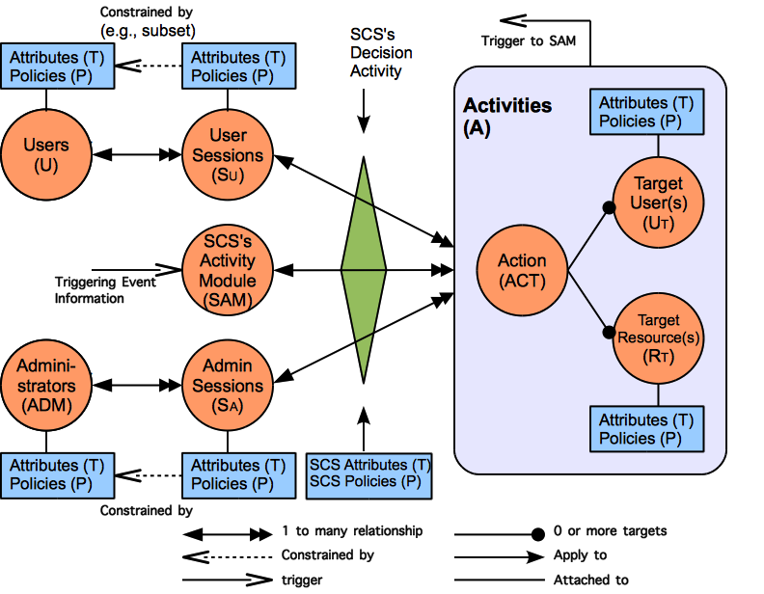
ACON Framework

Slide 10
ACON Framework Components
Users
represent a human being who performs activities in an SCS
Carry attributes and policies
Sessions
Represent an active user who has logged into the SCS
A user can have multiple sessions, but not vise versa
Carry attributes and policies that could be different from user attributes and policies

Slide 11
ACON Framework Components (cont)
Activities
User, SCS, SCS administrator’s activities
Comprise action, target users, target resources
Action
An abstract function available in SCS
E.g., read, rate, poke, friend-invite, activity notification
Target users(’ sessions)
Recipients of an action
Target Resources
Include users’/SCS’s shared contents, user/resource/session policies and attributes

Slide 12
ACON Framework Components (cont)
SCS’s Decision Activity
based on the consolidated individual user/resource policies and attributes together w/ SCS policies and attributes
SCS’s Activity Module (SAM)
A conceptual abstraction of functions that performs SCS’s automated service and control activities
SCS Administrators
Human being w/ a management role

Slide 13
ACON Framework Characteristics
Policy Individualization
A user’s individual policy includes privacy preferences and activity limits
Collectively used by SCS for control decision on activities
Can be configured by related users
Separation of user and resource policies
User policy allows controls on 1) user activities w/o knowing a particular resource and 2) activities performed against the user w/o knowing a particular resource or the actors
E.g., 1) Bart cannot be a friend of Homer’s coworker, 2) Homer doesn’t want to receive violent contents
User-session distinction
User relationship independent access control
SCS’s automated service and control activities

Slide 14
ACON_{user} Model – User Activity Control
U, S, ACT, R, T, P, SCS and D (users, sessions, actions, resources, attributes, policies, social computing system and decision predicate, respectively);
U_{T} ⊆ U and R_{T} ⊆ R (target users and target resources, respectively);
dot notation: we understand e.T and e.P to respectively denote the set of attributes and set of policies associated with entity e;
A, the set of activities is defined as A⊆ACT ×(2^{RT} ×2^{UT} −∅);
Let A = {a₁, a₂, ..., a_{n}}, we denote the components of each individual element as a_{i} = (a_{i}.ACT, a_{i}.R_{T} , a_{i}.U_{T} );

Slide 15
ACON_{user} Model – User Activity Control
AP_R_{T} :A→2^{RT×P}, AP_U_{T} :A→2^{UT×P}, AT_R_{T} :A→2^{RT×T}, AT_U_{T} :A→2^{UT×T}, mappings of activity to a set of target resources and policies, a set of target users and policies, a set of target resources and attributes, and a set of target users and attributes respectively defined as:
AP_R_{T}({a₁,..,a_{n}})=AP_R_{T}({a₁})∪...∪AP_R_{T}({a_{n}}), AP_R_{T}({a_{i}})={(r_{t},p)|r_{t} ∈a_{i}.R_{T},p∈r_{t}.P}
AP_U_{T}({a₁,..,a_{n}})=AP_U_{T}({a₁})∪...∪AP_U_{T}({a_{n}}), AP_U_{T}({a_{i}})={(u_{t},p)|u_{t} ∈a_{i}.U_{T},p∈u_{t}.P}
AT_R_{T}({a₁,..,a_{n}})=AT_R_{T}({a₁})∪...∪AT_R_{T}({a_{n}}), AT_R_{T}({a_{i}})= {(r_{t},t)|r_{t} ∈a_{i}.R_{T},t∈r_{t}.T}
AT_U_{T}({a₁,..,a_{n}})=AT_U_{T}({a₁})∪...∪AT_U_{T}({a_{n}}), AT_U_{T}({a_{i}})={(u_{t},t)|u_{t} ∈a_{i}.U_{T},t∈u_{t}.T};

Slide 16
ACON_{user} Model – User Activity Control
AP(a)=AP_R_{T}(a)∪AP_U_{T}(a),
AT(a)=AT_R_{T}(a)∪AT_U_{T}(a);
allowed(s,a)⇒D(s.P,s.T,a,AP(a), AT(a),scs.P,scs.T), where s ∈ S and a ∈ A.

Slide 17
ACON_{user} Model – Session Management
user_sessions : U → 2^{S}, session_users : S → U;
user_added_sessionT : S → 2^{T} , user_removed_sessionT : S → 2^{T} ;
scs_added_sessionT : S → 2^{T} , scs_removed_sessionT : S → 2^{T} , scs_required_sessionT : S → 2^{T} ;
user_added_sessionP : S → 2^{P} , user_removed_sessionP : S → 2^{P} ;
scs_added_sessionP : S → 2^{P} , scs_removed_sessionP : S → 2^{P} , scs_required_sessionT : S → 2^{T} ;
user_removed_sessionT(s) ⊆ {t ∈ T |t ∈ session users(s).T ∧ t ∉ scs_required_sessionT (s)};
user_removed_sessionP(s) ⊆ {p ∈ P |p ∈ session users(s).P ∧ p ∉ scs required_sessionP(s)};

Slide 18
ACON_{user} Model – Session Management
assignS_T : S → 2^{T} , assignS_P : S → 2^{P} , assignment of attributes and policies to sessions respectively;
assignS_T(s) ⊆ {t∈T|(t ∈ session_users(s).T ) ∨ (t∈ user_added_sessionT(s)) ∨ (t ∈ scs_added_sessionT(s))∧ ¬((t∈ user_removed_sessionT(s)) ∨ (t∈ scs_removed_sessionT(s)))};
assignS_P(s) ⊆ {p∈P|(p ∈ session_users(s).P )∨ (p∈ user_added_sessionP(s))∨ (p∈ scs_added_sessionP(s))∧ ¬((p∈ user_removed_sessionP(s))∨ (p∈ scs_removed_sessionP(s)))}.

Slide 19
Examples
A buyer can rate a seller only if the buyer bought a product from the seller (SCS.P).
N: a list of users, sellerList : S → 2^{N}
allowed(s, rate, u_{t}) ⇒ u_{t} ∈ sellerList(s)
A user can recommend a friendship between two friends if they are not a friend to each other(SCS.P).
N: a list of users, friends : S → 2^{N}
allowed(s, f-recommend, u_{t}1, u_{t}2)⇒
({u_{t}1, u_{t}2}∈ friends(s))∧(u_{t}2 ∉ friends(u_{t}1))∧
(u_{t}1 ∉ friends(u_{t}2))

Slide 20
Summary
Developed activity-centric access control framework for security and privacy in social computing systems.
Developed initial models for user activity controls and session management.

