Slide 1
Analyzing Malware Detection Effectiveness with Multiple Anti-Malware Programs
Jose A. Morales
SEI @ CMU
Shouhuai Xu
CS @ UTSA
Ravi Sandhu
ICS @ UTSA

Slide 2
Roadmap
Motivation
Experimental Methodology
Experimental Results
Summary

Slide 3
Motivation
We all are victims of computer malware.
We all use anti-malware programs.
Most of us, if not all, use a single anti-malware program (for economic reason).

Slide 4
Motivation (cont.)
Is one anti-malware program sufficient?
If not, how many?
How critical is it to install anti-malware program in clean state?

Slide 5
The Ideal
Ideally, an anti-malware program can detect and clean all malwares in a system (undecidability!)
An anti-malware program C₁ is competent if for every input S=S₀ it holds that after applying C₁, no others can detect any more malware.
Caveat: What is the ground truth?

Slide 6
The Reality
The above idea can be extended to multiple programs that work collectively.
Incompetence can be caused by
  Incompetent detection
  Incompetent cleaning up

Slide 7
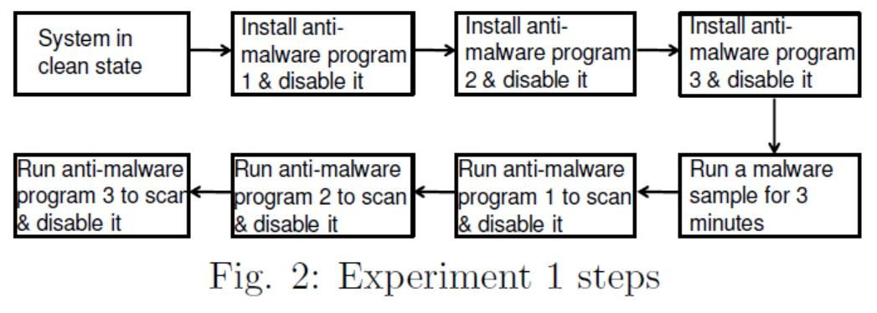
Experiment 1: Install Anti-Malware Programs in Clean State
Caveat: some malware may not do bad things until after running for more than 3 minutes or upon detecting the presence of VM

Slide 8
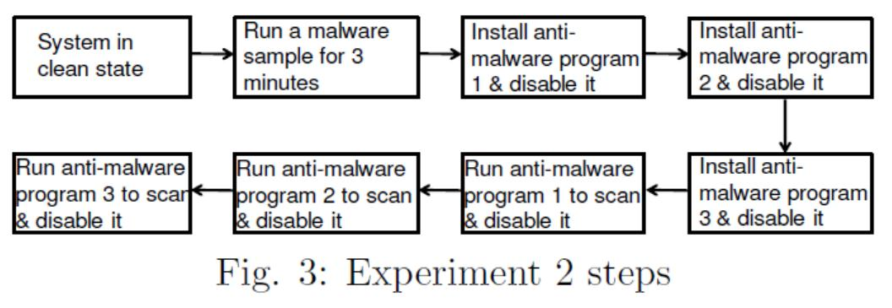
Experiment 2: Install Anti-Malware Programs in Possibly Compromised State
Caveat: some malware may not do bad things until after running for more than 3 minutes or upon detecting the presence of VM

Slide 9
Experiments Setup
Tested two sets of 3 anti-malware programs:
  1st set: ESET, AVG, Zonealarm
  2nd set: Kaspersky, G-data, Bitdefender
Tested all permutations of each set: 3!=6
Experiments carried out in Vmware
  Running Windows 7 OS freshly installed to assure clean-state environment

Slide 10
Experiments Setup (cont.)
500 malware samples
  worms, rootkits, bots, backdoors, password stealers, malware downloaders

Slide 11
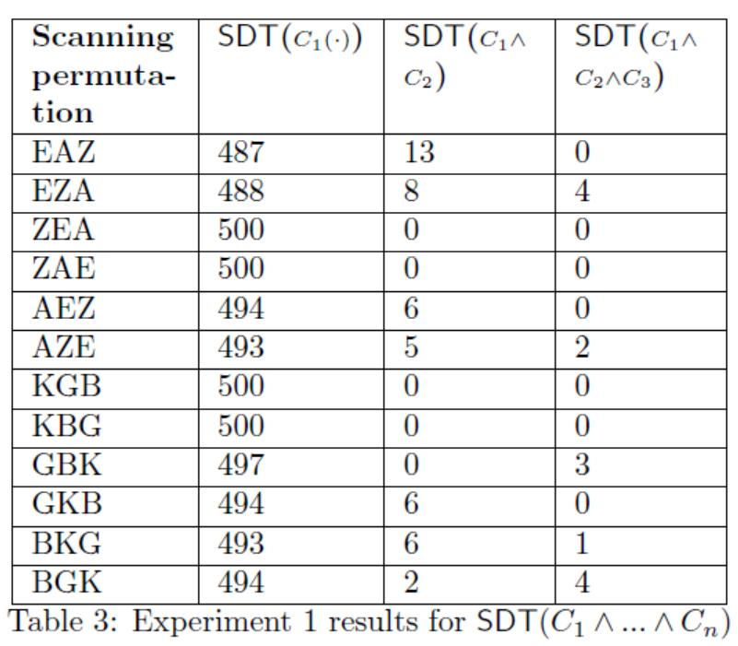
Experimental Results
Using multiple anti-malware programs does increase detection and cleaning up capability, despite some kind of diminishing return
Sometimes 3 anti-malware programs may not be sufficient (need to be verified by 4th anti-malware program)
Among the 500 malwares, the numbers of malwares detected & cleaned by the anti-malware programs.

Slide 12
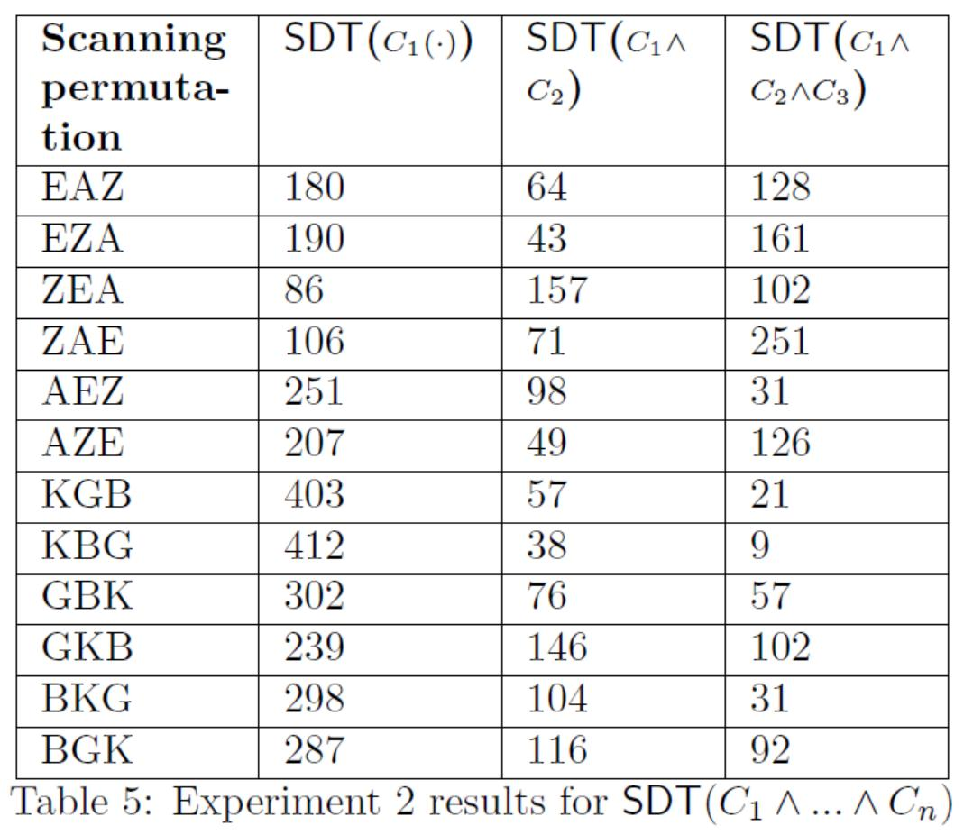
Experimental Results
Make sure anti-malware program installed in clean state
Anti-malware program installed in already compromised systems have high false-negatives
Tested anti-malware progams seem to lack a self-defense mechanisms
Malware running in a system may block access to resources needed by anti-malware
Among the 500 malwares, the numbers of malwares detected & cleaned by the anti-malware programs.

Slide 13
How Many Anti-Malware Tools Are Sufficient?
Based on experimental results (based on 500 malware samples only):
  1 is occasionally ok
  2 minimum for low protection
  3+ for medium+ protection

Slide 14
Summary
Current individual anti-malware programs do not provide sufficient protection
  Despite some anti-malware programs worked well with the 500 malware samples
Using multiple anti-malware programs together can improve protection
  Need to test with much larger malware sets

Slide 15
The Challenge
Implication: Current anti-malware technology is not sufficient
We need revolutionary technology in combating malware
We have to
How?
Things can be worse: Our another study showed that there are malwares that can evade perhaps all anti-malware programs

Slide 16
Thanks!
Questions or Comments?

