Slide 1
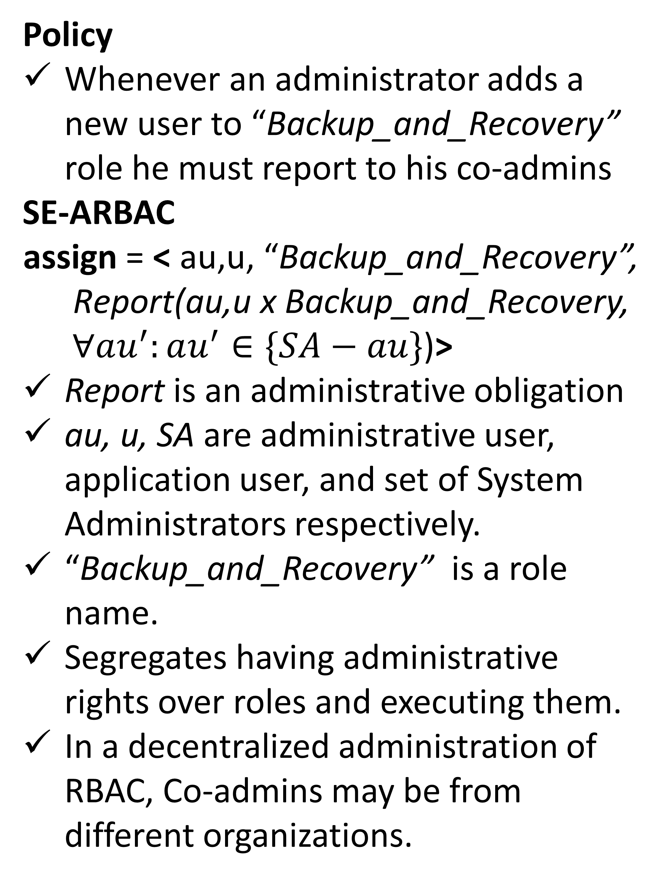
Security Enhanced Administrative
Role Based Access Control Models
Rajkumar P V and Ravi Sandhu
System Security Administration
An Example
Security Abstractions in RBAC
Role Based Access Control (RBAC) provides application level security abstractions: roles, permissions, and users.
Naturally fits in administration of organizational information systems.
Practically implemented in Operating Systems, Database Management Systems, Enterprise Resources Planning Applications, and Cloud Services.
Accountability in RBAC Administration
Accountability of system administrators is an important factor in system security.
Most of the existing administrative models for RBAC does not have sufficient monitoring features.
Enforcing accountability of RBAC administrators requires additional mechanisms.
Policy
Whenever an administrator adds a new user to “Backup_and_Recovery” role he must report to his co-admins
SE-ARBAC
$$\text{assign}\text{ = }\text{<} \text{au}\text{,}\text{u}\text{, “}\text{Ba}\text{c}\text{kup}\text{_}\text{and}\text{_}\text{Recovery}\text{”,}$$
$\text{Report}\text{(}\text{au}\text{,}\text{u} \text{x} \text{Ba}\text{c}\text{kup}\text{_}\text{and}\text{_}\text{Recovery}\text{,}$
$∀au^{′}:au^{′}∈\{SA−au\}$)>
Report is an administrative obligation
au, u, SA are administrative user, application user, and set of System Administrators respectively.
“Backup_and_Recovery” is a role name.
Segregates having administrative rights over roles and executing them.
In a decentralized administration of RBAC, Co-admins may be from different organizations.
Importance and Future Directions
Co-admin accountability checking gains importance as the cloud and mobile services increase their presence in practical business applications.
Further study is required on designing precise administrative obligations for different application contexts.
Development of supportive tools for accountability checking.
Administrative Obligations
Preliminary Idea
Systematic integration of obligations into RBAC administration would help in enforcing accountability of RBAC administrators and enhancing overall system security.

