Slide 1
An Access Control Framework for
Cloud-Enabled Wearable Internet of Things
Smriti Bhatt, Farhan Patwa and Ravi Sandhu
Institute for Cyber Security (ICS)
Center for Security and Privacy Enhanced Cloud Computing (C-SPECC)
Department of Computer Science
University of Texas at San Antonio
3rd IEEE International Conference on Collaboration and Internet Computing
San Jose, California, USA, October 15 - 17, 2017 ravi.sandhu@utsa.edu www.ics.utsa.edu www.cspecc.utsa.edu www.profsandhu.com

Slide 2
Outline
  Introduction
  Background
  Contributions
  Classification of IoT Devices
  Wearable Internet of Things
    Domains and Devices
  Access Control (AC) Framework
  Use Case
  AC Framework Objectives & Research Problems
  Conclusion and Future Work

Slide 3
Introduction
Internet of Things (IoT)
  Interconnection of Internet-enabled smart devices/things
  Enabling technologies – Internet, Cloud and Mobile computing, Big Data and Analytics, M2M technologies and communication protocols, …
  Diverse and pervasive concept
  Numerous IoT applications and services → various subfields of IoT
Wearable Internet of Things (WIoT)
  Revolutionizing industries like healthcare, and sports and fitness
  Enabling technologies – Internet, Smart phones, WSNs, and WBANs
Generally, IoT devices are resource constraint by nature
  Limited storage, power, and computation

Slide 4
Introduction (Contd.)
Cloud-Enabled Internet of Things (CEIoT)
  Integration of Cloud and IoT
  Major cloud services providers (e.g., AWS, Azure) utilize their cloud infrastructure to provide IoT solutions
  Virtually unlimited resources with analysis and visualization capabilities
Security and privacy are primary concerns for IoT
Here, we present an Access Control (AC) framework for CEIoT in context of WIoT (i.e. CEWIoT)

Slide 5
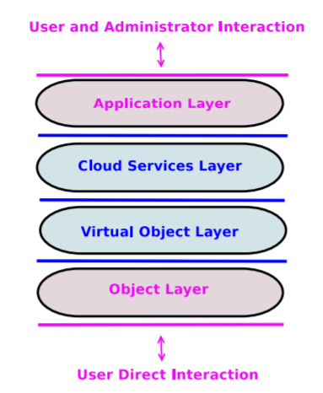
Background
Fig 1: An Access Control Oriented (ACO) Architecture for the CEIoT [1]

Slide 6
Contributions
  Present a general classification of IoT devices to realize different sub-fields of IoT
  Enhance the ACO architecture for CEWIoT by adding an Object Abstraction Layer
  Develop an Access Control (AC) framework for CEWIoT based on our enhanced ACO architecture
  Develop a use case to capture different interactions between ACO layers and propose its possible enforcement in a commercial CEIoT platform, viz., AWS IoT

Slide 7
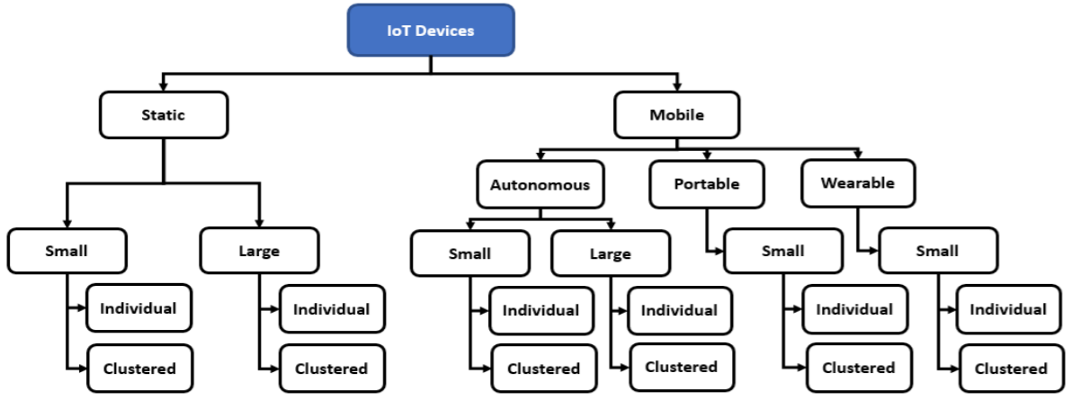
Classification of IoT Devices
Mobility
Size
Nature
Fig 2: A General Classification of IoT Devices

Slide 8
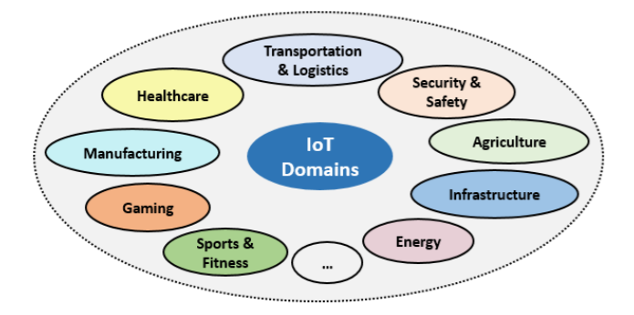
IoT Domains
Fig 3: IoT Application Domains

Slide 9
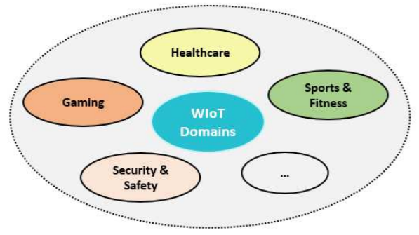
WIoT Domains and Devices
Wearable Devices:
  smart watches
  smart clothing and accessories
  wireless body sensors
  …
Types of Wearable Devices:
  In-Body
  On-Body
  Around-Body
Fig 4: WIoT Application Domains
Wearable devices data – highly privacy sensitive and confidential
A unified access control framework for CEWIoT securing IoT components and their interactions (communication and data exchange) is still lacking

Slide 10
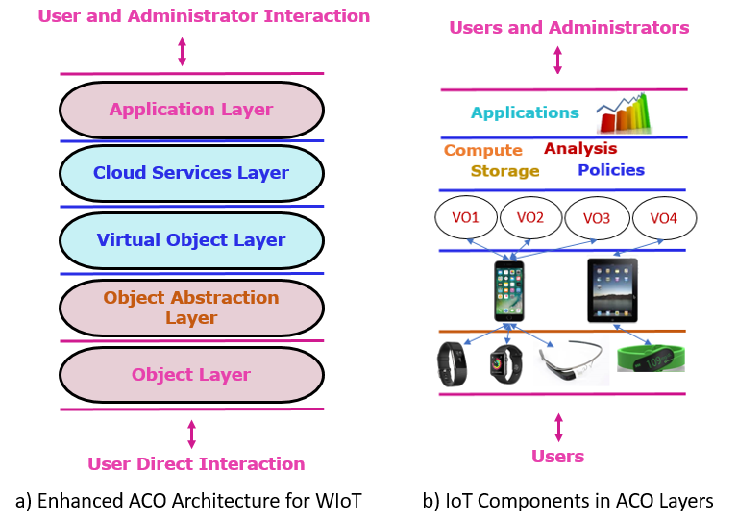
Enhanced ACO Architecture for WIoT
Interactions across the ACO Layers
Fig 5: Enhanced ACO Architecture for WIoT

Slide 11
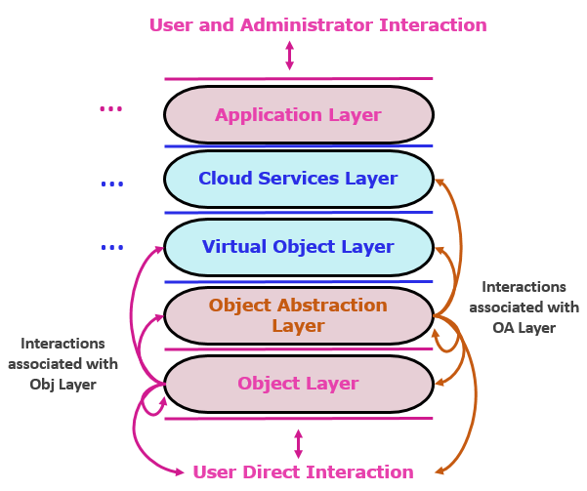
Access Control (AC) Framework
Each layer can interact with itself and up to two adjacent layers in each direction
Two types of interactions:
Direct Interaction
(Interactions with itself and direct adjacent layers)
Indirect Interaction
(Interactions with second level of adjacent layers)
Fig 6: Interactions Between ACO Layers

Slide 12
Access Control (AC) Framework (Contd.)
The access control (AC) framework –
A set of access control models categorized into three main access control categories:
  Object Access Control models
    Object Layer and Object Abstraction Layer
  Virtual Object Access Control models
    Virtual Object Layer
  Cloud Access Control models
    Cloud Services Layer and Applications Layer
Suitable access control models: Role-Based Access Control (RBAC), Attribute-Based Access Control (ABAC), Relationship-Based Access Control (ReBAC)

Slide 13
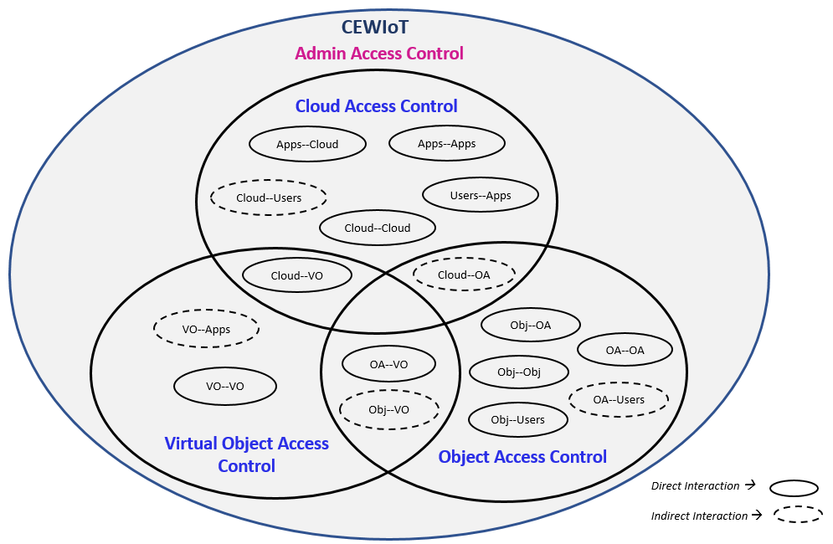
Access Control (AC) Framework (Contd.)
AWS-IoTAC Model [3]
Policy-based access control
ABAC in limited form
- Client Attributes
- Target Attributes
Alshehri and Sandhu [2]
VO-VO communications
Operational and Administrative Access Control Models
- ACLs, CapBAC, RBAC, ABAC
Fig 7: Access Control Framework Based on Interactions Between Different Layers of the ACO Architecture

Slide 14
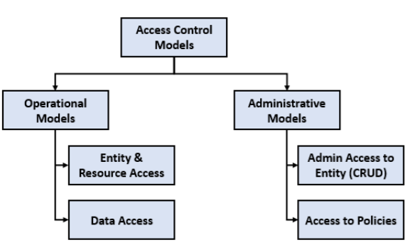
Types of Access Control Models
Fig 8: Types of Access Control Models

Slide 15
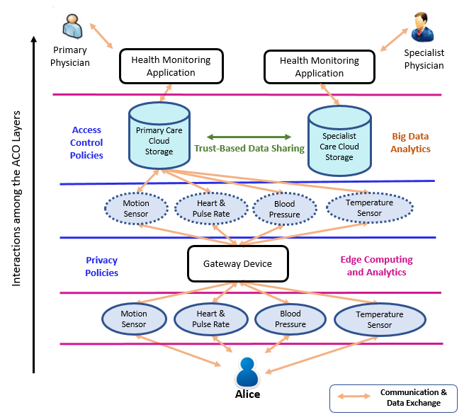
Use Case
Fig 9: Remote Health and Fitness Monitoring (RHFM) Example

Slide 16
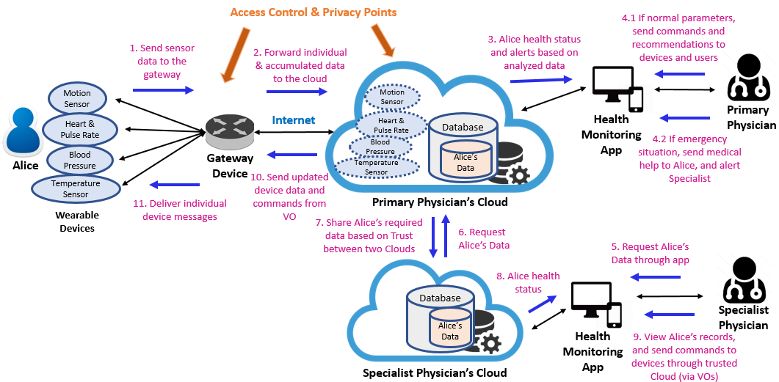
Use Case (Contd.)
Fig 10: A sequential view of the RHFM Use Case

Slide 17
Proposed Enforcement in AWS IoT
Based on our previous work [3], we propose a possible enforcement of our use case utilizing AWS IoT platform
In [3], we configured a smart home use case (with smart sensors, lights, and thermostat) in AWS IoT
Cloud Services
Authorization Policies
Storage and Analysis
…
Wearable Devices
Device Gateway
Virtual Things
Applications
X.509 Certificates
X.509 Certificates
Auth Policy
Auth Policy
Within a Single Account
Inter-Account models required!!

Slide 18
AC Framework Objectives & Research Problems
User-Based Device Authentication
User-Centric Data Security and Privacy
Edge Computing in WIoT (Cloudlets)
Multi-Cloud Architecture for WIoT (Collaboration and Edge Computing)

Slide 19
Conclusion and Future Work
Developed a conceptual AC framework for cloud-enabled wearable IoT (CEWIoT)
  Enable development of a family of AC models with fine-grained access control for specific interactions in CEWIoT
Discussed suitable access control models (e.g., RBAC, ABAC, ReBAC) for different AC categories
Presented a WIoT use case and its possible implementation in AWS IoT Future Work:
  Develop Cloud Access Control models (cross-tenant/account, multi-cloud models) – ABAC and other combinations

Slide 20
References
[1] Alshehri, Asma, and Ravi Sandhu. "Access control models for cloud-enabled internet of things: A proposed architecture and research agenda." In IEEE 2nd International Conference on Collaboration and Internet Computing (CIC), pp. 530-538. IEEE, 2016.
[2] Alshehri, Asma, and Ravi Sandhu. "Access Control Models for Virtual Object Communication in Cloud-Enabled IoT." In 18th International Conference on Information Reuse and Integration (IRI). IEEE. 2017.
[3] Bhatt, Smriti, Farhan Patwa, and Ravi Sandhu. "Access Control Model for AWS Internet of Things." In International Conference on Network and System Security, pp. 721-736. Springer, Cham, 2017.
(…More in the paper)

Slide 21
Thank you!
Questions?

