Slide 1
Institute for Cyber Security
Clustering-Based IaaS Cloud Monitoring
Mahmoud Abdelsalam*, Ram Krishnan✝ and Ravi Sandhu*
*Department of Computer Science
✝Department of Electrical and Computer Engineering
10th IEEE International Conference on Cloud Computing (CLOUD)
June 25-30, 2017
World-Leading Research with Real-World Impact!
‹#›
Notes:
‹#›

Slide 2
Goals
Develop a security monitoring framework for anomaly detection in cloud IaaS by:
leveraging essential cloud characteristics.
(i.e., Rapid Elasticity -> Auto-Scaling)
© Mahmoud Abdelsalam
World-Leading Research with Real-World Impact!
‹#›
Notes:
‹#›

Slide 3
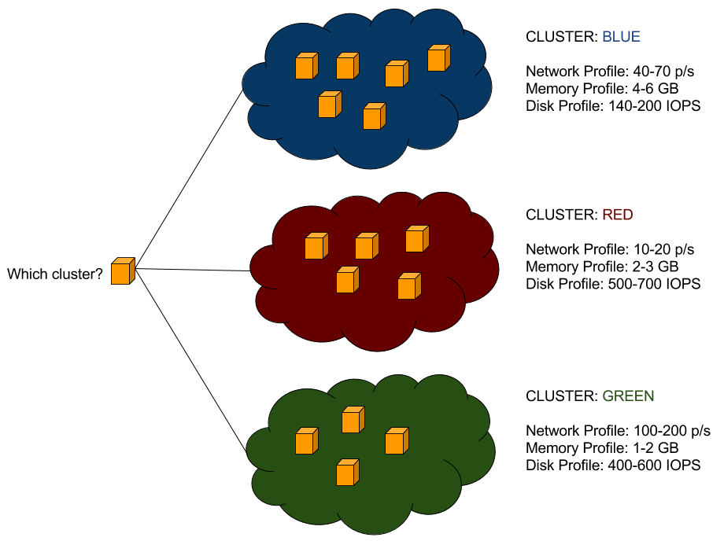
Proposed Approach
VMs doing the same function SHOULD behave similarly
Cluster VMs based on their attributes
New VM gets created?
“fit” VM with existing cluster
If successful: good
If not: report anomaly
© Mahmoud Abdelsalam
World-Leading Research with Real-World Impact!
‹#›
Notes:
‹#›

Slide 4
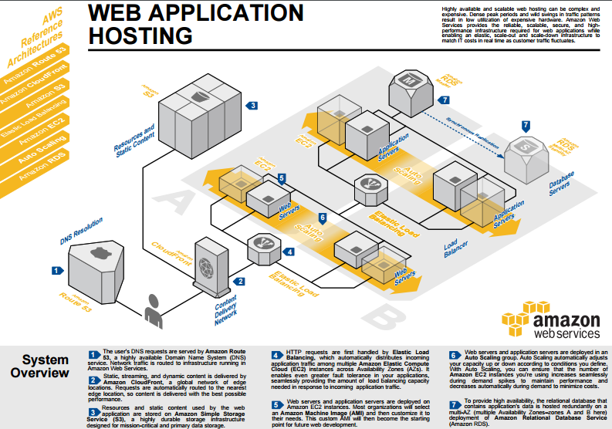
3-tier example
Reference: https://aws.amazon.com/architecture/
© Mahmoud Abdelsalam
World-Leading Research with Real-World Impact!
‹#›
Notes:
‹#›

Slide 5
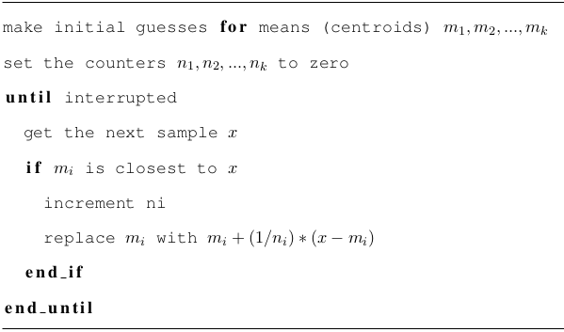
Sequential K-means
© Mahmoud Abdelsalam
World-Leading Research with Real-World Impact!
‹#›
Notes:
‹#›

Slide 6
Modified Sequential K-means
For the first m minutes, VM v data samples is compared and counted to all clusters.
VM v is assigned to the cluster with the maximum number of v’s data samples.
After that, v’s data samples is compared only to its assigned cluster to check for anomalies as well as updating the cluster’s information.
Stabilizing time is introduced to avoid false alarms.
© Mahmoud Abdelsalam
World-Leading Research with Real-World Impact!
‹#›
Notes:
‹#›

Slide 7
Black-box Features
Metric | Description | Unit
CPU utilization | Average CPU utilization | %
Memory usage | Volume of RAM used by the VM from the amount of its allocated memory | MB
Memory resident | Volume of RAM used by the VM on the physical machine | MB
Disk read requests | Rate of disk read requests | rate/s
Disk write requests | Rate of disk write requests | rate/s
Disk read bytes | Rate of disk read bytes | rate/s
Disk write bytes | Rate of disk write bytes | rate/s
Network outgoing bytes | Rate of network outgoing bytes | rate/s
Network incoming bytes | Rate of network incoming bytes | rate/s
© Mahmoud Abdelsalam
World-Leading Research with Real-World Impact!
‹#›
Notes:
‹#›

Slide 8
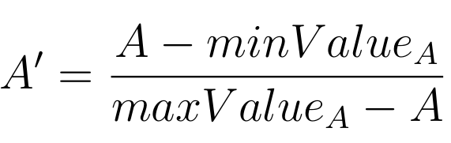
Features Normalization
Clustering algorithms can be very sensitive to data scales (more weight goes to features with higher values)
Data samples are not of the same scale.
Min-Max normalization is a technique where you can fit the data with a pre-defined boundary.
© Mahmoud Abdelsalam
World-Leading Research with Real-World Impact!
‹#›
Notes:
‹#›

Slide 9
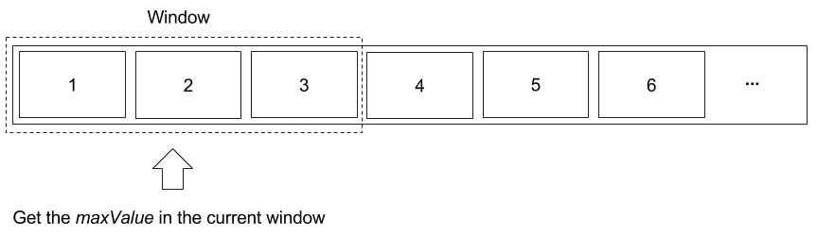
Features Normalization (cont.)
How to get maxValue?
  Pre-defined based on knowledge
  Get the max value of the data (infinite time series data?)
Use Min-Max normalization based on a fixed-size sliding window.
© Mahmoud Abdelsalam
World-Leading Research with Real-World Impact!
‹#›
Notes:
‹#›

Slide 10
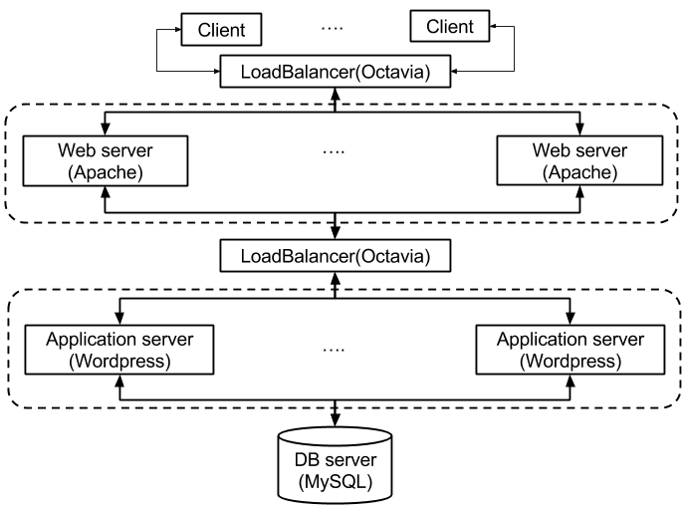
Testbed Setup
© Mahmoud Abdelsalam
World-Leading Research with Real-World Impact!
‹#›
Notes:
‹#›

Slide 11
Traffic Generation
Simple & realistic traffic generation
  Poisson
    Used in many cases due to its simplicity
  On/Off Pareto
    Internet traffic is proved to be of self-similar nature
The simulation parameters are as follows:
  Generator: On/Off Pareto, Poisson
  Number of concurrent clients: 50
  Requests arrival rate/hour: 3600
  Type of requests: GET and POST(randomly generated)
© Mahmoud Abdelsalam
World-Leading Research with Real-World Impact!
‹#›
Notes:
‹#›

Slide 12
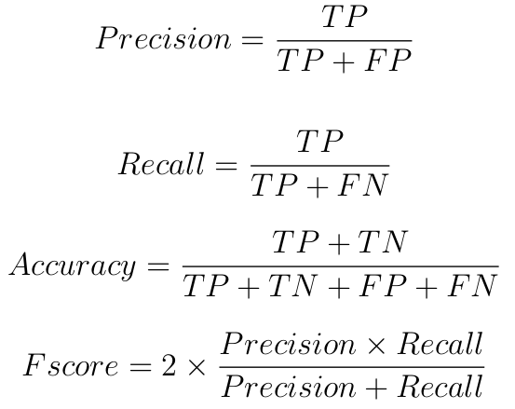
Experiments Evaluation
We use four metrics to evaluate the effectiveness and applicability of our approach:
© Mahmoud Abdelsalam
World-Leading Research with Real-World Impact!
‹#›
Notes:
‹#›

Slide 13
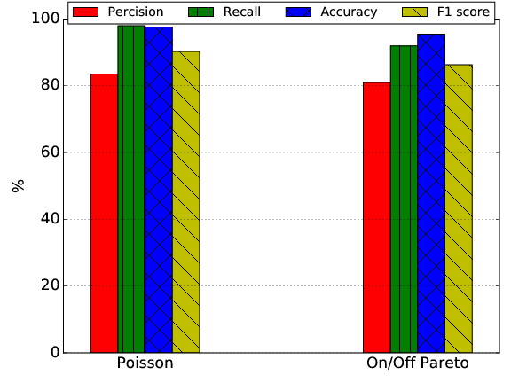
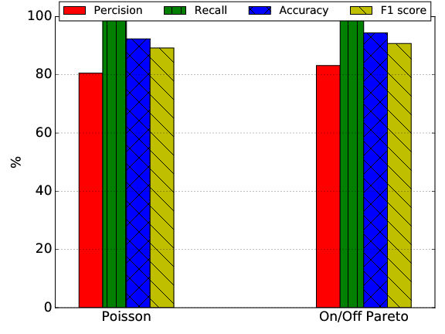
Results
Injected Anomalies: cpu, memory and disk intensive
EDoS: One form of EDoS is to create some VMs that remain dormant or idle
© Mahmoud Abdelsalam
World-Leading Research with Real-World Impact!
‹#›
Notes:
‹#›

Slide 14
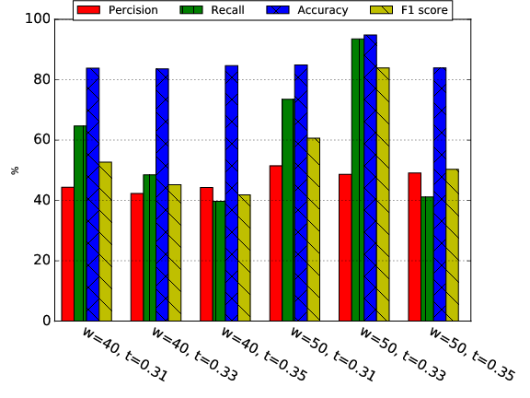
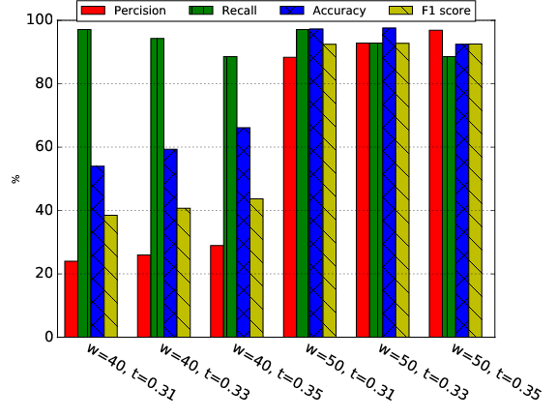
Results (cont.)
Ransomware is a very critical threat to cloud.
Netskope’s quarterly cloud report states that 43.7% of the cloud malware types detected in cloud apps are common ransomware delivery vehicles.
Ransomware (KillDisk) - Poisson
Ransomware (KillDisk) - On/Off Pareto
© Mahmoud Abdelsalam
World-Leading Research with Real-World Impact!
‹#›
Notes:
‹#›

Slide 15
Limitations
Vulnerable to low-profile anomalies and malware.
  Hard to detect using black-box features.
Expert is needed in parameter tuning which, in some cases, unavailable/unaffordable for some cloud tenants.
Attacks gradually change normal behavior of VMs
  Harder since the change of behavior has to be in all VMs of the same cluster at the same time.
© Mahmoud Abdelsalam
World-Leading Research with Real-World Impact!
‹#›
Notes:
‹#›

Slide 16

Questions/Comments
World-Leading Research with Real-World Impact!
‹#›

