Slide 1
Toward Deep Learning Based Access Control
Mohammad Nur Nobi, Ram Krishnan, Yufei Huang*, Mehrnoosh Shakarami, Ravi Sandhu
University of Texas at San Antonio
*University of Pittsburgh
April 26, 2022

Slide 2


Introduction
There are many mainstream approaches for access control
Access Control Lists (ACLs), Role Based Access Control (RBAC), Attribute Based Access Control (ABAC), Relationship Based Access Control (ReBAC), etc.
These approaches have their benefits and numerous advancements
Skilled security administrators needed to engineer and manage accesses
Over-provisioned to ease administrative burden
Under-provisioned for the sake of tightened security
Policy + Attributes
access request
permit/ deny
Access Control System
user
resource
Notes:
one fundamental issue has remained the same -- human administrators need to manage accesses.
Clearly, this leads to all types of errors and inefficiencies
Over-provision: plenty of users with accesses that should not have those accesses
Under-provision: plenty of users that lack accesses that should indeed have those accesses

Slide 3
A Sample System
Access Control State
<Alice, service1, read>
<Alice, service2, {read, write}>
<Bob, service1, {read, write}>
<Bob, service2, {read}>
Authorization Tuple
<User, Resource, {Operations}>
User Metadata
Resource Metadata
User | spending | join_date | credit_score
Alice | high | Nov 2010 | 700
Bob | high | Jul 2015 | 500
Resource | limit | process_time
service1 | 10K | 1 day
service2 | 5K | 1 week

Slide 4
Phase-1: Attribute Engineering
User metadata
Resource metadata
User | spending | join_date | credit_score
Alice | high | Nov 2010 | 700
Bob | high | Jul 2015 | 500
Resource | limit | process_time
service1 | 10K | 1 day
service2 | 5K | 1 week
Attribute
User | spending | C_status
Alice | high | platinum
Bob | high | silver
Resource | S_status
service1 | premium
service2 | regular
Attributes
Assignment
User Attributes
Resource Attributes
Notes:
Lets talk a bit details about a toy access control system
The idea of attribute engineering is to obtain a meaningful access control attribute combining one or more metadata.

Slide 5
Phase-2: Policy Engineering
User | spending | C_status
Alice | high | platinum
Bob | high | silver
Resource | S_status
service1 | premium
service2 | regular
Access Control State
<Alice, service1, {read}>
<Alice, service2, {read, write}>
<Bob, service1, {read, write}>
<Bob, service2, {read}>
User Attributes
Resource Attributes
Rule: <spending = high, C_status = platinum, S_status = premium> = read
access request
Access Control System
read
Generalization !
Alice
service1
Notes:
The rules are crafted in a way such that it can cover all the given access control state.
What if another user with different attributes value configuration that was not seen during this policy engineering process? – that is the idea of generalization where this rule based system suffers

Slide 6
Deep Learning
Self driving car
Healthcare
Banking
Learn by example
Learn directly from the raw data (no feature extraction)
Obtain an excellent accuracy
Notes:
We wanted to explore current progresses in deep learning system. Deep learning is successful in many applications including banking ,healthcare and autonomous vehicle systems.

Slide 7
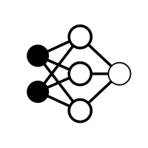
Deep Learning in Access Control
Could it learn from existing access control state of the system?
Could it learn directly from the metadata?
Could it make access control decisions that are accurate and generalize better?
Rules + Attributes
access request
permit
Access Control System
user
resource
Obviates the need for related processes
Attribute Engineering and Assignments
Policy Engineering
Deep Learning Based Access Control (DLBAC)
Notes:
Based on these possible advantages, we propose an automated and dynamic access control system leveraging advances in deep learning technology

Slide 8
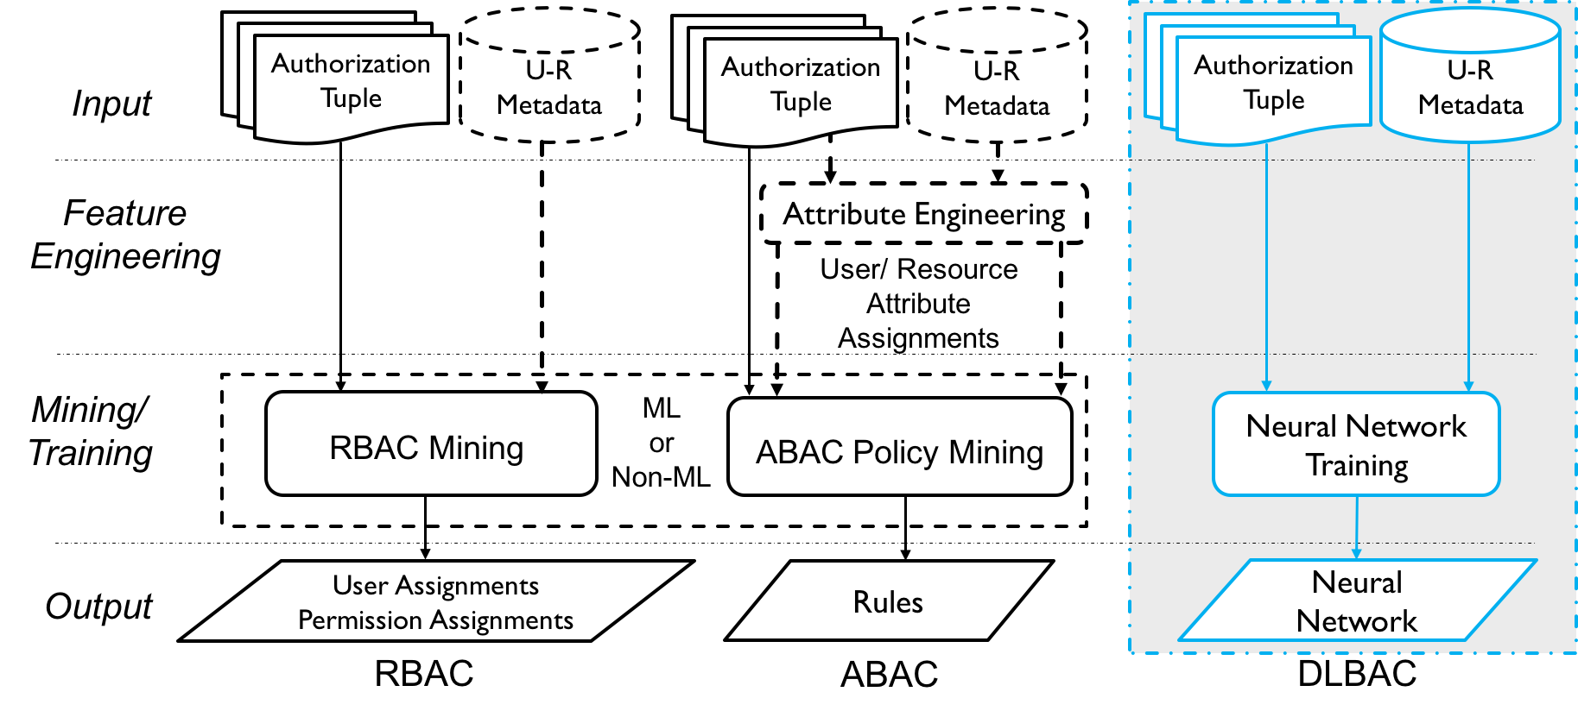
Policy Engineering in Classical Approaches vs. DLBAC

Slide 9
A Candidate DLBAC Model : DLBAC_{α}
Training data
Training data
ResNet Network
Authorization Tuple
Trained ResNet
Notes:
For DLBAC_alpha experiments we choose ResNet as the candidate neural network due to its advantages in different domains. 1. ResNet dominates in different deep learning applications and, 2. it reduces parameters and faster training

Slide 10
Authorization Tuple and Dataset in DLBAC_{α}
User/ Resource metadata
User: Alice
rank | team | project |  | join date
developer | dev | projA | … | Nov 2012
Operations: op1, op2, op3, op4
type | team | project |  | size
source | dev | projA | … | medium
Resource: projectA
Authorization Tuple:
<Alice, projectA, {op1, op3}>
developer | dev | projA | … | Nov 2012
source | dev | projA | … | medium
1 | 0 | 1 | 0
User metadata values
Resource metadata values
Access to operations
A dataset for DLBACα is the collection of such authorization tuples (samples)
Notes:
In access control, there is a lack of dataset. Therefore, researchers generally rely on synthetic datasets. However, we experimented on both synthetic and real-world datasets. First we will talk about synthetic dataset generation.

Slide 11
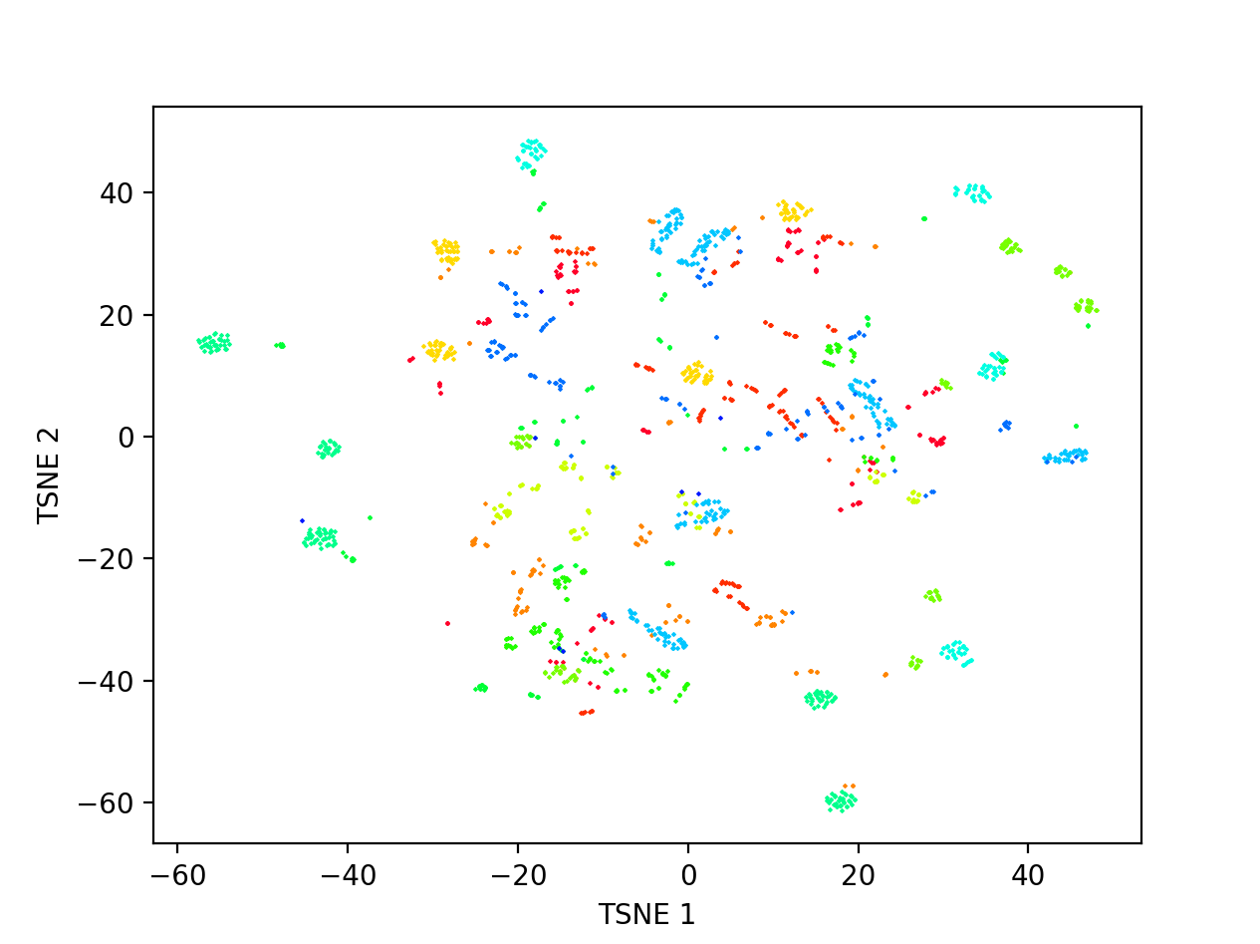
Dataset Generation
Generate a synthetic dataset using Xu et al. [1]
<Alice, projectA, {op1, op3}>
Each dot represents an authorization tuple
Each color indicates a unique combination of access operations
The position of a tuple is based on both user and resource metadata values
Two tuples are closed to each other, which indicates they have similar user-resource metadata values
multiple tuples of the same color indicate they have the same access
t-SNE plot of a synthetic dataset
Notes:
We visualize the dataset using t-SNE plot to understand the characteristics of the dataset
As the dots are easily separable in groups, creating a rule for each group can easily solve the access control mining problem

Slide 12
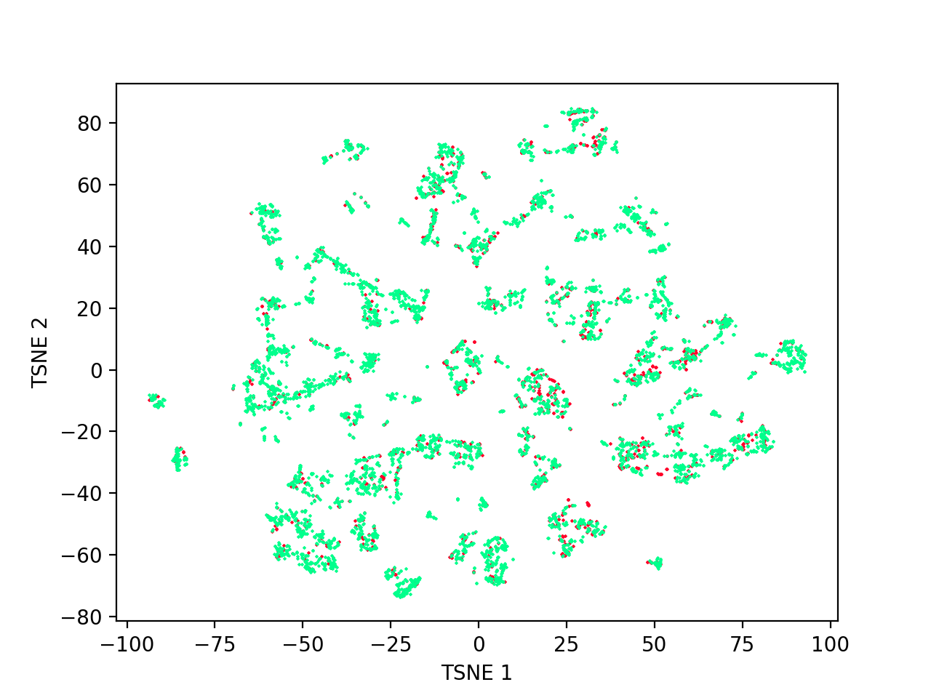
Real-world Systems Are Complex !
A dataset representing Amazon access control system
Notes:
However, real-world systems are much more complex with lots of overlapping among authorization tuples
We try to simulate real-world scenario as close as possible in our synthetic dataset generation

Slide 13
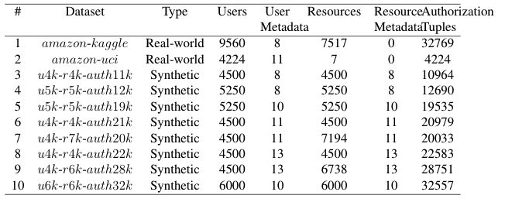
List of Datasets
Notes:
Eventually we create 8 datasets for DLBAC_alpha experimentation
We also experiment the performance of DLBAC_alpha with two real-world datasets.

Slide 14
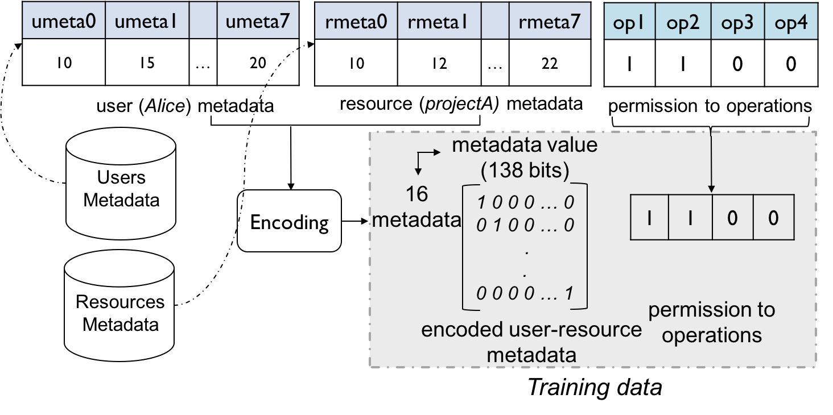
Preparing Training Data for DLBACα
We consider the data in our datasets are categorical
Notes:
Essentially the binary matrix is the input to the network
And network to learn to predict access probabilities for respective operation

Slide 15
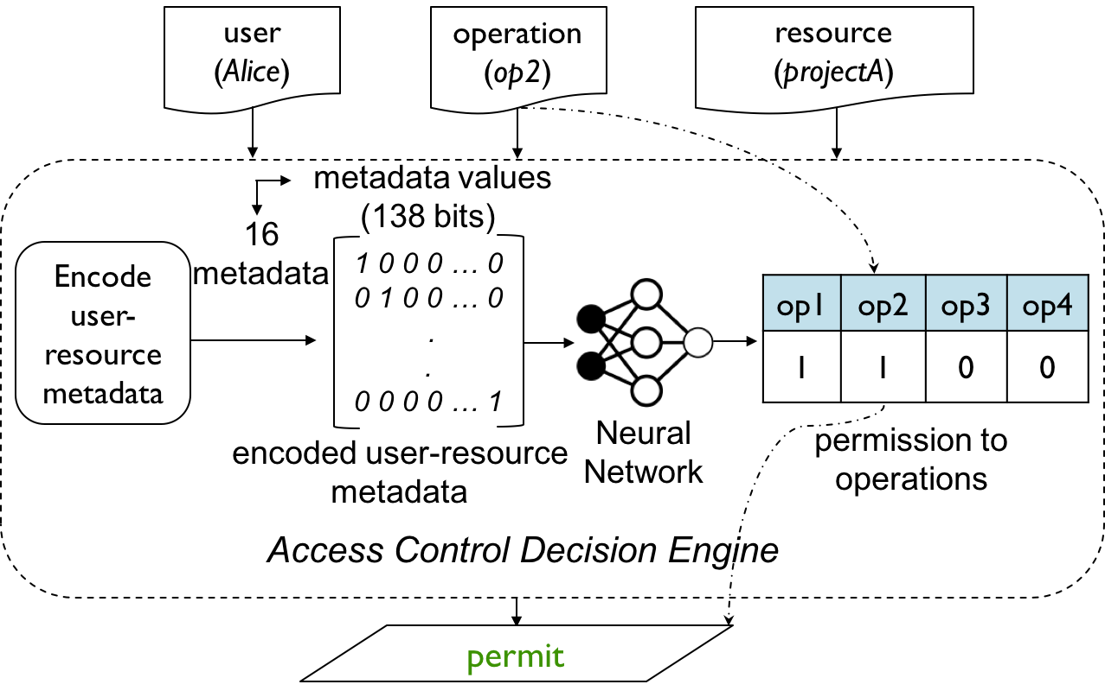
Decision Making Process in DLBACα
Permit decision is made comparing the output probability with a threshold
Notes:
The access control decision is obtained from comparing the probability of granting the permission at the output of the network with a threshold.

Slide 16
Evaluation Methodology
Classical ML Algorithms
State-of-the-art policy mining and ML-based techniques
SVM
XuStoller [1]
Random Forest (RF)
Multiple instances of DLBACα
ResNet (DLBAC_{α-R})
DenseNet (DLBAC_{α-D})
Xception (DLBAC_{α-X})
Multilayer Perceptron (MLP)
Rhapsody [2]
EPDE-ML [3]
Notes:
Rationale of using deep learning algorithm
FP: falsely permitted access
FN: falsely denied access

Slide 17
Evaluation Metrics
80% samples for the training, and 20% testing
F1, TPR
FPR
A higher F1 score: better generalization
A higher TPR: accurate and efficient in granting access
A lower FPR: efficient in denying access
Under-Provision vs. Over-Provision
Notes:
Policies (or models) with a higher F1 score: how precise it is.
lead to better generalization (consider both precision and sensitivity).
higher TPR is better as these scores indicate how accurately and efficiently the policies (or models) can grant access
A lower FPR is better as they are less likely to give access to requests, those which should be denied according to the ground truth access control policy
Lower TPR: Under-Privileged
Higher FPR: Over-Privileged

Slide 18
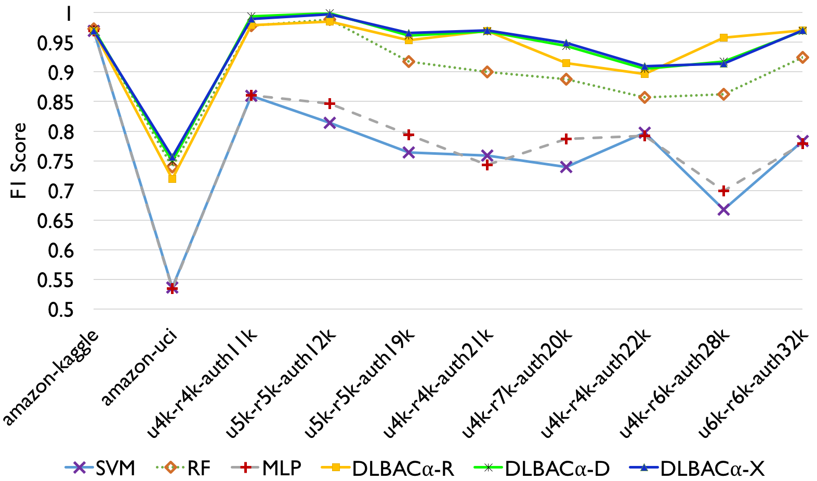
Comparison with ML Algorithms
DLBACα instances are more effective and accurate than classical ML approaches for making accurate access decisions
Notes:
Some performance, say RF, are close to DLBAC. However, the difference statistically significant.

Slide 19
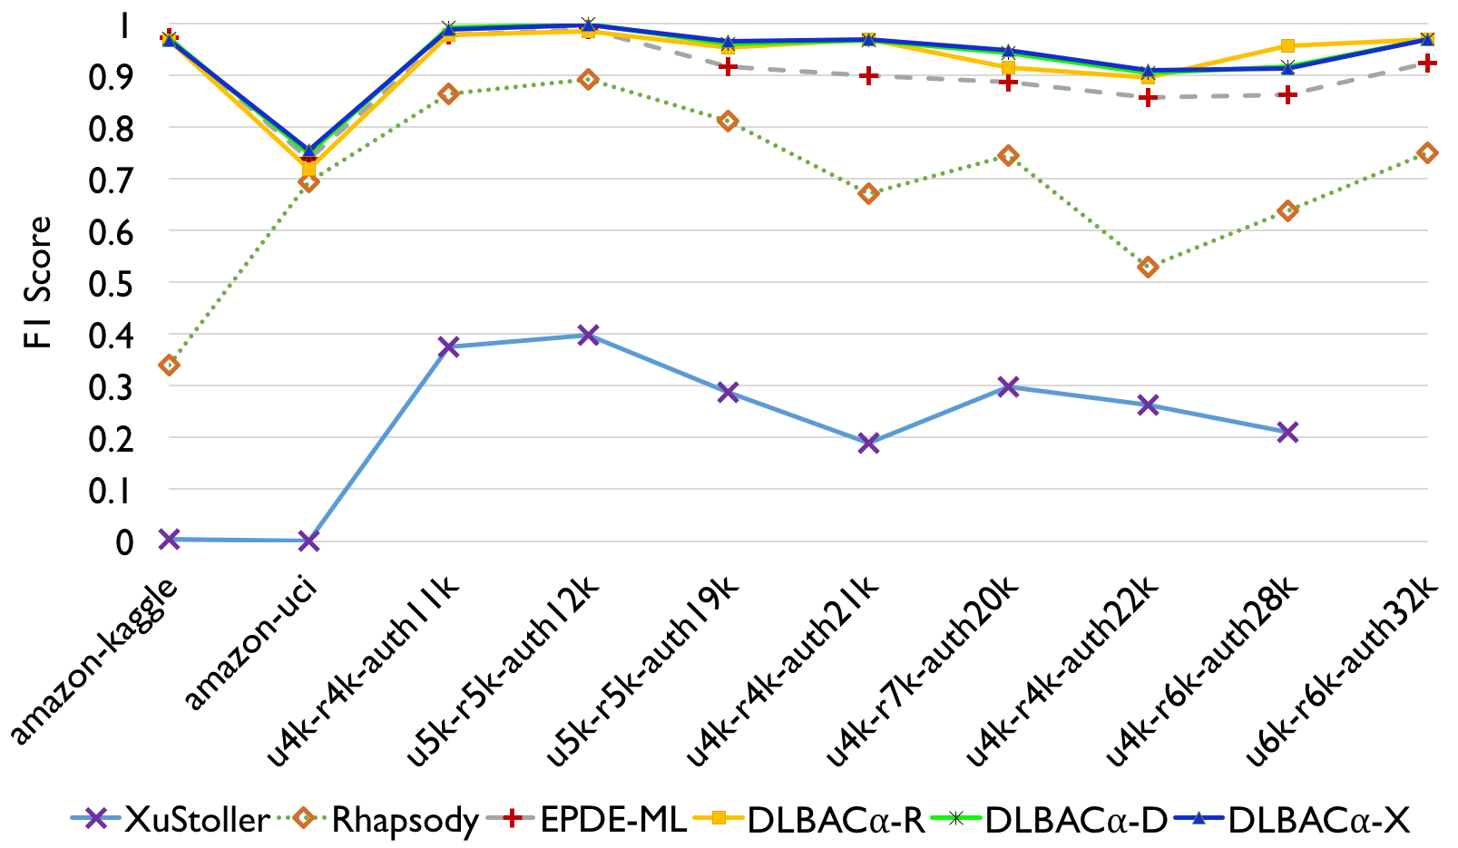
Comparison with Policy Mining Algorithms
A DLBACα can make more accurate access control decisions and generalize better

Slide 20
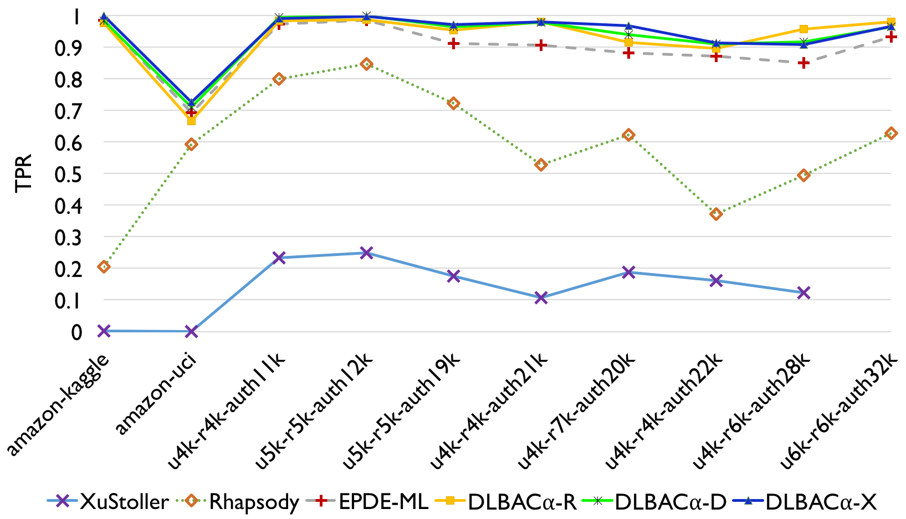
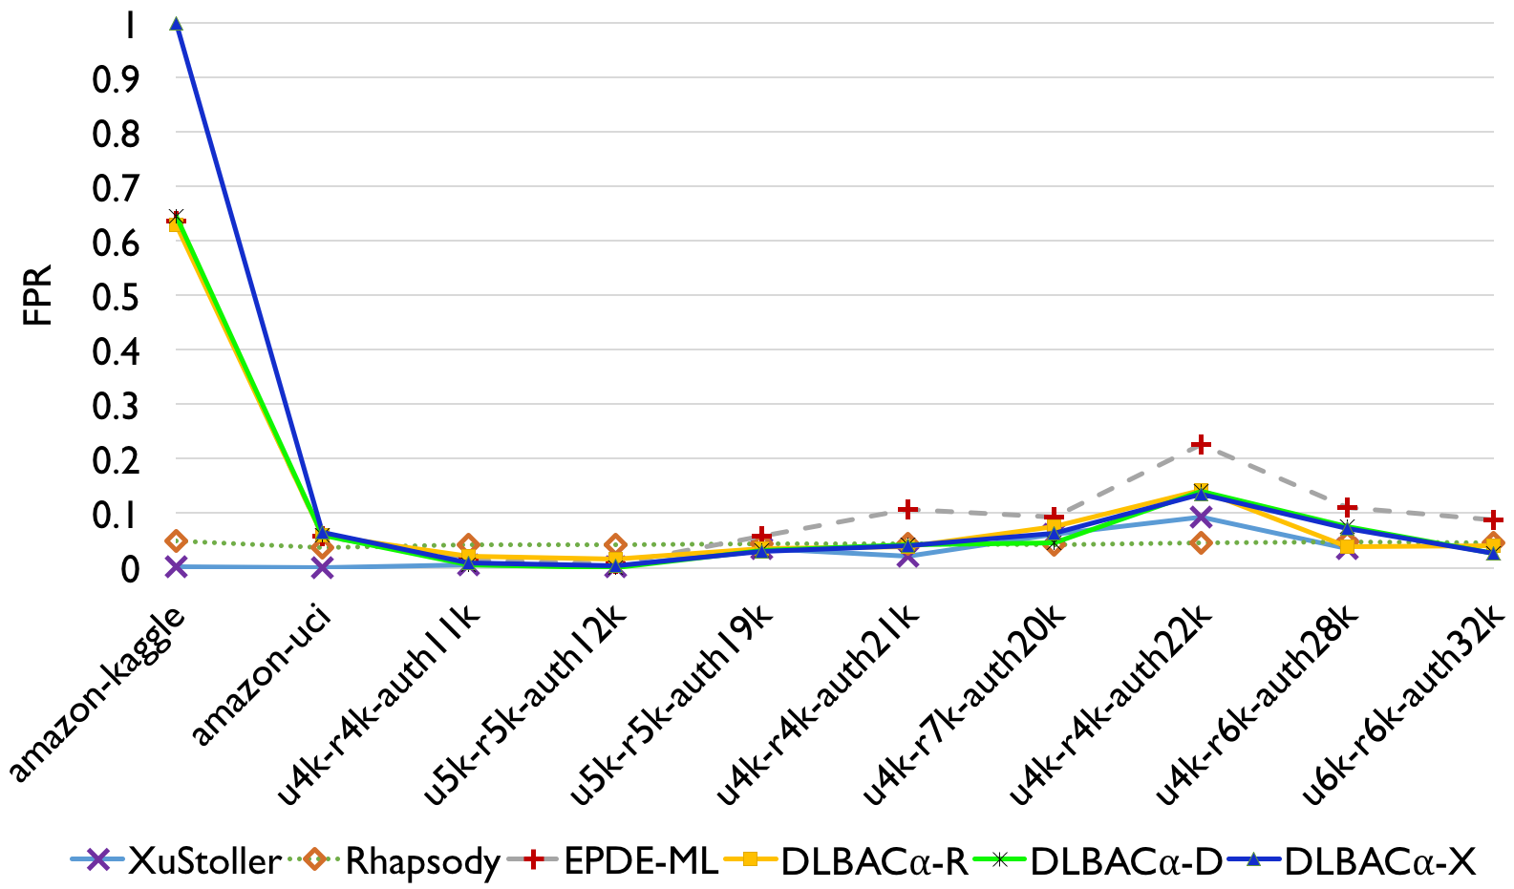
Comparison with Policy Mining Algorithms (cont’d)
handling desired accesses
handling unwanted accesses
A DLBACα can balance both permitting desired accesses and denying unwanted accesses
Notes:
TPR: accuracy in denying desirable access
FPR: accuracy in permitting unwanted access
TPR = 1 - FNR

Slide 21
Understanding DLBAC Decisions
Why does Bob’s ‘op2’ access been denied for projectB resource?
Bob
op2
projectB
Which metadata are important/ influential for this decision?
DLBACα
Propose two approaches
Integrated Gradients
Knowledge Transferring
deny
A sample access request
Notes:
Formalize DLBAC understanding as a neural network interpretation problem
Leverage deep learning interpretation technique

Slide 22
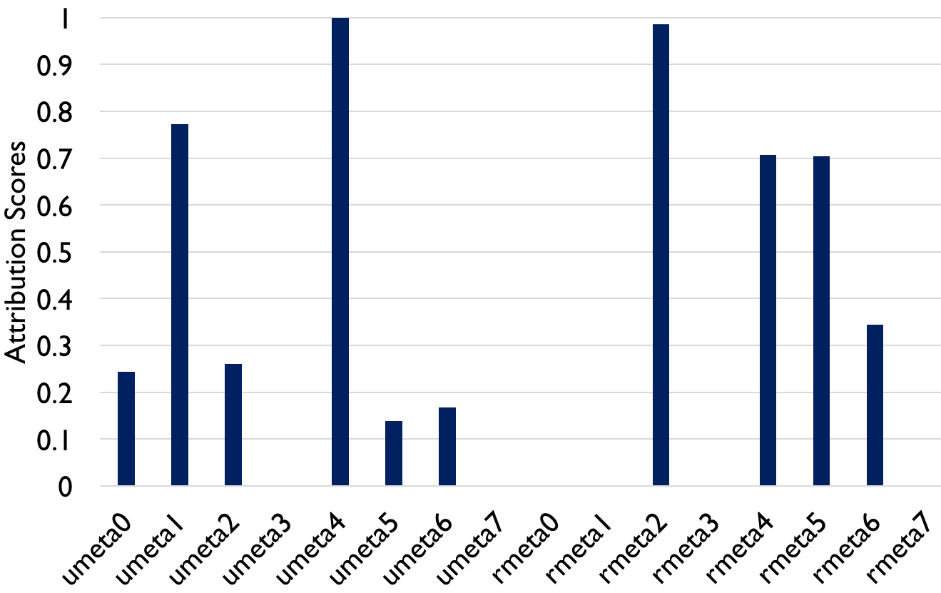
Integrated Gradients
Bob’s metadata
projectB’s metadata
Integrated Gradients
DLBACα
deny for op2
Local Interpretation
Notes:
Umeta4 and rmeta2 are most significant metadata for this decision
Whereas umeta7 and rmeta0 has no impact at all
Understanding single decision is known as local interpretation

Slide 23
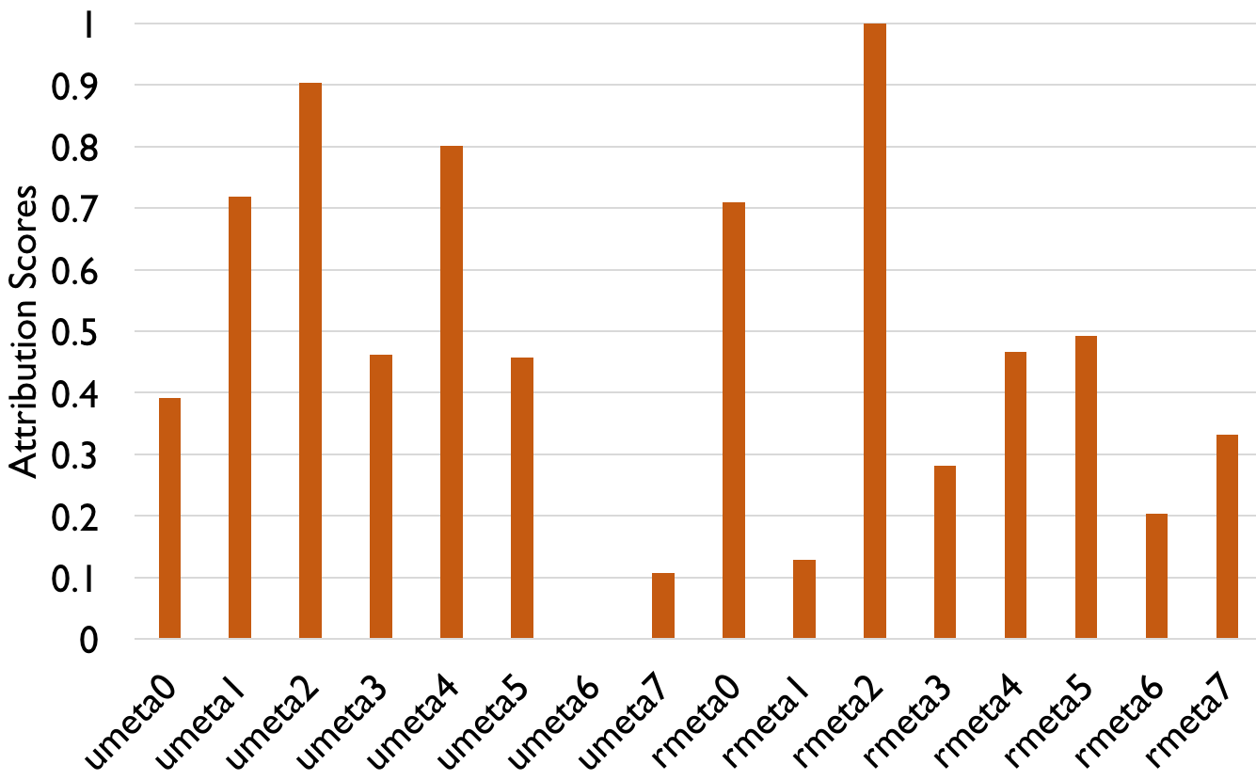
Integrated Gradients
Bob’s metadata
projectB’s metadata
Integrated Gradients
DLBACα
deny for op2
Global Interpretation
Notes:
Global interpretation: Understanding the significance of metadata in the entire system

Slide 24
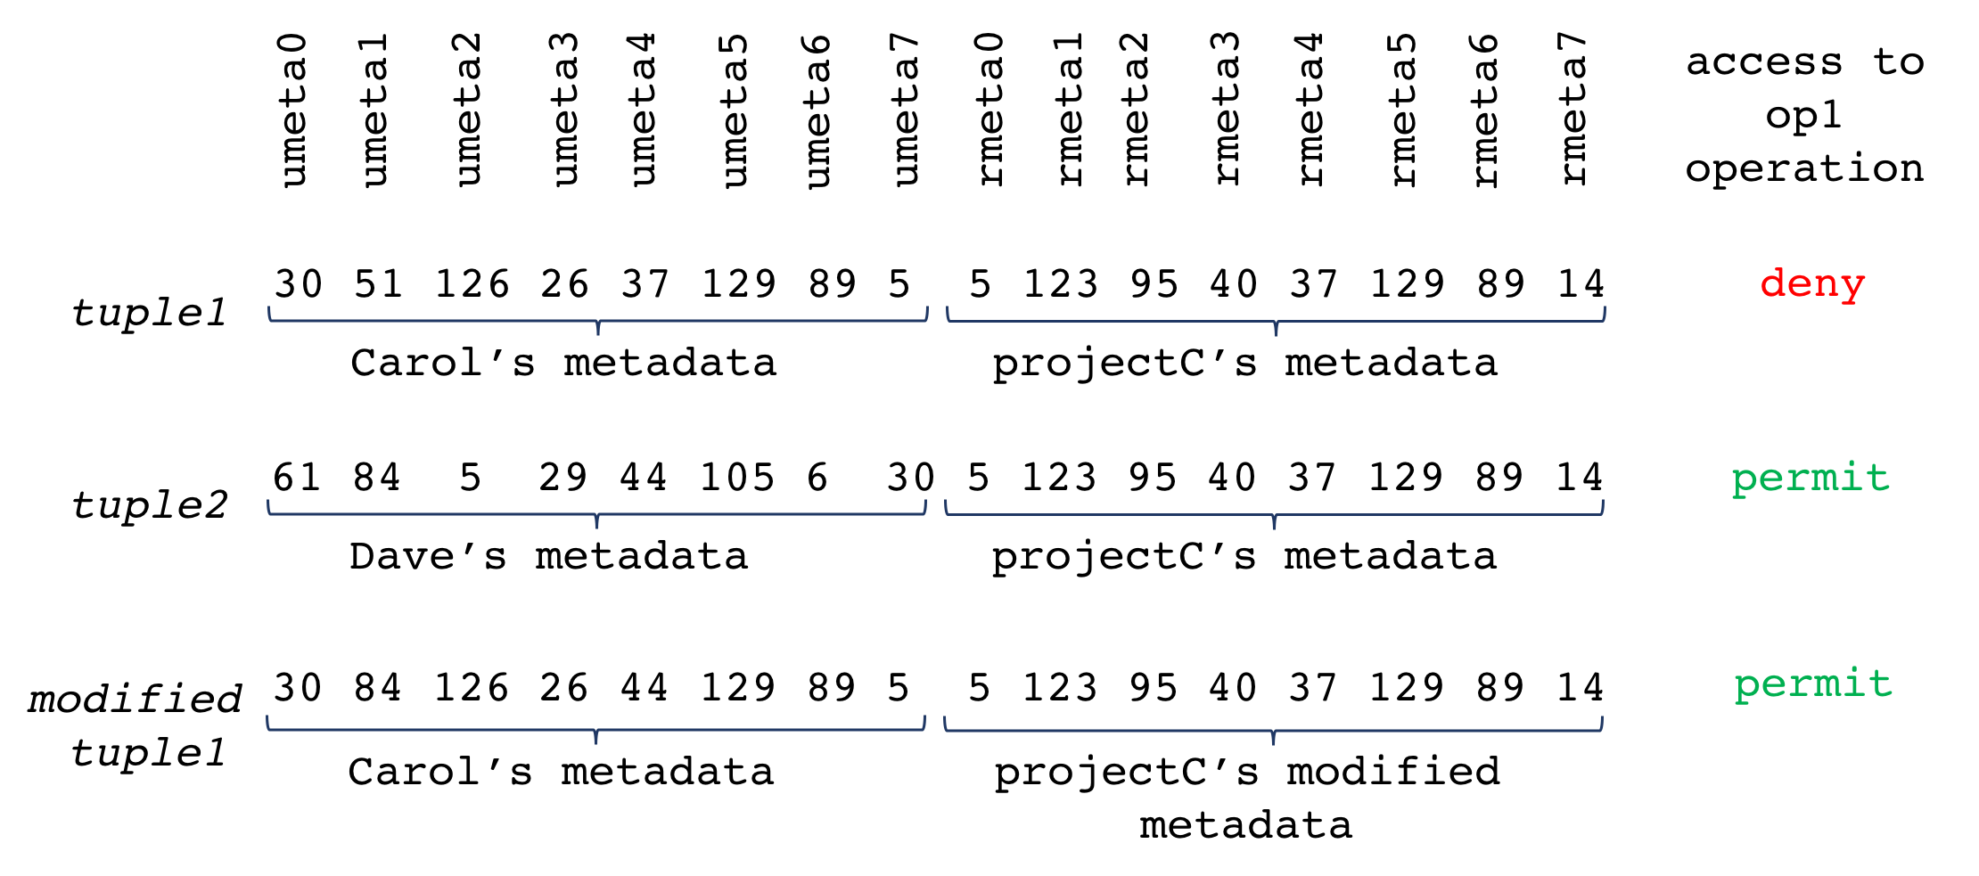
Application of Integrated Gradient-based Understanding
Strengthen the effect of “influential metadata”
Can be utilized in future access modification
doesn’t establish the relationship among metadata
Notes:
Lets assume, system admin know another user Dave has access to projectC resource
System admin can apply “integrated gradients” based understanding to learn what are the important metadata of Dave for this specific decision.
Then, the admin change Carol’s respective metadata values with Dave’s metadata values.
Based on the Carol’s modified metadata, he now has access to projectC resource.
Integrated Gradients doesn’t establish the relationship among metadata

Slide 25
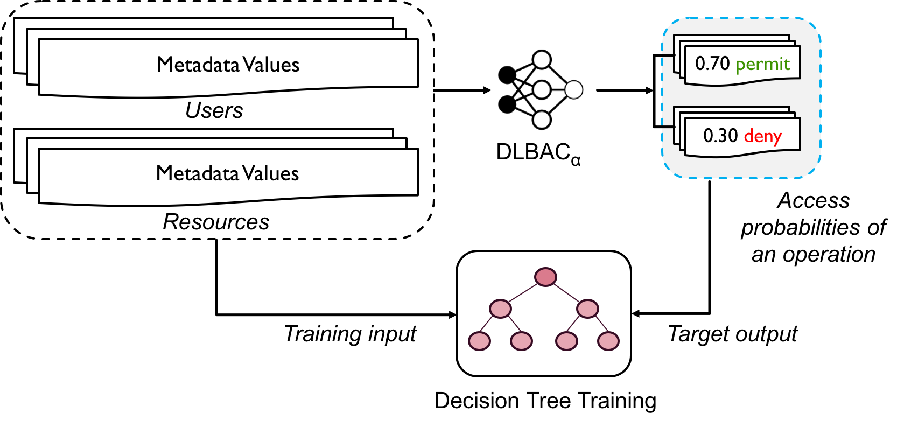
Knowledge Transferring
approximately understand the decision in the form of traditional rules
Rule: local interpretation
DT: global interpretation
Notes:
Knowledge transferring technique could help to identify such relationships.
With this technique we can approximately understand the decision of DLBAC_alpha in the form of traditional rules.
The probabilities are the knowledge of dlbac_alpha

Slide 26
Future Research Directions
DLBAC Administration
DLBAC in Tandem
Adversarial Attacks from Access Control Perspectives
Bias and Fairness
Notes:
Updating access control state to affect a particular change
Could be mitigated by developing life-long learning based methods
May not substitute traditional forms of access control immediately
Could be integrated to operate in tandem with traditional access controls
Acquire access permissions based on modified user and resource metadata
Need to investigate from both ML and access control perspectives
Human biases or errors in training data may exist
Critical to audit training data, evaluate decisions for fairness, etc.

Slide 27

DLBAC Source code and datasets URL:
https://github.com/dlbac/DlbacAlpha

Slide 29
Backup

Slide 30
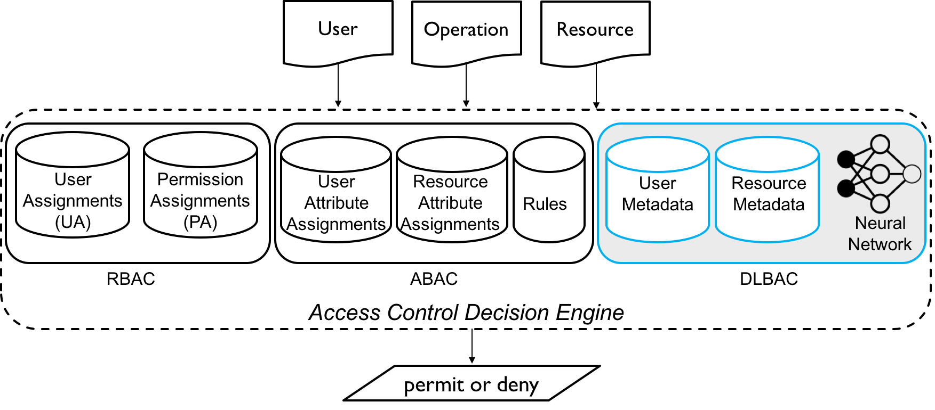
Decision Making in Classical Approaches vs. DLBAC
Notes:
As far decision making is concern, the DLBAC make access decisions based on a trained network as opposed to the rules or user/permission assignments in the case of ABAC and RBAC.

Slide 31
A Candidate DLBAC Model : DLBAC_{α}
Training data
Training data
ResNet Network
Authorization Tuple
Trained ResNet
ResNet dominates in different deep learning applications
Reduces parameters and faster training
Reducing the effect of vanishing gradient problem through identify layers
identity layer
weight layer
relu
weight layer
relu
+
How about Authorization Tuples?
Notes:
ResNet also has some other advantages like reduced parameters and training efficiency

Slide 32
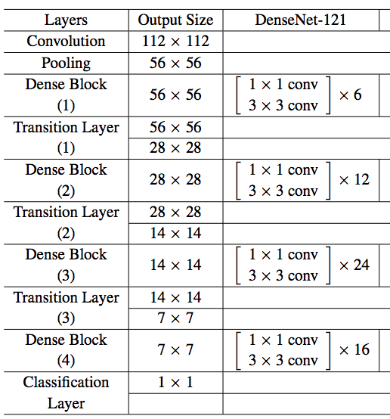
Network Architectures
For dataset 1-4: ResNet8
For dataset 5-10: ResNet50
ResNet, DenseNet

Slide 33
Dataset Generation
A set of user metadata (8)
A set of resource metadata (8)
A set of operations (4)
1
Create a set of ABAC Rules based on User and Resource metadata
2
for each Rule
Proposed by Xu et al. , Mining attribute-based access control policies, TDSC’2014
Create Users and assign values to all metadata
Create Resources and assign values to all metadata
3
Create Tuple based on User-Resource metadata and the Rules, and add to the dataset
4

Slide 34
Dataset Generation
A set of user metadata
A set of resource metadata
1
A set of operations
2
Hide a portion of metadata
3
Create a set of ABAC Rules based on User-Resource metadata; keep “hidden metadata” invisible to the Rules
for each Rule
Create Users and assign values to all metadata
Create Resources and assign values to all metadata
4
Create Authorization Tuple based on User-Resource metadata and the Rules, and add to the dataset
5
Notes:
To simulate the idea of real-world intuition
System admin do not consider all of the attributes while granting access.
There might have other metadata that have a passive impact of decision making

Slide 35
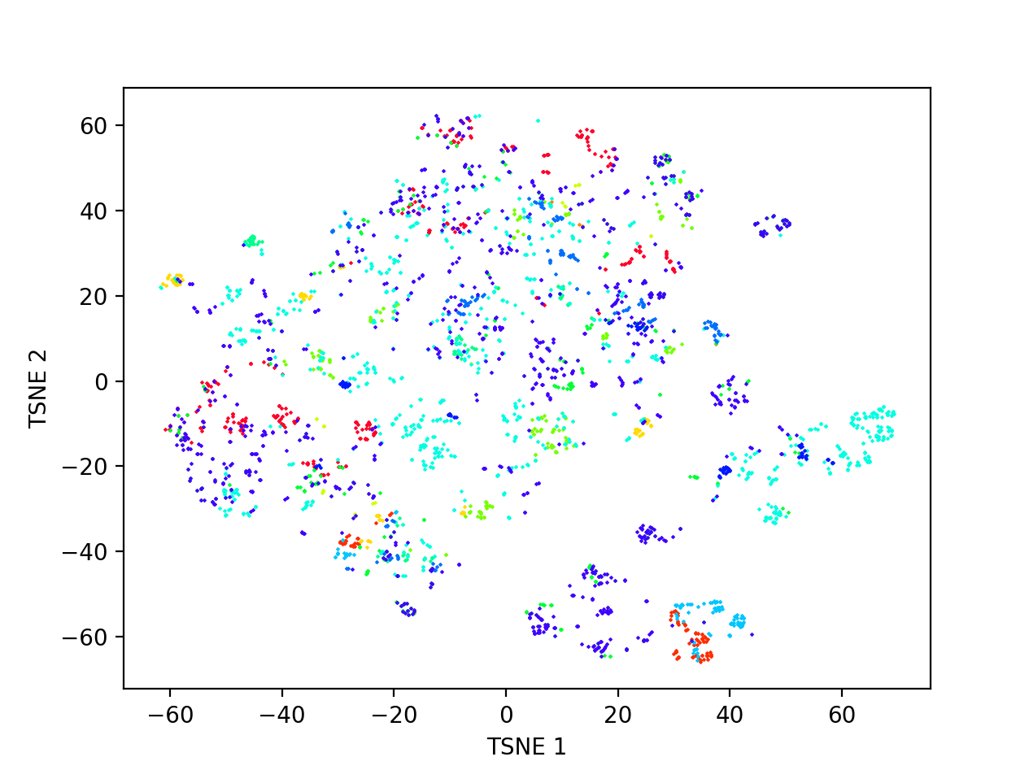
Dataset Generation
Mixes authorization tuples of other colors
There are tuples of same color those are easily distinguishable
Metadata values are assigned based on a very sparse distribution
We determine a fixed set of values for each metadata
A dataset with 1000 users and 639 resources, 3 hidden user/resource metadata.
Notes:
To simulate the idea of real-world intuition
System admin do not consider all of the attributes while granting access.
There might have other metadata that have a passive impact of decision making

Slide 36
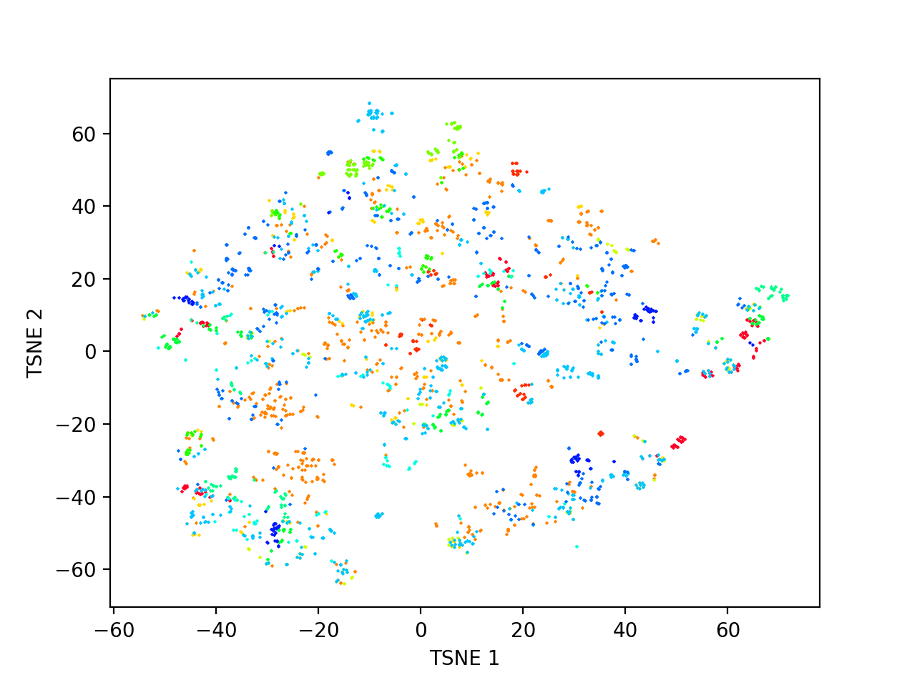
Dataset Generation
A dataset with 800 users and 665 resources, 3 hidden metadata, fixed set of metadata values.
A real-world dataset from Amazon

Slide 37
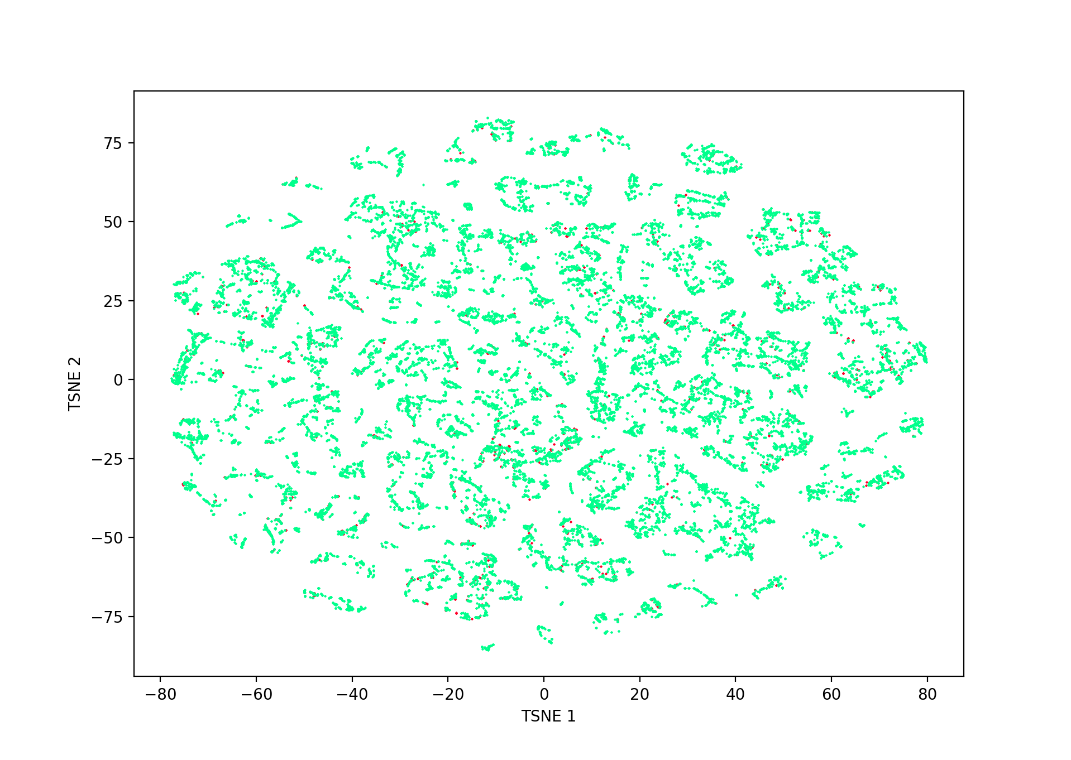
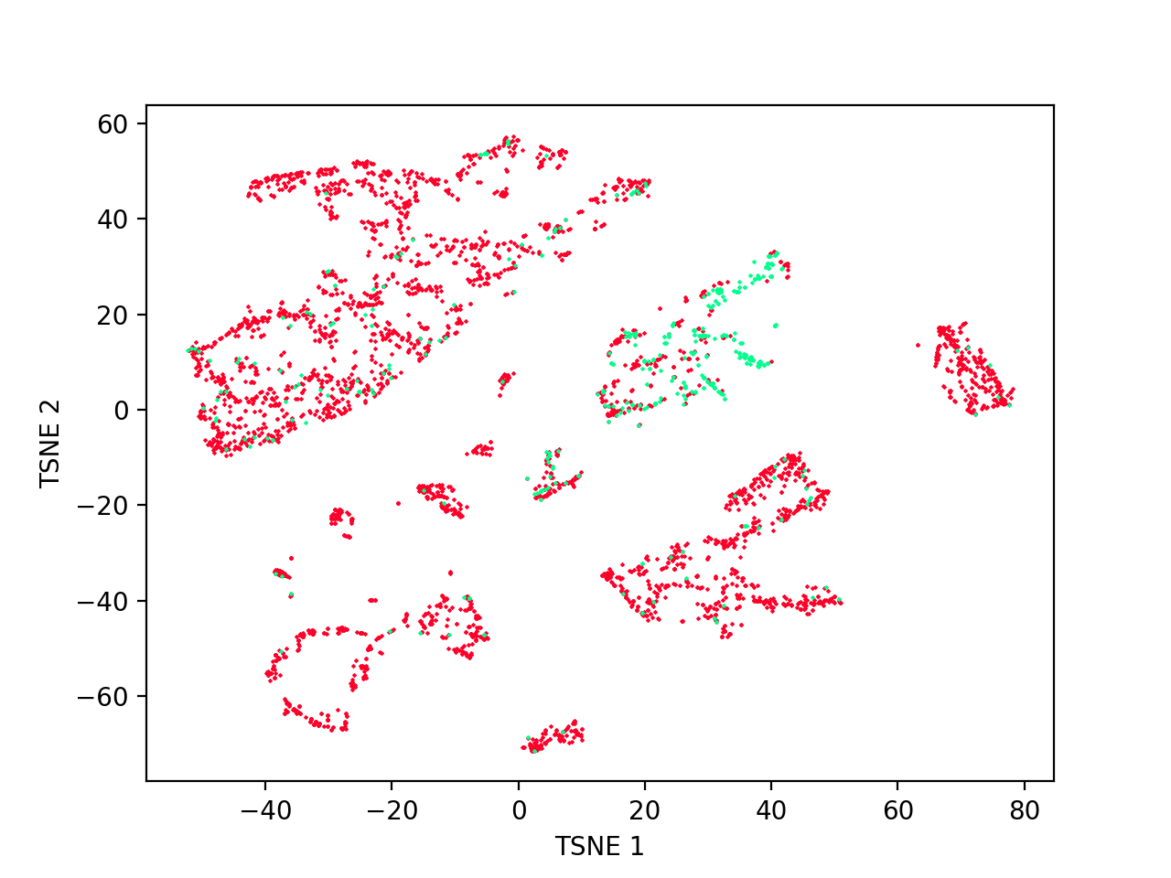
Characteristics of AmazonKaggle and AmazonUCI Datasets
Amazon Kaggle Dataset
Amazon UCI Dataset
Highly imbalanced !
Notes:
This is another reason why we created our synthetic datasets

Slide 38
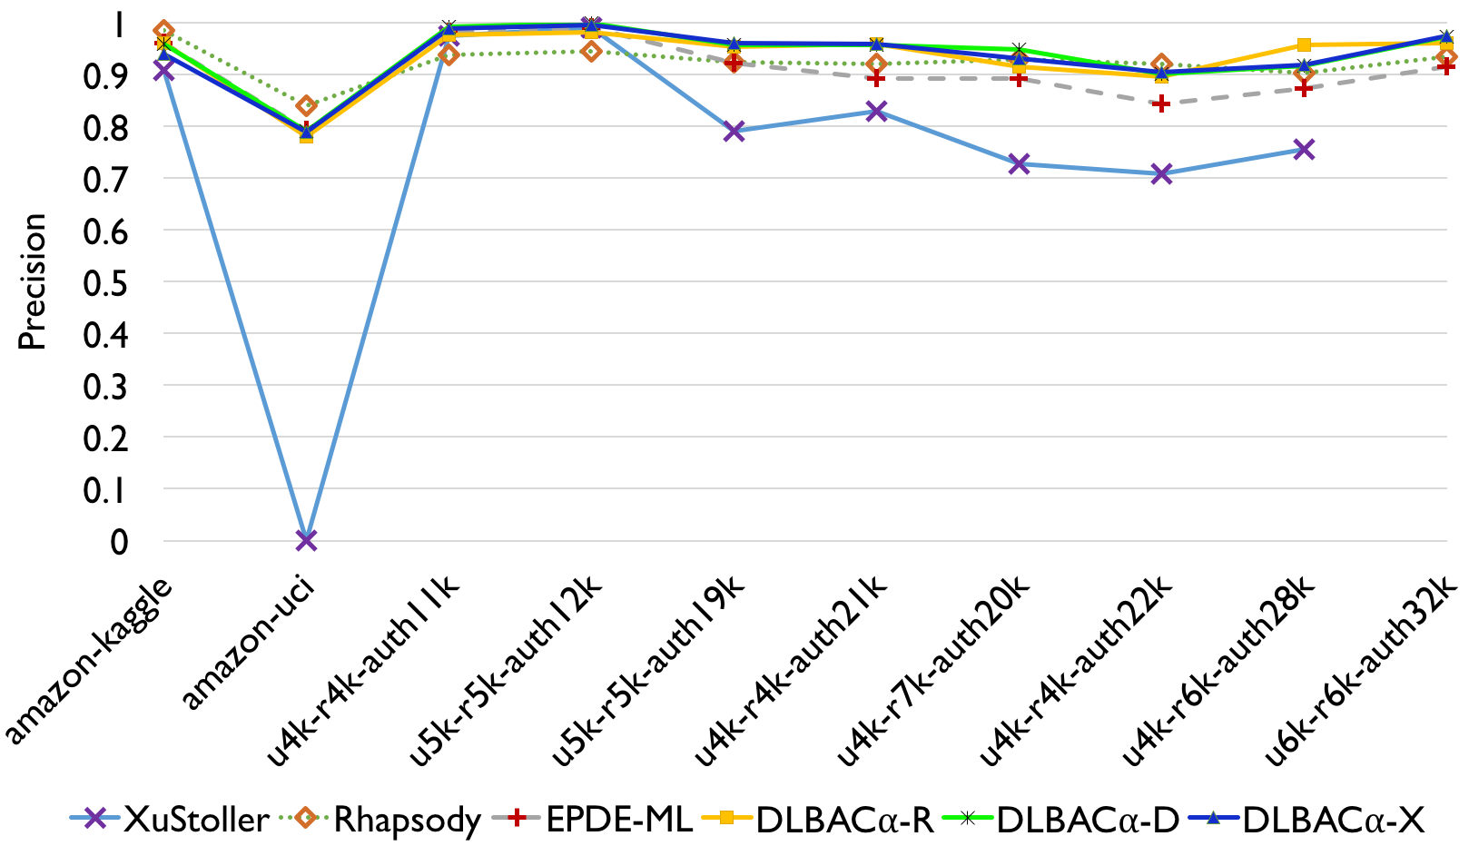
Performance Comparison with Policy Mining Algorithms
A deep learning based approach can properly balance both over-provision and under-provision

Slide 39
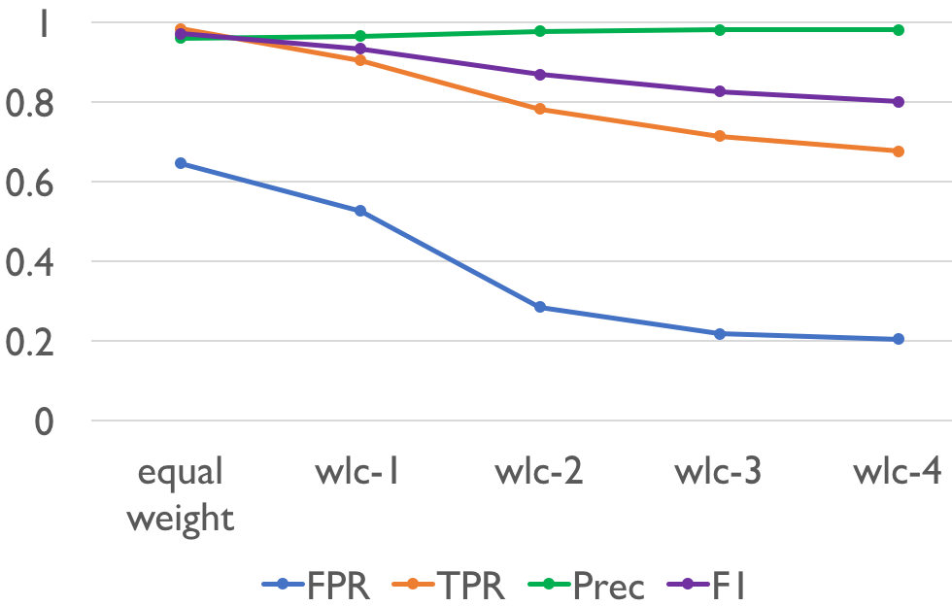
FPR Performance Improvement in DLBACα

Slide 40
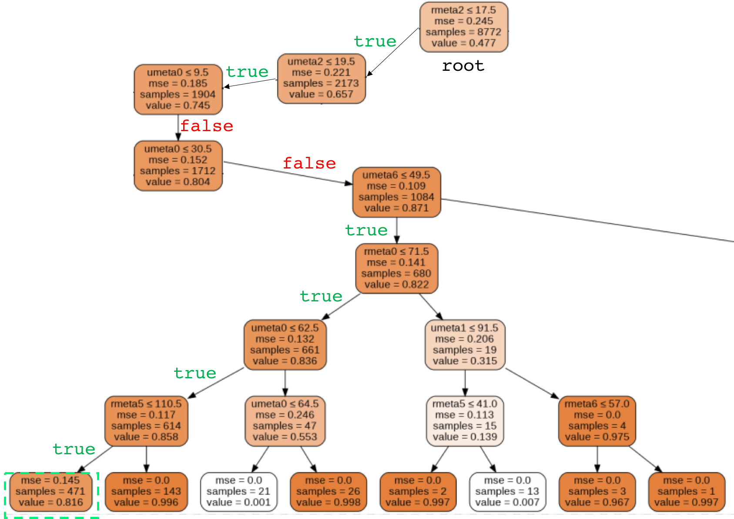
Decision Tree Generated from KT in DLBACα

Slide 41
Summary
Propose DLBAC framework as an automated access control system
Experiment and evaluate the performance of DLBAC prototype using both synthetic and real-world access control data
DLBAC Performance:
Make more accurate access control decisions and generalize better
Properly balance both permitting desired accesses and denying unwanted accesses
Propose two methods for understanding DLBAC decisions in human terms

