Slide 1
Classifying and Comparing Attribute-Based and Relationship-Based Access control
Institute for Cyber Security
by
Tahmina Ahmed, Ravi Sandhu and Jaehong Park
ACM CODASPY
March 22-24, 2017
World-Leading Research with Real-World Impact!

Slide 2
Outline
Introduction
Background & Motivation
Attributes: Definitions and Assumptions
ReBAC Classification
ABAC Classification
Multilevel Relationship Expression With Attributes
Comparison: ABAC Vs. ReBAC
Conclusion
World-Leading Research with Real-World Impact!

Slide 3
ReBAC
Uses social relationship to access OSN resources
Social
Uses social relationship/relationship between system entities to access resources in any system
Beyond Social
Figure 1: Using Relationship in Authorization policy expression is used for social and beyond social environment

Slide 4
ABAC
ABAC
DAC
MAC
RBAC
Figure 2: ABAC can configure DAC, MAC and RBAC [Zin et al. 2012]

Slide 5
ReBAC Vs. ABAC
?
ReBAC
ABAC
Are they Comparable ?
Can Attributes Express Relationships?
Can ReBAC Configure ABAC? Vice versa?
Do they have equal expressive power?
If not
Which one is more expressive?

Slide 6
Attribute Types
Attribute Value Structure
Atomic-valued or Single-valued Attribute (e.g. gender)
Set-valued or Multi-valued Attribute (e.g. phoneNumber)
Structured Attribute (e.g person-Info (name, age, phoneNumber ))
Attribute Value Scope
Entity Attribute (e.g. friend)
Non-entity Attribute (e.g. age)
Boundedness of attribute range
Finite Domain Attribute (e.g. gender)
Infinite Domain Attribute (e.g. time)
Attribute association
Contextual or Environmental Attribute (e.g. currentTime)
Meta Attribute (e.g. role(user) = manager , task(manager) = supervise)
Attribute mutability
Mutable Attribute
Immutable Attribute

Slide 7

Attribute Function Composition
$$f:X→Y$$
$$g:Y→Z$$
$x∈X , g\left(f\left(x\right)\right)∈Z$

Slide 8
Assumptions
All non entity attribute are finite domain
Entity attribute functions are partial functions defined on existing entities only
Inner attribute function in an attribute function composition should always be entity attributes
Structured attribute is a multivalued tuple of atomic or set-valued attributes. So it is more expressive than atomic or set-valued attribute.

Slide 9
ReBAC Classification
Figure 3.: ReBAC Framework

Slide 10
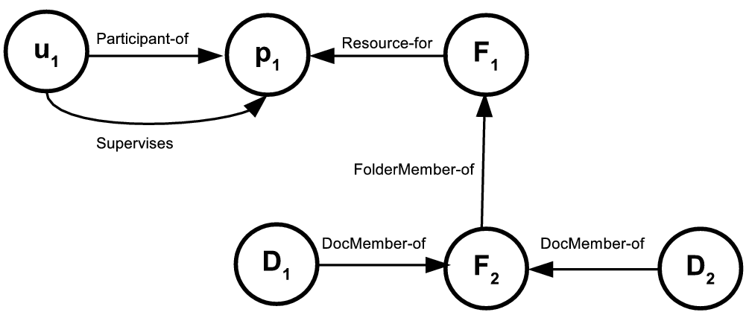
Example
Figure 4.: A Simple Relationship Graph Expressible in ReBAC_{B} [Crampton et al. 2014 ]

Slide 11
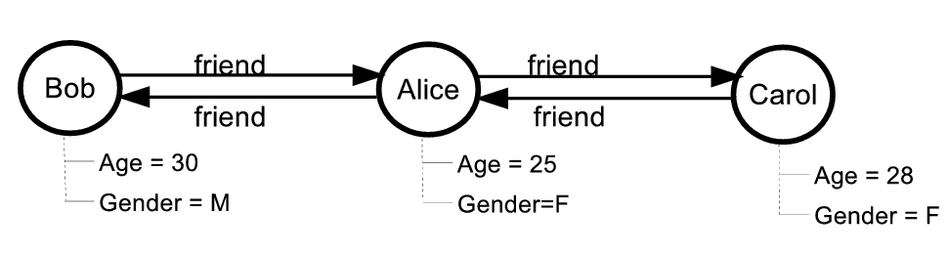
Example (Continued…)
Figure 5: An Example of Node Attributes in Relationship Graph Expressible in ReBAC_{BN}
Figure 6: An Example of Edge Attributes in Relationship Graph Expressible in ReBAC_{BE}

Slide 12
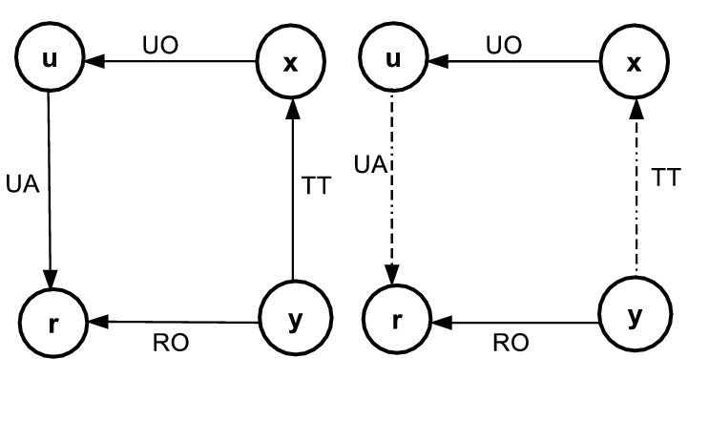
Example (Continued…)
Structure Edge Attribute:
dependsOn
Sub Attributes of dependsON
Source Node
Target Node
RelationshipType
dependsOn (u,r,UA) = (y,x,TT)
Figure 7: An Example of Node Attributes in Relationship Graph Expressible in ReBAC_{BNES} [Cheng et al. 2016]

Slide 13
ABAC Classification
Figure 8: ABAC Framework

Slide 14
Expressing Relationship Graph with Attributes
Entity types = {user, project, folder , document}
Attributes:
User attributes ={Participant-of, Supervises}
Folder attributes = {Resource-for, FolderMember-of}
Project attributes = {}
Document attributes ={DocMember-of}
Relationship Graph in Figure 4 is Expressible with ABAC_{E}

Slide 15
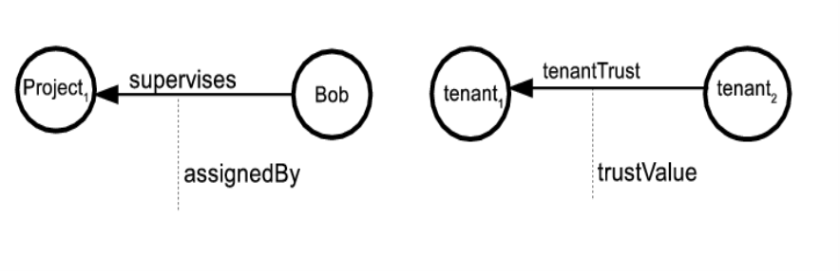
Expressing Relationship Graph with Attributes (Continued…)
entityType = {user}
Attribute:
User’s entity attribute ={friend}
User’s Non Entity Attribute ={Name, Age, Gender}
Relationship Graph in Figure 5 is Expressible with ABAC_{E}
entityType = {user, project, tenant}
Attribute:
user’s atomic entity attribute ={supervises}
User’s structured entity Attribute ={assignedBy}
e.g. assignedBy(Bob) = (“Project1”, “supervises”, “Alice”)
Relationship Graph in Figure 6 is Expressible with ABAC_{ES}

Slide 16
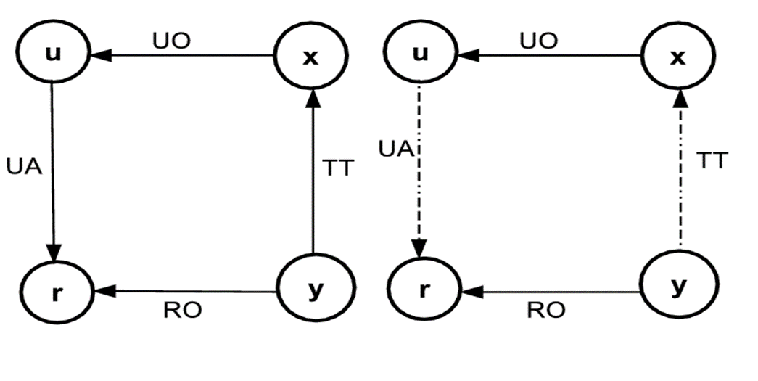
Expressing Relationship Graph with Attributes (Continued…)
Entity types: {user, tenant, role}
Attribute:
User’s atomic entity attribute: {UO,UA}
Users Structured Entity Attribute: {dependentEdge}
dependentEdge(u) = (“r”,“UA”,
{(y,x,TT)} )
Relationship Graph in Figure 7 is Expressible with ABAC_{ES}

Slide 17
Expressing Multilevel Relationship With Attributes
friend
friend
Alice
Bob
Carol
Figure 9. A simple Relationship Graph
Attribute Composition
Needs one attribute: friend
Policy Expression uses
Attribute composition
friend(Alice)={Bob}
friend(friend(Alice))={Carol}
Composite Attribute
Needs two attribute
1. friend
2. friendOfFriend
Policy Expression uses
direct attributes
friend(Alice) ={Bob}
friendOfFriend(Alice)={Carol}

Slide 18
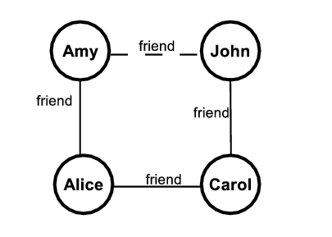
Example
friend(Alice) = {Amy, Carol}
friendOfFriend(Alice) = {John}
friend
Figure 10. A simple Relationship Graph
If the friend relationship between Amy and John deleted
friendOfFriend(Alice) = ?
Instead of keeping the end user as attribute value we have to keep the exact path information.

Slide 19
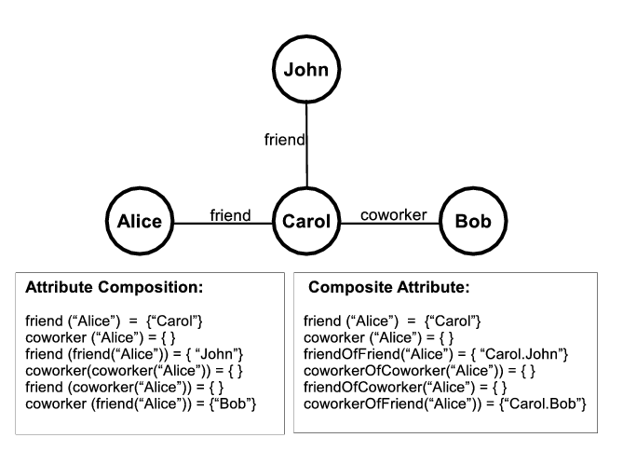
Example
Figure 12: Multilevel Relationship Expression with Attribute

Slide 20
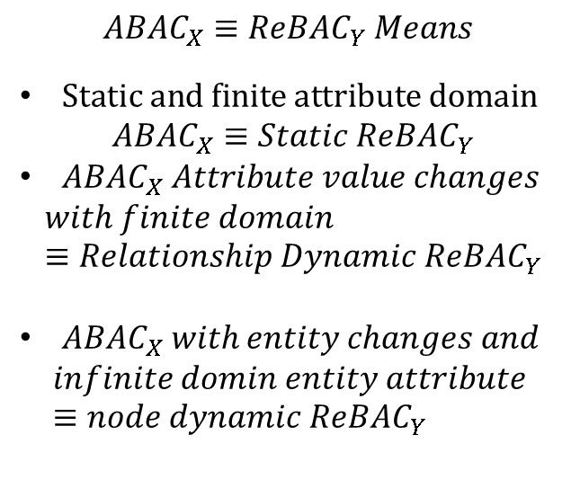
Comparison: On Dynamics
$$ABAC_{X}≡ReBA{C_{Y} Means}_{ }$$
$Static and finite attribute domain$
$$ABAC_{X}≡Static ReBAC_{Y}$$
$ABAC_{X} Attribute value changes$
$$with finite domain≡Relationship Dynamic ReBAC_{Y}$$
$ABAC_{X} with entity changes and$
$$infinite domin entity attribute ≡node dynamic ReBAC_{Y}$$
Figure 12: ReBAC Dynamics, ABAC Dynamics and Attribute Domain wise Comparison between ReBAC and ABAC

Slide 21
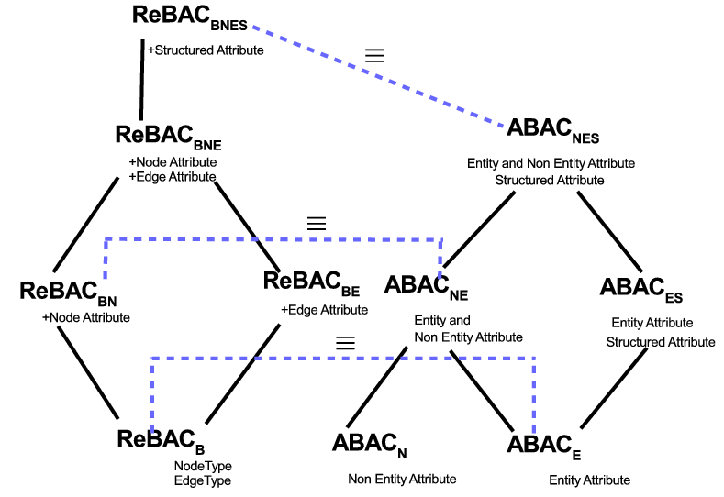
Comparison: Equivalent Structural Models for ReBAC and ABAC
Figure 13: Equivalence of ReBAC and ABAC Structural Classification

Slide 22
Comparison: Non-Equivalent Structural models for ReBAC and ABAC
Figure 14: Non-Equivalence of ReBAC and ABAC Structural Classification

Slide 23
Comparison: On Performance
Attribute Composition is similar to ReBAC and Both have polynomial complexity for authorization policy and constant complexity on update
Composite attribute has constant complexity on authorization policy and polynomial complexity on update to maintain relationship changes.
Performance Depends on :
Node Dynamics
Relationship Dynamics
Density of the Relationship Graph

Slide 24
Comparison: Choice of Models
For static system or only non entity attribute change------Composite attribute is the best approach
System with huge node dynamics, relationship dynamics and high relationship density----- Attribute composition is the best option
If the system is in the middle between two extremes ---- A hybrid approach where both composite attribute and attribute composition is used.
Hybrid Approach:
To achieve p level relationship composition it uses m level composite attribute and n level attribute composition where p = n X m.

Slide 25
Comparison: In Respect of PEI Framework
No Difference
Both the approaches differ here
Figure 15: PEI Framework

Slide 26
Conclusion
Our results indicate that the relationship between ABAC and ReBAC is subtle and variable depending on the precise flavor of these two access control approaches in any given model. At the same time we are able to make some general statements about this comparison.
Metrics beyond theoretical equivalence need to be brought into consideration to better understand the relative advantages and disadvantages of these two approaches. Performance is one such metrics but others such as maintainability, robustness, and agility, also need to be studied.

Slide 27

Questions/Comments
World-Leading Research with Real-World Impact!

