Slide 1
Multi-Tenancy Authorization Models for
Collaborative Cloud Services
Bo Tang, Ravi Sandhu, and Qi Li
Presented by Bo Tang

Slide 2
OUTLINE
Introduction
Background & Motivation
Formalized Models
  MTAS
  AMTAS
  Enhanced Trust Models
Policy Specification
Conclusion and Future Work

Slide 3
OUTLINE
Introduction
Background & Motivation
Formalized Models
  MTAS
  AMTAS
  Enhanced Trust Models
Policy Specification
Conclusion and Future Work

Slide 4
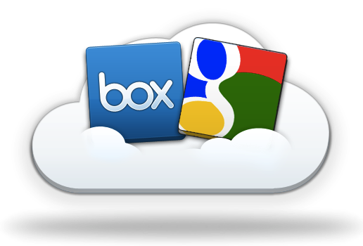
Cloud Computing
Shared infrastructure
  [$$$] -----> [$|$|$]
Multi-Tenancy
  Virtually dedicated resources
Drawbacks:
  Data Locked-in
    Collaborations can only be achieved through desktop.
    E.g.: open Dropbox files with GoogleDoc.
  How to collaborate?
Source: http://blog.box.com/2011/06/box-and-google-docs-accelerating-the-cloud-workforce/
Notes:
This kind of collaboration is not necessarily among parties. It could be among applications.
Subleasing an apartment for 2 rooms. A living room and a bedroom. Direct access in between.
E.g.: subleasing two rooms in an apartment.
One for storage, the other for living.
Direct accessible in between.

Slide 5
Collaborative Access Control
Centralized Facility
  Chance for centralized models in distributed systems
Agility
  Collaboration and collaborators are temporary
Homogeneity
  Handful of popular brands
Out-Sourcing Trust
  Built-in collaboration spirit
Notes:
This kind of collaboration is not necessarily among parties. It could be among applications.
Subleasing an apartment for 2 rooms. A living room and a bedroom. Direct access in between.
E.g.: subleasing two rooms in an apartment.
One for storage, the other for living.
Direct accessible in between.

Slide 6
Industry Solutions
Microsoft and IBM: Fine-grained data sharing in SaaS using DB schema
  Only feasible in DB
NASA: RBAC + OpenStack
  Lacks ability to support collaborations
Salesforce (Force.com): SSO + SAML
  Focus on authentication
  Heavy management of certificates
Source: http://msdn.microsoft.com/en-us/library/aa479086.aspx
http://nebula.nasa.gov/blog/2010/06/03/nebulas-implementation-role-based-access-control-rbac/
http://wiki.developerforce.com/page/Single_Sign-On_with_SAML_on_Force.com

Slide 7
OUTLINE
Introduction
Background & Motivation
Formalized Models
  MTAS
  AMTAS
  Enhanced Trust Models
Policy Specification
Conclusion and Future Work

Slide 8
Example

Slide 9
Literature
Problem:
semantic mismatch
RBAC
  CBAC, GB-RBAC, ROBAC
  Require central authority managing collaborations
Delegation Models
  dRBAC and PBDM
  Lacks agility (which the cloud requires)
Grids
  CAS, VOMS, PERMIS
  Absence of centralized facility and homogeneous architecture (which the cloud has)

Slide 10
Literature (Contd.)
  Role-based Trust
  RT, Traust, RMTN AND RAMARS_TM
  Calero et al: towards a multi-tenant authorization system for cloud services
    Implementation level PoC
    Open for extensions in trust models
  Suits the cloud (out-sourcing trust)
Challenge:
trust relation

Slide 11
OUTLINE
Introduction
Background & Motivation
Formalized Models
  MTAS
  AMTAS
  Enhanced Trust Models
Policy Specification
Conclusion and Future Work

Slide 12
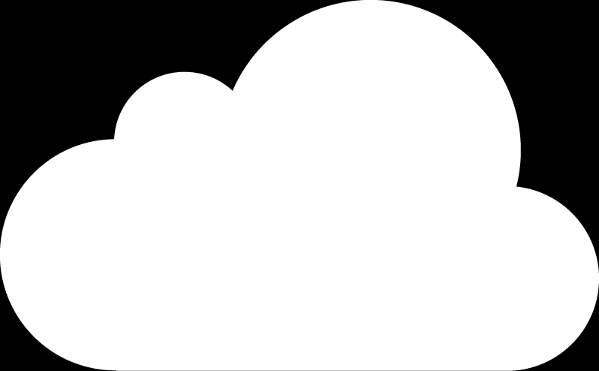
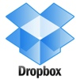







Authorization as a Service (AaaS)
AaaS
Multi-Tenant
Access Control
Cross-Tenant
Access

Slide 13
MTAS

Slide 14
MTAS Trust Model
If A trusts B then B (resource owner) can assign
  B’s permissions to A’s roles; and
  B’s roles as junior roles to A’s roles.
Tenant A
Tenant B
No trust
Resources
AuthStmts
Resources
AuthStmts
A trust B
Resources
AuthStmts
Resources
AuthStmts
User
Notes:
Non-animation version

Slide 15
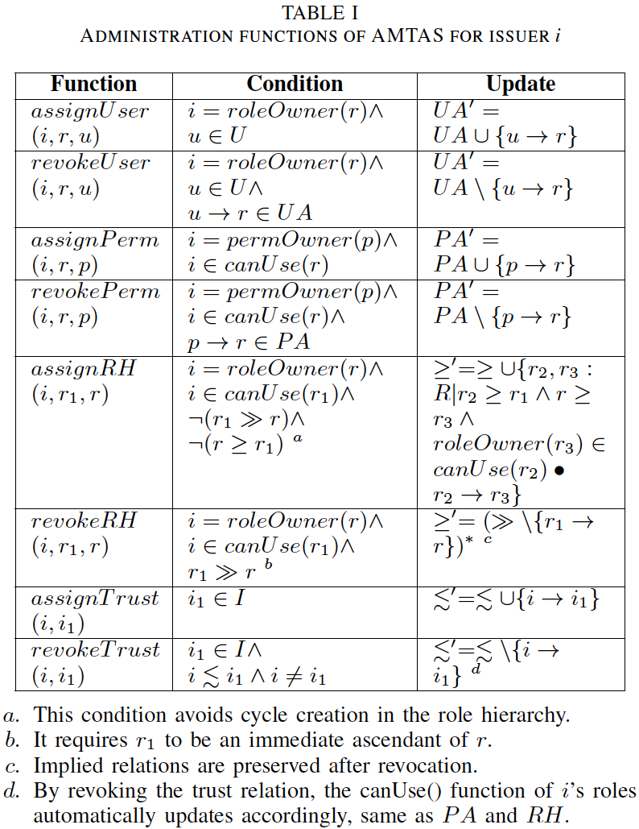
AMTAS
CSP admin
Issuer 1
admin
Issuer 2
admin

Slide 16
Enhanced Trust Models
Problem of MTAS
  Over exposure of truster’s authorization information
Truster-Centric Public Role (TCPR)
  Expose only the truster’s public roles
Relation-Centric Public Role (RCPR)
  Expose public roles in terms of each trust relation

Slide 17
Constraints
Cyclic Role Hierarchy: lead to implicit role upgrades in the role hierarchy
SoD: conflict of duties
  Tenant-level
    E.g.: SOX compliance companies may not hire same the same company for both consulting and auditing.
  Role-level
    across tenants
Chinese Wall: conflict of interests among tenants

Slide 18
OUTLINE
Introduction
Background & Motivation
Formalized Models
  MTAS
  AMTAS
  Enhanced Trust Models
Policy Specification
Conclusion and Future Work

Slide 19
Example

Slide 20
OUTLINE
Introduction
Background & Motivation
Formalized Models
  MTAS
  AMTAS
  Enhanced Trust Models
Policy Specification
Conclusion and Future Work

Slide 21
Conclusion
Collaboration needs in the cloud eco-system
Novel service model: AaaS
Proposed formal models
  MTAS, AMTAS, Enhanced Trust Models
  Constraints
Policy Specification

Slide 22
Future Work
Accomplished
  Prototype and evaluation
    Performance overhead ≈ 0.016 seconds
    Scalable in the cloud
  MT-RBAC (delegation-centric trust model)
On-going Projects
  OpenStack Keystone extensions
  Integrate trust into ABAC: MT-ABAC
  Unified trust framework

Slide 23
Q & A

Slide 24
Thank You!

