Slide 1
Institute for Cyber Security
Role-Centric Circle-of-Trust in Multi-Tenant
Cloud IaaS
Prof. Ravi Sandhu
Executive Director and Endowed Chair
DBSec
July 20, 2016
ravi.sandhu@utsa.edu
www.profsandhu.com
Navid Pustchi and Ravi Sandhu
© Ravi Sandhu
1

Slide 2







Why Federation ?
Large organization with multiple tenants
Distinct organizations’ federation
Service Provider
CERN
Software Development
Tenant
Software Development
Tenant
Acme
Financial
Tenant
© Ravi Sandhu
World-Leading Research with Real-World Impact!
3

Slide 3
Why Circle-of-Trust in Cloud?
A circle of Acme tenants
Public Cloud Service Provider
Acme
Circle-of-Trust
Sales
Tenant
Software Development
Tenant
Finance
Tenant
© Ravi Sandhu
World-Leading Research with Real-World Impact!
3

Slide 4
Peer-to-Peer vs Circle-of-Trust
Peer-to-Peer
Trust between a pair of tenants.
Specific set of actions between tenants.
Only trusted tenant acceptance.
Circle-of-Trust
Trust between a group of tenants.
Similar policies and rules.
Acceptance of all tenants in the circle.
Tenant A
Tenant B
Tenant A
Tenant B
Tenant C
Tenant D
Tenant E
Tenant F
© Ravi Sandhu
World-Leading Research with Real-World Impact!
4

Slide 5
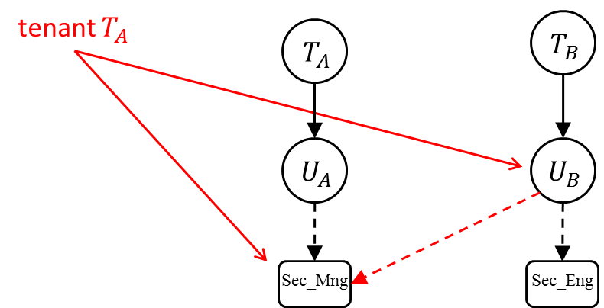
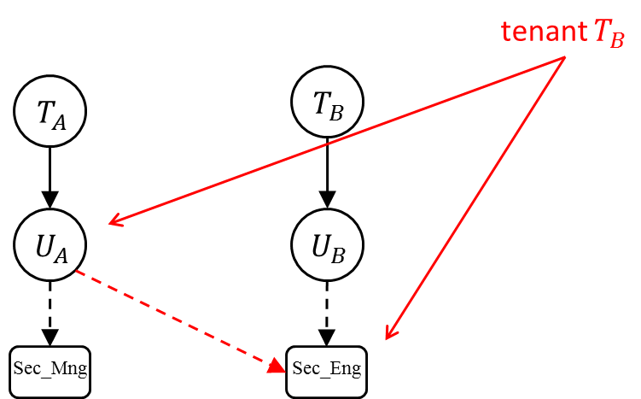
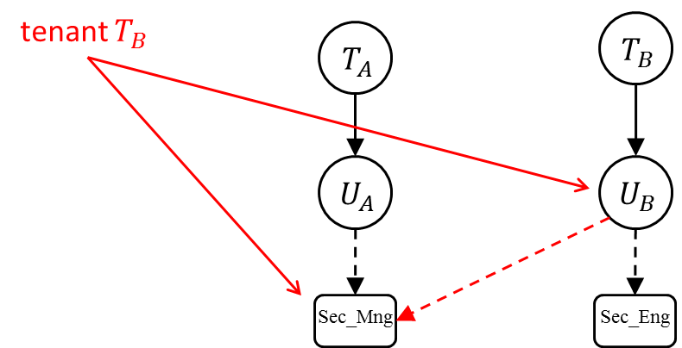

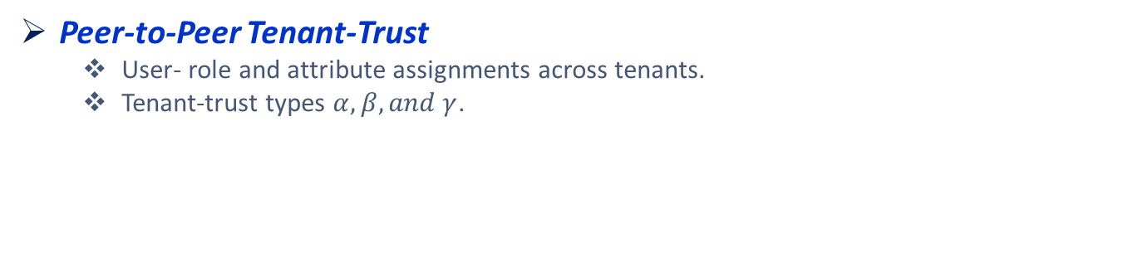


Peer-to-Peer Tenant-Trust
Peer-to-Peer Tenant-Trust
User- role and attribute assignments across tenants.
Tenant-trust types $α, β, and γ$.
$$α$$
$$β$$
$$γ$$
© Ravi Sandhu
World-Leading Research with Real-World Impact!
5

Slide 6
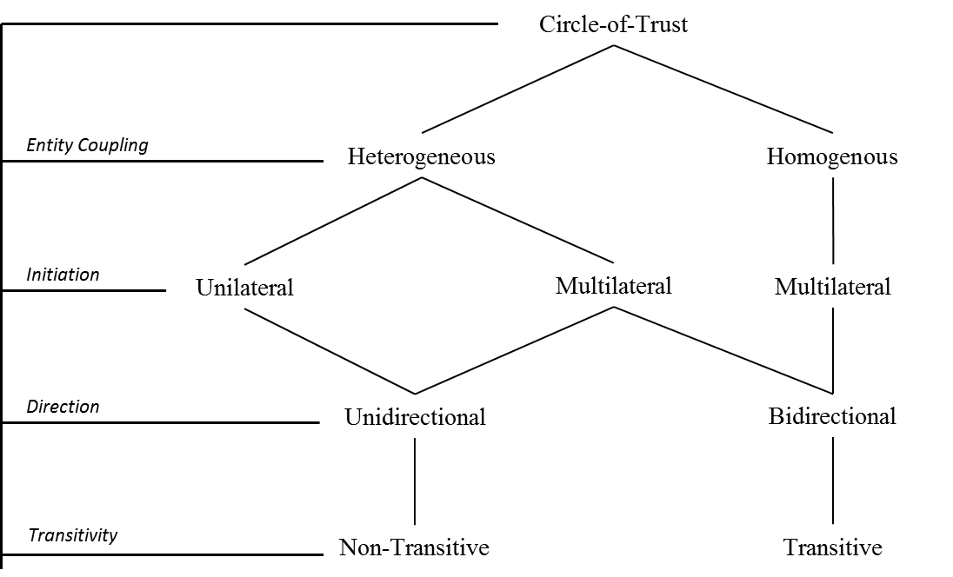
Circle-of-Trust Federation Trust
Homogeneous Circles
Multilateral, Bidirectional, Transitive.
Heterogeneous Circles
Multilateral, Unidirectional, Non-Transitive.
© Ravi Sandhu
World-Leading Research with Real-World Impact!
6

Slide 7



CoT Trust Types Use Case
UT System CoT Federation.
UT system students can take courses at any UT campus.
Students can access to libraries in UT system.
UTA
UTD
UTSA
UT
© Ravi Sandhu
World-Leading Research with Real-World Impact!
7

Slide 8

CoT Trust Types Use Case
UT System CoT Federation.
UT system students can take courses at any UT campus.
UTSA can assign students in UT to its courses.
UTA
UTD
UTSA
UT
$$CoT Type−ζ$$
© Ravi Sandhu
World-Leading Research with Real-World Impact!
8

Slide 9

CoT Trust Types Use Case
UT System CoT Federation.
Students can access to libraries in UT system.
UTA can assign its students to libraries in UT system.
UTA
UTD
UTSA
UT
$$CoT Type−ε$$
© Ravi Sandhu
World-Leading Research with Real-World Impact!
9

Slide 10













CoT Trust Types
Tenant-Trust Type$−ε$:
User-owner tenants are authorized to assign their users to roles in the circle.
Tenant-Trust Type$−ζ$:
Resource-owner tenants are authorized to assign users in the circle to their roles.
$$Tenant_{A}$$
$$CoT Type−ε$$
$$Tenant_{B}$$
$$Tenant_{A}$$
$$CoT Type−ζ$$
$$Tenant_{B}$$
$$U_{A}$$
$$U_{B}$$
$$U_{A}$$
$$U_{B}$$
$$R_{A}$$
$$R_{B}$$
$$R_{A}$$
$$R_{B}$$
© Ravi Sandhu
World-Leading Research with Real-World Impact!
10

Slide 11
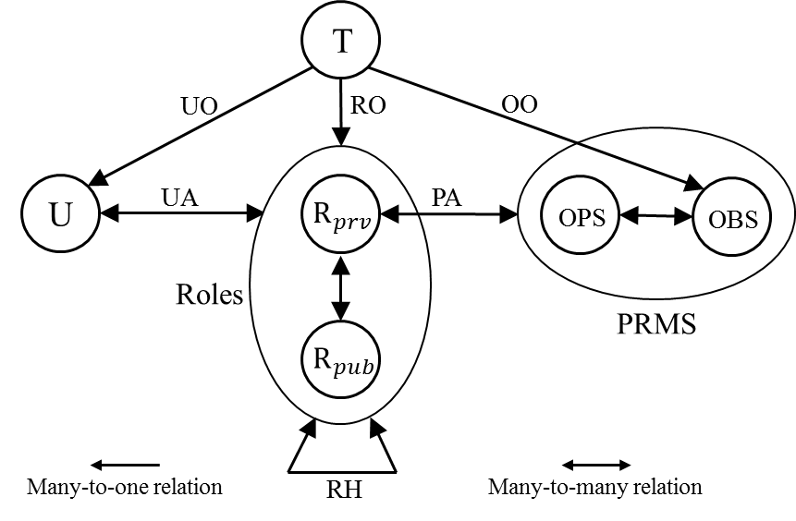


$${MT−RBAC}_{c}$$
Multi-Tenant Role-Based Access Control in Circle (${MT−RBAC}_{c}$)
Homogeneous circles.
Cross-tenant user-role assignments.
Trust is defined between tenants.
Tenant-trust types $ε \text{and} ζ$.
© Ravi Sandhu
World-Leading Research with Real-World Impact!
11

Slide 12

$${MT−RBAC}_{c}$$
Multi-Tenant Role-Based Access Control in Circle (${MT−RBAC}_{c}$)
Users, roles, and permissions are owned by tenants.
Users are assigned to private roles in tenants and public roles across tenants.
Permissions are assigned only to private roles.
Role Hierarchy:
Private roles only inherit private roles within a tenant.
Public roles inherit private role roles within a tenant.
Public roles inherit public roles within the circle.
© Ravi Sandhu
World-Leading Research with Real-World Impact!
12

Slide 13
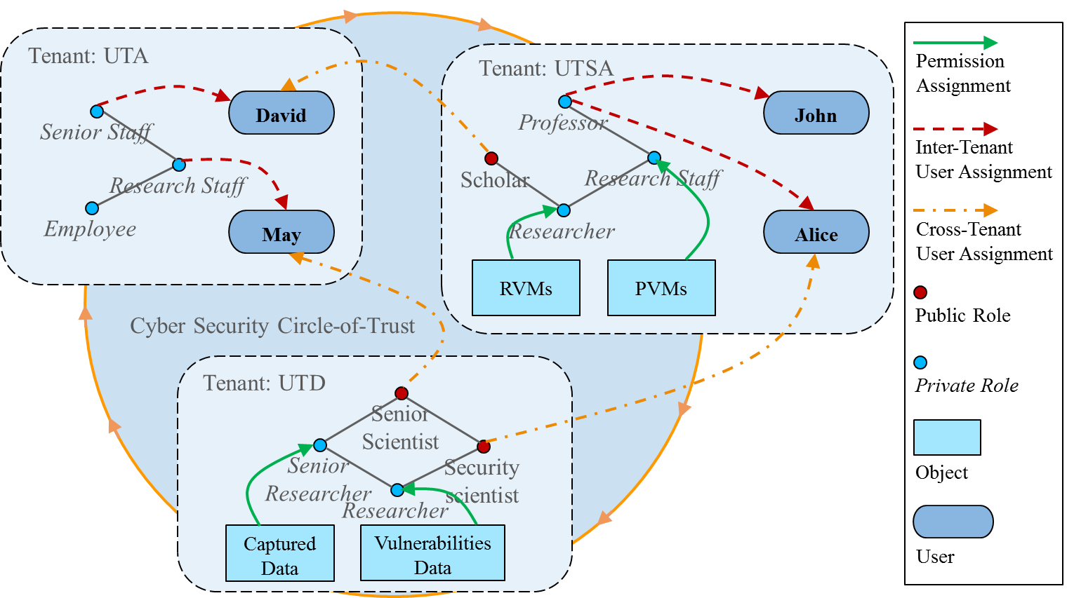

${MT−RBAC}_{c}$ Use Case
Homogeneous circle of UTA, UTSA, and UTD
© Ravi Sandhu
World-Leading Research with Real-World Impact!
13

Slide 14


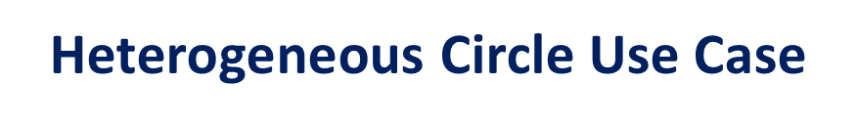
$\text{Heterogeneous}$ Circle Use Case
Heterogeneous circle of BoA, Chase, UTSA, Geico, and Allstate.
Each tenant can make user-role assignment based on its type.
UTSA can assign its students to discounted insurance offers and student accounts.
Bank and Insurance domains are not allowed to assign their users to UTSA resources.
University domain
UTSA
Bank domain
Insurance domain
BoA
Geico
Chase
Allstate
© Ravi Sandhu
World-Leading Research with Real-World Impact!
14

Slide 15
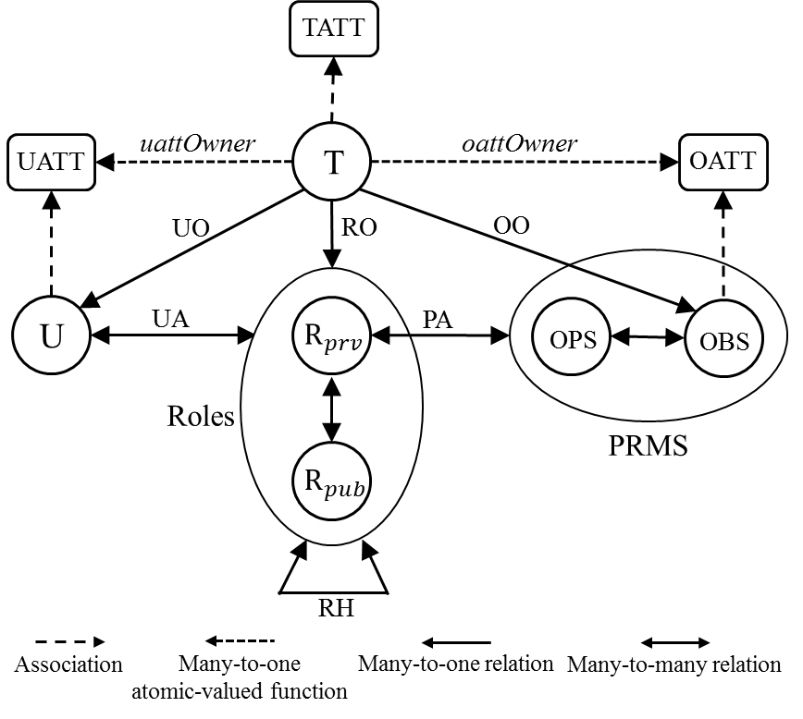


$${MT−RABAC}_{c}$$
Multi-Tenant Role-Centric Attribute-Based Access Control (${MT−RABAC}_{c}$)
Heterogeneous circles.
Attributes are associated with
Tenants
Users
Objects
Tenant attributes separate tenants with tenant type attribute.
© Ravi Sandhu
World-Leading Research with Real-World Impact!
15

Slide 16
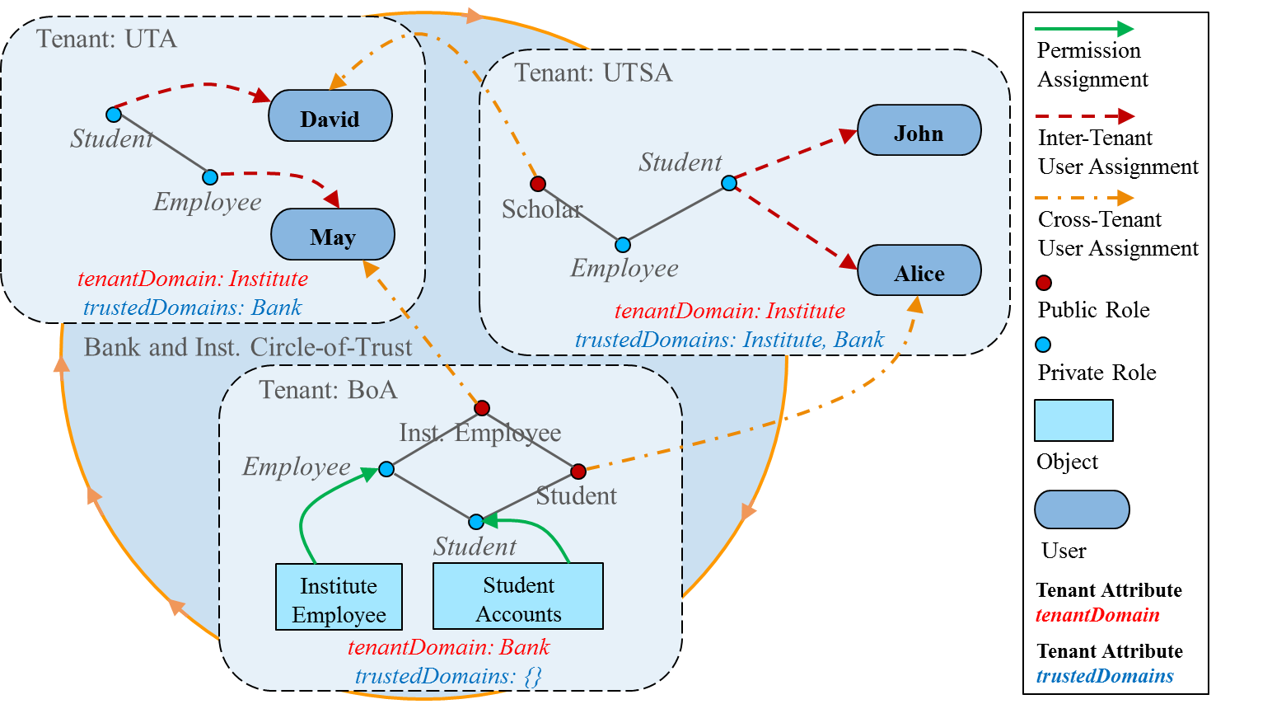

${MT−RABAC}_{c}$ Use Case
Heterogeneous circle of UTA, UTSA, and BoA
© Ravi Sandhu
World-Leading Research with Real-World Impact!
16

Slide 17
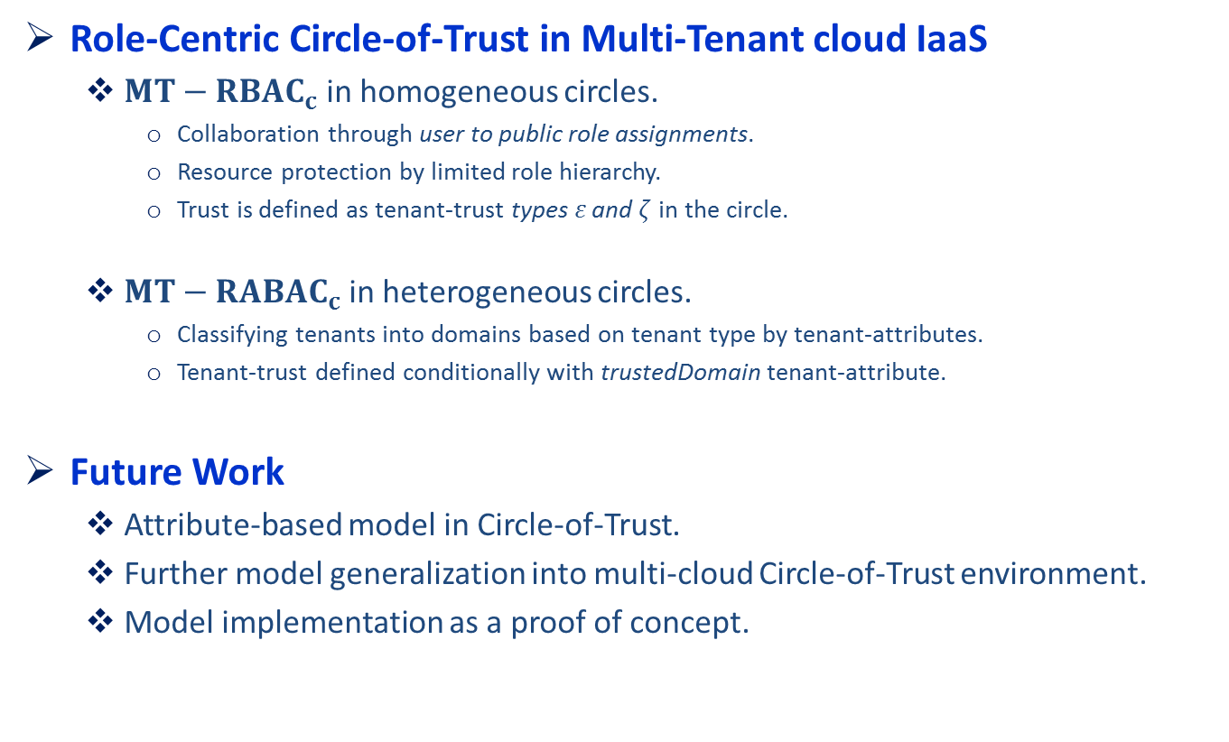
Conclusion
Role-Centric Circle-of-Trust in Multi-Tenant cloud IaaS
${MT−RBAC}_{c}$ in homogeneous circles.
Collaboration through user to public role assignments.
Resource protection by limited role hierarchy.
Trust is defined as tenant-trust types $ε \text{and} ζ$ in the circle.
${MT−RABAC}_{c}$ in heterogeneous circles.
Classifying tenants into domains based on tenant type by tenant-attributes.
Tenant-trust defined conditionally with trustedDomain tenant-attribute.
Future Work
Attribute-based model in Circle-of-Trust.
Further model generalization into multi-cloud Circle-of-Trust environment.
Model implementation as a proof of concept.
© Ravi Sandhu
World-Leading Research with Real-World Impact!
17

