Slide 1



DUCE: Distributed Usage Control Enforcement for Private Data Sharing in Internet of Things
Na Shi, Bo Tang, Ravi Sandhu, and Qi Li
July 20, 2021

Slide 2




The Cloud-Enabled IoT^{[5, 6]}
Devices Platforms
Cloud
Applications Platforms
[5] Bhatt, S., Sandhu, R.: ABAC-CC: Attribute-based access control and communication control for internet of things. In: Proceedings of the 25th ACM Symposium on Access Control Models and Technologies, pp. 203–212 (2020).
[6] Chen, R., et al.: Trust-based service management for mobile cloud IoT systems. IEEE Trans. Netw. Serv. Manag. 16(1), 246–263 (2018).

Slide 3


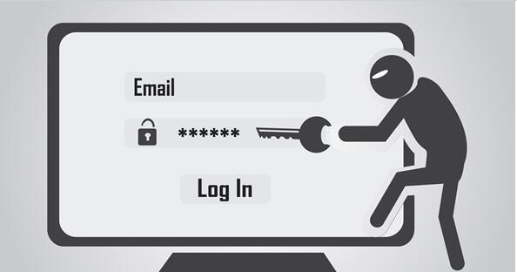

The Private Data Sharing Scenario
Personal information trading!
Devices Platforms
b) data request
Applications Platforms
Hacker
e) data response
user
data
data
acquisition
c) authorization request
delete?
d) authorization response
lose control of the data!
a) report request
f) report response
“delete-after-use”
Motivations: A distributed usage control enforcement model with privacy preserving for private data sharing.

Slide 4
What is UCONABC ^{[24]}?
continuity of control on usage of digital resource
[24] Park, J., Sandhu, R.: The uconabc usage control model. ACM Trans. Inf. Syst. Secur. (TISSEC) 7(1), 128–174 (2004).

Slide 5
Things Need to Be Done in the Model
Privacy Preserving
requires that the shared user data and the keys in authorization used to decrypt this data should be protected.
Integrity Protection
requires that the policy defined by users and enforcement records should not be tampered with.
Traceability
requires that violations must be able to be traced through enforcement records, and are visible to users.

Slide 6
Our Approach: DUCE
A distribute usage control enforcement model for private data sharing by utilizing blockchain ^{[19]} technology and TEE.
[19] Maesa, D., Mori, P., Ricci, L.: A blockchain based approach for the definition of auditable access control systems. Comput. Secur. 84, 93–119 (2019).

Slide 7
Our Approach: DUCE
Enforcement process
1) Initialization phase.
2) Enforcement phase.
Authorization
Operation
Evaluation
Notification

Slide 8
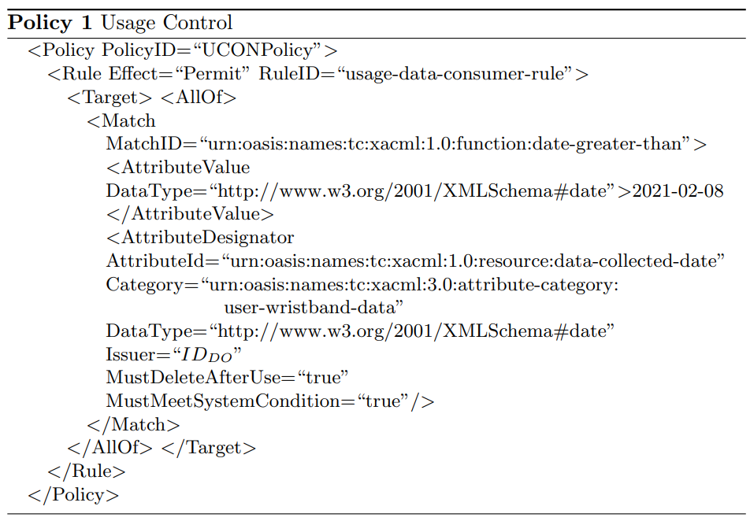
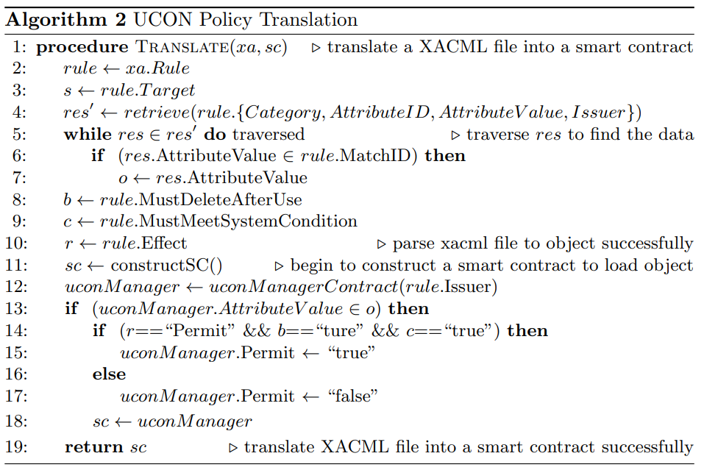
Our Approach: DUCE
Policy Administration
XACML ^{[3]} file -----(translate)----->> Smart Contracts ^{[19]}
[3] Anderson, A., et al.: eXtensible access control markup language (XACML) version 1.0. OASIS (2003).

Slide 9
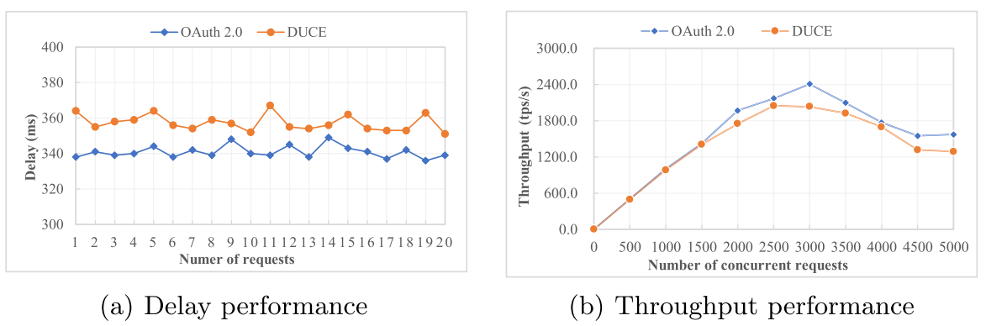
Evaluation
The implementation of DUCE
the baseline: OAuth 2.0
Blockchain Service ---- FISCO BCOS^{[1]}
TEE ---- SGX ^{[2]}
Cloud ---- Alibaba Cloud Elastic Compute Service^{[3]}
MySQL, Redis
The results (authorization and authentication)
Delay.
The time required for communication messages transmitting from one network end to another.
Throughput.
the maximum request number that the system can handle per unit time.
[1] http://www.fisco-bcos.org. [2] https://www.intel.com/content/www/us/en/architecture-and-technology/software-guard-extensions.html. [3] https://www.aliyun.com/.

Slide 10
Summary
A design overview is given with the distributed PDPs and PEPs.
DUCE leverages permissioned blockchain technology to build a trusted relationship between data-sharing parties, whereby the rules and enforcement records are tamper-proof and visible to users.
A Trusted Execution Environment (TEE) is used to ensure that the enforcement process of the rules and the usage of user data are trustworthy and controllable by users.
The policy administration model of DUCE is provided.
A policy example of “delete-after-use” in XACML
And the policy translation algorithm into Solidity language for smart contracts.
A prototype system is implemented.
This system is deployed along with an OAuth 2.0 benchmark system.
The end-to-end delay and throughput are evaluated and analyzed to demonstrate the viability of DUCE.

Slide 11
Thank you for your time !

