Slide 1
Institute for Cyber Security
Integrated Provenance Data for Access Control in Group-centric Collaboration
Dang Nguyen, Jaehong Park and Ravi Sandhu
Institute for Cyber Security
University of Texas at San Antonio
August 09, 2012
International Conference on Information Reuse and Integration
World-Leading Research with Real-World Impact!
1

Slide 2
PROVENANCE-AWARE SYSTEM
Provenance of a digital data object is defined as the documentation of its origin and all the processes that influence and lead to its current state.
In a provenance-aware system, related provenance information of system transactions/events are captured, stored, and maintained.
Provenance potentially provides many enhanced benefits: usage tracking, workflow control, versioning, trustworthiness, repeatabity, access control, etc.
Provenance information may be more sensitive than the underlying data.
World-Leading Research with Real-World Impact!

Slide 3
SECURE DIGITAL PROVENANCE
Is necessary: Integrity, Confidentiality, Availability, Privacy
Our focus: Access Control.
Two aspects: Provenance-based Access Control and Provenance Access Control.
Provenance data naturally forms a Directed-Acyclic Graph (DAG), aligned with information flow and causality
World-Leading Research with Real-World Impact!

Slide 4
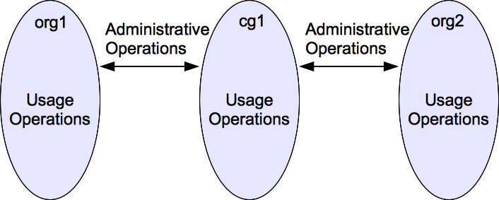
GROUP-CENTRIC COLLABORATION
Difference in the incorporation of base model for PBAC in uni vs. multi-provenance systems.
Group-centric collaboration provides secure information sharing.
Support administrative and usage operations.
Focus on usage operations such as: Add, Merge, Update, Create.
World-Leading Research with Real-World Impact!

Slide 5
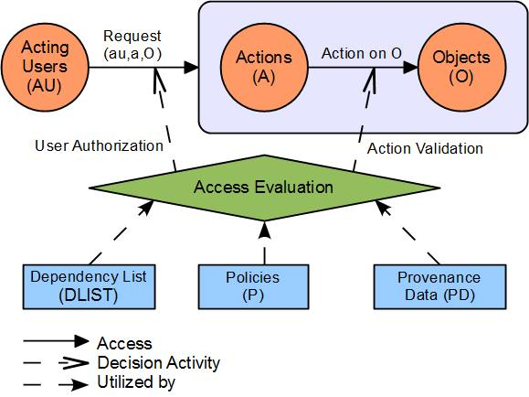
PBAC MODEL
World-Leading Research with Real-World Impact!

Slide 6
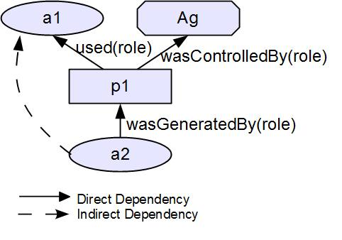
OPEN PROVENANCE MODEL (OPM)
World-Leading Research with Real-World Impact!

Slide 7
A SIMPLIFIED SCENARIO
An object is created in org1 and modified locally into versions in accordance to the versioning system.
At some point in time, a version of this object is added to a collaboration group cg1 so users from a different organization can participate in updating the object content (now represented as a different object with its own versions).
Meanwhile, users in the org1 also perform updates on local versions.
At some point, a version of the object from cg1 is merged back to the version tree of the original object in org1

Slide 8
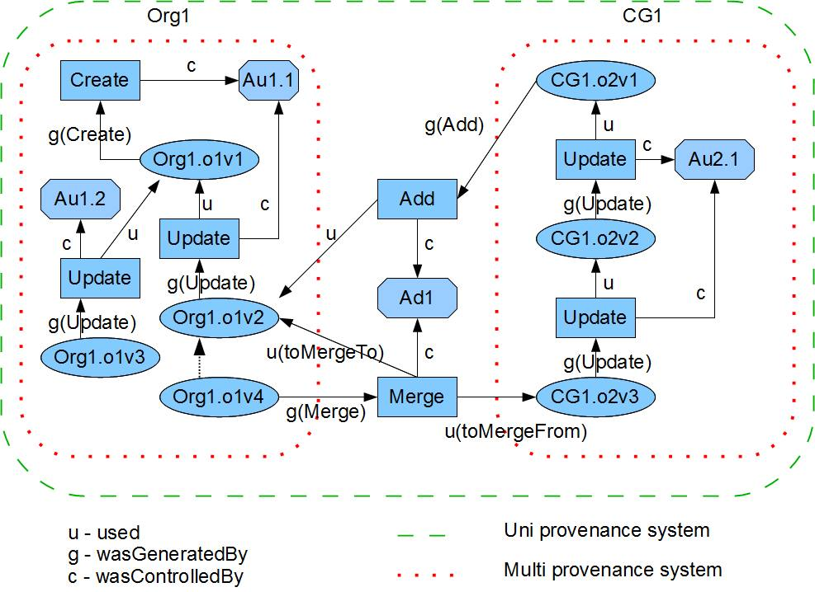
A SIMPLIFIED OPM SCENARIO
World-Leading Research with Real-World Impact!

Slide 9
SAMPLE POLICIES/ DLIST
Req (ad1,merge,CG1.o2v3,Org1.o1v2) ?
(wasDerivedVersionOfCopyOf:: [g(Update).u]*.g(Add).u)
Req(au2.1,update,CG1.o2v3) ?
(creatorOfOriginalVersionOf :: [g(Update).u]*.g(Add).u.[g(Update).u]*.g(Create).c)
World-Leading Research with Real-World Impact!

Slide 10
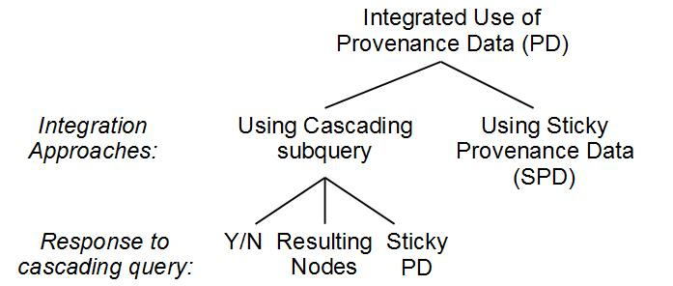
TAXONOMY OF APPROACHES
World-Leading Research with Real-World Impact!

Slide 11
CASCADING QUERY
A reconstructed query from the local query.
Can be transmitted and evaluated in remote system.
Three types of response, each require different additional information:
Y or N: (startingNode_new,dPath_new,rule_new) must be transmitted.
Resulting Nodes: (startingNode_new,dPath_new) must be transmitted.
Provenance Data Set: (startingNode_new) must be transmitted.
World-Leading Research with Real-World Impact!

Slide 12
CASCADING QUERY RESPONSE
ORG1
(startingNode_new,dPath_new,rule_new)
CG1
Y or N
(startingNode_new,dPath_new)
Resulting Nodes
(startingNode_new)
Provenance Data Set
World-Leading Research with Real-World Impact!

Slide 13
STICKY PROVENANCE DATA
The sticky provenance data of an object/version contains all the provenance information of that object/version up to the point in time when the information flow takes place.
Allows a locally generated query to be fully evaluated for decision making.
Demonstrate with a modified scenario next.
World-Leading Research with Real-World Impact!

Slide 14
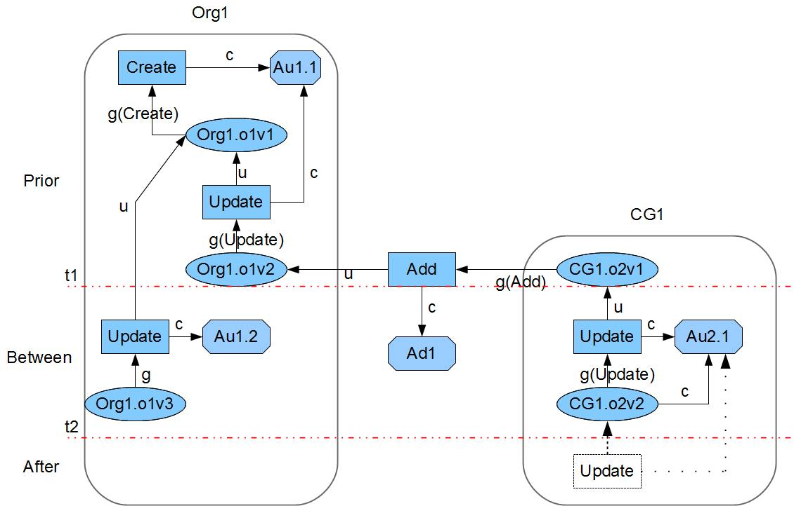
A “STICKY” SCENARIO
SPD
World-Leading Research with Real-World Impact!

Slide 15

A “STICKY” SCENARIO
CG1 Policy: No Update actions can be
performed on a group version if the original organization object version had been updated
SPD
World-Leading Research with Real-World Impact!

Slide 16
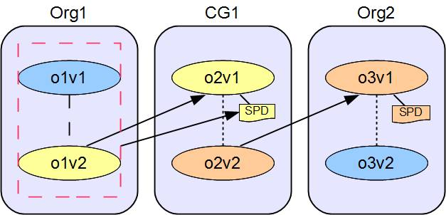
A “STICKIER” SCENARIO
Should SPD(o3v1) contain:
SPD(o2v1,o2v2) ?
SPD(o2v1,o2v2) + SPD(o2v1) ?
World-Leading Research with Real-World Impact!

Slide 17
CONCLUSION
Demonstrated the incorporation of PBAC in a Group-centric collaboration environment.
Identified the issue in a multi-provenance systems setting.
Proposed two approaches to address such issue.
World-Leading Research with Real-World Impact!

