Slide 1
Object-to-Object Relationship Based Access Control: Model and Multi-Cloud Demonstration
Institute for Cyber Security
by
Tahmina Ahmed, Farhan Patwa and Ravi Sandhu
Department of Computer Science
University of Texas at San Antonio
7/29/2016
World-Leading Research with Real-World Impact!

Slide 2
Outline
Introduction
Background and Motivation
    Relationship in OSN
    ReBAC beyond OSN
    Existence of Object Relationship independent of user
    Limitations of Existing ReBAC Models
Model Characteristics
OOReBAC Model
OOReBAC: Application
Implementation
World-Leading Research with Real-World Impact!

Slide 3
Relationships in OSN
User to user relationships in a sample social graph [UURAC, Cheng et al. 2012]
User to user, user to resource and resource to resource relationships in a sample social graph [URRAC, Cheng et al. 2012]

Slide 4
ReBAC in General Computing System beyond OSN
user₁
Participant-of
project₁
Participant-of
folder₁
Supervises
Member-of
doc₁
folder₂
doc₂
Member-of
Member-of
A sample Relationship Graph for Organizational Environment [RPPM, Crampton et al. ,2014 ]

Slide 5
Object Relationships in Existing ReBAC
Most of the ReBAC for OSN considers only user to user relationship
OSN has very specific types of resources – photos, notes, comments. Which only makes sense along with users.
Even though some ReBAC models consider general computing system they still need users/subjects existence in relationship graph.

Slide 6
Existence of Object Relationship Independent of User
Object Relationship in Object –Oriented System (Inheritance, Composition and Association)
History of a Git Project (Version Control System) is a DAG

Slide 7
Limitations of Existing ReBAC Models
Cannot configure relationship between objects independent of user.
Cannot express authorization policy solely considering object relationship.
Considering these limitations we are proposing an object-to-object relationship based access control model.

Slide 8
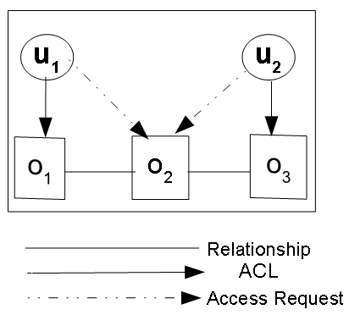
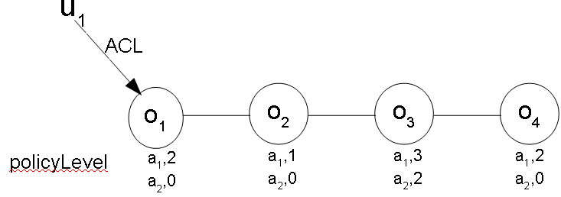
How the model would look like?
An Object to Object Relationship Based Access Control
Policy Level Example
policyLevel(a₁ ,o₁) =2
policyLevel(a₂ ,o₁) =0
policyLevel(a₁,o₂) =1
policyLevel(a₂ ,o₂) =0
policyLevel(a₁ ,o₃) =3
policyLevel(a₂ ,o₃) =2
policyLevel(a₁ ,o₄) =2
policyLevel(a₂ ,o₄) =0
ACL(o₁) = {u₁}
ACL(o₂) = {}
ACL(o₃) = {u₂}

Slide 9
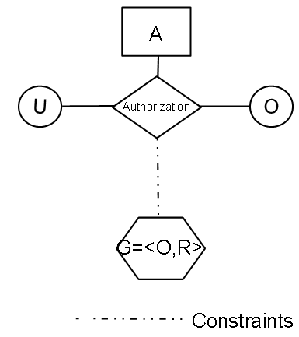
OOReBAC: Model Components and Definition

Slide 10
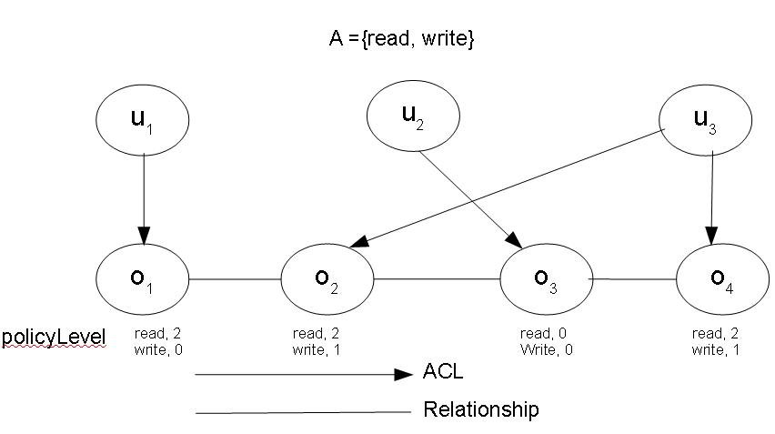
OOReBAC: An Example
Sequence of operations and its outcome:
Configuration:
Sequence of operations and its outcome:

Slide 11
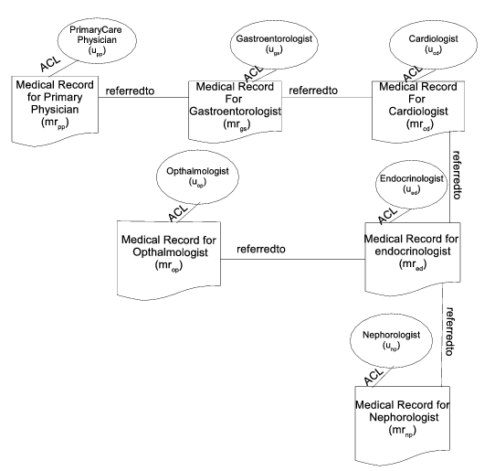
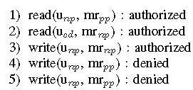
OOReBAC: Application
An OOReBAC Instantiation
Sequence of Operations and Outcomes

Slide 12
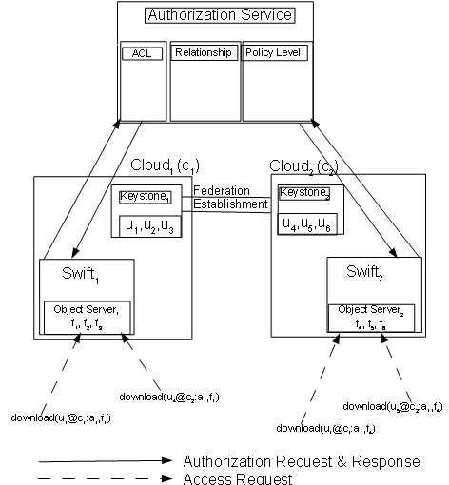
Implementation: Openstack Object Storage (Swift)
Relationship
ACL
PolicyLevel

Slide 13
Implementation
Functional Specification:
Algorithm for Authorization

Slide 14
Conclusion and Future Work
OOReBAC is the first attempt towards using object relationship independent of user in authorization policy specification and can only do where single type symmetric relationship is used.
Limitations of OOReBAC:
  Version Control system uses asymmetric relationship.
  Object oriented Programming needs multiple Type asymmetric relationships.
We need to extend this model to accommodate multiple type asymmetric relationships to configure version control and object oriented system.
World-Leading Research with Real-World Impact!

Slide 15

Questions?
World-Leading Research with Real-World Impact!

