Slide 1


On the Cost-Effectiveness of TrustZone Defense on ARM Platform
Naiwei Liu, Wanyu zang, Meng yu, Ravi SANdhu
UTSA ICS lab; Roosevelt university

Slide 2
Contents
Abstract and Introduction
Related Work
Cache-Based Security Threats and Attack
Design and Implementations
Experimental Results
Evaluation
Future Work
Conclusion

Slide 3
Abstract and Introduction
Abstract
  In Recent years, many research efforts had been made on secure and safe environment on ARM platform.
  ARM structure and chips based on ARM had been taking up a lot of number of products in the market.
  Security problems and potential risks had been discussed.
  Cache and similar design brings in ‘trouble’ for security purposes.
  Uniqueness on ARM-based products made things even tougher to solve.
  What will we do?
    Design defense framework for ARM
    Evaluate by experiments
    Optimization

Slide 4
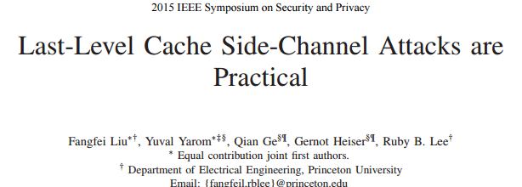
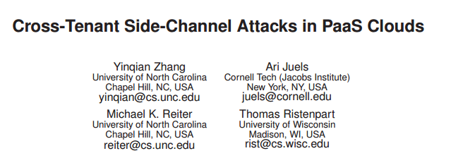
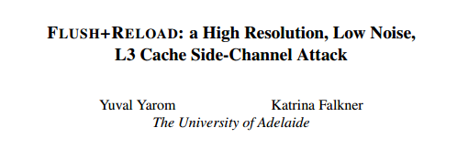
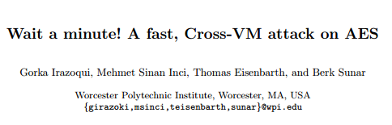
Abstract and Introduction
Introduction
  Last-Level Cache (LLC) is always the target of side-channel attack. On x86 structure, it is always L3 cache that is attacked.
  Last-level cache side-channels are effective enough to extract user’s private information.
  Side-channel: collecting information like performance counters, timing, power consumption, etc. And process the information to derive information about the victim.
  Most frequently used: access time based side-channels.
Notes:
For cache based side-channel attacks, the memory access
time could be much different depending on if the accessed data
is in the cache memory or not, thus the data being accessed
by the victim can be partially derived based on the data access
time if the attacker and the victim are sharing data in the cache.

Slide 5
Abstract and Introduction
Introduction (Continued)
  Side-channel attack based via LLC can be dangerous, even without compromising OS.
  Both on single OS machine and Virtual Machines (VMs) can be attacked.
  Typical type: FLUSH+RELOAD
    LLC is shared.
    FLUSH+RELOAD can be practical using unprivileged instructions.
    AES key of OpenSSL is recovered by this attack in lab test.
  Threats to the Internet of Things (IoT) and devices
  Modern TrustZone Design on ARM platform

Slide 6
Abstract and Introduction
Introduction (Continued)
  Contributions
    Research on side-channel and covert-channel attack: bandwidth and effect.
    Investigation on Flush operations on ARM platform and overhead.
    Study of TrustZone technology and previous security design based on TrustZone.
    Investigation on critical instructions related to TrustZone operations.
    Test of cache flush operations: overhead and effect.
    Different discussion based on ARMv8-A and ARMv8-M structures.

Slide 7
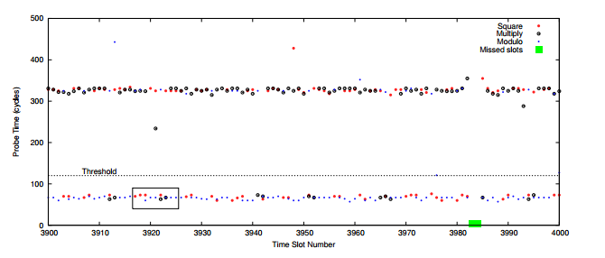
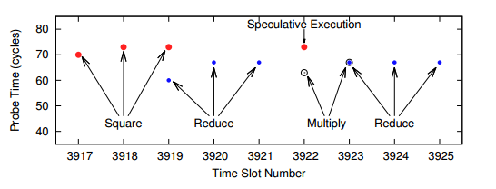
Related Work
Side Channel Attacks
  LLC based side-channel attacks: Flush+Reload, Prime+Probe
  Effectiveness of LLC based side-channels
Notes:
FLUSH+RELOAD is a Side-channel attack is an L3 cache which you place 'probes' on cache lines in the code segment of shared binaries, which get 'triggered' any time any Processes on the system loads that line into cache (i.e. the code was executed) which in effect allows an Observer to see which code other processes are executing.

Slide 8
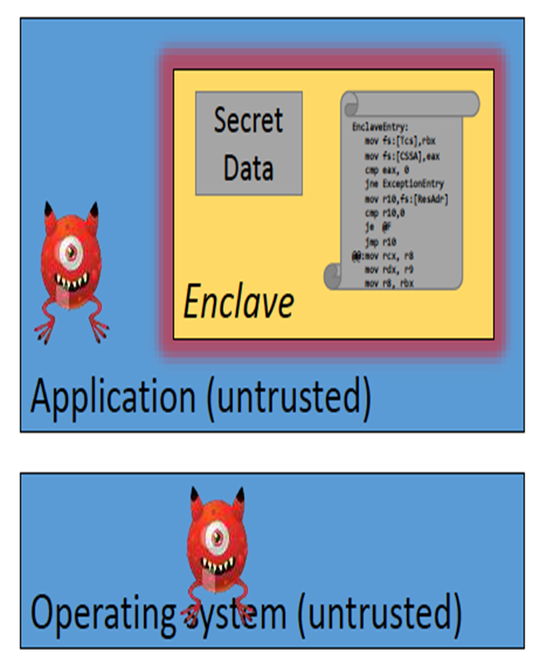
Related Work
Security Design and Protections
  Hardware Solution: Intel SGX, ARM TrustZone
    Hardware isolation for an enclave
    New instructions to establish, protect
    Call gate to enter
  Remote attestation
    Processor manufacturer is the root of the trust
  Prime+Probe Attack: March, 2017
    Target to DRAM
Notes:
SGX: Software Guard Extension

Slide 9
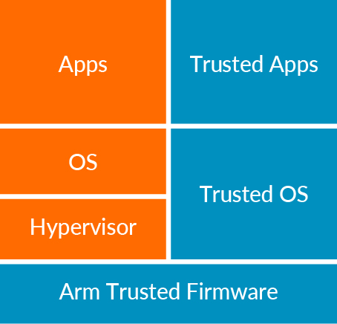
Related Work
ARM TrustZone
  Based on ARM Cortex-A and Cortex-M series
    Privileged instructions to call entry/exit
    Light-weighted comparing with other protection
  ARM helps in creating Trusted Execution Environments (TEE)
  Cache Problems
    ARM Cortex-A series
    ARM Cortex-M series (ARMv8-M)

Slide 10
Related Work
Previous Defense Strategy against Side-Channels
  LLC-level Protection (memory access control)
  Cache enclaves (Trusted vs. Untrusted)
  Scheduler-based solutions
  Others
Cache Flush against Side-Channels
  Benefits: easy to implement, ensure safety
  Problems: high overhead, not adaptive to every situation

Slide 11
Cache-Based Security Threats and Attack
Overview
Users’ memory access are not protected by TrustZone – Covert Channel (Sharing resources)
TrustZone Entry/Exit without Flushing cache – Side-Channel (Malicious collecting access time)
  Flush+Reload Attack
  Prime+Probe Attack
Malicious eavesdropping

Slide 12
Cache-Based Security Threats and Attack
Side-Channel Attack Experiment
Flush+Reload Attack
  step 0: attacker maps shared library → shared memory, shared in cache
  step 1: attacker flushes the shared line
  step 2: victim loads data while performing encryption
  step 3: attacker reloads data → fast access if the victim loaded the line
Prime+Probe Attack
  step 0: attacker fills the cache (prime)
  step 1: victim evicts cache lines while performing encryption
  step 2: attacker probes data to determine if the set was accessed

Slide 13
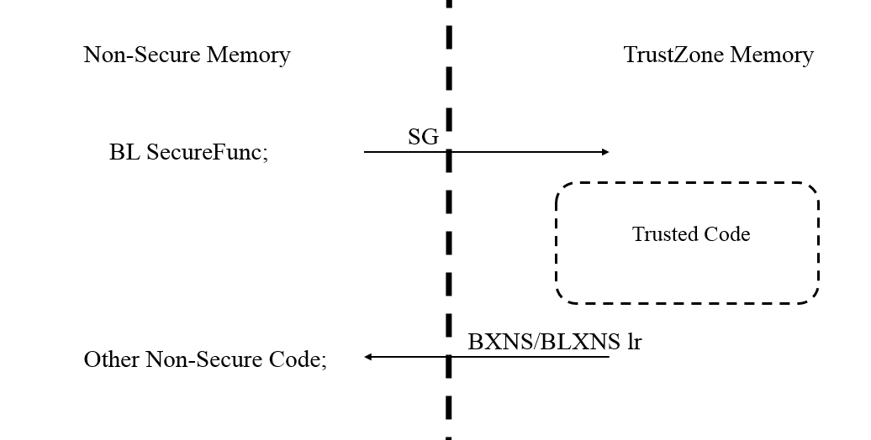
Design and Implementations
TrustZone-Related Instructions
  ARMv8-A
    Test Environment: ARM Juno r1 Board, with A57 and A53 chips; QEMU as testing benchmark.
  ARMv8-M
    Test Environment: ARM Development Kits with Cortex-M4

Slide 14
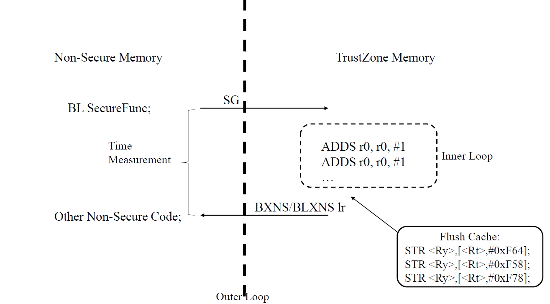
Design and Implementations
Experiments on TrustZone Instructions
ARMv8-M
Our experiments on ARMv8-M are using ARM Versatile V2M-MPS2 Motherboard with an ARM Cortex-M4 chip. It offers 8Mb of single cycle SRAM, and 16Mb of PSRAM. It supports the application of different ARM Cortex-M classes, from Cortex-M0, to M3, M4, and M7.

Slide 15
Experimental Results
Experiments on TrustZone Instructions
ARMv8-A
  We use Ubuntu 16.10 as the normal world OS, with 26 processes running on background, including the workload we use for testing. We count the smc-related instructions that belongs to TrustZone-related operations, and analyze the attributions of them.
Type | Percentage
Non-secure to Secure Test R/W | 2.87%
Secure to Non-secure Test R/W | 2.91%
Others (Access from Background) | 0.01%

Slide 16
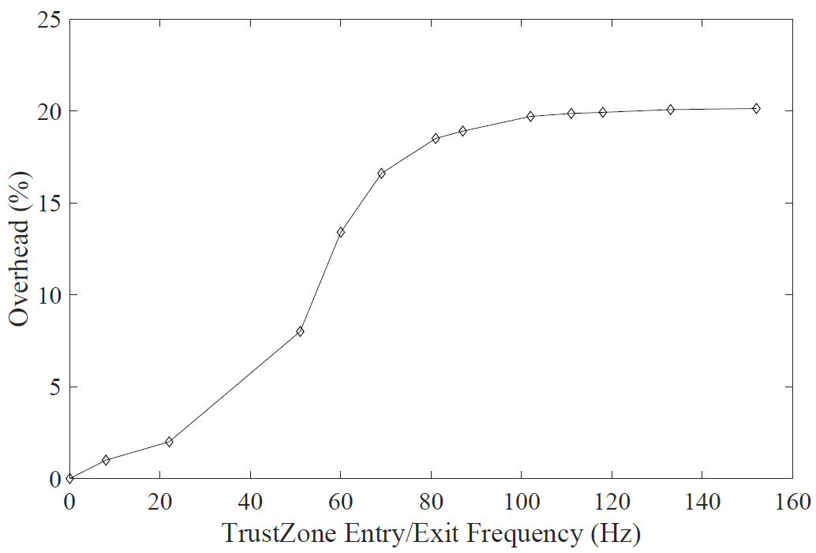
Experimental Results
Experiments on TrustZone Instructions
ARMv8-A
With every smc-related instruction, we operate Flush on cache.

Slide 17
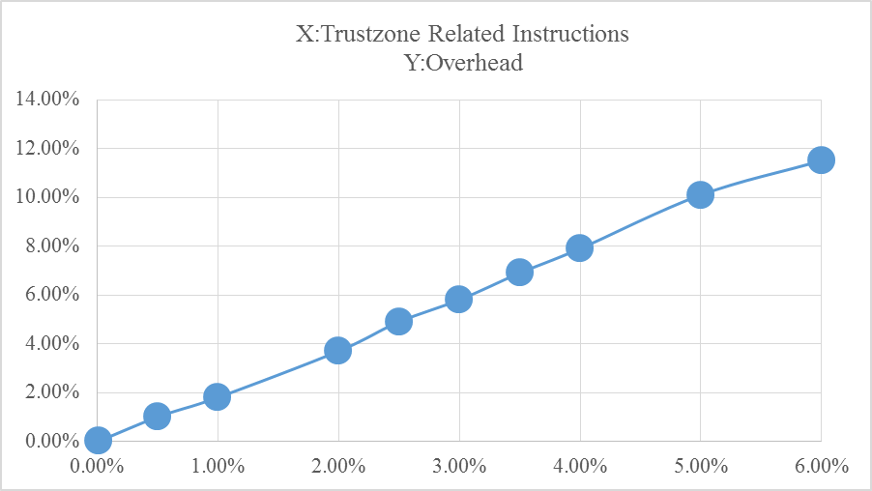
Experimental Results
Experiments on TrustZone Instructions
ARMv8-A
We change the overall percentage of smc instructions and see the overhead difference.

Slide 18
Experimental Results
Experiments on TrustZone Instructions
Cortex-M
Our experiments on ARMv8-M are using ARM Versatile V2M-MPS2 Motherboard with an ARM Cortex-M4 chip. It offers 8Mb of single cycle SRAM, and 16Mb of PSRAM. It supports the application of different ARM Cortex-M classes, from Cortex-M0, to M3, M4, and M7.

Slide 19
Experimental Results
Experiments on TrustZone Instructions
Cortex-M
Using Testing Program as shown above.
Operation | Direction | Cost on Average (Clock Cycles)
SG | Non-Secure to Secure | 3.5
BXNS/BLXNS | Secure to Non-Secure | 5.2

Slide 20
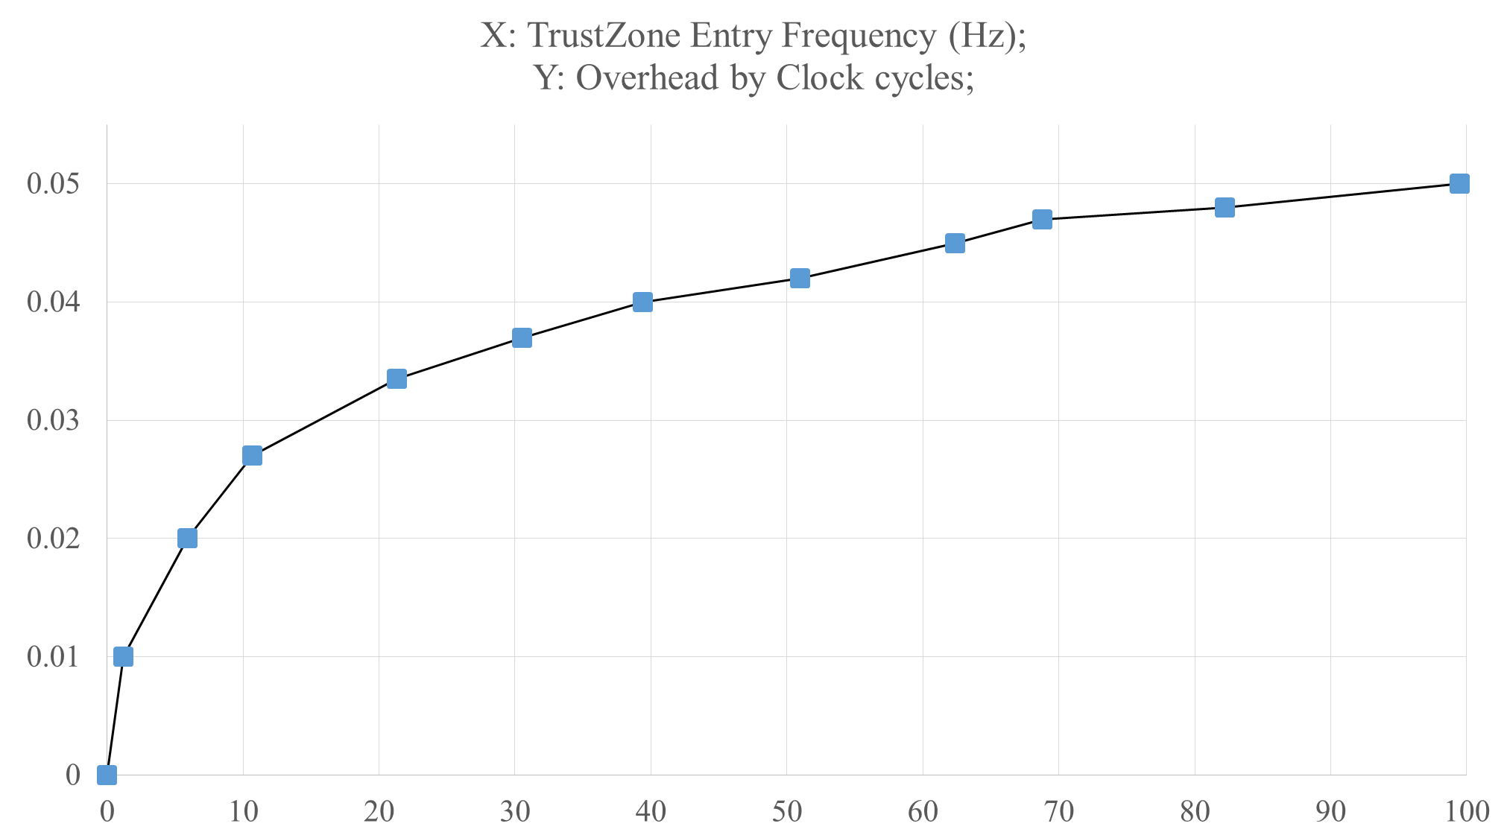
Experimental Results
Experiments on TrustZone Instructions
ARMv8-M
We change TrustZone entry/exit frequency by setting different parameters in inner and outer loop. The overhead can be limited to less than 5%.

Slide 21
Evaluation
On the cost-effectiveness balance of defending by Flush operations
  Flush operations are necessary, but they cost much;
  We can never wipe out the risk, but can cut down bandwidth;
  Adaptive strategy can be used to keep the balance of performance and effectiveness;
  Even better on ARMv8-M chips.

Slide 22
Evaluation
On TrustZone related instructions
  Most of the apps and users are not ‘making use of’ TrustZone features;
  On IoT devices, TrustZone is not costing much resources;
  It is possible to move some of the hardware/software security design into TrustZone surface;
  Cortex-M series chips perform better than Cortex-A series chips.
  On Cortex-A series chips or x86 chips, cache flush operations are just some instructions with privileges. However, the case are different on ARMv8-M. The allocation of a memory address to a cache address is defined by the designers of the applications.
  Because of the special structure of ARMv8-M, the cache Flush operations are sets of DSB (Data Synchronization Barrier) operations, with address-related instructions.

Slide 23
Future Work
Implementations and Experiments
  Design and implement a defense framework based on ARMv8-M.
  Test the performance of defense framework using some benchmarks, and optimize the framework to good effectiveness and lower overhead.
  Port defense framework to new ARMv8-M boards: M23 and M33 series chips.
Theory Work
  Study adaptive control method in theory to match the experimental results, and predict the optimal solution of best adaptive control in defense.
  Investigate entropy theory based on experimental results, predictions and related theory.
  Discuss performance of implemented defense framework in theory, and try to have theoretical conclusion on defense against cache-based attack.

Slide 24
Conclusion
Cache-based attack are new focal point on security design, with risks of leaking information through side-channel and covert channels.
Flushing cache is effective to cut down the risk, but with high performance overhead, and sometimes not affordable.
On IoT devices, the performance of connecting with TrustZone can be better, which brings the possibility to making use of TrustZone.

Slide 25
Thank you!
Naiwei Liu, UTSA ICS Lab, Naiwei.liu@utsa.edu
Ravi Sandhu, UTSA ICS Lab, ravi.sandhu@utsa.edu
Meng Yu, Roosevelt University, myu04@Roosevelt.edu

