Slide 1
Extending OpenStack Access Control with Domain Trust
Bo Tang and Ravi Sandhu
NSS 2014

Slide 2

The Cloud
Anytime
Anywhere
Notes:
The cloud emerged around 2007 and is now everywhere in the commercials, especially for technology. It enables people to access their data anytime anywhere.

Slide 3
Moving to the Cloud
Driving force:
  Anytime, Anywhere (Centralized infrastructure)
  [$$$] -----> [$|$|$] (Shared resources)
  Pay-on-the-go (On-demand services)
  Scalable and flexible
Resistance:
  Security & Privacy
    Data governance
    Access control
  Other problems
    Data Locked-in
    Lack Standard APIs

Slide 4
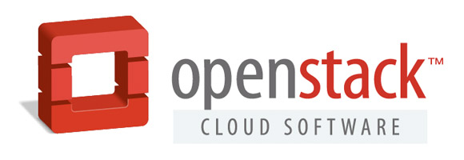
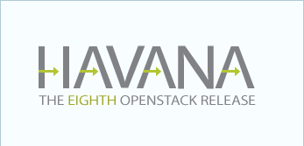
What is OpenStack?
Open source Cloud platform
  12,000 individual members
  260 supporting organizations
  130 countries
Havana Release
  Nov. 2013 - Hong Kong Summit
Keystone (IAM)
  Identity API v3
  Introduction of Domain concept
Source: http://www.openstack.org/software/havana/press-release

Slide 5
Multi-Tenancy
Multi-tenancy
  From Cloud Service Provider (CSP) perspective
    A billing customer, isolated with each other
    Manages its own users and cloud resources
  The owner of a tenant can be
    An individual, an organization or a department in an organization, etc.
Domain in OpenStack
  Each domain manages its own users and projects

Slide 6
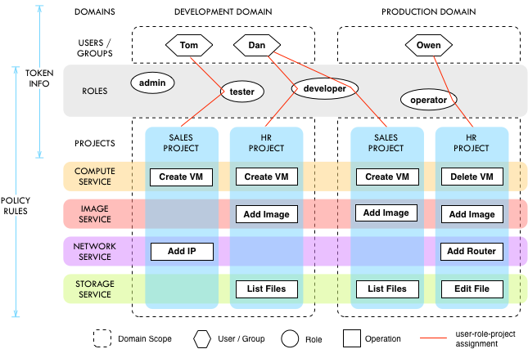
Motivation

Slide 7
Existing Approaches
Trust
  Active Directory Federation Service (AD FS)
    Multiple types of federation trust among domains
  Cross-account trust in AWS
    Unilateral trust with another account or external credentials
  Trust in OpenStack
    User to user delegation via roles

Slide 8
Scope and Assumptions
Standardized APIs
  Cross-tenant accesses are functionally available
Properly authenticated users
One Cloud Service
  Of a kind: IaaS, PaaS or SaaS.
  Multi-tenancy collaboration on a single cloud

Slide 9
Core OSAC

Slide 10
Definitions of OSAC
Roles
  Globally available
  Not owned by domains or projects
Tokens
  Credentials issued to authenticated users
  Will expire, similar to session concept in RBAC
Services
  Examples: Nova, Glance, Neutron
  Different services have different policies based on the role-permission assignments

Slide 11
Administration (AOSAC)
Cloud Admin
Domain A Admin
Domain B Admin
Project A1 Admin
Project A2 Admin
Project B1 Admin
Project B2 Admin
rule:add_user_to_project -> (role:keystone_admin ||
(role:project_admin && project_id:%(target_project_id)s) ||
(domain_role:domain_admin && domain_id:%(target_domain_id)s))
rule:add_project_to_domain -> (role:keystone_admin ||
(domain_role:domain_admin && domain_id:%(target_domain_id)s))
Source: https://wiki.openstack.org/wiki/Domains

Slide 12
Domain-Level Collaboration
Basic scenario
  User: u1 from Domain: d1
  Project: p2 from Domain: d2
Cross-domain actions
  Administrative
    Assign u1 to roles in p2
  Operational
    Allowing u1 to access p2 with the assigned roles
  Require proper trust relation between d1 and d2

Slide 13
Trust Framework

Slide 14
Domain Trust

Slide 15
Trust Types
Two-party unilateral unidirectional non-transitive
  Type-α, requires visibility of the trustee’s user information for the trustor to assign trustee’s users to roles in trustor’s projects, written as “⊴_{α}”.
  Type-β, requires the trustor to expose its user information for the trustee to assign trustor’s users to roles in trustee’s projects, written as “⊴_{β}”.
  Type-γ, requires the trustor to expose its project information for the trustee to assign trustee’s users to roles in trustor’s projects, written as “⊴_{γ}”.

Slide 16
OSAC-DT

Slide 17
Constraints & Administration
Constraints
  Separation of Duties (SoD)
    Mutually exclusive domain list
  Minimum Exposure
    Limit exposure of project and user to other domains
  Cardinality
    Limit the number of domains to be trusted
Domain Trust Administration
  The trustor manages the trust relation and constraints

Slide 18
Implementation
Type-γ trust
  Trustee manages cross-domain assignments
  Implemented as a extension module in Keystone
Experiment Environment
  1 unit = 1 CPU/1GB
  VMs with 1, 2, 4, 8 units of capability
  Devstack deployed in cloud environment
  Stand-alone Keystone service
  Test with REST API calls through curl commands

Slide 19
Prototype & Evaluation
Sequential request handling (Queuing)
  Domain trust introduces 0.7% authz. Overhead
  Scalability changes little with domain trust
Performance
Scalability

Slide 20
Related Work
RBAC extensions
  Centralized authority is usually required
    ROBAC, collaboration not supported
    GB-RBAC, group does not own users
Role-Based Delegation models
  Delegation chain lacks support of agile entities
Multi-Domain Interoperation
  Role-mapping requires PA to be domain-specific
Multi-Tenant Access Control models
  MTAS, MT-RBAC, CTTM

Slide 21
Conclusion & Future Work
Formalized OSAC model
  Administrative model (AOSAC)
Trust Framework & Trust Types
Formalized OSAC-DT model
  Administrative model (AOSAC-DT) & Constraints
Implementation & Experiments in OpenStack
  Acceptable performance & scalability change
Future work
  Hierarchical Multi-tenancy model
  Attribute-based models
  Implementation in future OpenStack

Slide 22
Acknowledgements
Dolph Mathews
  PTL of Keystone
Farhan Patwa
  Director of ICS
Jaehone Park
  Research Associate Profession in ICS

Slide 23

Q & A

Slide 24
Thank You!

