Slide 1
Adopting Provenance-based Access Control in OpenStack Cloud IaaS
Institute for Cyber Security
October , 2014
NSS Presentation
Institute for Cyber Security
University of Texas at San Antonio

Slide 2
Cloud Computing
Cloud computing has been the “next big thing.”
Has 3 primary service models:
  Software-as-a-Service (SaaS)
  Platform-as-a-Service (PaaS)
  Infrastructure-as-a-Service (IaaS)
We focus on PBAC for IaaS
  Specifically, multi-tenant single-cloud systems.
  OpenStack Nova / Glance.

Slide 3
Access Control Aspects
DSOD concerns for virtual resources management and protection
  Ex: Only virtual images up-loaders are allowed to delete.
Multi-tenant concerns
  A virtual image may be created in one tenant, copied to another tenant and modified, and used to launch a virtual machine instance in another.

Slide 4
Background: what is provenance?
Art definition of provenance
  Essential in judging authenticity and evaluating worth.
Data provenance in computing systems
  Is different from log data.
  Contains linkage of information pieces.
  Is utilized in different computing areas.

Slide 5
Provenance Data Model
[inspired by OPM]
4 Node Types
  Object (Artifact)
  Action (Process)
  Subject (Agent)
  Attribute
3 Causality dependency edge Types (not a dataflow) and Attribute Edge
Object (artifact)
Subject (agent)
c
Action (process)
u(type)
g(type)
Object (artifact)
t(type)
Attribute
Base PDM
Contextual Extension
c wasControlledBy
u used
g wasGeneratedBy
Inverse edges are enabled for usage in
queries, but cycle-avoidant.
Dep. edge
t hasAttribute
Attrb. edge

Slide 6
Dependency List
Dependency List (DL): A set of identified dependencies that consists of pairs of
  Dependency Name: abstracted dependency names (DNAME) and
  regular expression-based dependency path pattern (DPATH)
Examples
  < wasModifiedVof, g_{modify}.u_{input} >
  < wasUploadedBy, wasCopiedVof?.wasModifiedVof ∗.g_{upload}.c >

Slide 7
PBAC Models
PBAC_{B}: utilizes base data model
  Does not capture contextual information
PBAC_{C}: extending the base model
  Incorporate contextual information associated with the main entities (Subjects, etc.)
  Extend base data model with attributes

Slide 8
Tenant-aware PBAC
Tenants as contextual information.

Slide 9
Architecture Overview
(PS)
(PBAS)

Slide 10
Deployment Architecture
Variations:
Integrated Deployment
Stand-alone Deployment
Hybrid Deployment
Design pros & cons:
Ease of integration -
Communication latency -
Provenance data sharing -

Slide 11
Logical Architecture
PROVAUTHZ-SERVICE
Dataflow
PROV-SERVICE Dataflow

Slide 12
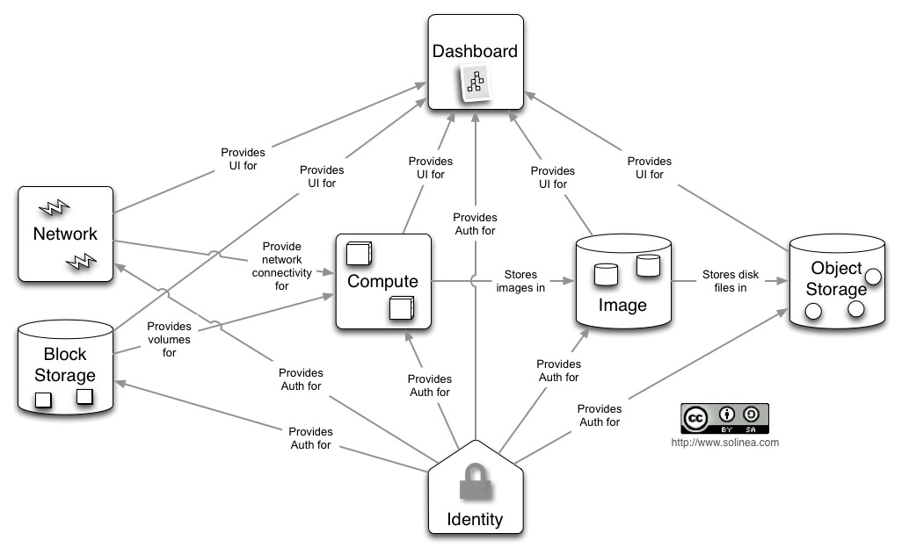
OpenStack Conceptual
Architecture

Slide 13
OpenStack Authorization
?
PBAS

Slide 14
Nova PBAS
Implementation

Slide 15
Experiments
Measure the time an authorization process takes from the time of request until decision is returned.
  nova list
  glance image-list
4 experimental configurations:
  E1: normal Nova and Glance authorization.
  E2: integrated PBAS/PS services with Nova and Glance.
  E3: integrated PBAS/PS service, stand-alone from Nova and Glance.
  E4: separate PBAS and PS services, stand-alone from Nova and Glance.
Deployment Configurations:
  4GB RAM, 2.5 GHz quad-core CPU.
  OpenStack Devstack (Grizzly) on 12.04 Ubuntu.
Mainly test deep-shaped provenance graphs.
  Generate mock data for virtual images and machines scenario.

Slide 16
Results and Evaluation
Traversal Distance | Glance (e1) | Glance (e2) | Glance (e3) | Glance (e4)
No PBAC | 0.55 | - | - | -
20 Edges | - | 0.575 | 0.607 | .642
1000 edges | - | .612 | .788 | .852
Traversal Distance | Nova (e1) | Nova (e2) | Nova (e3) | Nova (e4)
No PBAC | 0.75 | - | - | -
20 Edges | - | 0.84 | 0.902 | 1.062
1000 edges | - | 2.292 | .362 | 4.102

Slide 17
Future Work and Directions
Expanding provenance data model to include user-declared provenance data.
Collaborated PBAC usage
  Multi-cloud.
  Distributed systems.
Full-cycle implementation and evaluation
  including provenance capturing service.

Slide 18
Thank you!!!
Questions and Comments?

Slide 19
PBAC_{B} Components
Subjects
Request(s,a,o)
Actions
Action on O
Objects
User authorization
Action validation
Access Evaluation
Policies
Dependency
Lists
Base Provenance Data
access
decision
activities
utilized by

Slide 20
PBAC_{C} Components
Contextual Info.
Assoc. with
Assoc. with
Assoc. with
Subjects
Actions
Objects
Captured as
Access Evaluation
Policies
Dependency
Lists
Base Provenance Data
Attribute
Provenance Data

