Slide 1
Institute for Cyber Security
A Formal Model for Isolation Management in Cloud Infrastructure-as-a-Service
Khalid Zaman Bijon, Ram Krishnan and Ravi Sandhu
Institute for Cyber Security
University of Texas at San Antonio
October 15-17, 2014
NSS 2014: The 8th International Conference on Network and System Security
World-Leading Research with Real-World Impact!
1
Notes:
Hello Everybody, My name is khalid bijon and I am from Institue for cyber security at University of Texas at San Antonio. In this paper, I worked along with my advisor Prof. Ravi Sandhu and Ram krishana. We develoop a framework for risk-awrae role based access control.

Slide 2
Intro. & Motivation
A IaaS cloud service provider offers
A number of heterogeneous virtual resources, e.g., virtual machines, virtual networks, etc.
To a large number of clients, also referred as tenants.
Management of these virtual resources is very complex
Cloud datacenter may contain thousands of virtual resources from hundreds of tenants.
Different configurations requirements from different tenants.
Management proper sharing of physical resources among different virtual resources across tenants (multi-tenancy).
The challenge is to develop proper mechanism to manage isolation of the virtual resources across tenants.
World-Leading Research with Real-World Impact!
2

Slide 3
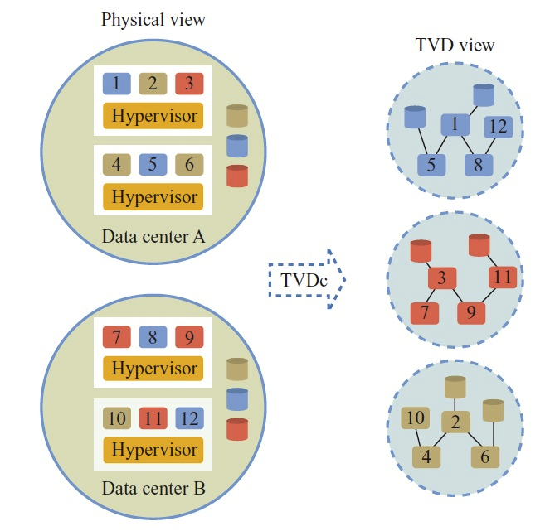
Background
Recently, trusted virtual datacenter (TVDc)[1] is proposed to manage isolation in cloud IaaS
By defining trusted virtual domains (TVDs) where each TVD is assigned to virtual machines and its associated virtual resources such as virtual networks, virtual storages, etc. that serve a common purpose.
A TVD identifier is represented as a security
clearance (also referred as a color).
Here, for example, a color can
represent the virtual resources of
a particular tenant.
Therefore, in TVDc, virtual
resources with same color are
viewed as single and disjoint
computing resources.
3
[1] S. Berger et al. Security for the cloud infrastructure: Trusted virtual data center implementation. IBM Journal of R&D, 53(4):6{1, 2009.

Slide 4
Background (cont.)
TVDc provide mechanism for isolating administrative user privileges
Proposed three different administrative roles for performing three different jobs in cloud: IT datacenter administrator, TVDc administrator, and tenant administrator.
IT datacenter administrator
A user having this role is a superuser in the system.
Discover virtual resources and grouped as different trusted virtual datacenters (TVDc) groups.
Assign a TVDc group to each user having TVDc or tenant administrator role.
Create colors and assign colors to each user having TVDc administrator role.
TVDc administrator
Assign colors to virtual resources in their TVDc groups.
Assign colors to users having tenant administrator role and belongs to same TVDc groups.
Tenant administrator
perform basic cloud administrative operations, such as connect vm to a virtual network, if the resources have same color.
World-Leading Research with Real-World Impact!
4

Slide 5
Isolations
TVDc supports following four types of isolations:
Data Sharing
A VM Only can share data with another VM with same color.
VMs are allowed to connect to a VLAN only if both VMs and the VLAN have common colors.
Hypervisor (host) Authorization
A host is assigned a set of colors.
Only allowed to run vms having a color belong to that set.
Co-location Management
Certain colors can be declared as conflicting with each other.
Constraints VMs to run in same host that are assigned conflicting colors.
Management Constraints
Tenant Administrator role.
Each user having this role only perform operation within his assigned color.
World-Leading Research with Real-World Impact!
5

Slide 6
Proposed Model
Develop a formal model for TVDc which we call Formalized-TVDc (also referred as F-TVDc)
Leverage an Attribute based system to represent different properties of the virtual resources, such as color and TVDc groups
Consists authorization model for three type of administrative users
Enforcement mechanism for the co-location constraints
World-Leading Research with Real-World Impact!
6

Slide 7
Formalized-TVDc
F-TVDc contains following sets of the basic components:
CLR = Finite set of existing colors
VDc = Finite set of existing virtual data centers
AROLE = {itAdmin, tvdcAdmin, tntAdmin}
AU = Finite set of existing admin-users
VM = Finite set of existing virtual machines
VMM = Finite set of existing hypervisors
BR = Finite set of existing virtual bridges
VLAN = Finite set of existing virtual LANs
Admin-users and virtual resources have different attributes:
Attributes are name:value pairs
Can be set valued or atomic valued
Characterize different properties of the element
World-Leading Research with Real-World Impact!
7

Slide 8
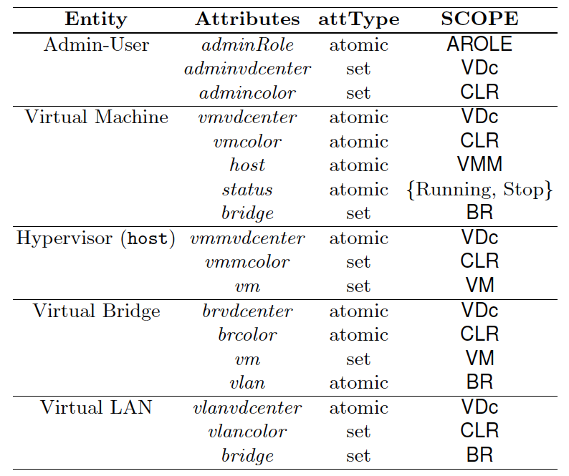
Attributes
World-Leading Research with Real-World Impact!
8

Slide 9
Administrative Models
F-TVDc formally specifies operations for the admin-users with three different roles
Operations for admin-users with itAdmin role
CreateVDC: This operation creates a virtual datacenter,
CreateCl and RemoveCl: Using these two operations, an admin-user with itAdmin role create a new color cl and remove an existing color cl.
Add_Cl_{TVDcAdmin}: This operation adds a clearance to an admin-user having tvdcAdmin role.
Rem_Cl_{TVDcAdmin}: Using this operation, an itAdmin removes a color cl from an admin-user having role tvdcAdmin.
Assign_VDC_{Admin}:This operation assign a virtual datacenter identifier to an admin-user having tvdcAdmin or tenantAdmin role.
Similarly, Assign_VDC_{VM}, Assign_VDC_{VMM}, Assign_VDC_{VLAN}, and Assign_VDC_{BR} assign a virtual datacenter identifier to respective virtual resource.
All these operations are only authorized for admin-users who have itAdmin assigned to their adminRole attribute
World-Leading Research with Real-World Impact!
9

Slide 10
Administrative Models (cont.)
Operations for admin-users with tvdcAdmin role:
Assign_Cl_{TAdmin}: This operation adds a clearance to an admin-user having tenantAdmin role. The tvdcAdmin can only add a clearance to a tenantAdmin if they are in same virtual datacenter which is assigned to their adminvdcenter attribute.
RM_Cl_{TAdmin}: This operation removes a clearance from an admin-user having tenantAdmin role. The tvdcAdmin can only remove a clearance to a tenantAdmin if they are in same virtual datacenter which is assigned to their adminvdcenter attribute.
Similarly, Assign_Cl_{VM}, Assign_Cl_{VMM}, Assign_Cl_{VLAN}, and Assign_Cl_{BR} assign a virtual datacenter identifier to respective virtual resource by a admin-user having tvdcAdmin role and they are in same virtual datacenter.
World-Leading Research with Real-World Impact!
10
Notes:
10

Slide 11
Administrative Models (cont.)
Operations for admin-users with tenantAdmin role:
Boot: Using this operation a tenant admin-user u boots a VM vm in a Host vmm.
1. The precondition of this operation veries if the u has same color of the vm. This ensures management isolation constraint.
2. It also varifies if both VM (vm) and Host (vmm) has same color which ensures host authorization isolation.
ConVmToBr and ConBrToVLAN: These operations connect a vm to a virtual bridge br and a bridge to a virtual LAN respectively.
1. A vm can be connected to a virtual bridge if they have same color.
2. A virtual bridge can be connected to a VLAN if they have same color.
3. This approach ensures data isolation constraint.
World-Leading Research with Real-World Impact!
11
Notes:
11

Slide 12
Administrative Models (cont.)
Co-location Constraints Verification
Verified during each boot operation
Evaluate_CLocConst method is called
Some colors are specified as conflicted in a set called ConflictColor
VMs with conflicted color in same Host
Ensures co-location isolation of VMs
World-Leading Research with Real-World Impact!
12
Notes:
12

Slide 13
Conclusion
Formally represents an isolation management process of virtual resources in cloud IaaS.
Develop an attribute based system
Identified administrative operations in cloud IaaS
Develop a mechanism to handle co-location issues in multi-tenant scenarios
Future Work
Identify conflicts among various attributes, e.g., tenant, performance, of virtual machines
Suitable virtual machine scheduler when there are conflicts
World-Leading Research with Real-World Impact!
13
Notes:
13

