Slide 1


Institute for Cyber Security
On the Relationship between Finite Domain ABAM and PreUCONA
Asma Alshehri and Ravi Sandhu
Department of Computer Science
10th International Conference on Network and System Security (NSS)
September 28-30, 2016

Slide 2
Outline
Introduction
ABAM model
PreUCONA model
Expressing PreUCONA IN ABAM
Reducing ABAM to PreUCONA
Right-Less ABAM with Two Parameters (RL-ABAM2)
Expressing RL-ABAM2 in PreUCONA
Conclusion
Notes:
Fig. 1. ABAM access matrix [14]

Slide 3
Introduction
ABAM:
HRU + Attributes
Test for and modify attribute values
Set of attributes is finite
PreUCONA
Sub-model of UCON
Test for and modify attribute values prior access
Set of attributes is finite
Notes:
Fig. 1. ABAM access matrix [14]

Slide 4
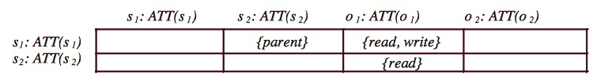
Attribute Based Access Matrix (ABAM)
Components:
Subjects (S) and Objects (O)
Attributes and Attribute Tuples
Rights (R) and Access Matrix
Attribute Predicates (P)
Primitive Operations
Commands
ABAM access matrix [*]
* Zhang, X., Li, Y., Nalla, D.: An attribute-based access matrix model. In: the 2005 ACM Symposium on Applied Computing, pp. 359-363 (2005).
Notes:
Fig. 1. ABAM access matrix [14]

Slide 5
Attribute Based Access Matrix (ABAM)
ABAM Commands:
Parameters (entities with possibly new attribute values)
Conditions
A sequence of primitive operations.
Command
If
then
end
ABAM access matrix [*]
* Zhang, X., Li, Y., Nalla, D.: An attribute-based access matrix model. In: the 2005 ACM Symposium on Applied Computing, pp. 359-363 (2005).
Notes:
Fig. 1. ABAM access matrix [14]

Slide 6
PreUCONA
Three components:
An object schema
A set of finite usage rights
A set of usage control commands
Notes:
Fig. 1. ABAM access matrix [14]

Slide 7
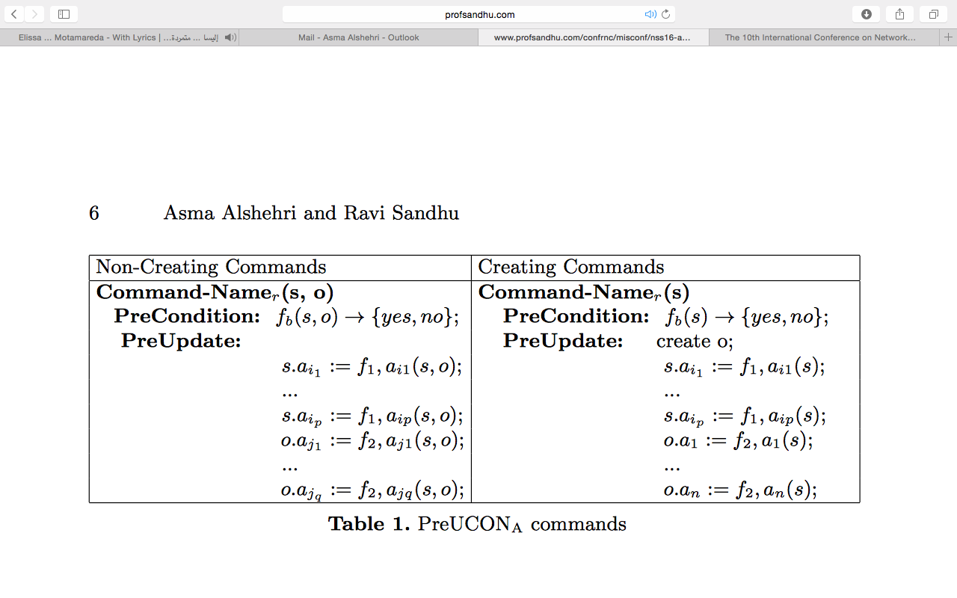
PreUCONA
PreUCONA Commands:
Notes:
Fig. 1. ABAM access matrix [14]

Slide 8
Expressing PreUCONA IN ABAM
Challenges:
Condition Part in PreUCONA permits arbitrary computable Boolean functions
Condition Part in ABAM only permits propositional logic formulas
Finite domain results in:
PreUCONA can be computed for all possible attribute values of s and o
The results can be “compiled” into multiple ABAM commands.
Notes:
Fig. 1. ABAM access matrix [14]

Slide 9
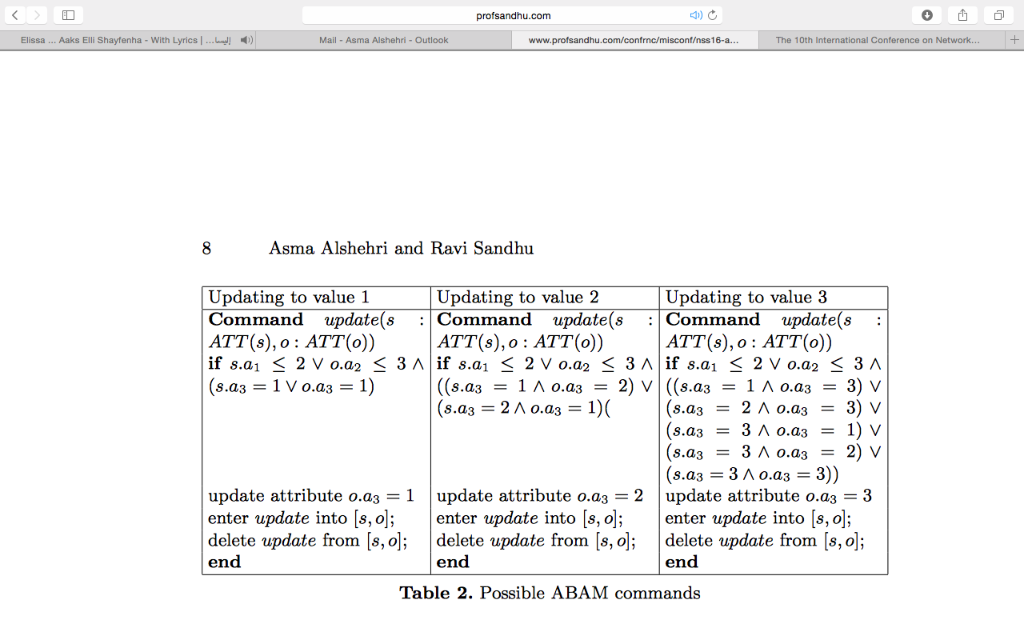
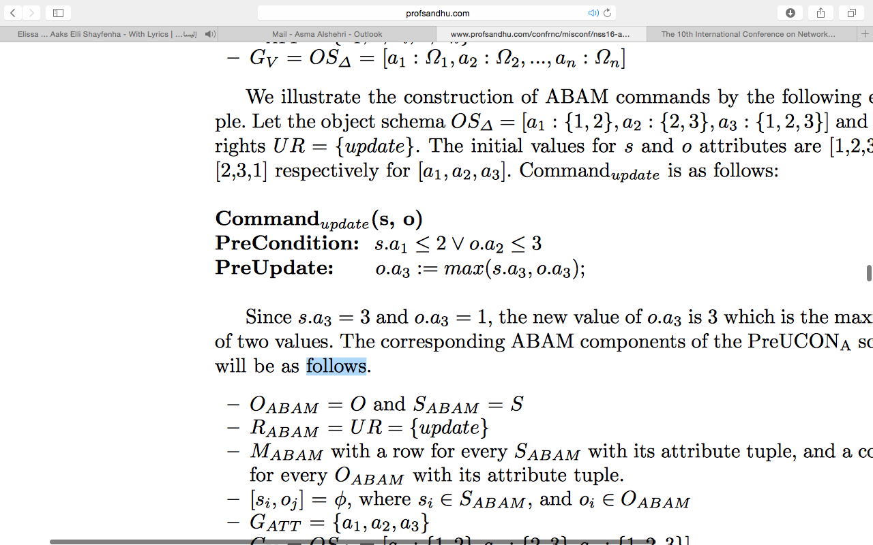
Expressing PreUCONA IN ABAM
Example: Let the object schema and usage rights UR = {update}. The initial values for s and o attributes are [1,2,3] and [2,3,1] respectively for . The PreUCONA update command is in the left side, and the table shows the possible ABAM commands:
Notes:
Fig. 1. ABAM access matrix [14]

Slide 10
Reducing ABAM to PreUCONA
Challenges of Reducing ABAM to PreUCONA
PreUCONA command has the ability to grant a non-persistent right in each command
ABAM command has the power of granting one or more rights to the actor, maintaining the given rights in the corresponding cell of the actor, and permitting two or more parameters (more targets) in each command.
Unrestricted use of rights in ABAM will result in undecidable safety whereas PreUCONA has decidable safety
Reducing ABAM to PreUCONA is not possible
Right-Less ABAM with Two Parameters (RL-ABAM2) is a restricted form of ABAM that can be reduced to PreUCONA
Notes:
Fig. 1. ABAM access matrix [14]

Slide 11
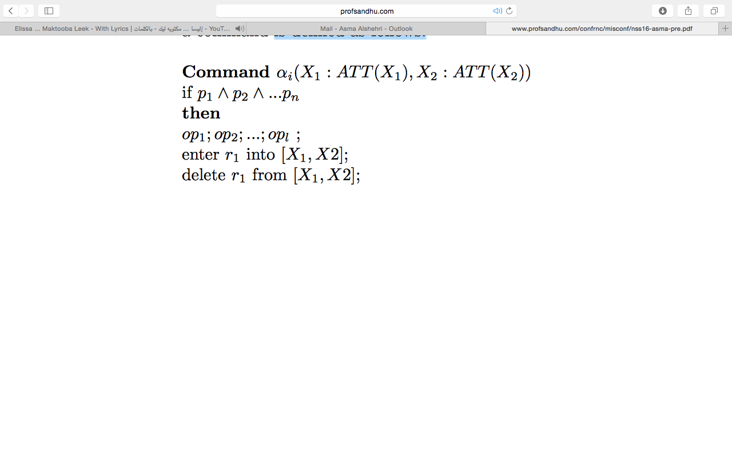
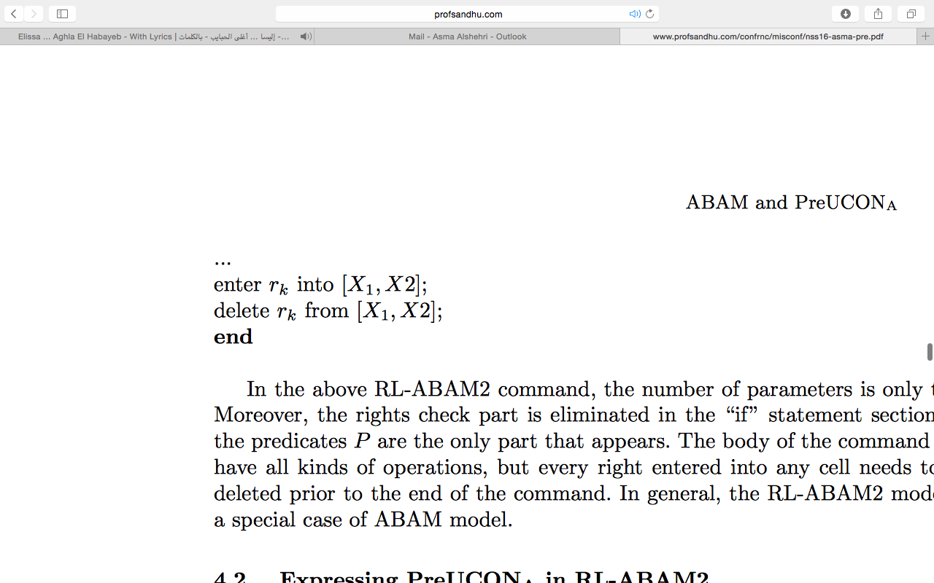
Right-Less ABAM with Two Parameters (RL-ABAM2)
RL-ABAM2 command is limited in terms:
Number of parameters
The if statement section
The existence of rights
RL-ABAM2 command is is defined as follows:
Notes:
Fig. 1. ABAM access matrix [14]

Slide 12
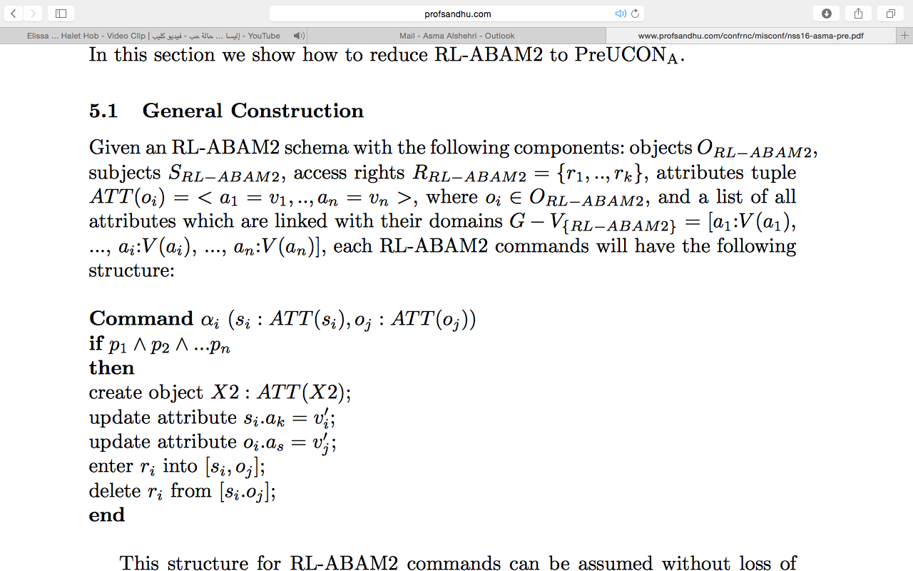
Expressing RL-ABAM2 in PreUCONA
Notes:
Fig. 1. ABAM access matrix [14]

Slide 13
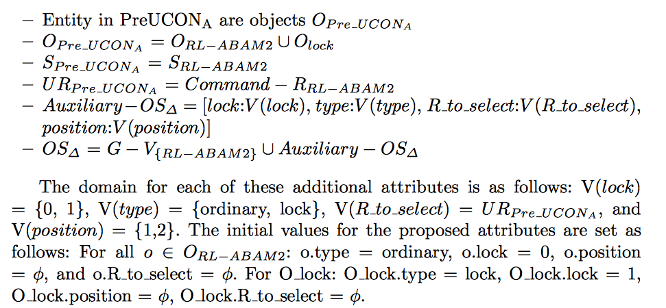
Expressing RL-ABAM2 in PreUCONA
The corresponding PreUCONA components of the RL-ABAM2 schema are extended as follows:
Notes:
Fig. 1. ABAM access matrix [14]

Slide 14
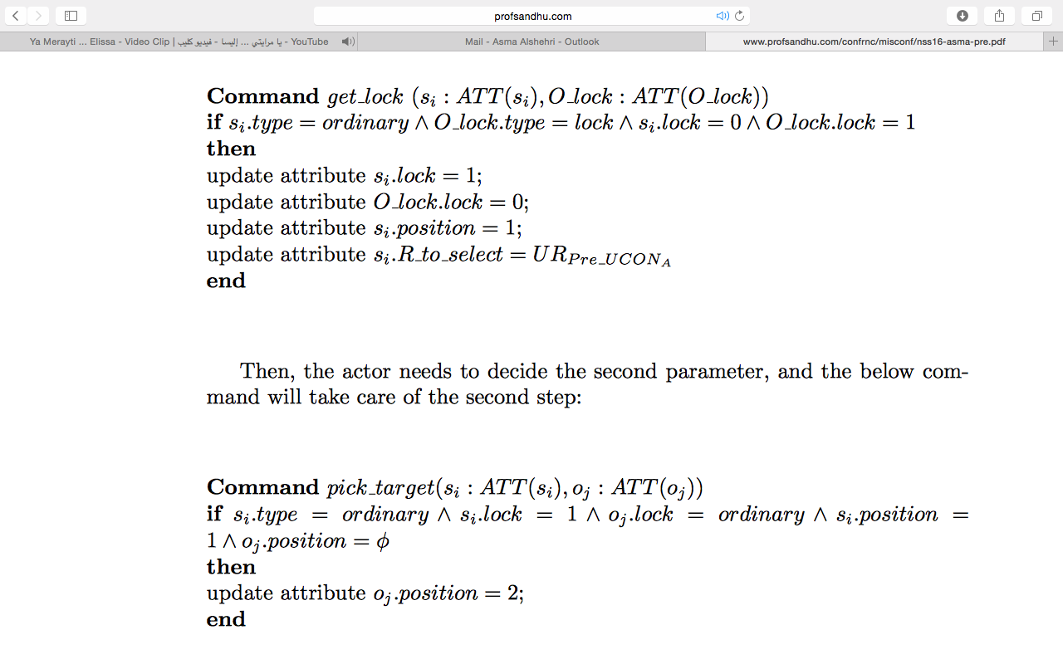
Expressing RL-ABAM2 in PreUCONA
To apply a RL-ABAM2 command in PreUCONA commands, a sequence of steps is introduced as follows:
1- Give a lock to the first parameter of the RL-ABAM2 command
2- Decide the second parameter of the Rl-ABAM2 command
Notes:
Fig. 1. ABAM access matrix [14]

Slide 15
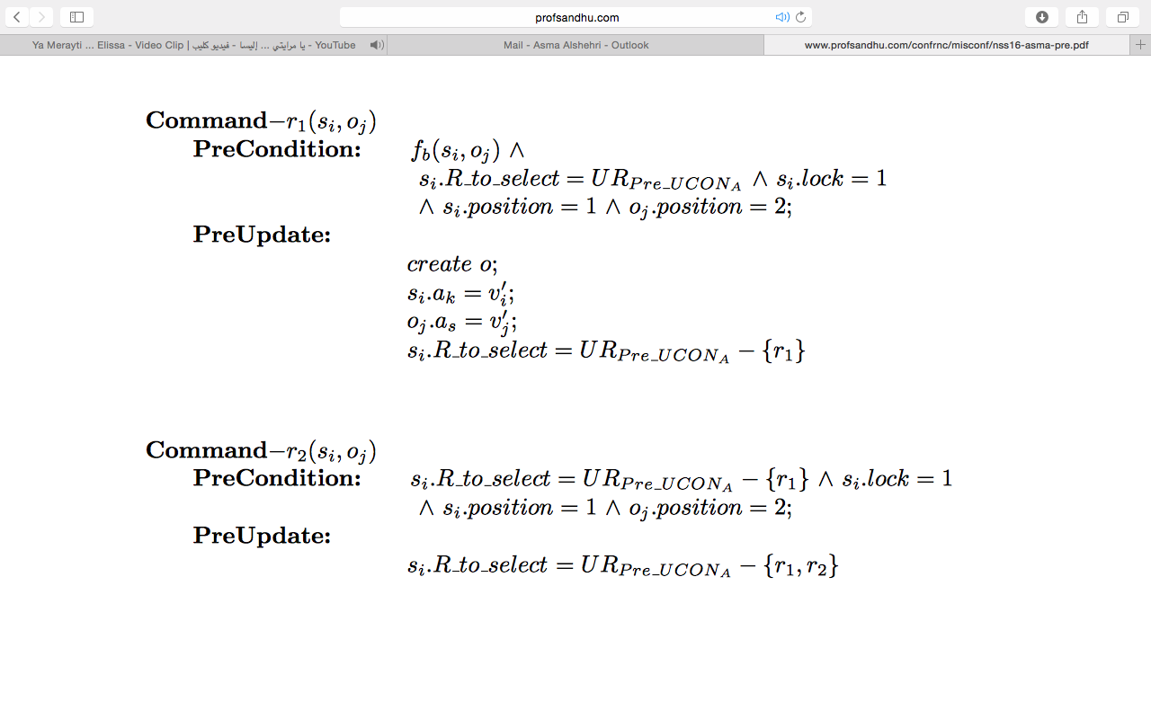
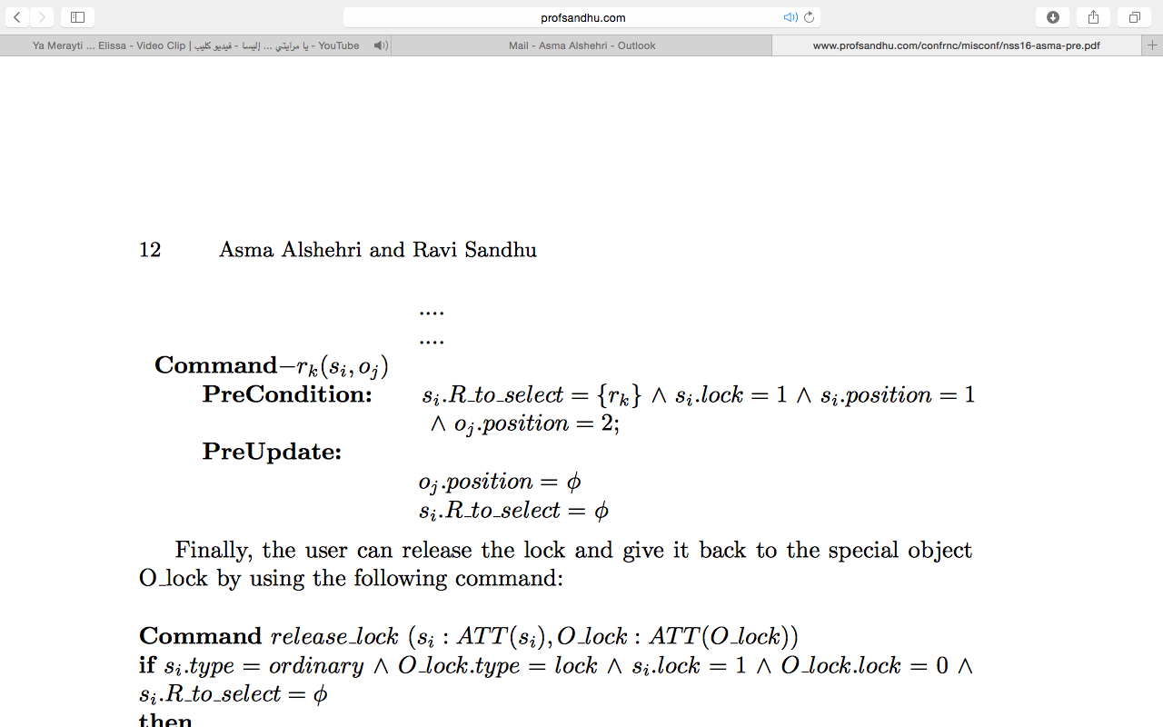
Expressing RL-ABAM2 in PreUCONA
3- Implement a sequence of PreUCONA commands (depend on the number of the operation over rights in the body of an RL-ABAM2 command)
Notes:
Fig. 1. ABAM access matrix [14]

Slide 16
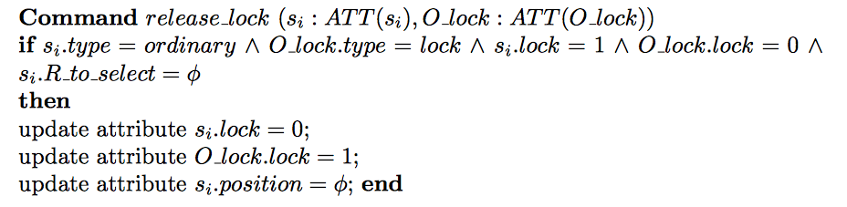
Expressing RL-ABAM2 in PreUCONA
4- Release the lock from the first parameter (actor) of the RL-ABAM2 command.
Notes:
Fig. 1. ABAM access matrix [14]

Slide 17
Conclusion
The study of ABAM indicates that a safe application of access rights could be based on the following principles:
1- Do not use rights in the if part of commands
2- Some rights could be left behind by commands so their next use is more efficient
3- There is a meaningful place for access matrix rights
Notes:
Fig. 1. ABAM access matrix [14]

Slide 18
Institute for Cyber Security
Thank you!!
Any Questions??

