Slide 1


Institute for Cyber Security
The GURA_{G} Administrative Model for User and Group Attribute Assignment
Prof. Ravi Sandhu
Executive Director and Endowed Chair
10th International Conference on Network and System Security (NSS)
September 28-30, 2016
ravi.sandhu@utsa.edu
www.profsandhu.com
Maanak Gupta and Ravi Sandhu
Department of Computer Science

Slide 2
Attribute Based Access Control (ABAC)
Attribute Based Access Control
  requires attributes of entities to make access control decisions.
  provides flexible and fine grained access control
  needs attributes (characteristics of entities) to be assigned by security administrators before access policies can be enforced.
  Several models have been developed
  ABAC_{α} model [DBSec12]
  Attribute based encryption (ABE) [CCS06]
  Logical Based Framework for ABAC [FMSE04]
  Attributed based AC for web services [ICWS'05]
  Guide to ABAC Definitions and Considerations [NIST SP 800-162]
  etcetera!!

Slide 3



ABAC Administration
GURA (Single User, Single Attribute Value Assignment)
Single value
Attribute Value
satisfy condition
assign or delete
Administrator
User
Multiple values
Attribute Value
Who ?
Prerequisite Cond.
assign or delete
HGABAC
Attribute Value
assign or delete
Attribute Value
Multiple values
satisfy condition
Single value
Attribute Value
assign or delete
Administrator
Multiple Users

Slide 4
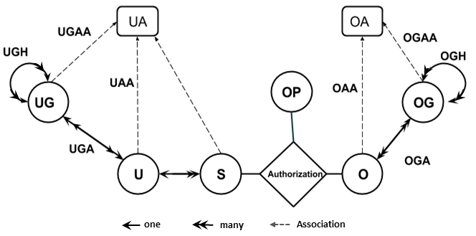
Redefined HGABAC
U: User
UG: User-Group
S: Subject
UA: User Attributes
O: Object
OG: Object-Group
OA: Object Attributes
OP: Operation (Actions)
[Servos et al] proposed Hierarchical Group and Attribute based Access Control (HGABAC) operational model
  Introduces the notion of User and Object Groups
  Core advantage is simplified administration of attributes
  User and Objects are assigned set of attributes in one go as compared to single assignment at a time.

Slide 5
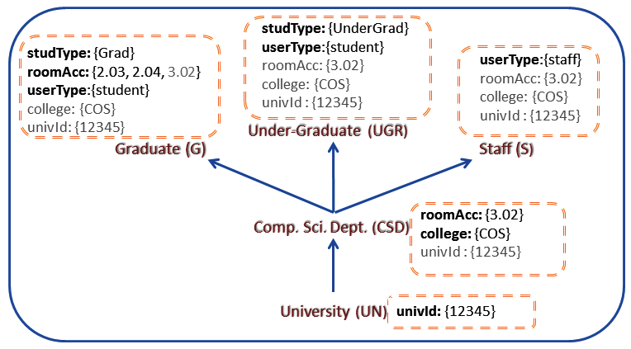
Example User-Group Hierarchy
Attribute Inheritance
Senior Groups inherit attributes from junior group
  Graduate group (G) is senior to CSD and UN
  G inherits attributes from both CSD and UN
  example: ‘univId’ and ‘college’ attribute for G inherited from UN and CSD
  User assigned to group G will have direct attributes and attributes from G

Slide 6
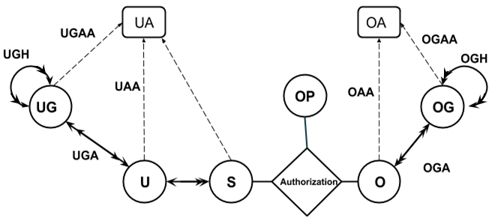
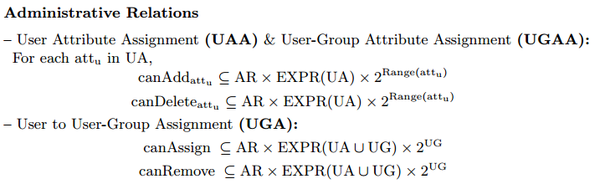
GURA_{G} Administrative Model
This paper proposes the first administration model for HGABAC model referred as GURA_{G}.
GURA_{G} Sub Models
UAA: User Attribute Assignment
UGAA: User Group Attribute Assignment
UGA: User to User-Group Assignment

Slide 7
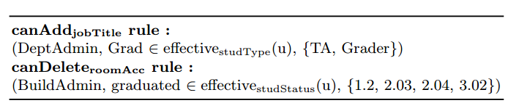
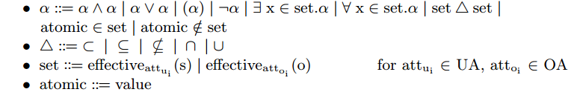
User Attribute Assignment (UAA)
Example UAA rules
Administrative Role
Prerequisite Condition
Allowed values
Rule 1: Administrative Role DeptAdmin (or senior) can add any value in {TA, Grader} to user attribute ‘jobTitle’ if the user’s ‘studType’ attribute includes ‘Grad’ value.
Common Policy Expression Language:
EXPR(UA) in UAA:

Slide 8
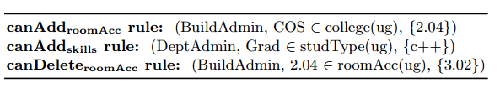
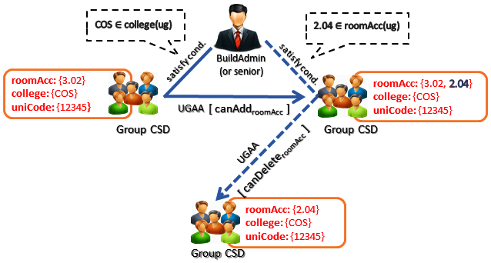
User Group Attribute Assignment
(UGAA)
Example UGAA rules
EXPR(UA) in UGAA:

Slide 9
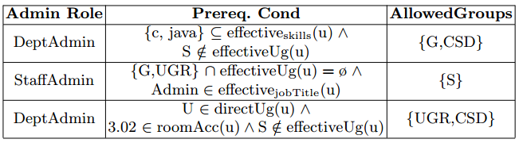
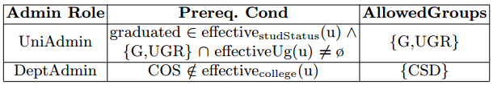

User to User-Group Assignment (UGA)
Example UGA canAssign rules:
Example UGA canRemove rules:
EXPR(UA ∪ UG)
in UGA:

Slide 10

User to User-Group Assignment (UGA)
Prerequisite Cond:
{c,java} ⊆ effective_{skills} (u) ∧
S ∉ effectiveUg (u)
1
satisfy cond.
DeptAdmin
(or senior)
direct & effective attributes
effective attributes
2
UGA
studId: {abc12}
skills: {c,java}
roomAcc: {1.2}
studType: {Grad}
roomAcc: {2.03, 2.04, 3.02}
userType: {student}
college: {COS}
univId: {12345}
3
USER
GRADUATE GROUP (G)
studId: {abc12}
skills: {c,java}
roomAcc: {1.2, 2.03, 2.04, 3.02}
studType: {Grad}
userType: {student}
college: {COS}
univId: {12345}
USER
effective attributes
Here the user has been assigned set of attributes by group G membership, in lieu of single attribute assignment, making attribute administration easy.

Slide 11
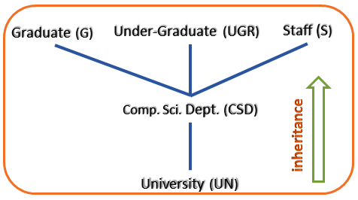
GURA_{G} Model Extensions
Weak Removal versus Strong Removal
✓✓
weak
USER
  Weak Removal will not impact implicit membership
      After removal from CSD, user still inherits attribute of CSD through G.
    Strong Removal will remove both explicit and implicit memberships
      User will be removed from G, if removed from CSD and authorized by rules.

Slide 12
GURA_{G} Model Extensions
Weak Removal versus Strong Removal
strong
USER
  Weak Removal will not impact implicit membership
      After removal from CSD, user still inherits attribute of CSD through G.
    Strong Removal will remove both explicit and implicit memberships
      User will be removed from G, if removed from CSD and authorized by rules.

Slide 13
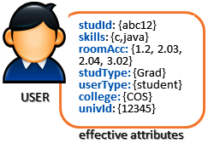
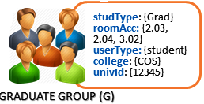

GURA_{G} Model Extensions
Inherited Value Deletion in User
Inherited Value Deletion in User Group
1
canDelete_{univId}
effective attributes
1
studType: {Grad}
roomAcc: {2.03, 2.04, 3.02}
userType: {student}
canDelete_{userType}
2
ADMIN ROLE
canRemove
GROUP (G3)
2
canDelete_{userType}
inherited value
2
roomAcc: {2.04, 3.02}
userType: {student}
roomAcc:
{2.03}
userType:
{student}
GROUP (G1)
GROUP (G2)
Deleting an inherited value from a user will require to remove the membership of a user from all the user groups from where the value is inherited.
Deleting an inherited value from a user group will require the deletion of value from all the junior groups which have value directly assigned.
Note: Administrative Rules must exist to authorize operations.
© Ravi Sandhu
World-Leading Research with Real-World Impact!
13

Slide 14
Discussions and Future Work
Advantage:
  Simplified distributed attribute administration.
  RBAC advantage inherited.
Limitations:
  Cascading pre-assignment of attributes may lead to some values assignment not essentially required by the entity.
  UGA may require multiple pre-assignments of junior group to assign senior group, though the same inheritance can be achieved by senior group membership only.
Future Work:
    Reachability Analysis for GURA_{G}
    User and Object Group hierarchy administration.
    Attribute based User and Group attribute management.

Slide 15
Institute for Cyber Security
Thank you!!
Any Questions??

