Slide 1
Institute for Cyber Security
Safety of ABAC_{α} is Decidable
Tahmina Ahmed and Ravi Sandhu
Institute for Cyber Security and
Department of Computer Science
11th International Conference on
Network and System Security (NSS)
Helsinki, Finland
August 21-23, 2017
ravi.sandhu@utsa.edu
www.profsandhu.com
www.ics.utsa.edu
© Ahmed & Sandhu
World-Leading Research with Real-World Impact!

Slide 2
Safety Problem
Can subject s obtain a right r on an object o?
In current state?
In some future state?
© Ahmed & Sandhu
World-Leading Research with Real-World Impact!
2

Slide 3
Access Control Evolution
Discretionary Access Control (DAC), 1970
Mandatory Access Control (MAC), 1970
Role Based Access Control (RBAC), 1995
Attribute Based Access Control (ABAC), ????
© Ahmed & Sandhu
World-Leading Research with Real-World Impact!
3

Slide 4
Access Control Evolution
Discretionary Access Control (DAC), 1970
Mandatory Access Control (MAC), 1970
Role Based Access Control (RBAC), 1995
Safety
Complexity
Attribute Based Access Control (ABAC), ????
© Ahmed & Sandhu
World-Leading Research with Real-World Impact!
4

Slide 5
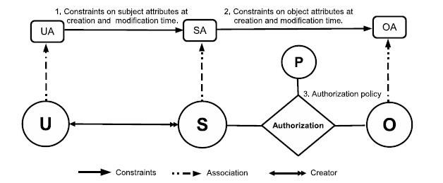
ABAC_{α} Model
Can be configured to do simple forms of DAC, MAC, RBAC
Jin, Krishnan, Sandhu 2012
© Ahmed & Sandhu
World-Leading Research with Real-World Impact!
5

Slide 6
ABAC_{α} Model
Policy Configuration Points
Can be configured to do simple forms of DAC, MAC, RBAC
Jin, Krishnan, Sandhu 2012
© Ahmed & Sandhu
World-Leading Research with Real-World Impact!
6

Slide 7



$$ABAC_{α} Model Components$$
Set of Users (U) , Subjects (S)
and Objects(O)
Set of User Attributes (UA),
Subject Attributes (SA)
and Object Attributes (OA)
Authorization Policy:
Set of Permissions P
Authorization Policy $Authorization_{p}(s,o)$
Creation and Modification Policy:
Subject Creation and Modification Constraint
Object Creation and Modification constraint
Functional Specification
$Access_{p}\left(s,o\right)$
$CreateSubject\left(u,s,savt\right)$
$ModifySubjectAtt\left(u,s,savt\right)$
$DeleteSubject\left(u,s\right)$
$CreateObject\left(s,o,oavt\right)$
$ModifyObjectAtt(s,o,oavt)$
© Ahmed & Sandhu

Slide 8
Safety Decision Strategy
Can subject s obtain a right r on an object o?
Develop a safety algorithm specifically for ABAC_{α}
Reduce the safety problem for ABAC_{α} to the safety problem for some other ABAC model with known decidable safety
© Ahmed & Sandhu
World-Leading Research with Real-World Impact!
8

Slide 9
Safety Decision Strategy
Can subject s obtain a right r on an object o?
Develop a safety algorithm specifically for ABAC_{α}
Reduce the safety problem for ABAC_{α} to the safety problem for some other ABAC model with known decidable safety
© Ahmed & Sandhu
World-Leading Research with Real-World Impact!
9

Slide 10
UCON_{ABC} Model
unified model integrating
authorization
obligation
conditions
and incorporating
continuity of decisions
mutability of attributes
Usage Control Models, early 2000s
Park, Sandhu, Pretschner
© Ahmed & Sandhu
World-Leading Research with Real-World Impact!
10

Slide 11

$UCON_{preA}^{finite }$ Model
unified model integrating
authorization
obligation
conditions
and incorporating
continuity of decisions
mutability of attributes
Finite
domains
X
X
X
X
Usage Control Models, early 2000s
Park, Sandhu, Pretschner
© Ahmed & Sandhu
World-Leading Research with Real-World Impact!
11

Slide 12
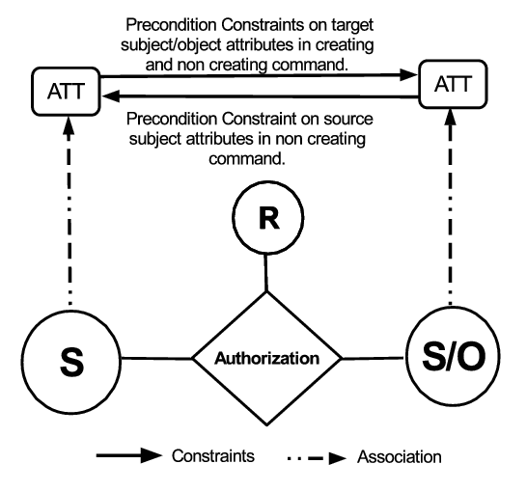

$UCON_{preA}^{finite }$ Model
$Figure 4$: $UCON_{preA}^{finite}$ Model
© Ahmed & Sandhu

Slide 13

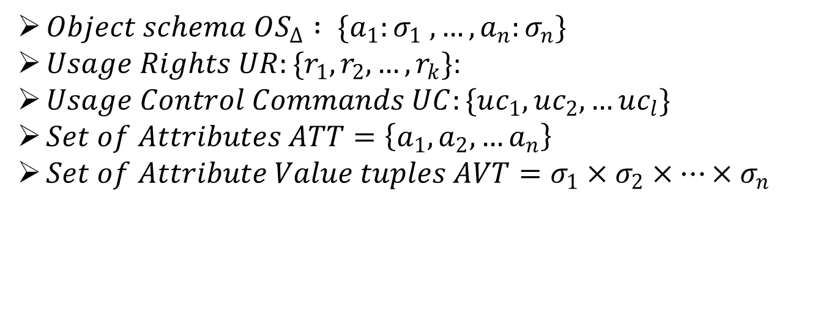
$UCON_{preA}^{finite }$ Model Components
$Object schema OS_{Δ} : \{a_{1}:σ_{1} , …, a_{n}:σ_{n}\}$
$Usage Rights UR:\{r_{1}, r_{2}, …, r_{k}\}$:
$Usage Control Commands UC:\{uc_{1}, uc_{2},…uc_{l}\}$
$Set of Attributes ATT=\left\{a_{1}, a_{2}, …a_{n}\right\}$
$Set of Attribute Value tuples AVT=σ_{1}×σ_{2}×…{×σ}_{n}$
© Ahmed & Sandhu

Slide 14
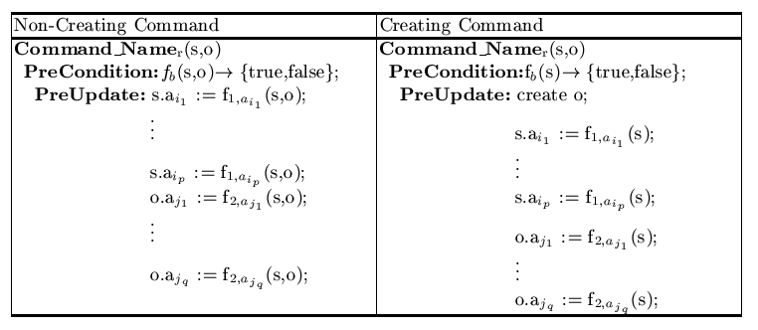

$UCON_{preA}^{finite }$ Command Structure
© Ahmed & Sandhu

Slide 15
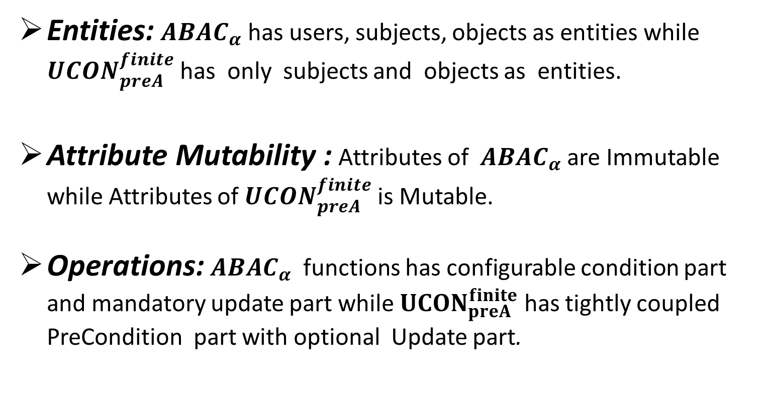

$ABAC_{α}$ Vs. $UCON_{preA}^{finite}$
Entities:$ABAC_{α}$ has users, subjects, objects as entities while $UCON_{preA}^{finite}$ has only subjects and objects as entities.
Attribute Mutability : Attributes of $ABAC_{α}$ are Immutable while Attributes of $UCON_{preA}^{finite}$is Mutable.
Operations:$ABAC_{α}$ functions has configurable condition part and mandatory update part while $UCON_{preA}^{finite}$ has tightly coupled PreCondition part with optional Update part.
© Ahmed & Sandhu

Slide 16
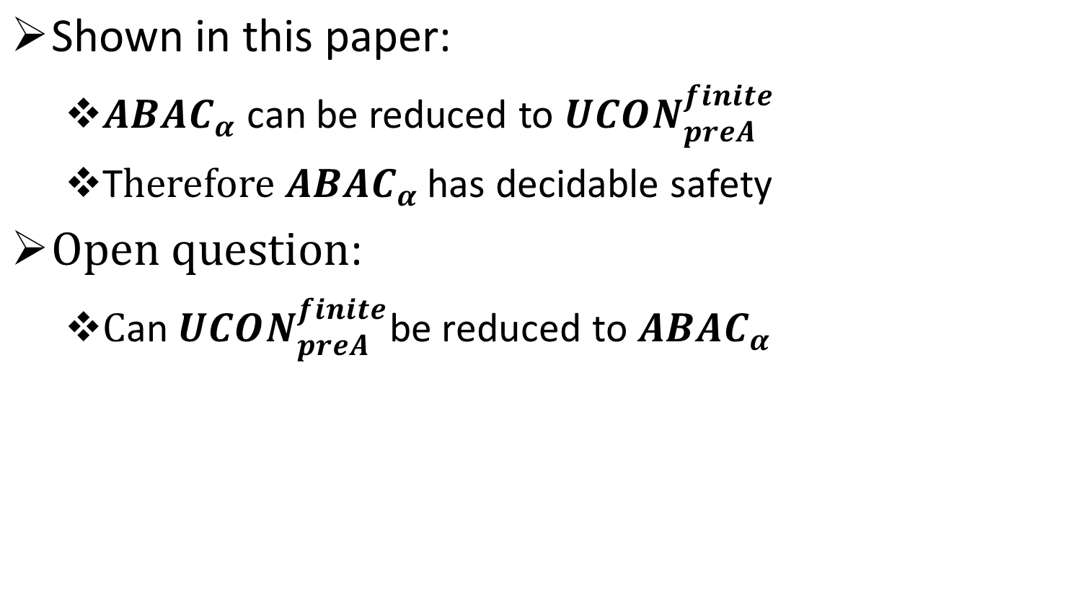
$ABAC_{α}$ Vs. $UCON_{preA}^{finite}$
$\text{Shown} \text{in} \text{this} \text{paper}\text{:}$
$ABAC_{α}$ can be reduced to $UCON_{preA}^{finite}$
T$herefore ABAC_{α}$ has decidable safety
$\text{O}\text{pen} \text{question}\text{:}$
$\text{C}\text{an} UCON_{preA}^{finite}\text{be} \text{reduced} \text{to} ABAC_{α}$
© Ahmed & Sandhu

