Slide 1
Institute for Cyber Security
MT-ABAC: A Multi-Tenant Attribute-Based Access Control Model with Tenant Trust
Navid Pustchi and Ravi Sandhu
Institute for Cyber Security
University of Texas at San Antonio
November 3-5, 2015
9th International Conference on Network and System Security
World-Leading Research with Real-World Impact!

Slide 2
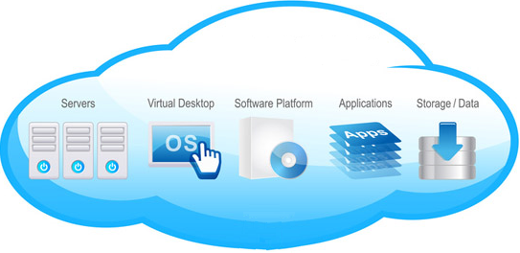

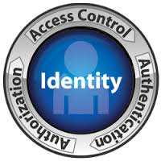

“Moving” to Cloud
Flexibility
Reliability
Accessibility
Mobility
security
World-Leading Research with Real-World Impact!

Slide 3







Why Collaboration ?
Rackspace
Software Development
Tenant
Software Development
Tenant
Intel
Financial
Tenant
Large Organization with multiple tenants
Distinct Organizations’ Collaborative tasks
Cloud Service Provider
World-Leading Research with Real-World Impact!

Slide 4
Scope of Contribution
Contribution
An Attribute Based Access Control Model to enable collaboration between trusted tenants
Cross-tenant attribute assignment
Users cross-tenant access consistent with trust relation
Scope
Infrastructure-as-a-Service (IaaS)
Single cloud
Multi-tenant
World-Leading Research with Real-World Impact!

Slide 5
Multi-Tenancy
Multi-tenancy
From Cloud Service Provider (CSP) perspective
Each customer bounded to a tenant, isolated from each other
Manages its own users and cloud resources
Tenant owner
An individual
An organization
A department of an organization
World-Leading Research with Real-World Impact!

Slide 6
Attribute Based Access Control (ABAC)
Attributes are name:value pairs
Represents user and resource properties
Associated with
Users
Objects
Tenants
Contexts
Converted to rights by authorization policies
In-time
Entity attributes
Set of actions
World-Leading Research with Real-World Impact!

Slide 7
Why Another Model
ABAC
RBAC shortcomings needs custom extension
For example real time environmental parameters.
ABAC is more flexible
Accommodate environmental parameters.
MT-ABAC
Multi-tenancy
Collaboration consistent with trust
World-Leading Research with Real-World Impact!

Slide 8

${ABAC}_{0}$ Model Structure
UATT
OATT
U
Auth
O
A
Association
Access Decision
World-Leading Research with Real-World Impact!

Slide 9
${ABAC}_{0}$ Model Structure
Finite set of users and objects
UATT
OATT
U
Auth
O
A
Association
Access Decision
Set of actions
typically = {create, read, update, delete}
World-Leading Research with Real-World Impact!

Slide 10
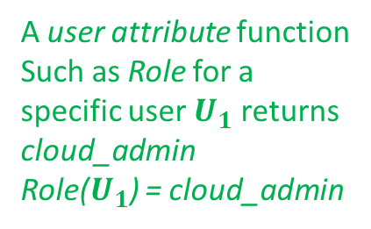
${ABAC}_{0}$ Model Structure
Finite set of user and object attribute functions
UATT
OATT
U
Auth
O
A user attribute function
Such as Role for a specific user $U_{1}$ returns cloud_admin
Role($U_{1}$) = cloud_admin
A
Policy Configuration point
Association
Access Decision
World-Leading Research with Real-World Impact!

Slide 11
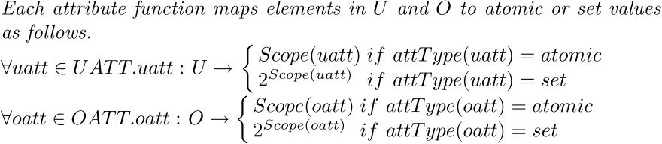
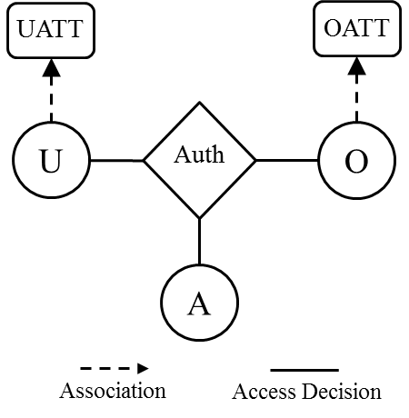

${ABAC}_{0}$ Model Structure
Attribute Functions
Authorization Policy
World-Leading Research with Real-World Impact!

Slide 12

${MT−ABAC}_{0}$ Model Structure
UATT
trustedTenants
uattOwner
U
T
userOwner
oattOwner
objOwner
Auth
O
OATT
A
Association
Access Decision
Many-to-one
atomic-valued function
Many-to-many
set-valued function
World-Leading Research with Real-World Impact!

Slide 13
${MT−ABAC}_{0}$ Model Structure
Finite set of existing tenants
UATT
trustedTenants
uattOwner
U
T
userOwner
oattOwner
objOwner
Auth
O
OATT
Each user and object owned by a single tenant
A
Association
Access Decision
Many-to-one
atomic-valued function
Many-to-many
set-valued function
World-Leading Research with Real-World Impact!

Slide 14
${MT−ABAC}_{0}$ Model Structure
Required atomic-valued attribute function mapping users and objects to owner tenant
UATT
trustedTenants
uattOwner
U
T
userOwner
oattOwner
objOwner
Auth
O
OATT
A
Association
Access Decision
Many-to-one
atomic-valued function
Many-to-many
set-valued function
World-Leading Research with Real-World Impact!

Slide 15
${MT−ABAC}_{0}$ Model Structure
Required atomic-valued meta-attribute function mapping user and object attributes to owner tenant
UATT
trustedTenants
uattOwner
U
T
userOwner
oattOwner
objOwner
Auth
O
OATT
A
Association
Access Decision
Many-to-one
atomic-valued function
Many-to-many
set-valued function
World-Leading Research with Real-World Impact!

Slide 16
${MT−ABAC}_{0}$ Model Structure
Each tenant assigns values
to attributes it owns
UATT
trustedTenants
uattOwner
U
T
userOwner
oattOwner
objOwner
Auth
O
OATT
A
Association
Access Decision
Many-to-one
atomic-valued function
Many-to-many
set-valued function
World-Leading Research with Real-World Impact!

Slide 17






Tenant-Trust
Tenant-trust type-$β$
If $T_{A}⊴_{β}T_{B}$, tenant $T_{B}$ is authorized to assign values for$T_{B}$'s user attributes to tenant $T_{A}$'s users. Tenant $T_{A}$controls tenant-trust existence while $T_{B}$ controls cross-tenant attribute assignments.
tenant $T_{B}$
$$T_{A}$$
$$T_{B}$$
$$U_{A}$$
$$U_{B}$$
Sec_Mng
Sec_Eng
World-Leading Research with Real-World Impact!

Slide 18
${MT−ABAC}_{0}$ Model Structure
UATT
trustedTenants
uattOwner
U
T
userOwner
oattOwner
Required set-valued attribute
function mapping a tenant to
the power set of trusted
tenants
objOwner
Auth
O
OATT
A
Association
Access Decision
Many-to-one
atomic-valued function
Many-to-many
set-valued function
World-Leading Research with Real-World Impact!

Slide 19
${MT−ABAC}_{0}$ Model Structure
UATT
Objects only assigned values for attributes owned by objects' owner tenant
trustedTenants
uattOwner
U
T
userOwner
oattOwner
User attributes assigned values from owning tenant and trusted tenants
objOwner
Auth
O
OATT
A
Association
Access Decision
Many-to-one
atomic-valued function
Many-to-many
set-valued function
World-Leading Research with Real-World Impact!

Slide 20
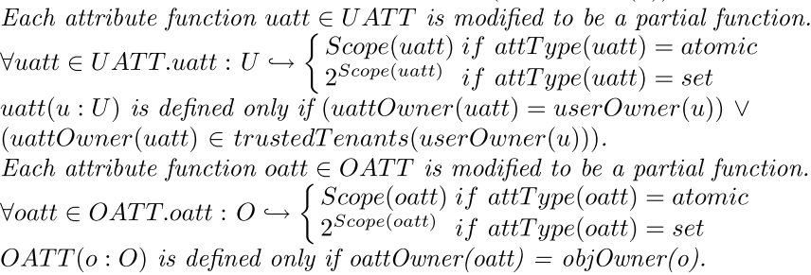
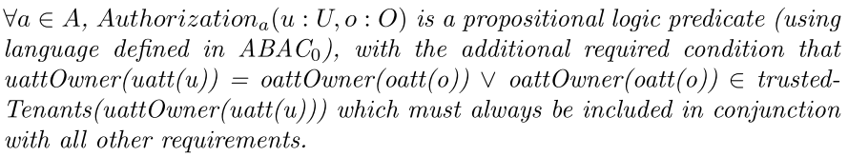
${MT−ABAC}_{0}$ Model Structure
Attribute Functions
Authorization Policy
World-Leading Research with Real-World Impact!

Slide 21
${MT−ABAC}_{0}$ Model Structure
User attributes assigned values from owning tenant and trusted tenants
Attribute Functions
Authorization Policy
Objects only assigned values for attributes owned by objects' owner tenant
World-Leading Research with Real-World Impact!

Slide 22
${MT−ABAC}_{0}$ Model Structure
Attribute Functions
Authorization Policy
User and object attribute owner one tenant or trust exist between them
World-Leading Research with Real-World Impact!

Slide 23


Tenant-Trust
Tenant-trust type-$α$
If $T_{A}⊴_{α}T_{B}$, tenant $T_{A}$ is authorized to assign values for$T_{A}$'s user attributes to tenant $T_{B}$'s users. Tenant $T_{A}$controls tenant-trust existence and cross-tenant attribute assignments.
tenant $T_{A}$
$$T_{A}$$
$$T_{B}$$
$$U_{A}$$
$$U_{B}$$
Sec_Mng
Sec_Eng
World-Leading Research with Real-World Impact!

Slide 24


Tenant-Trust
Tenant-trust type-$γ$
If $T_{A}⊴_{γ}T_{B}$, tenant $T_{B}$ is authorized to assign values for$T_{A}$'s user attributes to tenant $T_{B}$'s users. Tenant $T_{A}$controls tenant-trust existence while $T_{B}$ controls cross-tenant attribute assignments.
tenant $T_{B}$
$$T_{A}$$
$$T_{B}$$
$$U_{A}$$
$$U_{B}$$
Sec_Mng
Sec_Eng
World-Leading Research with Real-World Impact!

Slide 25

${MT−RBAC}_{0}$ Model Structure
TT
T
UO
RO
OO
U
UA
R
PA
OPS
OBS
PRMS
Many-to-one relation
Many-to-many relation
World-Leading Research with Real-World Impact!

Slide 26
${MT−RBAC}_{0}$ Model Structure
Users, Roles, and Objects owned by tenants
TT
T
UO
RO
OO
U
UA
R
PA
OPS
OBS
PRMS
Many-to-one relation
Many-to-many relation
World-Leading Research with Real-World Impact!

Slide 27
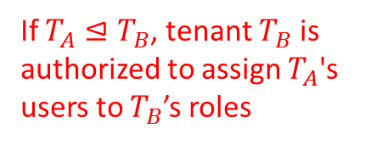
${MT−RBAC}_{0}$ Model Structure
User-assignment is same tenant or user owner tenant trusts role owner tenant
TT
T
If $T_{A}⊴T_{B}$, tenant $T_{B}$ is authorized to assign $T_{A}$'s users to $T_{B}$’s roles
UO
OO
RO
U
UA
R
PA
OPS
OBS
PRMS
Many-to-one relation
Many-to-many relation
World-Leading Research with Real-World Impact!

Slide 28

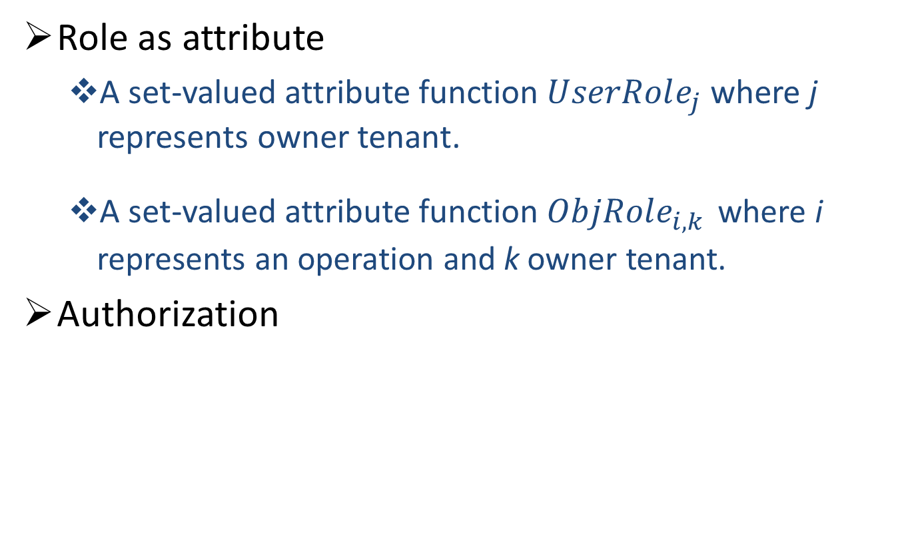
Configuring ${MT−RBAC}_{0}$ to ${MT−ABAC}_{0}$
Role as attribute
A set-valued attribute function $UserRole_{j}$ where j represents owner tenant.
A set-valued attribute function $ObjRole_{i,k}$ where i represents an operation and k owner tenant.
Authorization
World-Leading Research with Real-World Impact!

Slide 29
Conclusion
Multi-tenant attribute-based access control model
Collaboration is enabled through cross-tenant attribute assignment.
Trust as a required attribute function.
Isolated attributes within tenants.
Future Work
Other trust types.
Multi-cloud environments.
Relaxing object attribute assignments.
World-Leading Research with Real-World Impact!

