Slide 1
Relationship-based Access Control for Online Social Networks: Beyond User-to-User Relationships
Institute for Cyber Security
Sep. 3, 2012
PASSAT 2012, Amsterdam, The Netherlands
Yuan Cheng, Jaehong Park and Ravi Sandhu
Institute for Cyber Security
University of Texas at San Antonio
World-Leading Research with Real-World Impact!

Slide 2
Outline
Motivation
Model Components
Model
Use Cases
Conclusions
World-Leading Research with Real-World Impact!

Slide 3

Relationship-based Access Control
Users in Online Social Networks (OSNs) are connected with social relationships (user-to-user relationships)
Owner of the resource can control its release based on such relationships between the access requester and the owner
World-Leading Research with Real-World Impact!

Slide 4
Sharings in Online Social Networks
Online Social Networks provide services to promote information sharing by utilizing user activity information and shared contents
Users share information with other users
A user creates information to share with other users.
A user sends information to other users. (e.g., poke, invite)
A user receives information from/about other users.
Information about a user’s sharing activity is shared.
Both resource and user as a target of sharing activity
Alice pokes bob

Slide 5
Controls in Online Social Networks
A user wants to control other users’ access to her own shared information
Only friends can read my post
A user wants to control other users’ activities who are related to the user
My children cannot be a friend of my co-workers
My activities should not be notified to my coworkers
A user wants to control her outgoing/incoming activities
No accidental access to violent contents
Do not poke me
A user’s activity influences access control decisions
Once Alice sends a friend request to Bob, Bob can see Alice’s profile

Slide 6
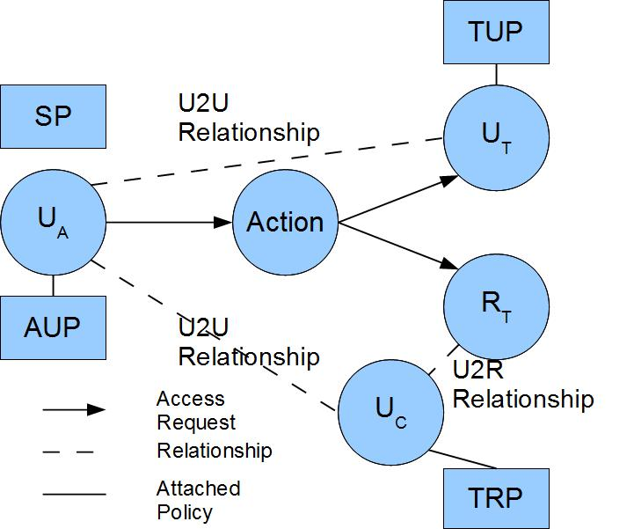
U2U Relationship-based Access Control (UURAC) Model
U_{A}: Accessing User
U_{T}: Target User
U_{C}: Controlling User
R_{T}: Target Resource
AUP: Accessing User Policy
TUP: Target User Policy
TRP: Target Resource Policy
SP: System Policy
Policy Individualization
User and Resource as a Target
Separation of user policies for incoming and outgoing actions
Regular Expression based path pattern w/ max hopcounts (e.g., <u_{a}, (f*c,3)>)

Slide 7
Limitation of U2U Relationships
We rely on the controlling user and ownership to regulate access to resources in UURAC (U2U Relationship-based AC)
Needs more flexible control
Parental control, related user’s control (e.g., tagged user)
User relationships to resources (e.g., U-U-R)
User relationships via resources (e.g., U-R-U)
World-Leading Research with Real-World Impact!

Slide 8
Beyond U2U Relationships
There are various types of relationships between users and resources in addition to U2U relationships and ownership
e.g., share, like, comment, tag, etc
U2U, U2R and R2R
U2R further enables relationship and policy administration
World-Leading Research with Real-World Impact!

Slide 9
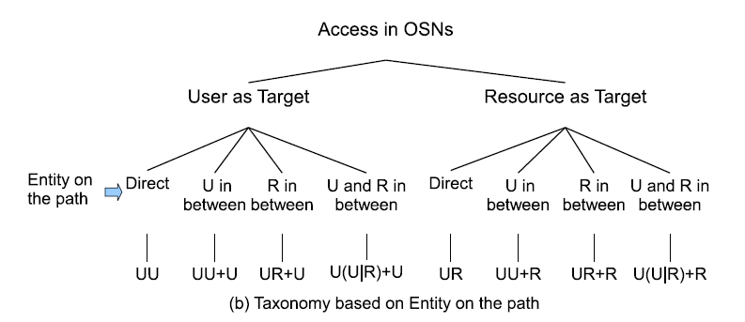
Access Scenarios
World-Leading Research with Real-World Impact!

Slide 10
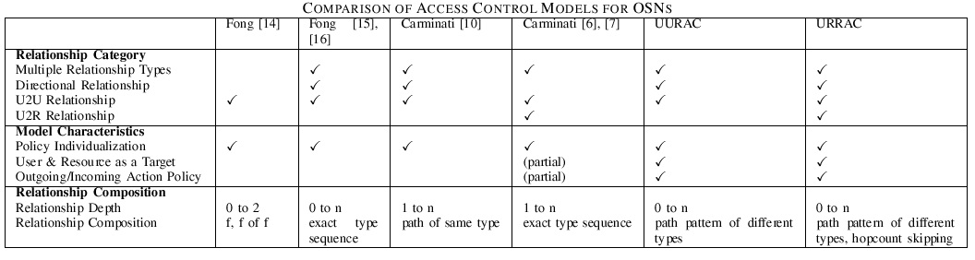
Related Works
Access Control Models for OSNs
The advantages of URRAC:
Path pattern of different relationship types and hopcount skipping make policy specification more expressive
System-level conflict resolution policy
World-Leading Research with Real-World Impact!

Slide 11
Outline
Motivation
Model Components
Model
Use Cases
Conclusions
World-Leading Research with Real-World Impact!

Slide 12
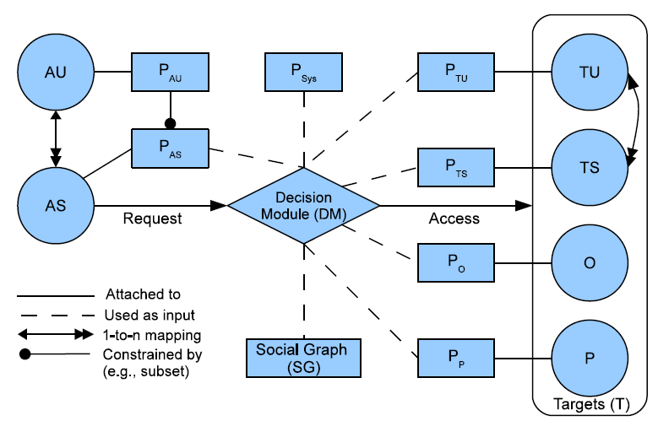
URRAC Model Components
AU: Accessing User
AS: Accessing Session
TU: Target User
TS: Target Session
O: Object
P: Policy
P_{AU}: Accessing User Policy
P_{AS}: Accessing Session Policy
P_{TU}: Target User Policy
P_{TS}: Target Session Policy
P_{O}: Object Policy
P_{P}: Policy for Policy
P_{Sys}: System Policy
World-Leading Research with Real-World Impact!

Slide 13
Outline
Motivation
Model Components
Model
Use Cases
Conclusions
World-Leading Research with Real-World Impact!

Slide 14
Characteristics of URRAC in OSNs
Policy Individualization
Users define their own privacy and activity preferences
Related users can configure policies too
Collectively used by the system for control decision
Policy Administration
Policy and Relationship Management
Users specify policies for other users and resources
User-session Distinction
A user can have multiple sessions with different sets of privileges
Especially useful in mobile and location-based applications
Relationship-based Access Control
World-Leading Research with Real-World Impact!

Slide 15
Social Networks
Social graph is modeled as a directed labeled simple graph G=<V, E, Σ>
V = U U R, where U is users and R is resources
Edges E as relationships
Σ={σ₁, σ₂, …,σ_{n}, σ₁⁻¹, σ₂⁻¹,…, σ_{n}⁻¹} as relationship types supported
World-Leading Research with Real-World Impact!

Slide 16
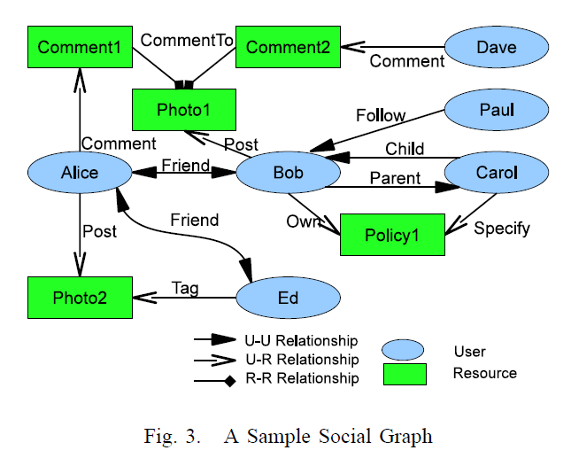
URRAC Social Graph

Slide 17
Action and Access Request
ACT = {act₁, act₂,. . .,act_{n}} is the set of OSN supported actions
Access Request <s, act, T>
s tries to perform act on T
Target T ⊆ (2^{TU ∪ R} - Ø) is a non-empty set of users and resources
T may contain multiple targets
World-Leading Research with Real-World Impact!

Slide 18
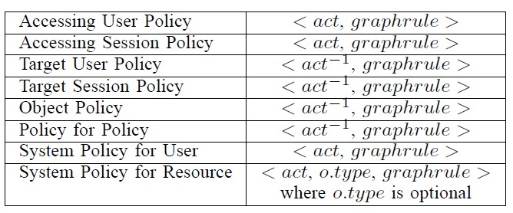
Authorization Policy
action⁻¹ in TUP, TSP, OP and PP is the passive form since it applies to the recipient of action
SP does not differentiate the active and passive forms
SP for resource needs o.type to refine the scope of the resource
World-Leading Research with Real-World Impact!

Slide 19
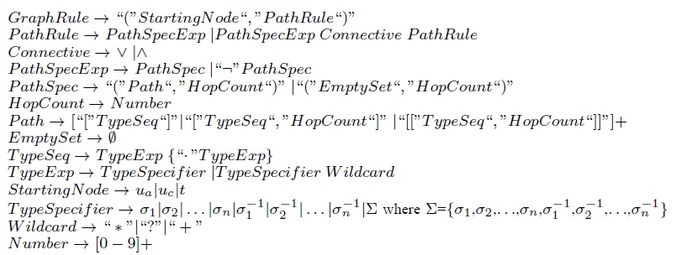
Graph Rule Grammar
World-Leading Research with Real-World Impact!

Slide 20
Hopcount Skipping
Six degrees of separation
Any pair of persons are distanced by about 6 people on average. (4.74 shown by recent study)
Hopcount for U2U relationships is practically small
U2R and R2R relationships may form a long sequence
Omit the distance created by resources
Local hopcount stated inside “[[]]” will not be counted in global hopcount.
E.g., “([f*,3][[c*, 2]],3)”, the local hopcount 2 for c* does not apply to the global hopcount 3, thus allowing f* to have up to 3 hops.
World-Leading Research with Real-World Impact!

Slide 21
Policy Conflict Resolution
System-defined conflict resolution for potential conflicts among user-specified policies
Disjunctive, conjunctive and prioritized order between relationship types
∧,∨, > represent disjunction, conjunction and precedence
@ is a special relationship “null’’ that denotes “self”
World-Leading Research with Real-World Impact!
Notes:
Multiple policies having weight in authorization result in decision conflicts inevitably. While assuming policies specified by the system will always be unambiguous, conflict resolution policies are responsible for interpreting how the potential policy conflicts within each category of user-specified policies can be resolved in terms of the precedence or connectives over relationship types

Slide 22
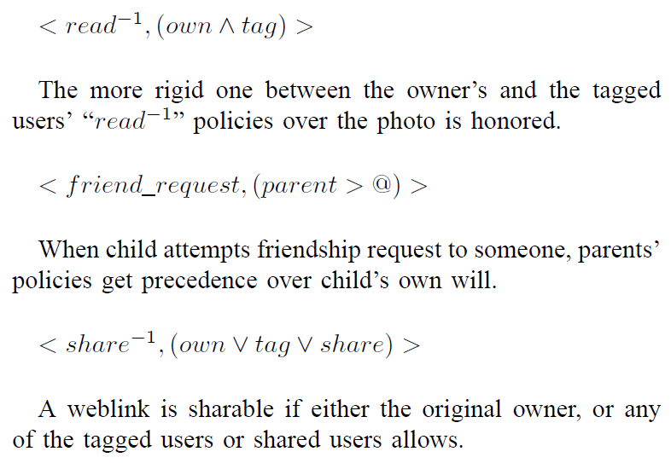
Policy Conflict Resolution (cont.)
World-Leading Research with Real-World Impact!

Slide 23
Access Evaluation Procedure
Policy Collecting
To authorize <s, act, T>, we need the following policies:
s’s session policy about act
a collection of act⁻¹ policies from each target in T
system policies over act and object type, if target is an object
World-Leading Research with Real-World Impact!

Slide 24
Policy Extraction
It determines the starting node, where the evaluation starts
If s is start, then every t in T (and u_{c}) becomes the evaluating node; otherwise, s is the evaluating node.
Policy: <action, (r.type), graph rule>
Graph Rule: start, path rule
Path Rule: path spec ∧|∨ path spec
Path Spec: path, hopcount
Path-check each path spec using Algorithm 2 in Cheng et al [11]
World-Leading Research with Real-World Impact!

Slide 25
Policy Evaluation
Evaluate a combined result based on conjunctive or disjunctive connectives between path specs
Make a collective result for multiple policies in each policy set.
Policy conflicts may arise. We apply CRP_{Sys} to resolve conflicts.
Compose the final result from the result of each policy set (P_{AS}, P_{TU}/P_{TS}/P_{O}/P_{P}, P_{Sys})
World-Leading Research with Real-World Impact!

Slide 26
Outline
Motivation
Model Components
Model
Use Cases
Conclusions
World-Leading Research with Real-World Impact!

Slide 27
Example
View a photo where a friend is tagged. Bob and Ed are friends of Alice, but not friends of each other. Alice posted a photo and tagged Ed on it. Later, Bob sees the activity from his news feed and decides to view the photo: (Bob, read, Photo2)
Bob’s P_{AS}(read): <read,(u_{a},([Σ_{u_u}*,2][[Σ_{u_r} ,1]],2))>
Photo2’s P_{O}(read⁻¹) by Alice: <read⁻¹,(t,([post⁻¹,1][friend*,3],4))>
Photo2’s P_{O}(read⁻¹) by Ed: <read⁻¹,(u_{c},([friend],1))>
AP_{Sys}(read): <read,(ua,([Σ_{u_u}*,5][[Σ_{u_r} ,1]],5))>
CRP_{Sys}(read): <read⁻¹,(own∧tag)>
In conflicts
World-Leading Research with Real-World Impact!

Slide 28
Example (cont.)
Parental control of policies. The system features parental control such as allowing parents to configure their children’s policies. The policies are used to control the incoming or outgoing activities of children, but are subject to the parents’ will. For instance, Bob’s mother Carol requests to set some policy, say Policy1 for Bob: (Carol, specify policy, Policy1)
Carol’s P_{AS}(specify_policy): <specify_policy,(u_{a},([own],1)∨([child·own],2))>
Policy1’s P_{P}(specify_policy⁻¹) by Bob: <specify_policy⁻¹,(t,([own⁻¹],1))>
P_{Sys}(specify_policy): <specify_policy,(u_{a},([own],1)∨([child·own],2))>
CRP_{Sys}(specify_policy): <specify_policy, (parent ∧ @)>
World-Leading Research with Real-World Impact!

Slide 29
Outline
Motivation
Model Components
Model
Use Cases
Conclusions
World-Leading Research with Real-World Impact!

Slide 30
Summary
Proposed a U2U, U2R and R2R relationship-based access control model for users’ usage and administrative access in OSNs
Access control policies are based on regular expression based path patterns
Hopcount skipping for more expressiveness
Provided a system-level conflict resolution policies based on relationship precedence
World-Leading Research with Real-World Impact!

Slide 31
Future Work
Incorporate attribute-based controls
Extend DFS-based path checking algorithm to cover U2R and R2R relationships
Undertake performance and scalability tests
World-Leading Research with Real-World Impact!

Slide 32
Questions?
World-Leading Research with Real-World Impact!

