Slide 1
A Multi-Tenant RBAC Model for Collaborative Cloud Services
Bo Tang, Qi Li and Ravi Sandhu
Presented by Bo Tang
at
The 11th International Conference on
Privacy, Security and Trust (PST)
July 12, 2013
Tarragona, Spain

Slide 2
OUTLINE
Introduction and Background
A Family of Multi-Tenant RBAC (MT-RBAC) Models
MT-RBAC_{0,1,2}
Administrative MT-RBAC (AMT-RBAC) model
Constraints
Prototype Implementation and Evaluation
Related Work
Conclusion and Future Work

Slide 3
OUTLINE
Introduction
A Family of Multi-Tenant RBAC (MT-RBAC) Models
MT-RBAC_{0,1,2}
Administrative MT-RBAC (AMT-RBAC) model
Constraints
Prototype Implementation and Evaluation
Related Work
Conclusion and Future Work

Slide 4
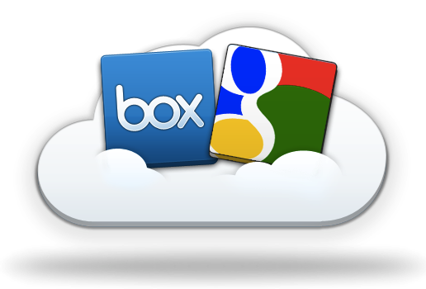
Cloud Computing
Shared infrastructure
[$$$] -----> [$|$|$]
Multi-Tenancy
Virtually dedicated resources
Drawbacks:
Data Locked-in
Collaborations can only be achieved through desktop.
E.g.: create/edit Word documents in Dropbox.
How to collaborate in the cloud?
Source: http://blog.box.com/2011/06/box-and-google-docs-accelerating-the-cloud-workforce/
Notes:
This kind of collaboration is not necessarily among parties. It could be among applications.
Subleasing an apartment for 2 rooms. A living room and a bedroom. Direct access in between.
E.g.: subleasing two rooms in an apartment.
One for storage, the other for living.
Direct accessible in between.

Slide 5
Motivation
C1. Charlie as a developer in OS has to access the source code stored in Dev.E to perform his out-sourcing job;
C2. Alice as an auditor in AF requires read-only access to financial reports stored in Acc.E; and
C3. Alice needs read-only accesses to Dev.E and Dev.OS in order to audit the out-sourcing project.

Slide 6
Industry Solutions
Microsoft and IBM: Fine-grained data sharing in SaaS using DB schema
Only feasible in DB
NASA: RBAC + OpenStack (Nebula)
Lacks ability to support multi-org collaborations
Salesforce (Force.com): Single Sign-On + SAML
Focus on authentication and simple authorization
Heavy management of certificates
Source: http://msdn.microsoft.com/en-us/library/aa479086.aspx
http://nebula.nasa.gov/blog/2010/06/03/nebulas-implementation-role-based-access-control-rbac/
http://wiki.developerforce.com/page/Single_Sign-On_with_SAML_on_Force.com
Notes:
Security Assertion Markup Language (SAML) provides a secure, XML-based solution for exchanging user security information between an identity provider (your company) and a service provider (Force.com).

Slide 7
OUTLINE
Introduction
A Family of Multi-Tenant RBAC (MT-RBAC) Models
MT-RBAC_{0,1,2}
Administrative MT-RBAC (AMT-RBAC) model
Constraints
Prototype Implementation and Evaluation
Related Work
Conclusion and Future Work

Slide 8
MT-RBAC

Slide 9
Trust Model
If B (resource owner) trusts A then A can assign
B’s permissions to A’s roles; and
B’s roles as junior roles to A’s roles.
CanUse(r_{B}) = {A, B, …}
Tenant A
Tenant B
If No trust
Resources
AuthStmts
Resources
AuthStmts
If B trust A
Resources
AuthStmts
Resources
AuthStmts
User
Notes:
Non-animation version

Slide 10
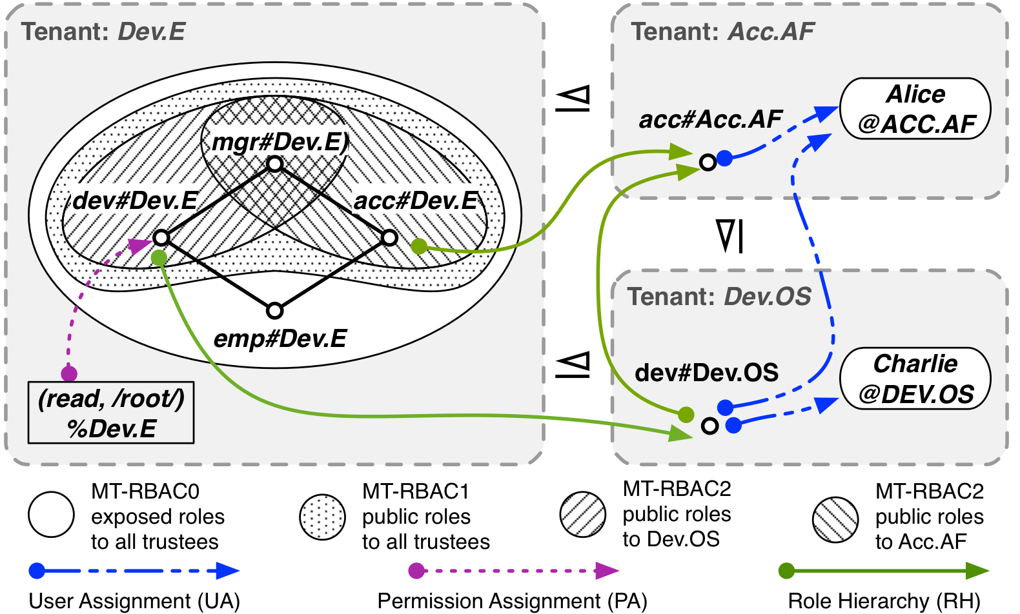
MT-RBAC_{0,1,2}

Slide 11
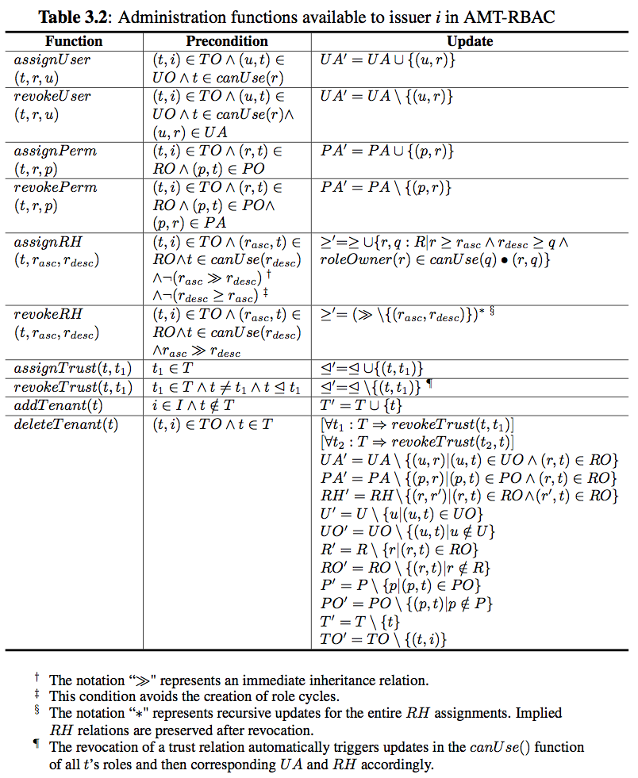
AMT-RBAC

Slide 12
AMT-RBAC (Contd.)

Slide 13
Constraints
Cyclic Role Hierarchy: lead to implicit role upgrades in the role hierarchy
SoD: conflict of duties
Tenant-level
E.g.: SOX compliance companies may not hire the same company for both consulting and auditing.
Role-level
across tenants
Chinese Wall: conflict of interests among tenants
E.g.: do not share infrastructure with competitors.
Tenant 1
Tenant 2
M1
M2
E1
E2

Slide 14
OUTLINE
Introduction
A Family of Multi-Tenant RBAC (MT-RBAC) Models
MT-RBAC_{0,1,2}
Administrative MT-RBAC (AMT-RBAC) model
Constraints
Prototype Implementation and Evaluation
Related Work
Conclusion and Future Work

Slide 15
Policy Specification of MT-RBAC₂
user = “Charlie”; permission = “(read, /root/)%Dev.E”
tr = “Dev.E”; te = “Dev.OS”

Slide 16
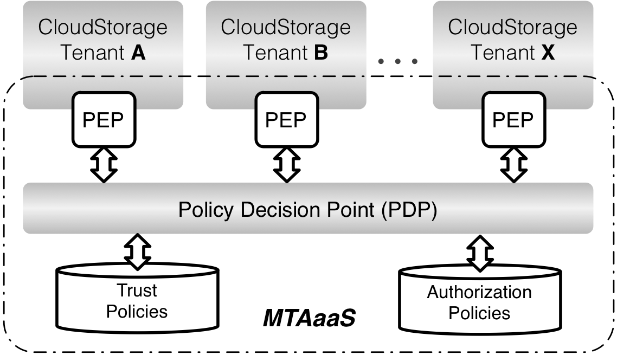
MTAaaS Platform Prototype
Experiment Settings
CloudStorage: an open source web based cloud storage and sharing system.
Joyent, FlexCloud
Authorization Service
Centralized PDP
Distributed PEP

Slide 17
Evaluation: Performance
MT-RBAC vs RBAC
More policy references incur more decision time
MT-RBAC₂ introduces 16 ms overhead on average.
PDP Performance
Client-End Performance

Slide 18
Evaluation: Scalability
Scalable by changing either
PDP capability; or
Number of PEPs.
PDP Scalability
PEP Scalability

Slide 19
OUTLINE
Introduction
A Family of Multi-Tenant RBAC (MT-RBAC) Models
MT-RBAC_{0,1,2}
Administrative MT-RBAC (AMT-RBAC) model
Constraints
Prototype Implementation and Evaluation
Related Work
Conclusion and Future Work

Slide 20
Characteristics of Cloud
Agility
Collaboration and collaborators are temporary
Centralized Facility
No need to use cryptographic certificates
Homogeneity
Same access control model in each tenant
Out-Sourcing Trust
Collaboration spirit
Notes:
This kind of collaboration is not necessarily among parties. It could be among applications.
Subleasing an apartment for 2 rooms. A living room and a bedroom. Direct access in between.
E.g.: subleasing two rooms in an apartment.
One for storage, the other for living.
Direct accessible in between.

Slide 21
Literature in Multi-org/dom
RBAC
CBAC, GB-RBAC, ROBAC (e.g.: player transfer in NBA)
Require central authority managing collaborations
Delegation Models
dRBAC and PBDM (e.g.: allowing subleasing)
Lacks agility (which the cloud requires)
Grids
CAS, VOMS, PERMIS
Absence of centralized facility and homogeneous architecture (which the cloud has)

Slide 22
Literature (Contd.)
Role-based Trust
RT, Traust, RMTN AND RAMARS_TM
Calero et al: towards a multi-tenant authorization system for cloud services
Implementation level PoC
Coarse-grained trust model
MTAS
Suits the cloud (out-sourcing trust)
Critical:
trust model

Slide 23
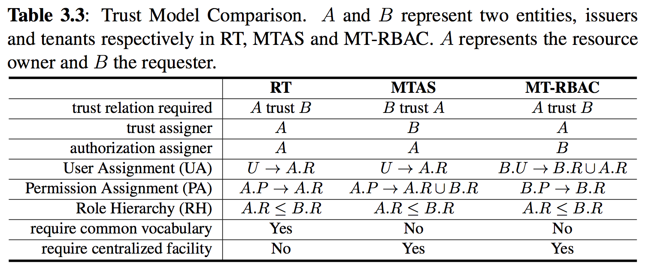
Role-Based Trust Model Comp.

Slide 24
OUTLINE
Introduction
A Family of Multi-Tenant RBAC (MT-RBAC) Models
MT-RBAC_{0,1,2}
Administrative MT-RBAC (AMT-RBAC) model
Constraints
Prototype Implementation and Evaluation
Related Work
Conclusion and Future Work

Slide 25
Conclusion
Collaboration needs among cloud services
MT-RBAC model family
Formalization
Administration
Constraints
MTAaaS architecture viable in the cloud
Overhead ≈ 16ms and scalable in the cloud
Comparison of role-based trust models

Slide 26
Future Work
Cross-tenant trust models in cloud computing
Other multi-tenant access control models
MT-ABAC
MT-RT
MT-PBAC and more.
Implementation MT-RBAC in OpenStack API.

Slide 27

Q & A

Slide 28
Thank You!

Slide 29








Multi-Tenant Authorization as a Service (MTAaaS)
User IDs
Resource Catalogs
Authz Policies
MTAaaS
Multi-Tenant
Access Control
Cross-Tenant
Access

