Slide 1
A Provenance-based Access Control Model for Dynamic Separation of Duties
Institute for Cyber Security
July 10, 2013
PST 2013
Dang Nguyen, Jaehong Park, and Ravi Sandhu
Institute for Cyber Security
University of Texas at San Antonio

Slide 2
Separation of Duties (SoD)
Duties
The responsibilities required for accomplishing a certain task
Example: washing dishes, flying airplane, saving the world, etc.
Responsibilities are assigned to people (or users)
Conflicting Duties
Too many responsibilities = corrupted power
Example: “One Ring to rule them all”
Essentially an Access Control Problem
Who can have which responsibility?

Slide 3
RBAC Approach for SoD
Roles as semantic constructs
Various responsibilities can be encapsulated within a specific role.
Example: Professor is responsible for assigning and grading homework.
Responsibilities are mapped to roles, which are then assigned to users.
Conflicting Roles
Two main approaches: Static and Dynamic.

Slide 4
Static Separation of Duties
Mainly deals with role assignment
No two conflicting roles can be assigned to the same user.
Example: A user should not be assigned both police and thief roles.
Narrow scope
Unable to address SoD concerns in dynamic environment.

Slide 5
Dynamic Separation of Duties
Utilizes the Role Activation concept
Two conflicting roles can be assigned to the same user, just not activated at the same time (or under other constraints)..
Variations of DSOD
Expressing different concerns.
Each concern features unique characteristic.

Slide 6
DSOD Variations + Features
Features | Simple DSOD | Obj- DSOD | Ops- DSOD | HDSOD | TCE
Per Role | √ | √ | √ | √ | √
Per Action |  | √ | √ | √ | √
Per Object |  | √ |  | √ | √
Task-aware |  |  | √ | √ | √
Order-aware |  |  |  | √ | √
Weighted Action-aware |  |  |  |  | √

Slide 7
DSOD Examples
Scenario: Homework Grading System
Students can upload/replace/submit a homework to the system.
Once it is submitted, the homework can be reviewed by other students or designated graders until it is graded by the teaching assistant (TA).
The Professor holds the highest authority.
Variations of DSOD constraints:
Cannot activate roles Reviewer and Student at the same time – Simple DSOD
Can activate roles Reviewer and Student, but cannot review the homework submitted – Object-based DSOD
Cannot activate roles TA and Student, if permitted actions cover Professor’s – Operational DSOD
Cannot grade a homework before it is submitted – History-based DSOD
Cannot grade a homework unless reviews’ combined weights exceeds 3 – TCE

Slide 8
PBAC Approach to DSOD

Slide 9
PBAC Approach to DSOD
Naturally provide history information
Existing approaches assume ready availability for usages.
Expressive control unit (dependency names)
Facilitate policy specification and convenient enforcement.
Enables new DSOD concerns
Capable of capturing more interesting behavior from system events.
Easily incorporated with other AC mechanisms
RBAC and more

Slide 10
DSOD Variations + Features
Features | Simple DSOD | Obj- DSOD | Ops- DSOD | HDSOD | TCE | DSOD in PBAC
Per Role | √ | √ | √ | √ | √ | √
Per Action |  | √ | √ | √ | √ | √
Per Object |  | √ |  | √ | √ | √
Task-aware |  |  |  | √ | √ | √
Order-aware |  |  | √ | √ | √ | √
Weighted Action-aware |  |  |  |  | √ | √

Slide 11
DSOD Variations + Features
Features | Simple DSOD | Obj- DSOD | Ops- DSOD | HDSOD | TCE | DSOD in PBAC
Per Role | √ | √ | √ | √ | √ | √
Per Action |  | √ | √ | √ | √ | √
Per Object |  | √ |  | √ | √ | √
Task-aware |  |  |  | √ | √ | √
Order-aware |  |  | √ | √ | √ | √
Weighted Action-aware |  |  |  |  | √ | √
Dependency Path Patterns- aware |  |  |  |  |  | √

Slide 12
DSOD Variations + Features
Features | Simple DSOD | Obj- DSOD | Ops- DSOD | HDSOD | TCE | DSOD in PBAC
Per Role | √ | √ | √ | √ | √ | √
Per Action |  | √ | √ | √ | √ | √
Per Object |  | √ |  | √ | √ | √
Task-aware |  |  |  | √ | √ | √
Order-aware |  |  | √ | √ | √ | √
Weighted Action-aware |  |  |  |  | √ | √
Dependency Path Patterns- aware |  |  |  |  |  | √
Past Attribute-aware |  |  |  |  |  | √
Notes:
Other DSOD works assume necessary information is available to the system.

Slide 13
Provenance Data
Information of operations/transactions performed against data objects and versions
Actions that were performed against data
Acting Users/Subjects who performed actions on data
Data Objects used for actions
Data Objects generated from actions
Additional Contextual Information of the above entities
Directed Acyclic Graph (DAG)
Causality dependencies between entities (acting users / subjects, action processes and data objects)
Dependency graph can be traced for the discovery of Origin, usage, versioning info, etc.
Notes:
For title page,
Contribution of this paper includes proposing a base pbac model.
Another contribution can be found in a broader scope: common foundation for access control in prov-aware systems.
================
PBAC can support origin/usage-based control, Dynamic Separation of Duty (DSOD), workflow control, etc.

Slide 14
Provenance-aware Systems
Capturing provenance data
Storing provenance data
Querying provenance data
Using provenance data
Securing provenance data
Provenance Data Model
Access Control
Notes:
Analyzing provenance data
Pbac is not as extensible as abac. However,
What is pbac’s policy configuration point?
ABAC is application independent.
To put meaning on attribute you need application

Slide 15
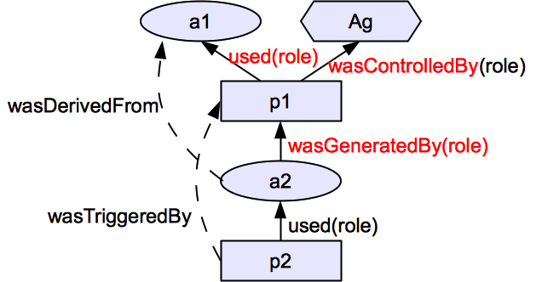
From Open Provenance Model (OPM)
3 Node Types
Object (Artifact)
Action (Process)
User/Subject (Agent)
5 Causality dependency edge Types (not a dataflow)
Provenance data: a set of 2 entities & 1 dependency
E.g., (ag,p1,a1,a2): <p1,ag,c>,<p1,a1,u>,<a2,p1,g>
Notes:
Our model is different since we allow indirect dependency from a2 to ag.

Slide 16
OPM Example
100g Sugar
100g
Flour
100g
Butter
Two
Eggs
John
used
wasControlledBy
Bake
wasGeneratedBy
wasDerivedFrom
Cake

Slide 17
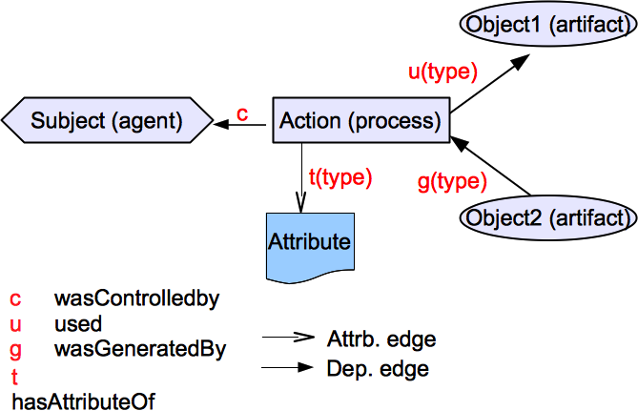
Provenance Data Model

Slide 18
Capturing Provenance Data
(Subject1, Grade1, HW1, GradedHW1, ContextualInfoSet-Grade1)
(Grade1, u, HW1)
(Grade1, c, Subject1)
(GradedHW1, g, Grade1)
(Grade1, t[actingUser], Alice)
(Grade1, t[activeRole], TA)
(Grade1, t[weight], 2)
(Grade1, t[object-size], 10MB)

Slide 19
Provenance Graph
Sub1
c
HW1
u
Grade1
g
HW1_G
t(actUser)
t(…)
t(…)
t(…)
Alice
TA
2
10MB

Slide 20
Storing and Querying Provenance Data
Resource Description Framework (RDF) provides natural representation of triples.
RDF-format triples can be stored in databases.
Utilizes SPARQL Protocol and RDF Query Language for extracting useful provenance information.
Starting Node: any entities (not attribute nodes)
A matching path pattern: combination of dependency edges

Slide 21
Provenance Graph
Sub1
c
HW1
u
Grade1
g
HW1_G
t(actUser)
t(…)
t(…)
t(…)
Alice
TA
2
10MB

Slide 22
Provenance Graph
Sub1
c
SELECT ?agent WHERE { HW1_G [g:c] ?agent}
HW1
u
Grade1
g
HW1_G
t(actUser)
t(…)
t(…)
t(…)
Alice
TA
2
10MB

Slide 23
Provenance Graph
Sub1
c
SELECT ?user WHERE { HW1_G [g:t[actUser]] ?user}
HW1
u
Grade1
g
HW1-G
t(actUser)
t(…)
t(…)
t(…)
Alice
TA
2
10MB

Slide 24
Provenance Graph
Sub1
Sub2
c
c
HW1
u
Grade1
g
HW1_G
u
Grade2
g
HW1_G’
t(actUser)
t(…)
t(…)
t(…)
Alice
TA
2
10MB

Slide 25
Provenance Graph
Sub1
Sub2
c
c
HW1
u
Grade1
g
HW1_G
u
Grade2
g
HW1_G’
t(actUser)
t(…)
t(…)
t(…)
SELECT ?user
WHERE
{ HW1_G’ [g:u:g:c] ?user}
Alice
TA
2
10MB
{ HW1_G’ [[g:u]*:g:c] ?user}

Slide 26
Provenance-aware Systems
Using provenance data
Securing provenance data
PBAC
PAC
Notes:
Analyzing provenance data
Pbac is not as extensible as abac. However,
What is pbac’s policy configuration point?
ABAC is application independent.
To put meaning on attribute you need application

Slide 27
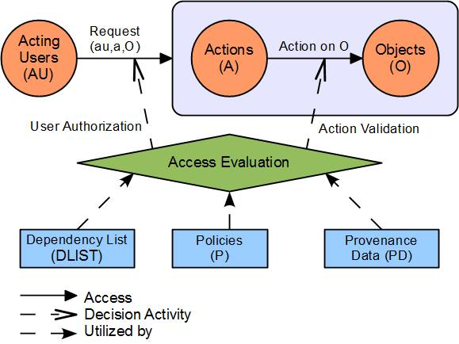
PBAC Model Components
Notes:
Direct dependency as a result of transaction is captured in base provenance data.
System computable dependency instances are derived based on PDB and object DL.
User declares dependency instances using dependency names found in DL.

Slide 28
Dependency List
Object Dependency List (DL_{O}): A set of identified dependencies that consists of pairs of
Dependency Name: abstracted dependency names (DNAME) and
regular expression-based object dependency path pattern (DPATH)
System-computable (complex) dependency instances
using pre-defined dependency names and matching dependency path patterns in DL (and querying base provenance data)
User-declared (complex) dependency instances
using pre-defined dependency names in DL
Examples
< wasSubmittedVof, g_{submit}.u_{input} >
< wasAuthoredBy, wasSubmittedVof?.wasReplacedVof ∗.g_{upload}.c >

Slide 29
PBAC_{B}: A Base Model
System-captured Base Provenance Data only
Using sub-types of 3 direct dependencies (u, g, c)
No user-declared provenance data
Object dependency only
Supports Simple and effective policy specification and access control management
Supports DSOD, workflow control, origin-based control, usage-based control, object versioning, etc.

Slide 30
Limitations of PBAC_{B}
Simplified data model
Does not capture contextual information
Unable to address advanced DSOD
Access evaluation restrained to User Verification and Action Validation
PBAC_{C}: extending the base model

Slide 31
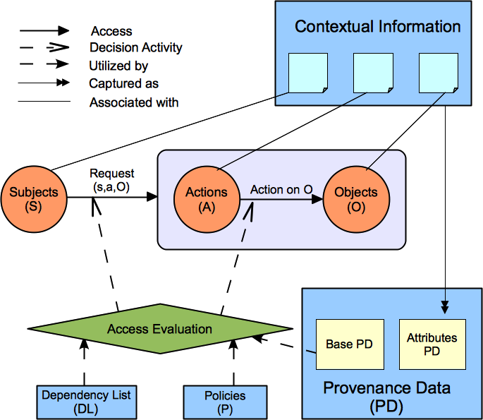
PBAC_{C} : PBAC_{B} + Contextual Info.

Slide 32
Provenance Data Model

Slide 33
Provenance Data Model
A new type of entity, Attribute, to capture all contextual information.
A new type of edge (can be considered dependency), t, that connects an entity and the associated attribute.
Notice all attribute types (regardless of association) is concentrated in Action entities.
Action instances define system events.

Slide 34
PBAC_{C} : PBAC_{B} + Contextual Info.
Introduce Subject entities
Incorporate contextual information associated with the main entities (Users, Subjects, etc.)
Enable more variations of dependency
Access evaluation now utilizes attributes
Enable enhanced traditional and new features of DSOD
More flexible policy specification (startNode = (S, A, or O))

Slide 35
Enhanced DSOD Features
Awareness of Past-Action attribute.
Context information of action varies in different states in time
Past context information may potentially be significant for current state
Example: policy can specify decision rules based on either past or current assigned weight to action types
Dependency Path Pattern-based DSOD.
More expressive control units
Can achieve wide variety of path patterns
Combinations of actions, versioning, etc.

Slide 36
Policies
An informal policy language is used to specify access decision rules based on dependency name control units
Example ObjDSOD:
English Policy: requires the requesting subject on replacing a homework object to be activated by the same acting user who activated the subject on uploading it.
Informal Policy:
allow(sub,replace,o) => (sub,hasPerformedActions:hasAttributeOf(actingUser)) ϵ (o,wasUploadedBy) and count(o,wasSubmittedVof) = 0.
Smooth conversion to XACML policy language
Can be easily enforced
A proof-of-concept prototype is implemented

Slide 37
Sample XACML policy
<Policy PolicyId="replacePolicy"
RuleCombiningAlgId="urn:oasis:names:tc:xacml:1.0:rulecombining-
algorithm:ordered-permit-overrides">
<Target>
...
<Actions>
<Action>
<ActionMatch MatchId="urn:oasis:names:tc:xacml:1.0 :function:string-equal">
<AttributeValue DataType="http://www.w3.org/2001/XMLSchema#string">replace</AttributeValue>
<ActionAttributeDesignator AttributeId="urn:oasis:names:tc:xacml:1.0:action:action-id“ DataType="http://www.w3.org/2001/XMLSchema#string" />
</ActionMatch>
</Action>
</Actions>

Slide 38
Sample XACML policy
…
<Rule RuleId="ReplaceRule" Effect="Permit">
<Condition FunctionId="urn:oasis:names:tc:xacml:1.0:function:and">
<Apply FunctionId="urn:oasis:names:tc:xacml:1.0:function:string-is-in">
<Apply FunctionId="provenance-query-SPARQL">
<Apply FunctionId="urn:oasis:names:tc:xacml:1.0:function:string-one-and-only">
<SubjectAttributeDesignator AttributeId=“urn:oasis:names:tc:xacml:1.0:subject:subject-id”DataType="http://www.w3.org/2001/XMLSchema#string" /></Apply>
<AttributeValue DataType="http://www.w3.org/2001/XMLSchema#string">hasPerformedActions:hasAttributeOf(actingUser)
</AttributeValue>
</Apply>
<Apply FunctionId="provenance-query-SPARQL">
<Apply FunctionId="urn:oasis:names:tc:xacml:1.0:function:string-one-and-only">
<ResourceAttributeDesignator AttributeId="urn:oasis:names:tc:xacml:1.0:resource:resourceid” DataType="http://www.w3.org/2001/XMLSchema#string" />
</Apply>
<AttributeValue DataType="http://www.w3.org/2001/XMLSchema#string">wasUploadedBy</AttributeValue>
</Apply>
</Apply>
…

Slide 39
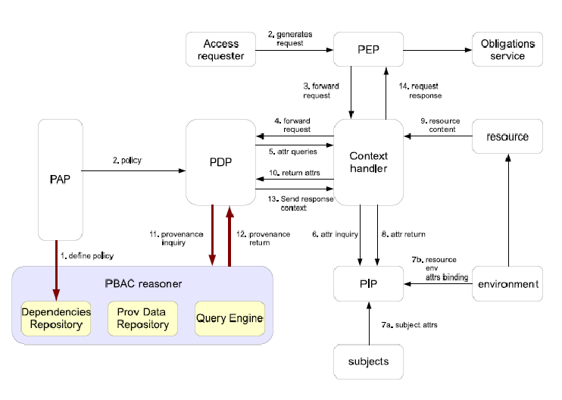
Extended XACML Architecture

Slide 40
PBAC Reasoner Implementation
Dependency Repository
Provenance Data Repository
Query Engine
Extend OASIS XACML
Utilize top-of-the-shelf toolkits
MySQL
Jena
ARQ

Slide 41
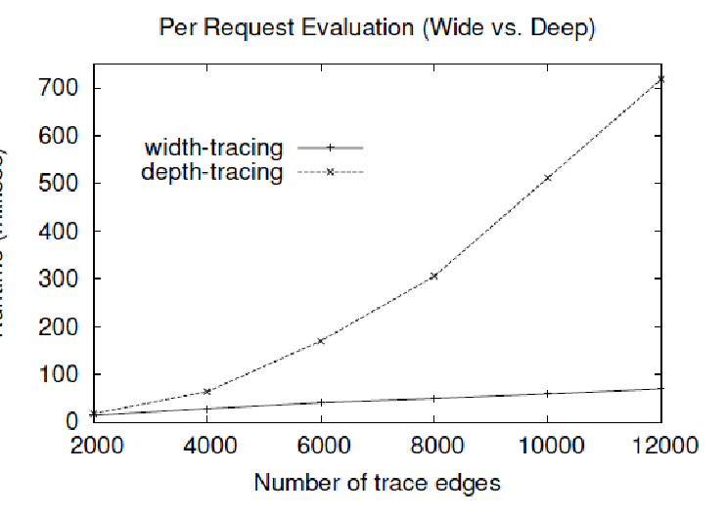
Experiment and Performance
System
Ubuntu 12.10 image with 4GB Memory and 2.5 GHz quad-core CPU running on a Joyent SmartData center (ICS Private Cloud).
Mock Data simulating HGS scenario
Different shapes of provenance graph
Extreme depth and width settings
Results for tracing 2k/12k edges
0.017/0.718 second per deep request
0.014/0.069 second per wide request

Slide 42
Throughput Evaluation
Results for tracing 2k/12k edges
0.0096/0.154 second per deep request
0.035/0.04 second per wide request
FEASIBLE !!!

Slide 43
Conclusion
Propose a PBAC approach for traditional and enhanced DSOD variations
Extend the base PBAC model to capture contextual information
Proof-of-concept prototype on XACML architecture extension
An access control foundation for secure provenance computing!

Slide 44
Thank you!!!
Questions and Comments?

