Slide 1


Institute for Cyber Security
Multi-Layer Authorization Framework for a Representative Hadoop Ecosystem Deployment
Maanak Gupta, Farhan Patwa, James Benson, and Ravi Sandhu
Institute for Cyber Security and Department of Computer Science
University of Texas at San Antonio
22nd ACM Symposium on Access Control Models and Technologies (SACMAT)
June 21-23, 2017, Indianapolis, IN, USA

Slide 2
Agenda
Introduction and Motivation
Multi-layer Access Control
Hadoop Ecosystem Authorization Architecture
Access Control Mechanisms and Policy Configuration Points
Conclusion

Slide 3
Big Data and Big Challenges
IDC 2025 :
  global “datasphere” – 163 zettabytes
  10x than 2016
Opportunities: 21st century gold for data miners
Big Data require “Big Systems”
Security:
Secure Storage
Privacy Concerns (e.g. HIPPA)
Fine granular access requirements

Slide 4
Hadoop Ecosystem
Hadoop: resilient, cost efficient distributed storage (HDFS) and processing framework (MapReduce) and YARN
Ecosystem = Hadoop core +
Open-Source Projects
Hadoop Data Lake
Security Concerns

Slide 5
Multi-Layer Access Control
Data and Service Objects
Services
Cluster Resources and Applications
HDFS NameNode,
YARN ResourceManager
Apache Hive
HDFS Files,
Hive Tables
Kafka Topics
YARN Queues,
Cluster Nodes

Slide 6
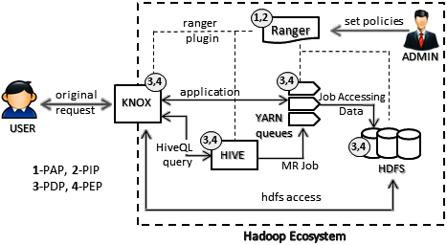
Hadoop Ecosystem
Authorization Architecture

Slide 7
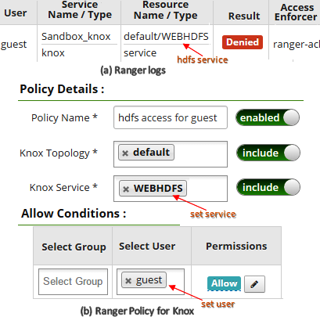
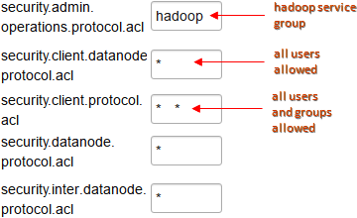
Hadoop and Data Services Access
Hadoop Daemons Access Configuration
WebHDFS Access via Apache Knox

Slide 8
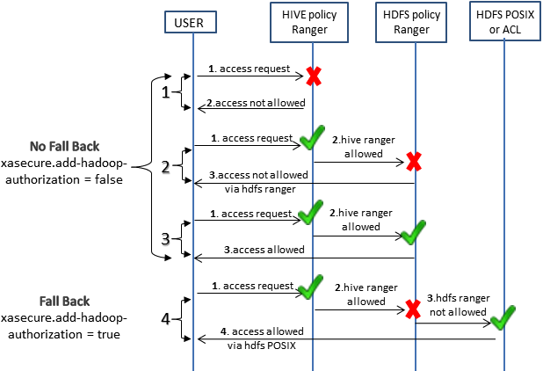
Data Objects Access
Hive and HDFS Access Configurations

Slide 9
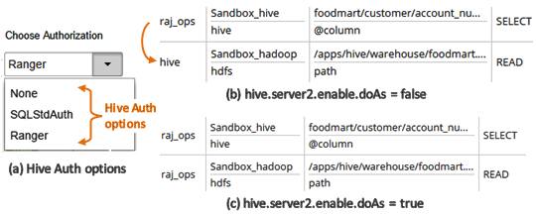
Data Objects Access
Authorization Options and End User Impersonation

Slide 10
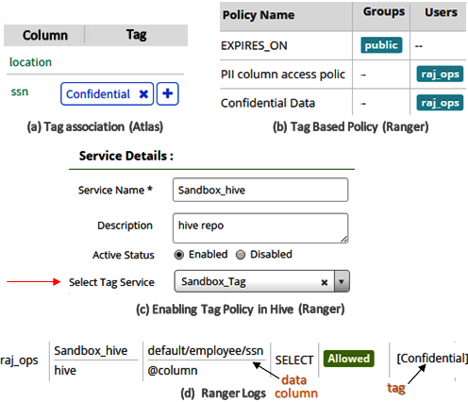
Data Objects Access
Tag Based Policy Configuration

Slide 11
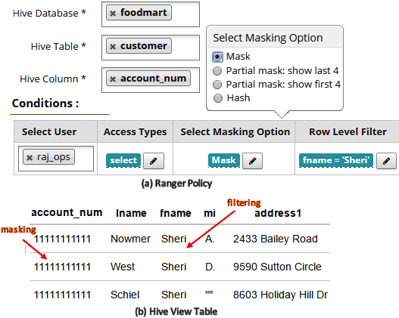
Data Objects Access
Data Masking and Column Filtering

Slide 12
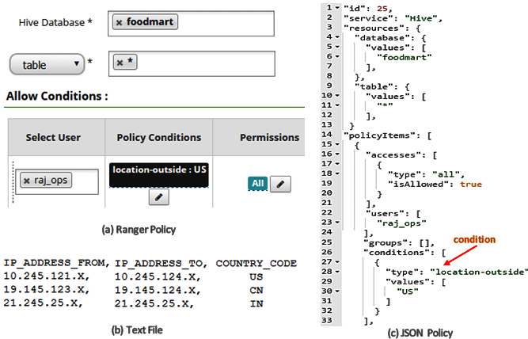
Context Enricher and Policy Conditions
Geo Location Based Policies

Slide 13
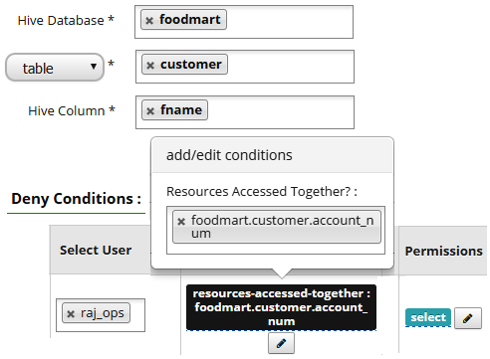
Context Enricher and Policy Conditions
Data Combination Prohibition

Slide 14
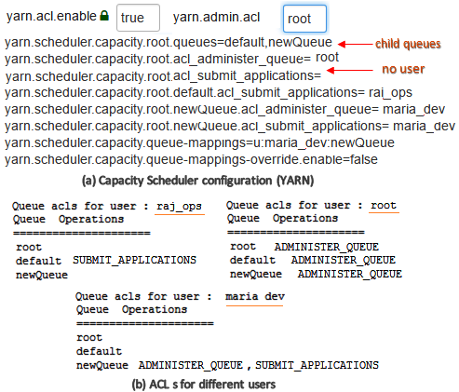
Cluster Resource and Application Access
root
root
access rights
default
newQueue
YARN Queue Access Control Configuration

Slide 15
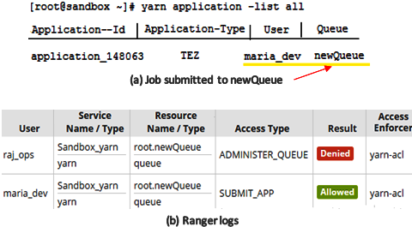
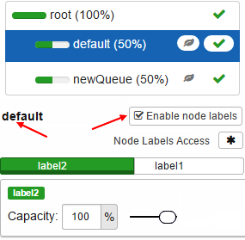
Cluster Resource and Application Access
Queue and Job Level Access Control
Cluster Nodes Configuration

Slide 16
Conclusion
Secure Hadoop Ecosystem
‘Defense in Depth’
Data and Service Objects
Hadoop And Services
Cluster Resource and Application

