Slide 1



IoT Passport: A Blockchain-Based Trust Framework for Collaborative Internet-of-Things
Bo Tang, Hongjuan Kang, Jingwen Fan
Information Security Laboratory,
Sichuan Changhong Electric Co., Ltd.
{bo.tang, hongjiuan.kang, jingwen.fan} @changhong.com
Qi Li
Institute for Network Sciences and Cyberspace, Tsinghua University BNRist, Tsinghua University qli01@tsinghua.edu.cn
Ravi Sandhu
Institute for Cyber Security and Department of Computer Science, University of Texas at San Antonio ravi.sandhu@utsa.edu
Blue Sky/Vision Track @ SACMAT`19
June 4, 2019

Slide 2

More “Things” than Human
Passed a single connected object per person in 2008 and projected to 26 smart objects per human by 2020*.
What will be the foreseeable outcome?
  AI helps us control objects in the background
  Multi-factor User Interface with sensors
  Collaborative IoT: things talk to each other
* S. Elbouanani, M. El Kiram, and O. Achbarou. 2015. Introduction to the Internet of Things security: Standardization and research challenges. In 2015 11th International Conference on Information Assurance and Security. IEEE, 32–37.

Slide 3
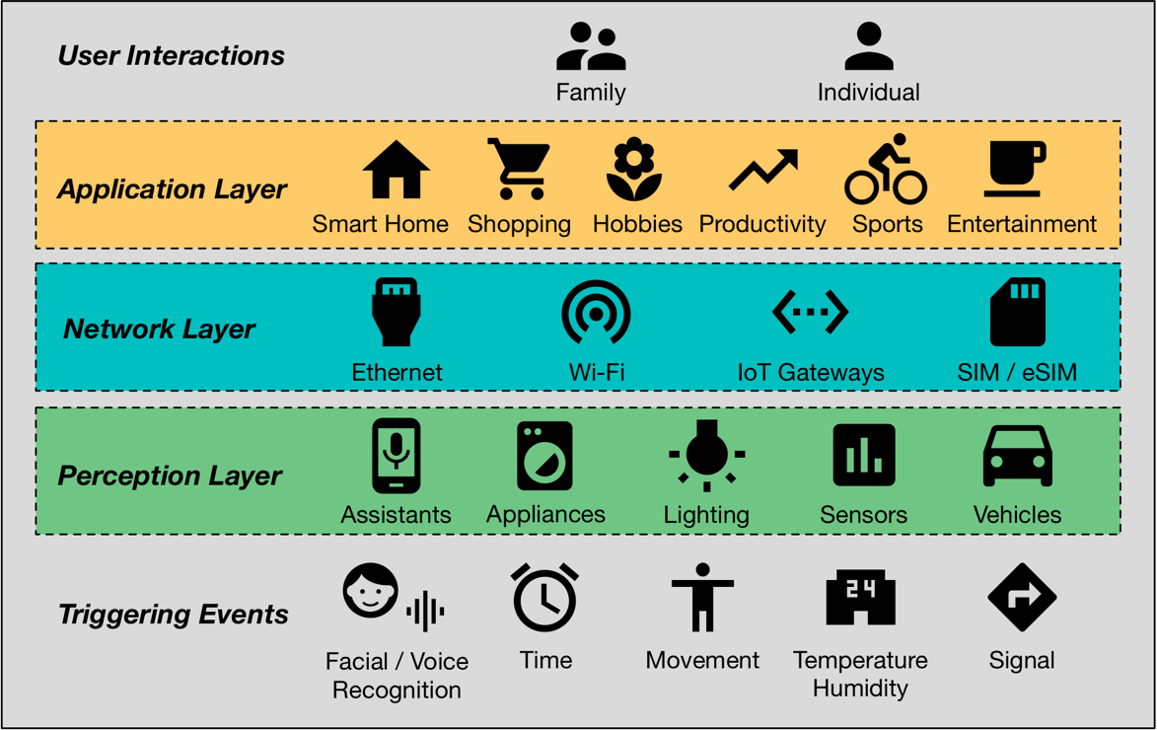
Smart Life
Ubiquitous physical infrastructure with sensors and actuators
Everything Connected
Lifestyle with smart things towards better life

Slide 4
User Scenarios
S1. On the way home, Alice converses with the AI assistant on her smart phone to check her food inventory. The smart refrigerator responds with a list and suggestions on grocery shopping. Moreover, the AI assistant provides a one-click option for same-day delivery.
S2. The facial detectors at Alice’s authenticate her on arrival and further detect her mood as currently blue, so yellow lights will turn on and soft sound tracks from her favorites will play.

Slide 5
Inevitable Cross-Platform Collaboration
Fragmented user needs inevitably lead to diverse brands and models of devices along time.
Collaboration costs multiply with scenarios for on-device solutions but hardware capabilities are limited.

Slide 6
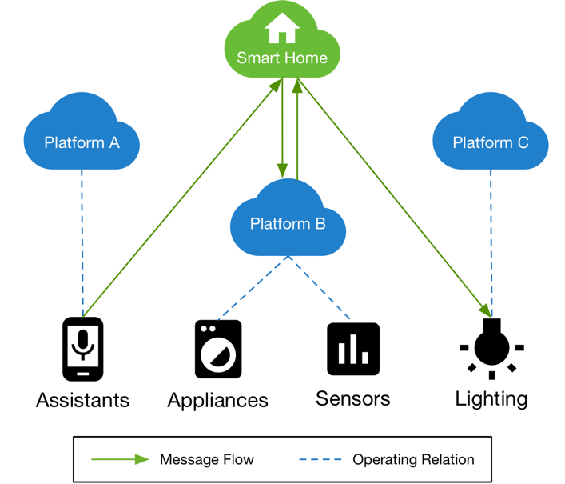
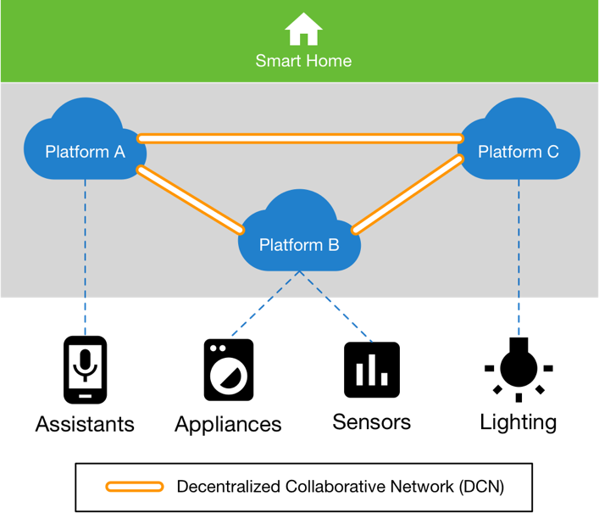
Centralized vs Decentralized
(a) Centralized solution: a single application manages collaboration among the participating devices and platforms
(b) Decentralized solution: a distributed application manages collaborative commands over the DCN

Slide 7
Goals
Key objectives
  Agreements between Platforms
  Security and Privacy
  Efficiency and Scalability
  Sustainable Ecosystem
Security Requirements
  Decentralized Trust Framework
  Access Control and Data Security
  Hierarchical Synchronization
  Incentive Policies

Slide 8
Federated Trust Requirements
across platforms
  Compatible with business needs and doubts
  Transparency in data governance policy enforcement
  Proper authority with managed devices (device citizenship)
  User privacy concern properly addressed and enforced
across devices
  Federated authentication mechanisms
  Authorization decisions are made in decentralized fashion

Slide 9
Related Works
Centralized authentication and authorization for IoT
  N. Ye et al. 2014. An efficient authentication and access control scheme for perception layer of internet of things. Appl. Math. & Info. Sci. 8, 4 (2014), 1–8.
  Maanak Gupta and Ravi Sandhu. 2018. Authorization Framework for Secure Cloud Assisted Connected Cars and Vehicular Internet of Things. In 23rd ACM on Symposium on Access Control Models and Technologies. ACM, 193–204.
Measurement-based trust models
  Audun Jøsang. 2001. A logic for uncertain probabilities. International Journal of Uncertainty, Fuzziness and Knowledge-Based Systems 9, 03 (2001), 279–311.
  Y. Ruan, A. Durresi, and L. Alfantoukh. 2016. Trust management framework for internet of things. In IEEE Conf. on Advanced Info. Nw. and Apps. 1013–1019.
Distributed access control using blockchain
  Jollen Chen. 2018. Hybrid blockchain and pseudonymous authentication for secure and trusted IoT networks. ACM SIGBED Review 15, 5 (2018), 22–28.
Attribute-Based Access Control
  Ravi Sandhu. 2012. The authorization leap from rights to attributes: maturation or chaos?. In 17th ACM SACMAT. ACM, 69–70.
  S. Sciancalepore et al. 2016. Attribute-based access control scheme in federated IoT platforms. In Wkshp. on Interoperability and Open-Source Solutions. 123–138.

Slide 10
Design Overview
Blockchain-Based Trust Framework (BBTF) in layers

Slide 11
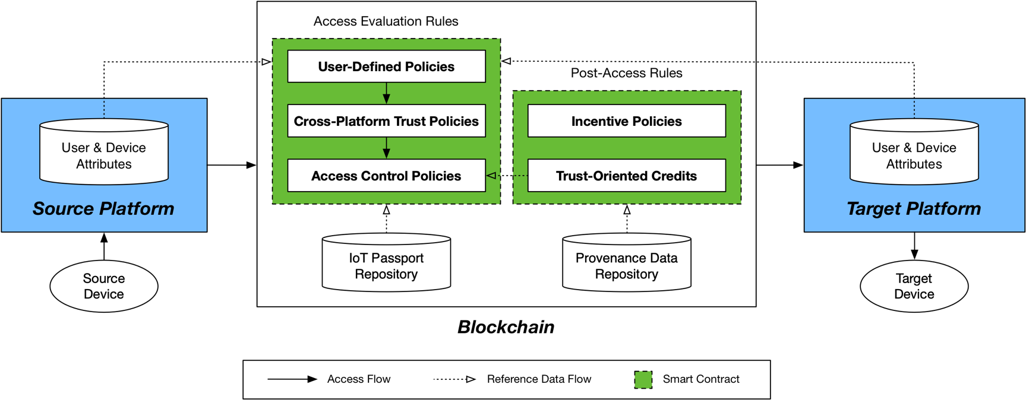
IoT Passport

Slide 12
Hierarchical Trust Domains
CAP Theorem selection: SC
  Scalability
  Consistency
  Loose Decentralization on the Edge

Slide 13
Blockchain-Based Access Control
Attribute-Based Access Control
  Take subject attributes, object attributes and environment conditions into access evaluation
  Blockchain guarantees the integrity, availability and non-repudiation of attributes
  Attributes retrievable from blockchain and participating platforms
Provenance-Based Access Control
  Use provenance data as attributes
  Persistent storage and proper sharing of the provenance data on blockchain

Slide 14
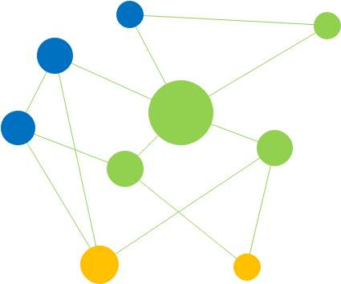
Incentive Policies
Service-based
  Service provider rewarded by consumer
Capability-based
  Capability provider rewarded by consumer
Ecosystem-based
  Public rankings of collaboration

Slide 15
Proposed Security Focused Research Agenda
Context-aware access control for IoT
Cross-platform trust models
On-blockchain policy administration and verification
Data on the Edge

Slide 16
Summary
With the booming Internet of Things, cross-platform collaboration becomes inevitable
Centralized solutions have limitations turning to decentralization
Decentralized trust framework using blockchain
IoT Passport
  Hierarchical trust domains for better scalability and efficiency
  Blockchain-based access control better enforcement with attributes
  Incentive policies establish sustainable ecosystem
Proposed security focused research agenda

