Slide 1

BlueSky: Activity Control: A Vision for "Active" Security Models for Smart Collaborative Systems
Tanjila Mawla
Department of Computer Science
Tennessee Tech University
Maanak Gupta
Department of Computer Science
Tennessee Tech University
Ravi Sandhu
Institute for Cyber Security (ICS) and NSF C-SPECC Center,
University of Texas at San Antonio
ACM Symposium on Access Control Models and Technologies
June 8 - 10th, 2022

Slide 2
Activity-Centric Access Control
The notion of Activity
Authorization (A)
Obligations (B)
Conditions (C)
Dependencies among Activities (D)

Slide 3
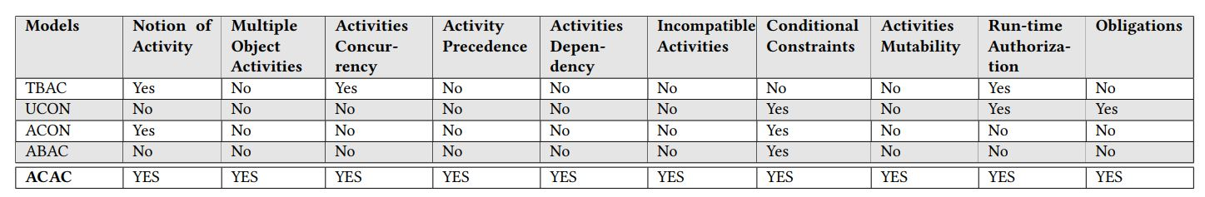
Comparison Overview of Features Proposed in ACAC Model
Table 1: Comparison Overview of Features Proposed in ACAC Model with other related models.

Slide 4
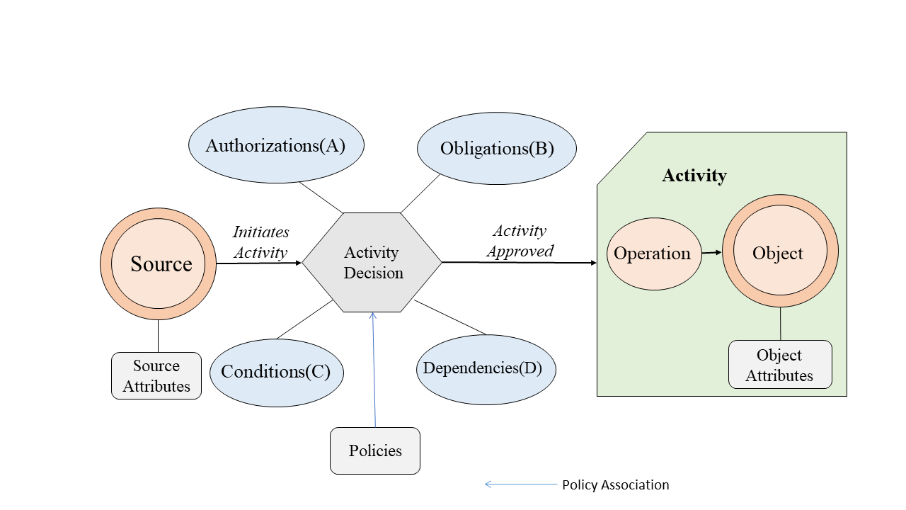
FOUNDATIONS OF ACTIVITY-CENTRIC MODEL FOR COLLABORATIVE ECOSYSTEM
Figure 1: ACAC Model Components.

Slide 5
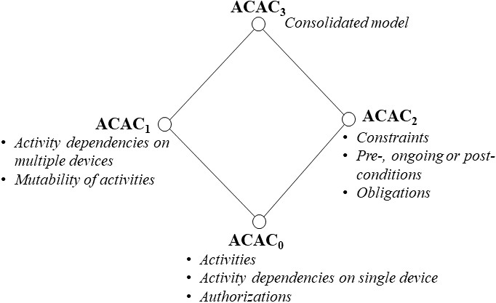
FOUNDATIONS OF ACTIVITY-CENTRIC MODEL FOR COLLABORATIVE ECOSYSTEM (Cont.)
Figure 2: A Framework for a Hierarchy of ACAC models

Slide 6
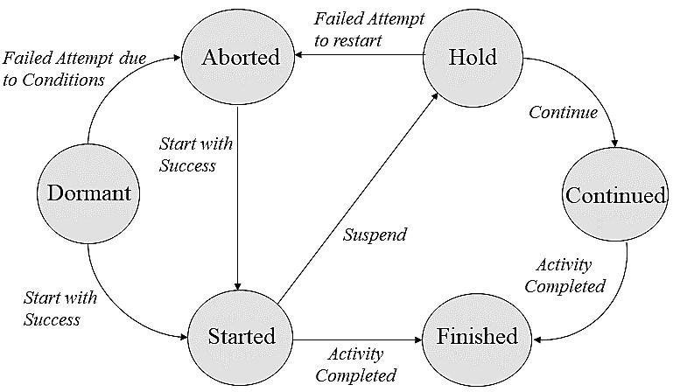
FOUNDATIONS OF ACTIVITY-CENTRIC MODEL FOR COLLABORATIVE ECOSYSTEM (Cont.)
Figure 3: States of an Activity

Slide 7
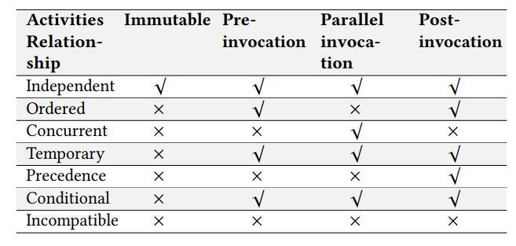
FOUNDATIONS OF ACTIVITY-CENTRIC MODEL FOR COLLABORATIVE ECOSYSTEM (Cont.)
Table 2: Mutability of Dependent Activities in terms of the
invocation time related to a requested activity. √ and × respectively denote the presence (mandatory or optional) and
absence of the corresponding field to support the relationships in the first column

Slide 8
ACAC and Zero-Trust
All data sources and computing services are considered resources.
All communication is secured regardless of network location.
Access to individual enterprise resources is granted on a per-session basis.
Access to resources is determined by dynamic policy —including the observable state of client identity, application/service, and the requesting asset—and may include other behavioral and environmental attributes.
The enterprise collects as much information as possible about the current state of assets, network infrastructure and communications and uses it to improve its security posture

Slide 9
Future Research Agenda
Operational and administrative formal model.
Policy language and enforcement architecture.
Risk adaptive ACAC incorporating zero-trust tenets.
Self-adaptive and AI-driven ACAC Deployment

Slide 10
Selected References
Thomas, R.K. and Sandhu, R.S., 1998. Task-based authorization controls (TBAC): A family of models for active and enterprise-oriented authorization management. In Database security XI (pp. 166-181). Springer, Boston, MA.
Park, J. and Sandhu, R., 2004. The UCONABC usage control model. ACM transactions on information and system security (TISSEC), 7(1), pp.128-174.
Park, J., Sandhu, R. and Cheng, Y., 2011, August. Acon: Activity-centric access control for social computing. In 2011 Sixth International Conference on Availability, Reliability and Security (pp. 242-247). IEEE.
Jin, X., Krishnan, R. and Sandhu, R., 2012, July. A unified attribute-based access control model covering DAC, MAC and RBAC. In IFIP Annual Conference on Data and Applications Security and Privacy (pp. 41-55). Springer, Berlin, Heidelberg.
Gupta, M. and Sandhu, R., 2021, June. Towards activity-centric access control for smart collaborative ecosystems. In Proceedings of the 26th ACM Symposium on Access Control Models and Technologies (pp. 155-164).
Rose, S., Borchert, O., Mitchell, S. and Connelly, S., 2020. Zero trust architecture (No. NIST Special Publication (SP) 800-207). National Institute of Standards and Technology.

Slide 11
Thank You!
Questions?

