Slide 1
BlueSky: Towards Convergence of Zero Trust Principles and Score-Based Authorization for IoT Enabled Smart Systems
Safwa Ameer
Institute for Cyber Security (ICS) Center for Security and Privacy Enhanced Cloud Computing (C-SPECC) Department of Computer Science University of Texas at San Antonio
Maanak Gupta Department of Computer Science Tennessee Tech University
Ravi Sandhu
Institute for Cyber Security (ICS) Center for Security and Privacy Enhanced Cloud Computing (C-SPECC) Department of Computer Science University of Texas at San Antonio
Smriti Bhatt Department of Computer Science Purdue University
ACM Symposium on Access Control Models and Technologies
June 8-10th, 2022
safwa.ameer@utsa.edu

Slide 2
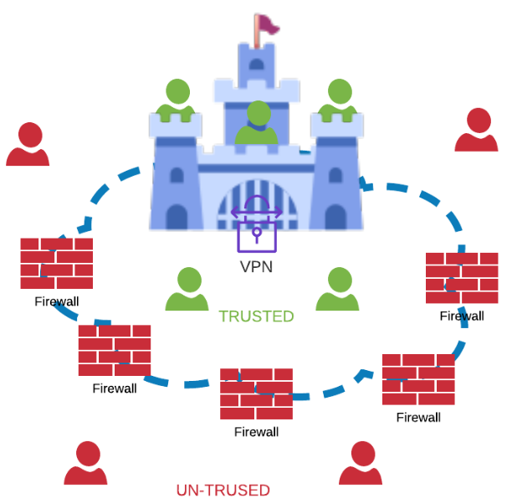

Traditional Security
The traditional approach to securing an enterprise’s infrastructure is to use network perimeter-based protection (known as the castle and moat approach).
The corporate firewall becomes the moat that encircles and protects the network castle and anyone inside is trusted while the rest of the world is untrusted.
The inherent weakness in this approach is the de facto classification of inside devices and users as trusted.
This problem is further aggravated by the growing adoption of SaaS/IaaS cloud services, more remote users, and bring your own device (BYOD) policies.
This complexity has outstripped legacy methods of perimeter-based network security as there is no single, easily identified perimeter for the enterprise.
This complexity has led to the development of a new model for cybersecurity known as “zero trust” (ZT) [1].

Slide 3
Zero Trust Basic Idea
Zero trust (ZT) is the term for an evolving set of cybersecurity paradigms that move defenses from static, network-based perimeters to focus on users, assets, and resources.
It assumes no implicit trust is granted to assets or user accounts based solely on their physical or network location.

Slide 4
Our Contribution
In This Paper:
We highlight the importance of considering ZT concepts when designing, enforcing, and implementing authorization models.
We propose the ZT authorization requirements framework (ZT-ARF).
We motivates the need to implement ZT principles when developing access control models for smart IoT systems.
We analyze access control requirements in IoT systems and accordingly specify which requirements components from our proposed ZT-ARF we need to include when designing an authorization model for integrated ZT IoT systems.
We propose our novel framework for ZT score-based authorization (ZT-SAF).
We highlight future research directions and propose a plan for designing, enforcing, and implementing the proposed ZT-SAF in smart connected IoT systems.

Slide 5
Our Contribution
In This Paper:
We highlight the importance of considering ZT concepts when designing, enforcing, and implementing authorization models.
We propose the ZT authorization requirements framework (ZT-ARF).
We motivates the need to implement ZT principles when developing access control models for smart IoT systems.
We analyze access control requirements in IoT systems and accordingly specify which requirements components from our proposed ZT-ARF we need to include when designing an authorization model for integrated ZT IoT systems.
We propose our novel framework for ZT score-based authorization access control policy model (ZT-SAF).
We highlight future research directions and propose a plan for designing, enforcing, and implementing the proposed ZT-SAF in smart connected IoT systems.
Identify during which part of the design process we need to incorporate the ZT tenets when developing an authorization model for a ZT system.
For this purpose, we provide a structured mapping between the ZT tenets and the PEI models framework .

Slide 6
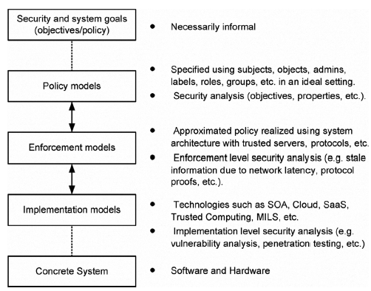
Mapping Between Zero Trust Tenets and The PEI Models Framework Layers
The PEI Models Framework:
The PEI Models Framework [2].

Slide 7
Mapping Between Zero Trust Tenets and The PEI Models Framework Layers
Zero trust Tenets:
The ZT NIST document [2] offer a way of defining ZT and ZTA in terms of basic tenets that should be adhered to when designing and deploying a ZT system.

Slide 8

Mapping Between Zero Trust Tenets and The PEI Models Framework Layers
The question remains, however, when we must consider different tenets? Particularly at which design and implementation stages should we incorporate each tenet into the access control system?
The PEI Models Framework [2].

Slide 9

Mapping Between Zero Trust Tenets and The PEI Models Framework Layers
Zero Trust Basic Tenets:
We carefully investigated each tenet in our paper.
We concluded that when designing a ZT authorization system, it is critical to consider the zero trust tenets that we would like to incorporate at the policy, enforcement, and implementation models layers in the PEI framework.
Although ZT basic tenets are the ideal goals, not all of them may be implemented in their purest form in every system.
There are no minimum requirements in terms of tenets or principles.
Different enterprises may choose to fully or partially incorporate some tenets while neglecting others.
The PEI Models Framework [2].

Slide 10
Our Contribution
In This Paper:
We highlight the importance of considering ZT concepts when designing, enforcing, and implementing authorization models. For this purpose, we provide a structured mapping between the ZT tenets and the PEI models framework [2].
We propose the ZT authorization requirements framework (ZT-ARF).
We motivates the need to implement ZT principles when developing access control models for smart IoT systems.
We analyze access control requirements in IoT systems and accordingly specify which requirements components from our proposed ZT-ARF we need to include when designing an authorization model for integrated ZT IoT systems.
We propose our novel framework for ZT score-based authorization (ZT-SAF).
We highlight future research directions and propose a plan for designing, enforcing, and implementing the proposed ZT-SAF in smart connected IoT systems.
which provides a structured view of different authorization requirements to consider when designing a ZT authorization policy model.

Slide 11
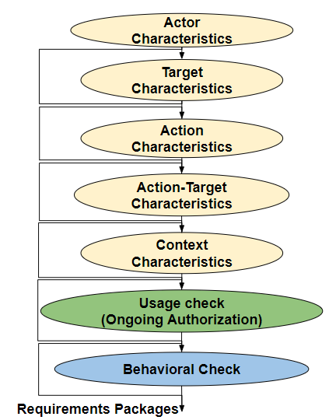
The Zero Trust Authorization Requirements Framework (ZT-ARF)
The system entity that initiates the access request (users, services, apps, devices)
Targets are the resources that need to be accessed in the request (users, devices, apps, info)
An executable image of a program (operations)
an approval to perform an action on a specific target (permissions, activities)
Environment characteristics.
System characteristics.
Threats and logs information.
The continuity of an access Decision.
The authorization system enforces the security policy:
a. Before the access execution.
b. During the execution,
c. After the execution.
To capture any abnormal behavior.

Slide 12
Our Contribution
In This Paper:
We highlight the importance of considering ZT concepts when designing, enforcing, and implementing authorization models. For this purpose, we provide a structured mapping between the ZT tenets and the PEI models framework [2].
We propose the ZT authorization requirements framework (ZT-ARF), which provides a structured view of different authorization requirements to consider when designing a ZT authorization policy model.
We motivates the need to implement ZT principles when developing access control models for smart IoT systems.
We analyze access control requirements in IoT systems and accordingly specify which requirements components from our proposed ZT-ARF we need to include when designing an authorization model for integrated ZT IoT systems.
We propose our novel framework for ZT score-based authorization (ZT-SAF).
We highlight future research directions and propose a plan for designing, enforcing, and implementing the proposed ZT-SAF in smart connected IoT systems.

Slide 13
Why ZT in IoT?
We believe that integrating ZT concepts is crucial when developing IoT systems for the following reasons:
ZT is a response to enterprise network trends that include remote users, bring your own device (BYOD), and cloud-based assets that do not fall within the enterprise’s network boundaries, which is typical for IoT use cases.
On the other hand, IoT systems possess some characteristics that make them need to integrate ZT paradigms into their authentication and authorization designs.

Slide 14
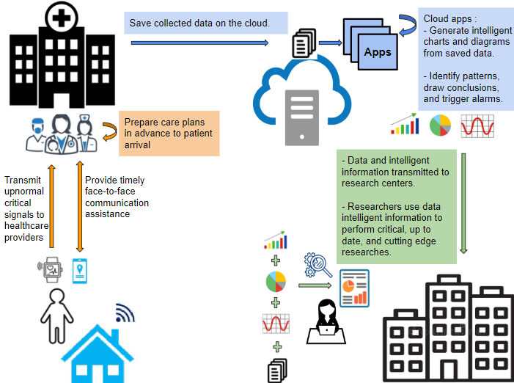
Why ZT in IoT?
.
The need arises for a systematic and dynamic research approach for IoT to maintain its success over the long term in securing authorization, resource access, communication, and data flow.

Slide 15


Toward Zero Trust Authorization In IoT Systems
We analyzed IoT systems authorization requirements.
To develop a ZT authorization system for an IoT application domain, we need to include the following components from the proposed ZT-ARF.
Actor characteristics, target characteristics, context characteristics, and usage check requirements components to build a dynamic authorization model.
Action and action-target characteristics components are critical in maintaining a fine-grained authorization model.
While the behavioral check requirements component provides more dynamic authorization models capable of capturing deviations from normal behaviors, it requires sophisticated policy and enforcement models.
Hence, we believe that including the behavioral check requirements components depends on the specific IoT application domain. Since it requires a trade-off between the sensitivity of the resources and data, the business needs on the one hand, and the cost and acceptable level of complexity on the other hand
.

Slide 16
Toward Zero Trust Authorization In IoT Systems
Criteria-Based Authorization Vs Score-Based Authorization:
The ZT paradigm differentiate between two types of authorization models based on how the input factors are evaluated to decide on access requests.
Criteria-based authorization model:
Assumes certain qualifications (conditions, characteristics, etc) must be met before access to a resource (e.g., read/write) can be granted. Access is granted or action applied to a resource only if all the criteria are met.
RBAC, UCON, ACON, ABAC.
Score-based authorization model:
Computes a confidence level (score) for the requested access. As long as the score exceeds the threshold value configured for the resource, access to the resource is granted or the action performed. Otherwise, the request is declined, or access privileges are reduced.
We believe that score-based models are more suitable for IoT systems, for the following reasons:
They are more dynamic since the score provides a current confidence level for the requesting actor and adjusts to changing factors more quickly than static policies modified by human administrators.
Many of the inputs from the sensors are subjective and probabilistic rather than absolute.
Therefore, it is imperative that authorization models considers the confidence level (score) of different access requests and that their policies can accommodate subjective information and uncertainty.
.

Slide 17


Toward Zero Trust Authorization In IoT Systems
Score –Based Authorization
ZT-ARF
To develop a ZT IoT system, the need arises for a contextual aware access control model capable of :
Incorporating actor, targets, action, action-target, context characteristics, and the usage check components from the ZT-ARF.
Dynamically deciding on access requests based on calculated score (confidence level) rather than on static access control policies.

Slide 18
Our Contribution
In This Paper:
We highlight the importance of considering ZT concepts when designing, enforcing, and implementing authorization models. For this purpose, we provide a structured mapping between the ZT tenets and the PEI models framework [2].
We propose the ZT authorization requirements framework (ZT-ARF), which provides a structured view of different authorization requirements to consider when designing a ZT authorization policy model.
We motivates the need to implement ZT principles when developing access control models for smart IoT systems.
We analyze access control requirements in IoT systems and accordingly specify which requirements components from our proposed ZT-ARF we need to include when designing an authorization model for integrated ZT IoT systems.
We propose our novel framework for ZT score-based authorization (ZT-SAF).
We highlight future research directions and propose a plan for designing, enforcing, and implementing the proposed ZT-SAF in smart connected IoT systems.

Slide 19
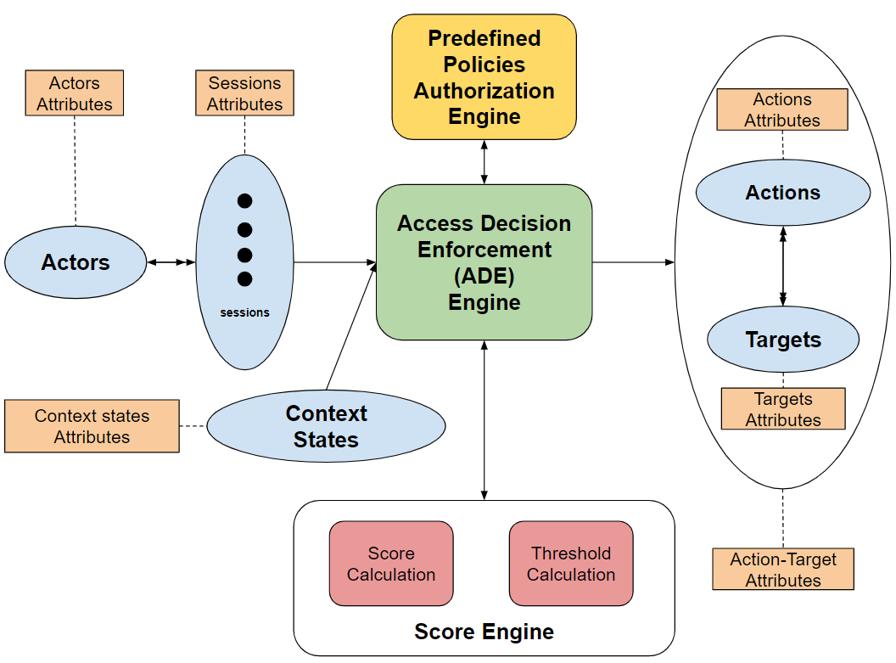
The Zero Trust Score-based authorization framework (ZT-SAF)

Slide 20
The Zero Trust Score-based authorization framework (ZT-SAF)

Slide 21
The Zero Trust Score-based authorization framework (ZT-SAF)

Slide 22
The Zero Trust Score-based authorization framework (ZT-SAF)

Slide 23
Future Research Agenda
Authorization Operational Policy Models and Extensions.
Framework Algorithms.
Administrative Policy Models.
Policy Language.
Enforcement Architectures.
Implementation Models.
Behaviorally Aware Models.
AI and Data Driven Deployment.
Applications domains in IoT.
ZT-SAF

Slide 24


Slide 25
Thank You

Slide 26
References
[1] R. Sandhu, et al. 2006. Secure information sharing enabled by trusted computing and PEI models. In ASIACCS ’06
[2] S. W. Rose, et al. 2020. Zero trust architecture. (2020).

