Slide 1




ABAC-CC: Attribute-Based Access Control and Communication Control for Internet of Things
Smriti Bhatt¹, Ravi Sandhu²
¹Department of Computing and Cyber Security, Texas A&M University-San Antonio
²Institute for Cyber Security (ICS), CREST-Center for Security and Privacy Enhanced Cloud Computing (C-SPECC)
Department of Computer Science, University of Texas at San Antonio
The 10th ACM Symposium on Access Control Models and Technologies (SACMAT)
June 10-12, 2020

Slide 2
Outline
  Introduction
  Background
  Cloud-Enabled IoT (CE-IoT) Architectures
  Access Control and Communication Control Requirements in CE-IoT
  Use Case Scenarios
  ABAC vs. ABCC
    Attribute-Based Communication Control (ABCC) – Conceptual model
    Attribute-Based Access Control (ABAC)
  Attribute-Based Access Control and Communication Control (ABAC-CC) Framework
  Future Research Directions
  Conclusion and Future Work

Slide 3
Introduction
  Internet of Things (IoT) - billions of connected smart things enabled by technologies like Cloud Computing, Artificial Intelligence (AI) and Machine Learning (ML)
  IoT devices have some unique characteristics unlike other Internet-connected user devices –
    Distributed and deployed in remote locations
    Diverse in nature (e.g., size, capability, functionality)
    Autonomous operation enabled by AI and Machine learning technologies
    Dynamic behavior based on the context
  Dynamic access control and communication control framework to adequately address security and privacy issues in the IoT space

Slide 4
Access Control and Communication Control
Dynamic
IoT Space
  Access Control:
  ensures secure access to protected resources from authorized entities only
  Communication Control: secures communication and data flow between authorized components
Attribute-Based Approach
Attribute-Based Access Control (ABAC)
Attribute-Based Communication Control (ABCC)

Slide 5
Background
  Cloud-Enabled Internet of Things (CE-IoT) –
    Cloud computing has become a key enabling technology with virtually unlimited capabilities (e.g., storage, computation, analytics) for IoT devices
  Major cloud services provides such as Amazon Web Services (AWS) Microsoft Azure, and Google Cloud, including others, have introduced new IoT services
  Emerging security and privacy threats in IoT with new challenges including traditional cloud threats and vulnerabilities

Slide 6
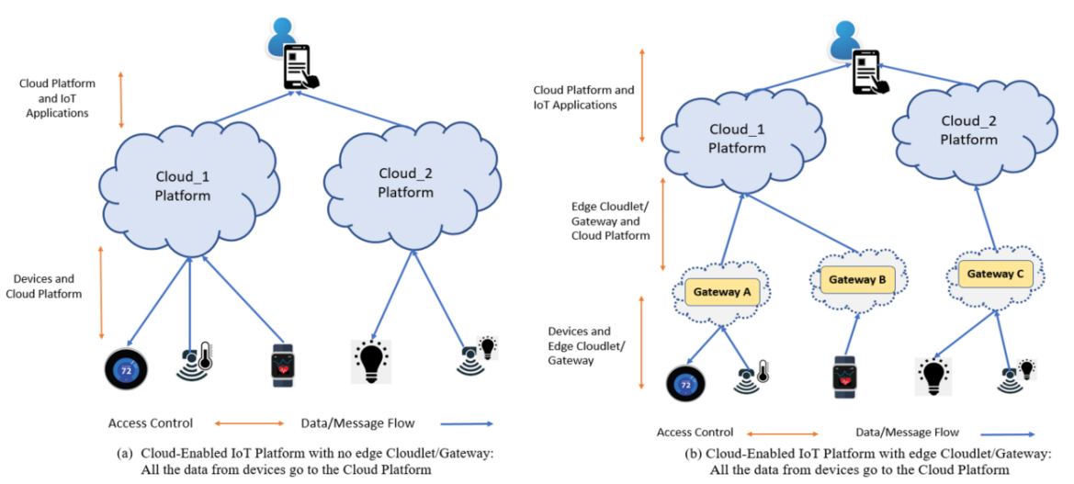
CE-IoT Architectures

Slide 7
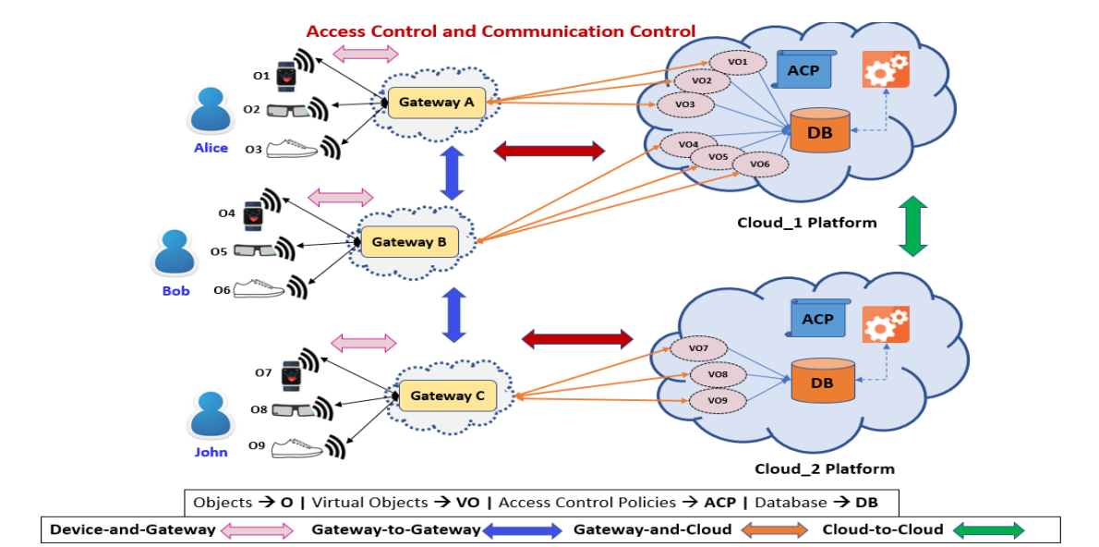
Access Control and Communication Control Requirements

Slide 8
Use Case Scenarios
Scenario 1 (Devices/Gateway to Cloud) -- Users want restrict privacy sensitive data to be shared with the Cloud at all times and rather confine the data at the edge network and only send important updates to cloud based on some predefined conditions.
Scenario 2 (Cloud to Gateway/Devices) -- Users want to restrict messages coming from Cloud to users through IoT applications.

Slide 9
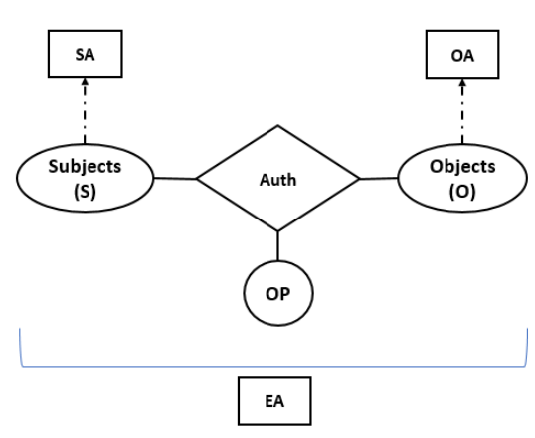

ABAC
Attribute-Based Access Control (ABAC)
Subjects: who request access (e.g., users, processes, devices, etc.)
Objects: protected resources and entities (e.g., devices, files or folders, data)
Subject Attributes (SA): title, age, etc.
Object Attributes (OA): sensitivity, type, etc.
Environmental Attributes (EA): location, time
Operations (or actions): read(r), write(w)
Authorization Function: Auth_func = (s, o, r)

Slide 10
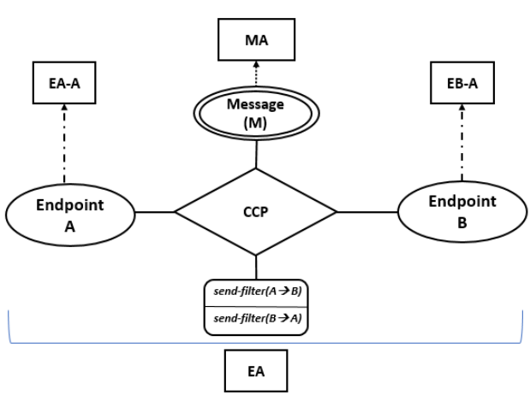
Attribute-Based Communication Control (ABCC)
EndpointA and EndpointB
Endpoint Attributes (EA-A and EB-A)
Message (M): unit of communication
Message Attribute (MA)
Environmental Attributes (EA): location, time
Operations: send-filter
  send-filter(A → B)
  send-filter(B → A)
Communication Control Policy (CCP) function: Decisions → message can be sent unfiltered (original message), filtered (removing/sanitizing sensitive information), or not sent from a sender to a receiver

Slide 11
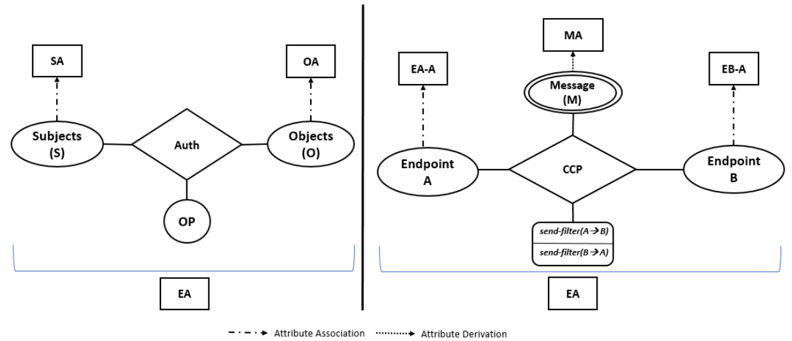
ABAC vs. ABCC

Slide 12
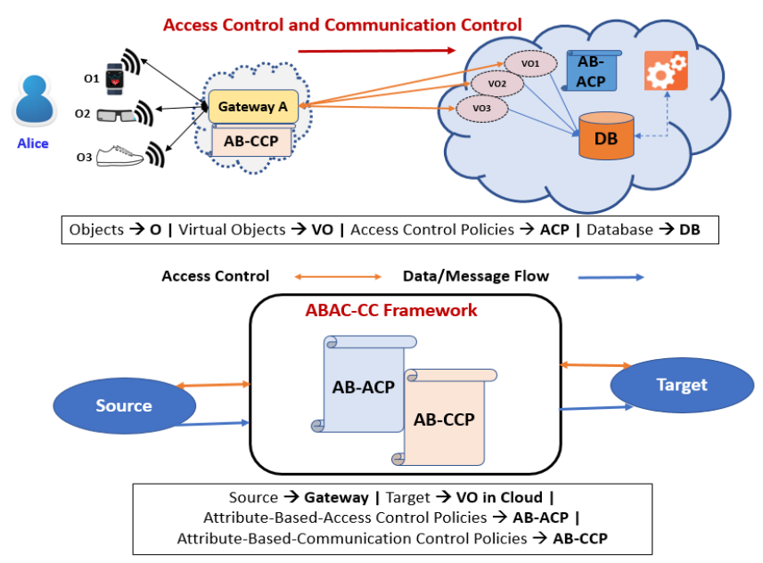
ABAC-CC in a Smart Health Monitoring Use Case Scenario
Access and Communication from Gateway to Cloud (VO)
Gateway (EndpointA)
VOs (EndpointB)
Gateway and Device attribute: owner
Message (m)
Message Attribute: location, temp, heartrate
send-filter(A->B) => m, or m’, or null

Slide 13
Future Research Directions
  Artificial Intelligence and Machine Learning
  Distributed Computing
  Collaborative IoT Models
  Insider Threats and Rogue Devices
  Dynamic Edge and Fog Computing

Slide 14
Conclusion and Future Work
  Introduced the Attribute-based Communication Control (ABCC) model and compared its structure with the basic ABAC
  Proposed an Attribute-Based approach for developing the ABAC-CC framework to secure access and communication in CE-IoT architecture
  Discussed a smart health monitoring use case and presented future research directions
  Goal:
    To reevaluate and rethink current access control mechanisms and design new models on top of the attribute-based approach to secure IoT access, communication, and data at rest and in motion
    Stimulate research on ABCC models for real-world IoT application domains, such as Smart Home, Smart Health
  Future Work: Develop formal ABCC models for securing communication between various components in the context of CE-IoT.

Slide 15
Thank You!
Questions???

