Slide 1
The EGRBAC Model for Smart Home IoT Access Control
Safwa Ameer
James Benson
Ravi Sandhu
Institute for Cyber Security (ICS)
Center for Security and Privacy Enhanced Cloud Computing (C-SPECC)
Department of Computer Science
University of Texas at San Antonio
Safwa.ameer@my.utsa.edu
Notes:
Hi Everyone, This is safwa Ameer a phd student from the university of Texas at San Antonio.
Our team work on developing Access Control models for different applications.
In the paper that I am going to present we developed the EGRBAC Model for smart home Iot access control.

Slide 2

Introduction & Motivation
The Internet of Things (IoT) is a new technology paradigm envisioned as a global network of machines and devices capable of interacting with each other.
Notes:
I am going to start with an introduction and the motivation behind this work.
First, what we mean by IoT, a simple definition is here.

Slide 3
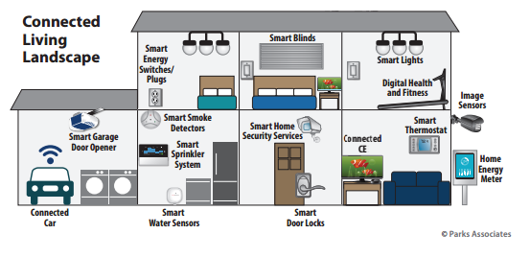
Introduction & Motivation
One of the most popular domains for deploying smart connected devices is the smart home.
Surprisingly, little attention has been paid to access control in home IoT.
AC issues have been explored extensively for many different domains.
Notes:
It will be part of every home turning our houses into smart houses, in which we have multiple users with complex social relationships between them using the same smart devices.
However, we cann’t simply adopt those models and use them for smart homes, the main reason behind that is:

Slide 4
Introduction & Motivation
Home IoT is signiﬁcantly different from traditional domains in:
  In home IoT we have many users who use the same device, for example: smart door lock, smart light,.. .
  The majority of IoT devices do not have screens and keyboards making them hands free for convenience while making authentication and access control more challenging.
  House residents usually have complex social relationship between them, which introduce a new threat model, e.g. an annoying child trying to control the smart light in his sibling’s room, a current or ex-partner trying to abuse one or all house residents.
  Smart home things are usually constrained resources in term of computational power, communication, and storage.

Slide 5
Introduction & Motivation
The characteristics that make IoT distinct from prior computing domains necessitate a rethinking of access control and authentication [1].
The need arises for a dynamic and ﬁne-grained access control mechanism, where users and resources are constrained [2].
Why focus on the home rather than general IoT?
  We believe that smart homes provide a rich yet scoped environment where we have limited number of users who want to access limited number of shared constrained smart things with different privileges. Such scoping is necessary to develop an initial set of models. In future these scoped models can be adapted and evolved to address the access control requirements of other IoT domains, such as a smart office, a smart classroom or a smart city.

Slide 6
Our Criteria for Smart Home IoT Access
Control Models
Based on the literature review that we have done, we believe that a smart home IoT access control model (whether it is device to device (D-D), user to device (U-D) or both) should exhibit, at least, the following characteristics:
  Dynamic, to capture environment and object contextual information.
  Fine-grained, so that a subset of the functionality of a device can be authorized rather than all-or-nothing access to the device.
  Suitable for constrained smart home devices.
Notes:
Next we will talk about our criteria for ….

Slide 7
Our Criteria for Smart Home IoT Access
Control Models
  Constructed speciﬁcally for smart home IoT or otherwise be interpreted for the smart home domain such as by appropriate use cases. To ensure that the model is suitable for smart home different specifications such as, social relationships between house members, cost effectiveness, usability, and so on
  The model should be demonstrated in a proof-of-concept, to be credible using commercially available technology with necessary enhancements.
  The model should have a formal deﬁnition, so that there is a precise and rigorous speciﬁcation of the intended behavior.
We investigated literature’s IoT access control models that govern user to device access against our criteria, and notably no model satisfies all desired specifications.

Slide 8

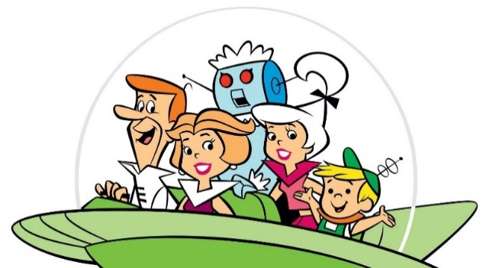
Our Threat Model
  In smart houses we have two types of adversaries:
    a- Outsider hacker who is trying to get digital or physical access to the house by exploiting system vulnerabilities.
b- The household members themselves. The insiders who have legitimate digital and physical access to the house, such as family members, guests, and workers.

Slide 9
Our Threat Model
The intention for legitimate users to break down the access control system of the smart home may vary; some examples may be:
  Curiosity (a kid playing with the oven setting).
  Disturbing other family members (a kid locking his brothers outside the house).
  Disobedience (a kid is trying to watch TV outside the allowed entertainment time).
  Robbery (a worker getting access to the camera system and adjust it to shutdown at a certain time).
The central focus of our paper is making sure that those legitimate users get access only to what they are authorized to by the house owner.

Slide 10
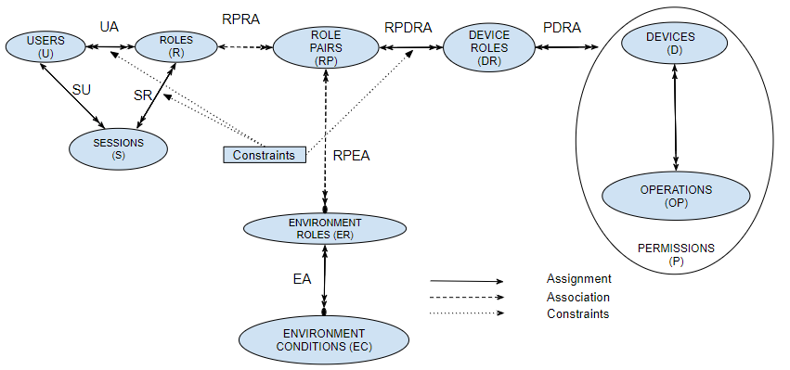
The EGRBAC Model
Notes:
The Extended Genarlized Role Based AC Model is is inspired by the early work of Covington the GRBAC Model. In which he introduced the concept of device roles, and environment roles.
We are going to go through different parts of the model in details.

Slide 11
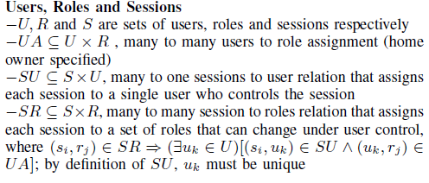
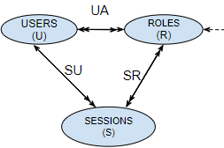
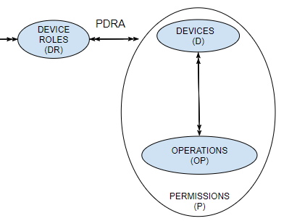
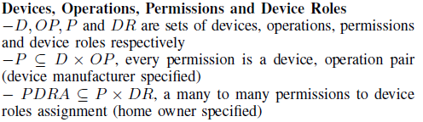
EGRBAC Model Formalization
Notes:
Users (U) and Roles (R) are familiar sets in RBAC systems.
A user is a human being who interacts with smart home devices as authorized.
Role specifically represents the relationship between the user and the family, which encompasses parents, kids, neighbours, friends and so on.
Users establish sessions during which they may activate a subset of the roles they assigned to. A user might have multiple sessions active simultaneously.
SU is a many to one relation that maps each session to its unique controlling user.
SR is a many to many relations that maps each session to the set of roles associated with it.
……………………………………………………….
Devices (D) are smart home devices such as a smart TV.
Operations (OP) represent actions on devices as specified by device manufacturers.
A permission is an approval to perform an operation on one device.
Device Roles (DR) are means of categorizing permissions of different devices.
For Example, we may have a device role called dangerous devices and assign dangerous permissions (such as, turning on the oven, turning on the mower, and opening and closing the front door lock) to it.
The many-to-many PDRA relation specifies this assignment.

Slide 12
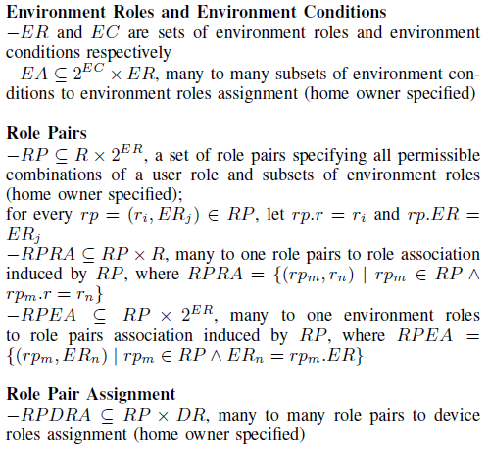
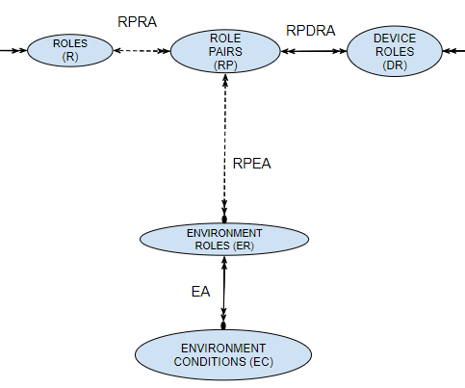
EGRBAC Model Formalization
Notes:
Environment Roles (ER) represent environmental contexts.
Environment roles are turned on/off (i.e., triggered) by Environment Conditions (EC) .
EA maps each environment role to the subset of Ecs which trigger it. For example we may have an ER Weekend evenings which can be turned on when the Ec (Saturday or Sunday), and the EC Evening time are satisfied.
…………………………………………………………………………………………………………………………
Each role pair is a combination of a role and a subset of the currently active environment roles.
A role pair rp has a role part rp.r that is the single role associated with it. And an environment role part rp.ER that is the subset of environment roles associated with rp.
RPDRA brings all these components together.
by assigning device roles to role pairs, and hence, for each role pair rp, the single role associated to it through RPRA can get access to all device roles assigned to it through RPDRA, when the set of environment roles which are associated to rp through RPEA are active.

Slide 13
The EGRBAC Model
The main idea in EGRBAC as a whole is that a user is assigned to a set of roles and according to the current active sessions, and current active environment roles some role pairs will be active, the user will get access to the permissions assigned to the device roles which are assigned to the current active role pairs.

Slide 14
Use Case
The objective is to allow kids to access a subset of permissions (On, Off, and PG contents) in entertainment devices (TV, DVD) during weekend evenings only.
Notes:
Here is a use case which demonstrates our model.

Slide 15

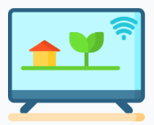




Use Case
$$OFF$$
$$ON$$
$$PG$$

Slide 16

Use Case
$$OFF$$
$$ON$$
$$PG$$

Slide 17

Use Case
$$OFF$$
$$ON$$
$$PG$$

Slide 18


Use Case
$$OFF$$
$$ON$$
$$PG$$

Slide 19
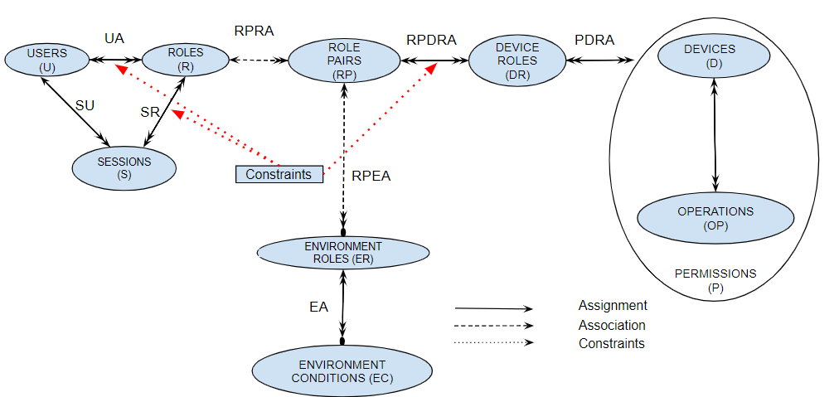
Constraints
A constraint is an invariant that must always be maintained.
Notes:
An important component of our Model is Constraints.
We have three types of constrained, which checked in different points.
We are going to explain the basic idea of each one of them.

Slide 20
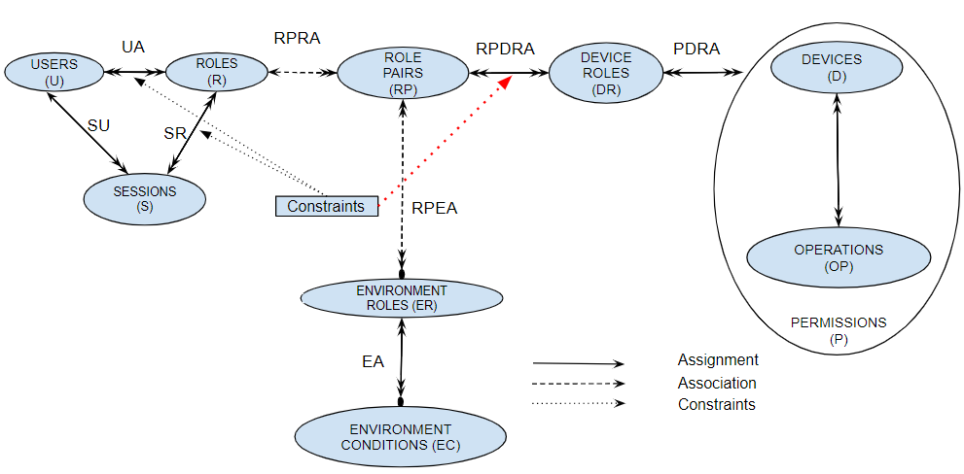
Constraints
1. Permission-role constraint
Notes:
The first constraint is Permission role constraint.
Which is checked when we want to assign device roles to role pairs.

Slide 21

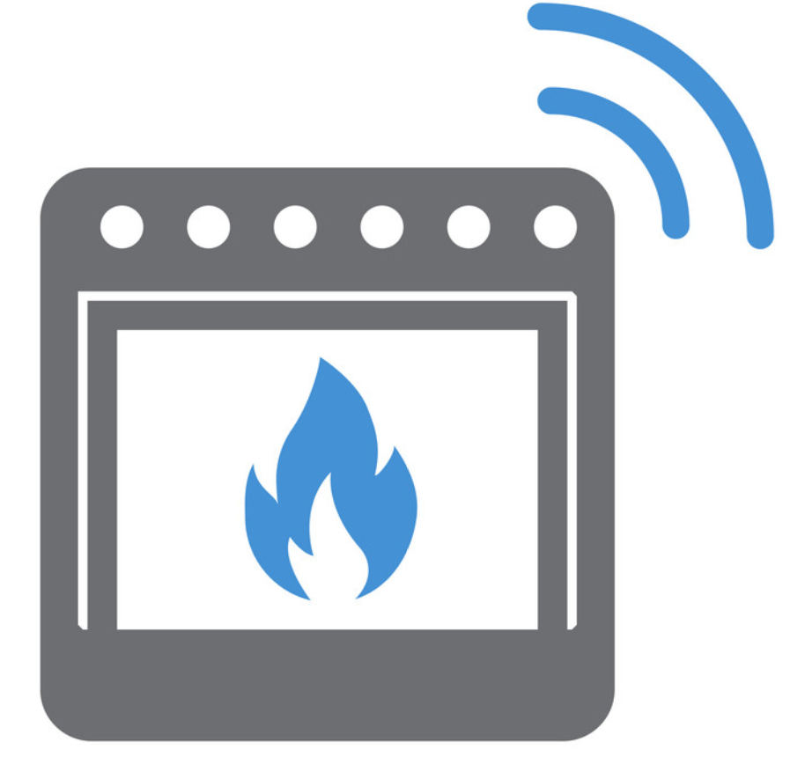




Constraints
These constraints prevent specific roles from getting access to specific permissions.
For example, what if we want to prevent future assignment of dangerous permissions to the role Kids (which could happen inadvertently by the homeowner)?
$$Lock$$
$$Unlock$$
$$ON$$
$$OFF$$

Slide 22
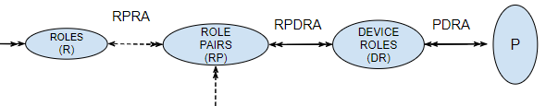

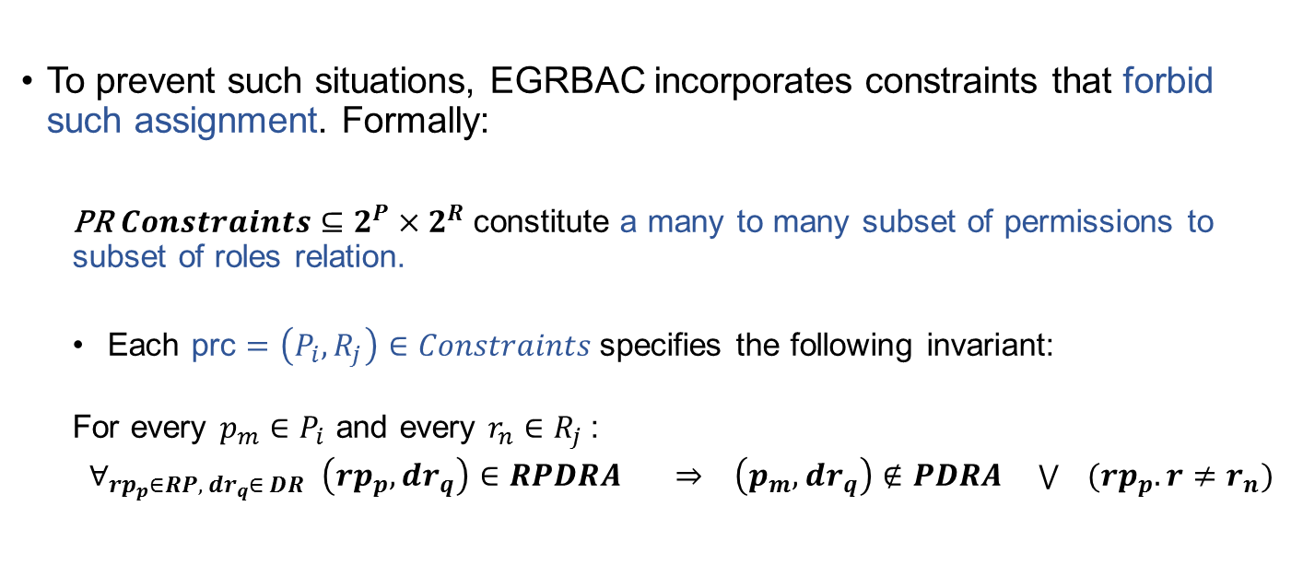



Constraints
To prevent such situations, EGRBAC incorporates constraints that forbid such assignment. Formally:
  PR$Constraints⊆2^{P}×2^{R}$constitute a many to many subset of permissions to subset of roles relation.
  Each prc $=\left(P_{i}, R_{j}\right)∈Constraints$specifies the following invariant:
  For every $p_{m}∈P_{i}$ and every $r_{n}∈R_{j }$:
  ${ ∀_{rp_{p}∈RP, dr_{q}∈ DR }\left(rp_{p},dr_{q}\right)∈RPDRA ⇒ \left(p_{m}, dr_{q}\right)∉PDRA \bigvee{ }(rp_{p}.r≠r_{n})}_{ }$
$${rp}_{p}$$
$$dr_{q}$$
$$p_{m}$$
$$r_{n}$$
Notes:
So whenever we want to assign any device role to any role pair, these permission role constraint must be checked.
If any one of them is violated the assignment can be completed.
Through this no one can assign a device role that has pm assigned to it to any role pair which has rn as the role part of it.

Slide 23
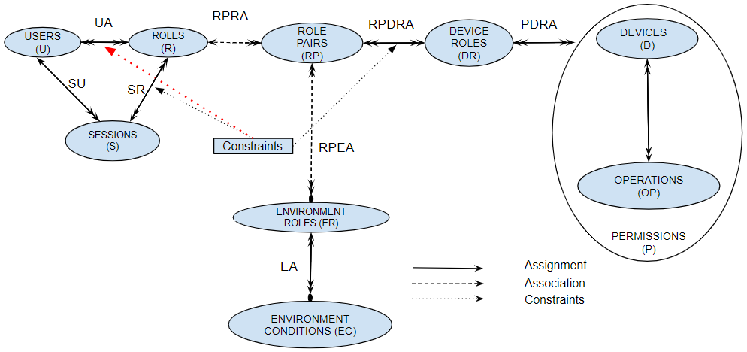
Constraints
2. Static separation of duty:
Notes:
The second constraint is SSD.
Which is checked when we want to assign roles to users.

Slide 24
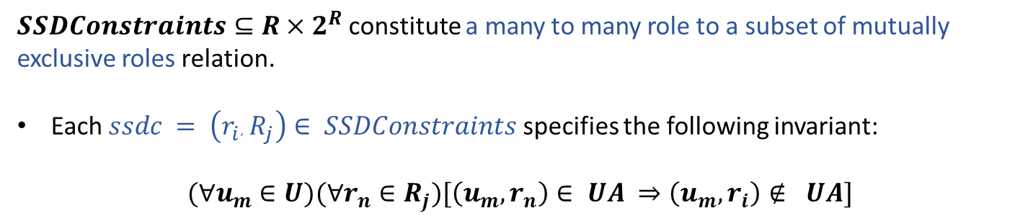
Constraints
If a user is authorized as a member of one role, the user is prohibited from being a member of a second conflicting role [16].
Kids
Parents
$SSDConstraints⊆R×2^{R}$constitute a many to many role to a subset of mutually exclusive roles relation.
Each $ssdc = \left(r_{i}, R_{j}\right)∈ SSDConstraints$specifies the following invariant:
$$(∀u_{m}∈U)(∀r_{n}∈R_{j})[\left(u_{m}, r_{n}\right)∈ UA ⇒\left(u_{m}, r_{i}\right)∉ UA]$$
Notes:
Here is the basic idea of SSD constraints.

Slide 25
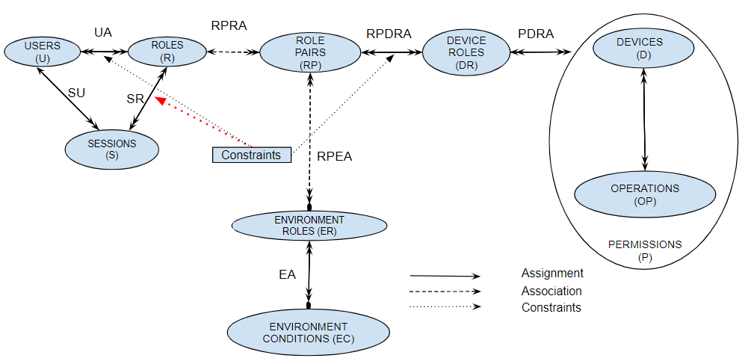
Constraints
3. Dynamic separation of duty:
Notes:
The third constraint is DSD.
Which is checked when we want to assign roles to sessions.

Slide 26

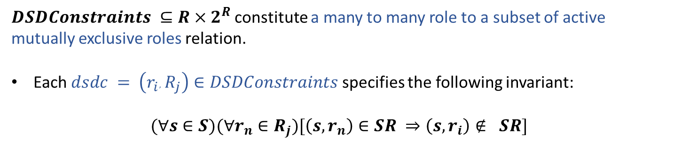
Constraints
With DSD it is permissible for a user to be authorized as a member of a set of roles which do not constitute a conflict of interest when acted in independently but produce policy concerns when allowed to be acted simultaneously in the same session [16].
Kids
Studying abroad Kids
$DSDConstraints ⊆R×2^{R}$constitute a many to many role to a subset of active mutually exclusive roles relation.
Each $dsdc = \left(r_{i}, R_{j}\right)∈DSDConstraints$specifies the following invariant:
$$(∀s∈S)(∀r_{n}∈R_{j})[\left(s, r_{n}\right)∈SR ⇒\left(s, r_{i}\right)∉ SR]$$
Notes:
Here is the basic idea of DSD constraints.

Slide 27
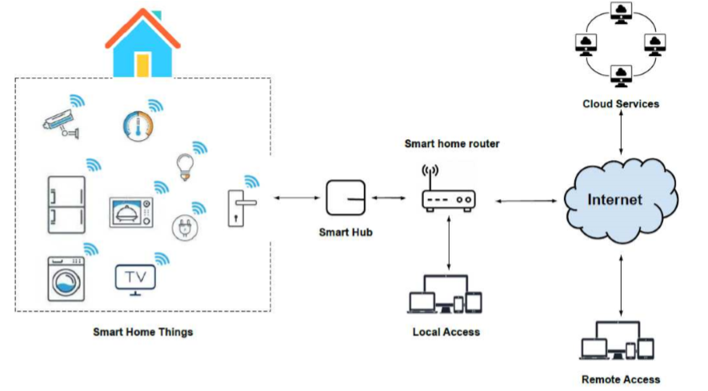
Enforcement Architecture
Adapted from [17]
There are two types of requests: A- Local requests. B- Remote requests.
We implemented our model using AWS IoT service.
Notes:
Here is the Enforcement architecture that we adopted for our implementation.
There are tow types of access: 1- local access when the user is inside the house, and remote access when the user is outside the house and try to access through the internet.
We can notice here that users cann’t access devices without going through the smart hub, in which we implement our logic.

Slide 28
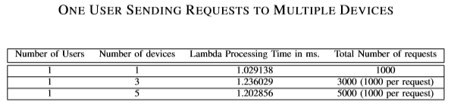
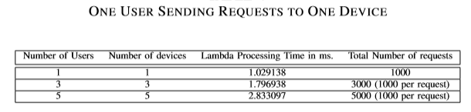
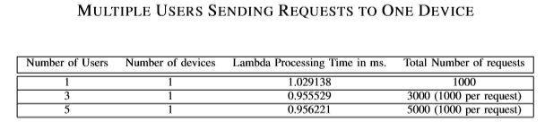
Performance Analysis
We conducted a performance test to depict how our system responds in different scenarios with different loads.
The results show that our model is functional, and applicable.
Notes:
In general the numbers are very slow.

Slide 29
Conclusion
We propose the EGRBAC access control model for smart home IoT.
Our model’s main goal is to ensure that legitimate users are only permitted to use the devices which they are allowed to access under the appropriate conditions.
It is a dynamic, fine-grained model.
In the future we are planning, to develop a family (or series) of models ranging from relatively simple and complete to incorporating increasingly sophisticated and comprehensive features.

Slide 30


Slide 31
Thank You

Slide 32
References
[1] W. He, M. Golla, R. Padhi, J. Ofek, M. D¨urmuth, E. Fernandes, and B. Ur, “Rethinking access control and authentication for the home internet of things (IoT),” in 27th USENIX Security Symposium (USENIX Security 18), 2018, pp. 255–272.
[2] A.Ouaddah,H.Mousannif,A.A.Elkalam,andA.A.Ouahman,“Access control in the internet of things: Big challenges and new opportunities,” Computer Networks, vol. 112, pp. 237–262, 2017.
[3] M. J. Covington, M. J. Moyer, and M. Ahamad, “Generalized rolebased access control for securing future applications,” Georgia Institute of Technology, Tech. Rep., 2000.
[15] R. S. Sandhu, “Role-based access control,” in Advances in computers. Elsevier, 1998, vol. 46, pp. 237–286.
[16] R. Sandhu, et al. The nist model for role-based access control: towards a unified standard. In ACM workshop on Role-based access control, 2000.
[17] D. Geneiatakis, et al. Security and privacy issues for an IoT based smart home. In 2017 40th MIPRO. IEEE, 2017

