Slide 1
Blockchain-Based Administration of Access in Smart Home IoT
Mehrnoosh Shakarami, James Benson, and Ravi Sandhu
Institute for Cyber Security (ICS),
Department of Computer Science,
University of Texas at San Antonio (UTSA)
ACM Workshop on Secure and Trustworthy Cyber-Physical Systems (SaT-CPS’22)
April 27, Baltimore-Washington DC Area, United States

Slide 2
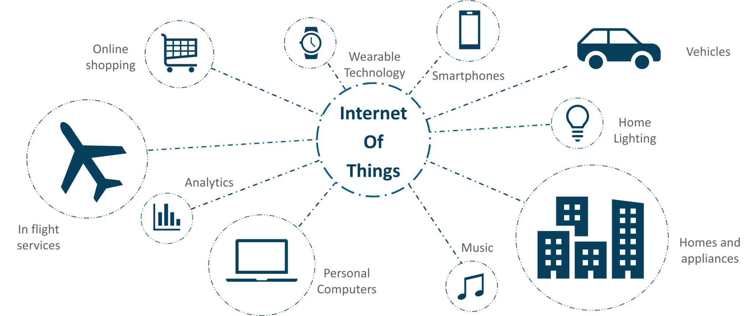
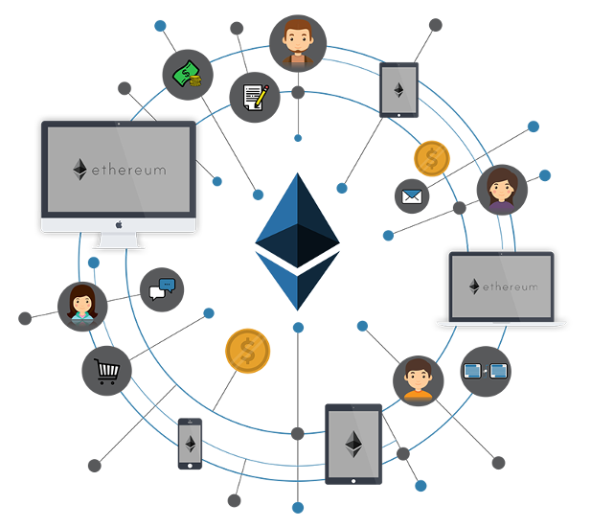
Introduction
Tailored authorization and access control for IoT.
  Many proposals remained at conceptual level.
Hype around using blockchain for IoT access control.
Operational vs. Administrative access control.
ACM Workshop on Secure and Trustworthy Cyber-Physical Systems (SaT-CPS’22)
This Photo by Unknown Author is licensed under CC BY-NC

Slide 3








Access Control in IoT Environments
Policy Specification
Granularity
Context Awareness
Policy Management
Policy Enforcement
Handling the complexity of Environment
Usability
Minimum user involvement
Light-weight
Reliability and Availability
Multi-domain Administration
We recognize smart home IoT unique characteristics necessitate oriented authorization models to be particularly designed, managed and enforced.
Little attention has been paid to administration of access in IoT environments.
ACM Workshop on Secure and Trustworthy Cyber-Physical Systems (SaT-CPS’22)

Slide 4
Blockchain for Access Control
Benefits:
Decentralized Control
Transparency and Auditability
Distributed Information
Tamper-proof
Why NOT Blockchain for Operational Access Control:
IoT Constraints
Long Transaction Confirmation Time
Financially Prohibitive
Why Blockchain for Administrative Access Control:
Less Frequency of Administrative Tasks
Posteriori Analysis
Scalable
No need for IoT devices to be engaged in blockchain
ACM Workshop on Secure and Trustworthy Cyber-Physical Systems (SaT-CPS’22)

Slide 5
Threat Model and Blockchain Benefits
Threat Model:
Insider Attack: Spoofing, Tampering, Privilege Escalation, Repudiation.
Assumptions:
Users’ communication with edge is secure over local network.
Routing attacks are out-of-scope.
Attacks against Web3 API are out-of-scope.
Attacks against user’s private key in their wallets considered to be out-of-scope.
Blockchain Security Benefits:
Administrator account cannot be faked.
Administrative policy is encoded in a smart contract recorded to ledger via consensus.
System is equipped with transparency and auditability.
ACM Workshop on Secure and Trustworthy Cyber-Physical Systems (SaT-CPS’22)

Slide 6

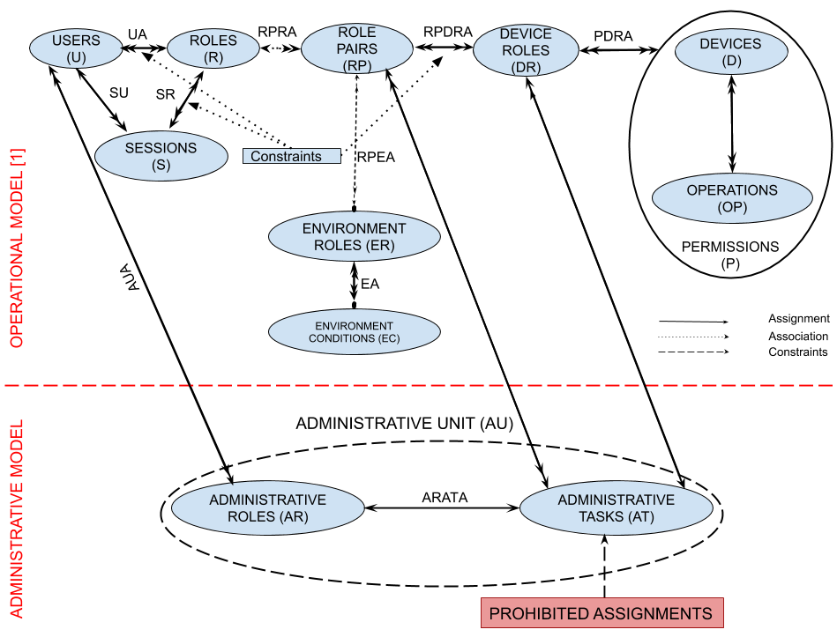











PEI: Policy – Basic Administrative Model
{(parent,Any_Time),(kid,Entertainment_Time)}
Entertainment_Devices
Bob
Alex
Julia
$P_{1}$={Turn On, Turn Off, PG, R}
Susan
Kids_Friendly_Content
$P_{2}$={Turn On, Turn Off, PG}
Basic Model to manage RPDRA Assignment
We recognize administration is best to be done decentralized. Decentralization provided through Administrative Units (AU).
We define one administrative unit per operational assignment to be managed, which includes a unique administrative role (AR) and a set of administrative tasks (AT).
Authorization is scoped as a set of administrative tasks defined to manage corresponding assignments in the operational model.
ACM Workshop on Secure and Trustworthy Cyber-Physical Systems (SaT-CPS’22)

Slide 7
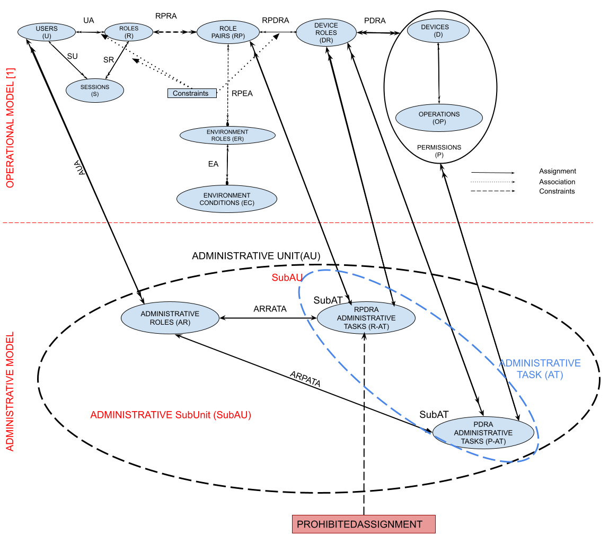
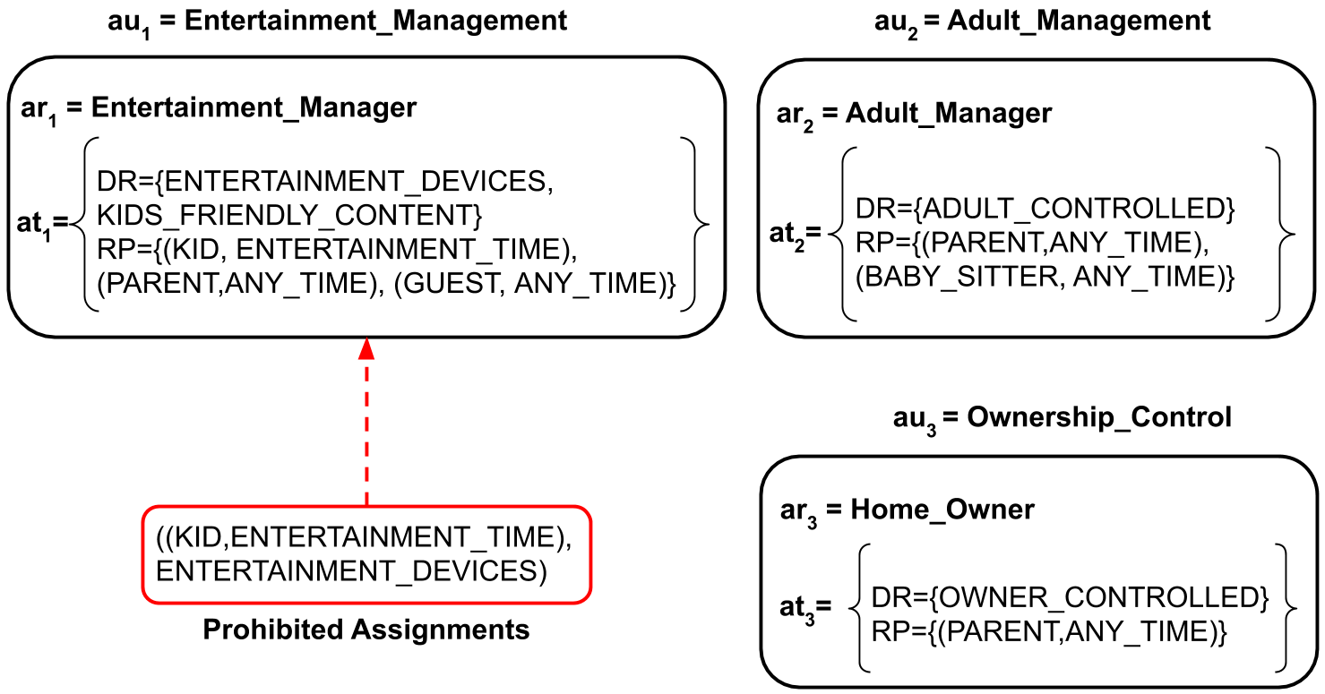
PEI: Policy – Extended Administrative Model
We extended our administrative model by defining one administrative unit per operational assignment to be managed.
Each administrative unit includes a unique administrative role which controls a predefined set of administrative tasks which represents its scope of administration.
Extended Model
ACM Workshop on Secure and Trustworthy Cyber-Physical Systems (SaT-CPS’22)

Slide 8
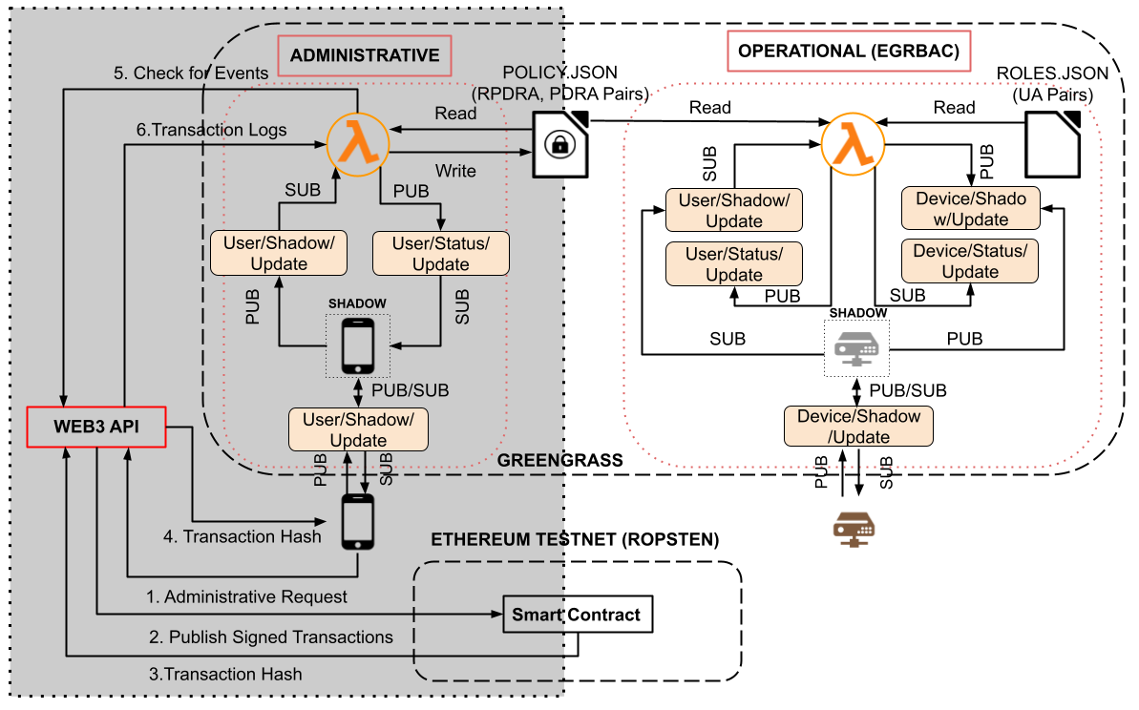
PEI: Enforcement Architecture
Decentralized
Ledger-based
Publish-subscribe
ACM Workshop on Secure and Trustworthy Cyber-Physical Systems (SaT-CPS’22)

Slide 9
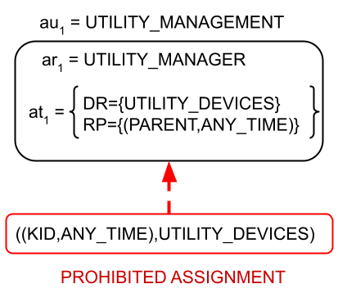
Sequence Diagram
ACM Workshop on Secure and Trustworthy Cyber-Physical Systems (SaT-CPS’22)

Slide 10
PEI: Implementation Setup
Administrative access control policy implemented in a single smart contract on the Ropsten.
Different administrative controls are coded as functions, which would be triggered by transactions.
Smart contract is programmed in Solidity and tested it on Remix IDE.
Infura is used as web3.0 API to interact with blockchain.
Experiment Environment:
  AWS IoT Greengrass v1.
  Greengrass runs on a dedicated virtual machine: one virtual CPU, 2 GB of RAM and 20 GB hard drive.
  The virtual machine’s operating system is Ubuntu 20.4.2 LTS and it is connected to a 1 Gbps network.
  Our AWS lambda code on the Greengrass is written in Python 3.8 and is running in a long-lived isolated runtime environment with limited RAM of 256 MB
Experiments are done for a normal distribution with a 99.9% confidence interval.
We ran our experiments in two settings with the policy sizes of n=20 and n=500.
  Both experiments were run for a total of 500 times.
ACM Workshop on Secure and Trustworthy Cyber-Physical Systems (SaT-CPS’22)

Slide 11
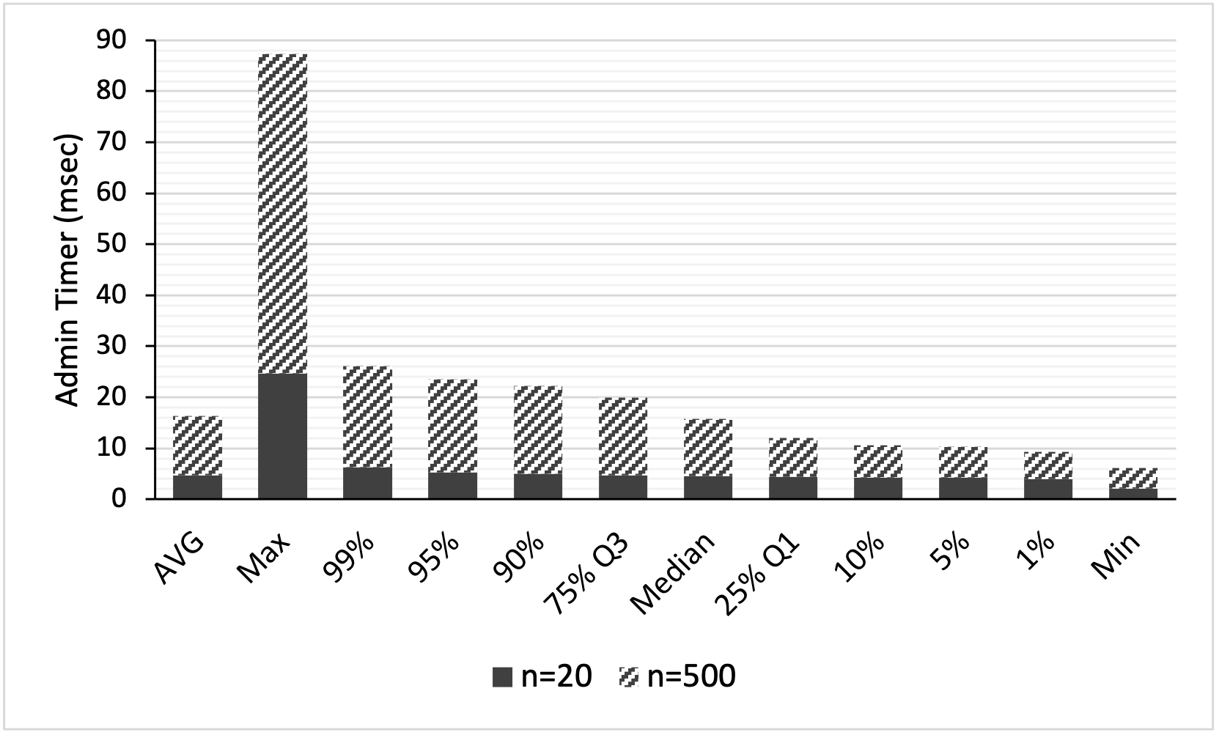
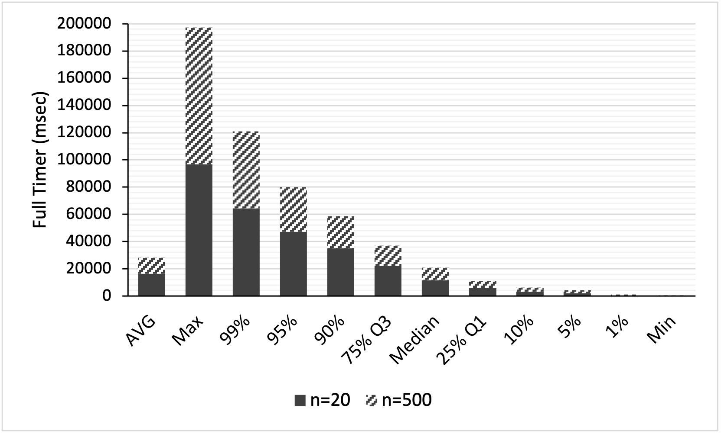
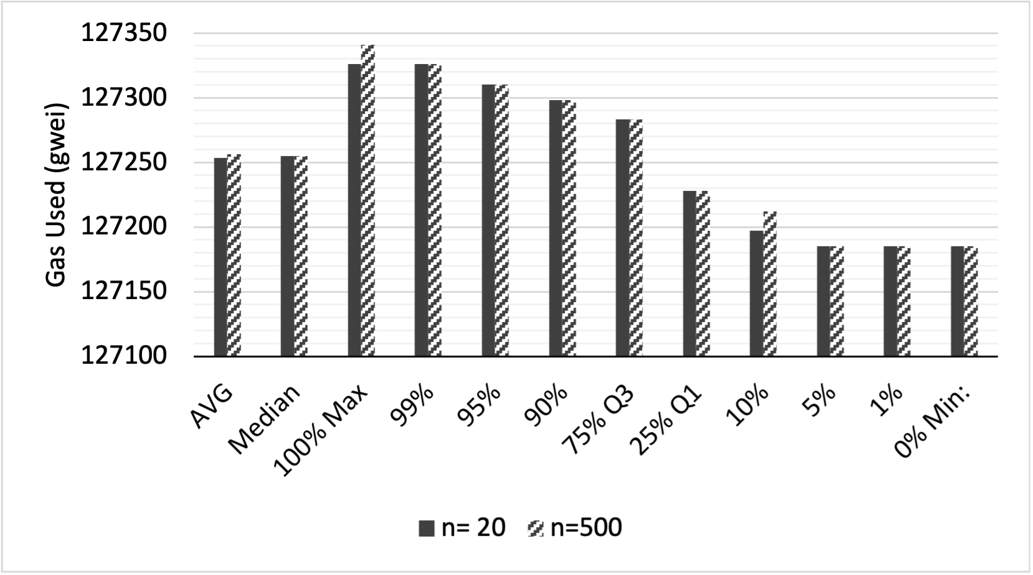
Implementation Results
Admin Timer: After a transaction has been successfully mined, Lambda checks the logs to search out the succeeded transactions. Then, it makes appropriate changes to the “policy.json” file and publishes the results to the User/Status/Update to inform the user about his/her administrative request.
Full Timer: Complete cycle of an administrator submitting a request, to that request being mined, and the lambda function processing the results and updating as necessary.
Gas Used: the actual amount of gas which was used during execution. Gas prices are denoted in GWEI, which equals to 10⁻⁹ ETH. We calculated the monetary cost of each transaction to be 28 cents.
ACM Workshop on Secure and Trustworthy Cyber-Physical Systems (SaT-CPS’22)

Slide 12


Discussions
Our administrative model features:
  Decoupled Assignment and Revocation
  Symmetric Assignment and Revocation
  Generalizability
  Transparency and Auditability
  Privacy
Security considerations specific to our architecture:
  Smart Contract Security
  Device-Cloud Communications
Limitations:
  Continuous Access control and Mutability
  Handling Conflicts
Our implementation results are reassuring that although the use of blockchain for operational access control is NOT promising, BUT it is promising to be utilized at administrative level.
Blockchain Hype
EGRBAC is not chosen as a de-facto!
ACM Workshop on Secure and Trustworthy Cyber-Physical Systems (SaT-CPS’22)

Slide 13

Q&A
Acknowledgement
Thanks for your time and attention!
This work is partially supported by NSF CREST Grant 1736209.
Any Questions?
ACM Workshop on Secure and Trustworthy Cyber-Physical Systems (SaT-CPS’22)

