Slide 1
The HABAC Model for Smart Home IoT and Comparison to EGRBAC
Safwa Ameer
Ravi Sandhu
SaT-CPS 2021
Institute for Cyber Security (ICS)
Center for Security and Privacy Enhanced Cloud Computing (C-SPECC)
Department of Computer Science
University of Texas at San Antonio
Notes:
Hi Everyone, This is safwa Ameer a phd candidate from the university of Texas at San Antonio.
Our team work on developing Access Control models for different applications.
In the paper that I am going to present the HABAC Model for smart home Iot access control, and how we compare it to another smart home model.

Slide 2

Introduction & Motivation
The Internet of Things (IoT) is a new technology paradigm envisioned as a global network of machines and devices capable of interacting with each other.
One of the most popular domains for deploying smart connected devices is the smart home.
Notes:
First, what we mean by IoT, we can simply defined it as a new technology paradigm ….

Slide 3
Problem Statement
In the literature, several AC models have been proposed for IoT in general. Most of them are built on RBAC or ABAC.
Some researchers argue that RBAC is more suitable for IoT, since it is simpler in management and review, while ABAC is complex.
Others argue that ABAC models are more scalable and dynamic, since they can capture different devices and environment contextual information.
However, RBAC models can be extended, such as the recent EGRBAC model [4] for smart home IoT which can express environment and device characteristics.
Hence, when it comes to smart homes, at this point it is not fully clear what is the benefit of ABAC over RBAC, and vice versa.

Slide 4
Problem Statement
Our intuitive insight is that a hybrid model will better capture smart home IoT AC requirements as this was already the case for traditional access control models.
In order to further investigate this intuition our approach is to develop pure RBAC and pure ABAC based models explicitly defined to meet smart home challenges and compare their benefits and drawbacks.
This comparison will provide insights to guide us in designing “optimal” hybrid models.
Notes:
Second, the problem statement.

Slide 5

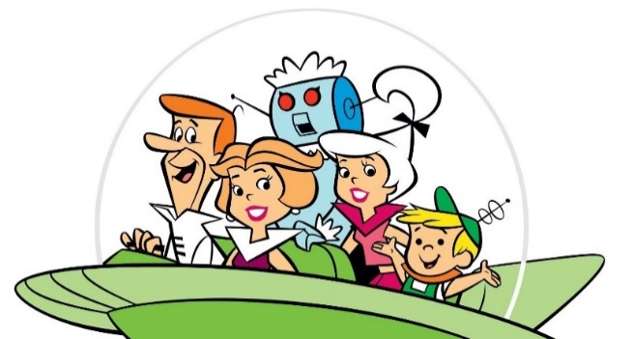
Threat Model
Scope or threat model:
  In smart houses we have two types of adversaries:
a- Outsider hacker who is trying to get digital or physical access to the house by exploiting system vulnerabilities.
b- The household members themselves. The insiders who have legitimate digital and physical access to the house, such as family members, guests, and workers.
The central focus of our work is making sure that those legitimate users get access only to what they are authorized to by the house owner.
Notes:
Here is our threat model.
The intention for legitimate users to break down the access control system of the smart home may vary; some examples may be:
Curiosity (a kid playing with the oven setting).
Disturbing other family members (a kid locking his brothers outside the house).
Disobedience (a kid is trying to watch TV outside the allowed entertainment time).
Robbery (a worker getting access to the camera system and adjust it to shutdown at a certain time).

Slide 6
Our Contribution
Design, formalize ABAC based access control model for smart home IoT (HABAC).
Analyze HABAC model relative to the previously published EGRBAC model [4]. Compare the theoretical expressive power of these models by:
  Introduce HABAC configuration that translates EGRBAC policies in a manner that they can be implemented by HABAC.
  Provide an algorithm to convert an HABAC specification to EGRBAC.
  Discuss the insights for practical deployment of these models resulting from these constructions.
Notes:
Here is our contribution.

Slide 7
Our Contribution
Design, formalize ABAC based access control model for smart home IoT (HABAC).
Analyze HABAC model relative to the previously published EGRBAC model [4]. Compare the theoretical expressive power of these models by:
  Introduce HABAC configuration that translates EGRBAC policies in a manner that they can be implemented by HABAC.
  Provide an algorithm to convert an HABAC specification to EGRBAC.
  Discuss the insights for practical deployment of these models resulting from these constructions.

Slide 8
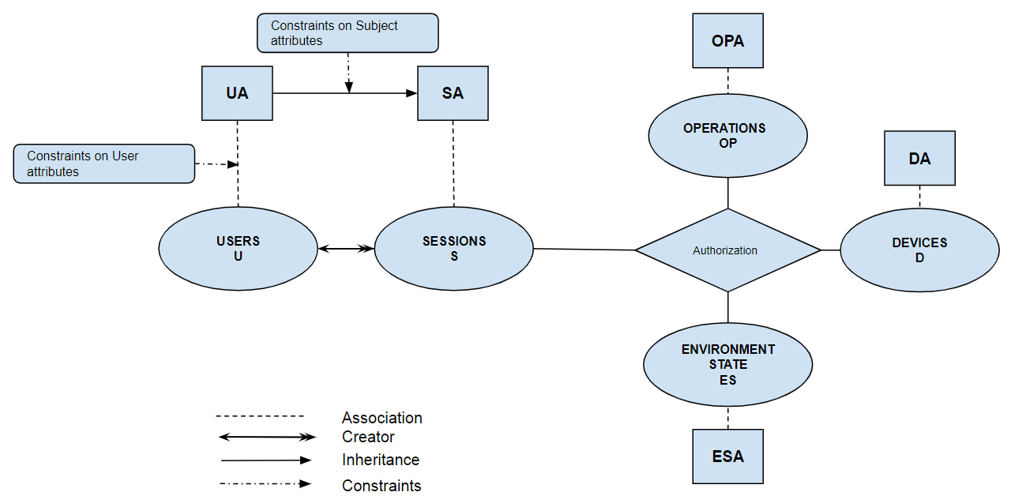
The HABAC Model
Notes:
Here is our smart home IoT attribute-based access control model, HABAC Model.
. We have:
1- Users (U).
2- Operations (OP).
3- Devices (D), and
4- Environment States (ES) . Which basically represent the environment state of a specific time that we want to describe, it may have values such as: current, yesterday, and so on.
Users, devices, operations, and environment states have characteristics which are used in access control decision and expressed as their attributes.

Slide 9

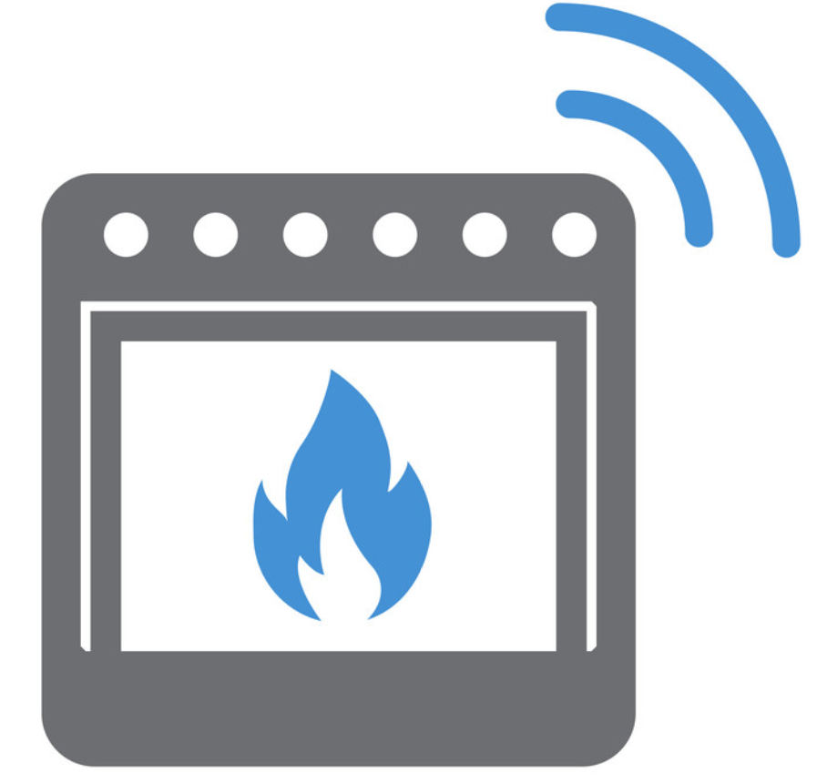
Use Case
The goal is to : Authorize teenagers (Anne) to use dangerous kitchen devices (Oven) only when one of the parents is in the kitchen.
Notes:
Here is a use case which demonstrates our model.

Slide 10
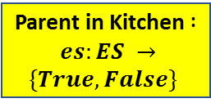
Use Case
Relationship (Anne) = teenager
Dangerous Kitchen Devices (Oven) = True
Parent in Kitchen $: es:ES →\{True, False\}$
Notes:
1- So, we first create user attribute Relationship, and then assign it to Anne with the value teenager.
2- Then, we create device attribute Dangerous kitchen , and assign it to the oven with the value True.
3- We also, create an environment state attribute parent in kitchen which can have two values True, or False. How different environment state attributes get triggered is outside the scope of our model.

Slide 11
Use Case
Add the authorization rule:
Relationship (Anne) = teenager
Dangerous Kitchen Devices (Oven) = True
Parent in Kitchen $: es:ES →\{True, False\}$
Notes:
4- And finally, we add an authorization policy rule, this authorization policy rule, give teenagers access to dangerous kitchen devices when one of the parents is in the kitchen.

Slide 12


Use Case
Check the authorization policy:
Relationship ($S_{X}$) = teenager
Relationship (Anne) = teenager
Dangerous Kitchen Devices (Oven) = True
$${ S}_{x}$$
Current
Parent in Kitchen $: es:ES →\{True, False\}$
Notes:
So, when a user is trying to access a device, he will create a session, that session will inherit the attribute Relationship= teenager.

Slide 13
Use Case
Check the authorization policy:
Relationship ($S_{X}$) = teenager
Relationship (Anne) = teenager
Dangerous Kitchen Devices (Oven) = True
$${ S}_{x}$$
TRUE
Parent in Kitchen (Current) = True
Current
Parent in Kitchen $: es:ES →\{True, False\}$
Notes:
If one of the parents is in the kitchen then:
Parent is in the kitchen attribute for the current environment state will be equal to TRUE
And hence, the authorization function will return true, and the user will be able to access the oven.

Slide 14
Use Case
Check the authorization policy:
Relationship ($S_{X}$) = teenager
Relationship (Anne) = teenager
Dangerous Kitchen Devices (Oven) = True
$${ S}_{x}$$
FALSE
Parent in Kitchen (Current) = False
Current
Parent in Kitchen $: es:ES →\{True, False\}$
Notes:
On the other hand, If no parent is in the kitchen then,:
Parent is in the kitchen attribute for the current environment state will be equal to False
And hence, the authorization function will return False, and the user will not be able to access the oven.

Slide 15
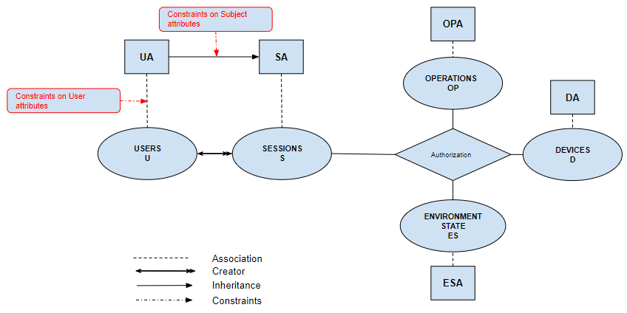
The HABAC Model
3- Constraints
Notes:
In this model, we have two constraints:
1- On user attributes.
2- On subject or session attributes.

Slide 16


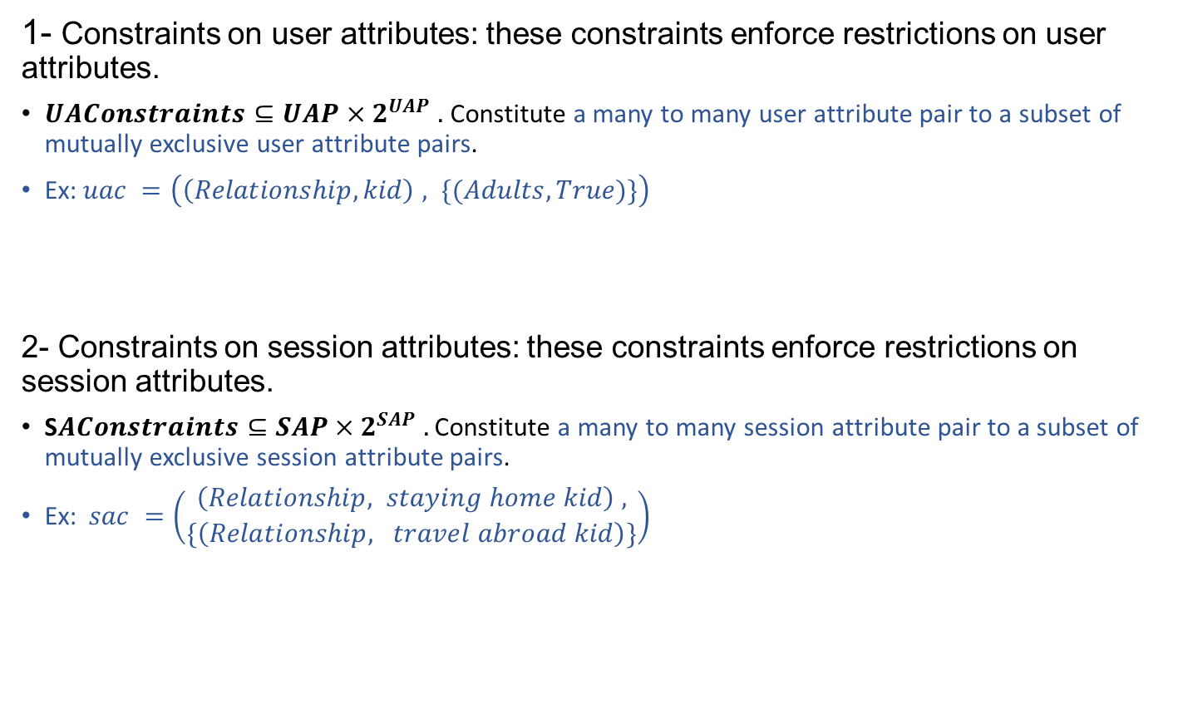
The HABAC Model
3- Constraints
1- Constraints on user attributes: these constraints enforce restrictions on user attributes.
$UAConstraints⊆UAP×2^{UAP} .$ Constitute a many to many user attribute pair to a subset of mutually exclusive user attribute pairs.
Ex:$uac =\left(\left(Relationship, kid\right) , \{(Adults, True)\}\right)$
2- Constraints on session attributes: these constraints enforce restrictions on session attributes.
S$AConstraints⊆SAP×2^{SAP} .$ Constitute a many to many session attribute pair to a subset of mutually exclusive session attribute pairs.
Ex:$sac =\left(\begin{aligned}\left(Relationship, staying home kid\right) , \\ \{\left(Relationship, travel abroad kid\right)\}\end{aligned}\right)$
(Relationship, kid)
(Adults, True)
(Relationship, staying home kid)
(Relationship, travel abroad kid)
Notes:
Constraints on user attributes: these..
For example, If I want to prevent any user who have his Relationship attribute equal to Kid, from having a value true for the attribute Adult. I will create this constraint on user attribute.
Constraints on session attributes: these..
For example, If I want to prevent any user who is currently have his Relationship attribute equal to Staying home Kid, from having another current value of the Relationship attribute equal to Travel abroad kid. I will create this constraint on session attribute.

Slide 17
Our Contribution
Design, formalize ABAC based access control model for smart home IoT (HABAC).
Analyze HABAC model relative to the previously published EGRBAC model [4]. Compare the theoretical expressive power of these models by:
  Introduce HABAC configuration that translates EGRBAC policies in a manner that they can be implemented by HABAC.
  Provide an algorithm to convert an HABAC specification to EGRBAC.
  Discuss the insights for practical deployment of these models resulting from these constructions.
Notes:
The second part of our contribution is to compare our model to the previously published model EGRBAC.

Slide 18
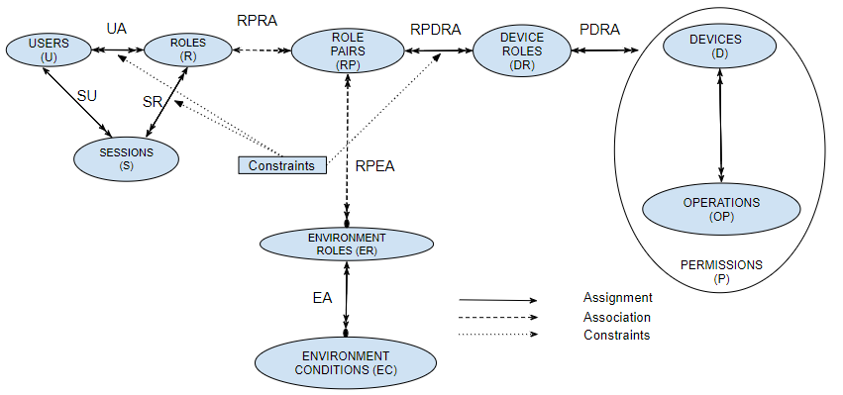
The HABAC Model
3- Constraints
The main idea in EGRBAC is that a user is assigned to a set of roles and according to the current active sessions, and current active environment roles some role pairs will be active, the user will get access to the permissions assigned to the device roles which are assigned to the current active role pairs.
Notes:
First, let us give a brief introduction to EGRBAC.
In addition to Roles, EGRBAC incorporates the notion of Device Roles and Environment Roles.
Roles (R) are analogous to the traditional RBAC users roles. However, in the context of smart homes, a role specifically represents the relationship between the user and the family.
Device roles (DR) are defined as means of categorizing permissions of different devices.
Environment roles (ER) represent environmental contexts, such as daytime/nighttime, and winter/summer.
A role pair 𝑟𝑝 has a role part 𝑟𝑝.𝑟 that is the single role associated with 𝑟𝑝, and an environment role part 𝑟𝑝.𝐸𝑅 that is the subset of environment roles associated with 𝑟𝑝.
The reasons for choosing EGRBAC in specific to compare it against HABAC are that:
1- First EGRBAC is a contextual aware, fine grained model designed specifically to meet smart home challenges.
2- Second, it satisfies different criterias for home IoT access control models proposed by different authores.

Slide 19
Our Contribution
Design, formalize ABAC based access control model for smart home IoT (HABAC).
Analyze HABAC model relative to the previously published EGRBAC model [4]. Compare the theoretical expressive power of these models by:
  Introduce HABAC configuration that translates EGRBAC policies in a manner that they can be implemented by HABAC.
  Provide an algorithm to convert an HABAC specification to EGRBAC.
  Discuss the insights for practical deployment of these models resulting from these constructions.
Notes:
So, the first step in comparing the two models, is introducing an approach that translates EGRBAC policies in a manner that they can be implemented by HABAC.

Slide 20
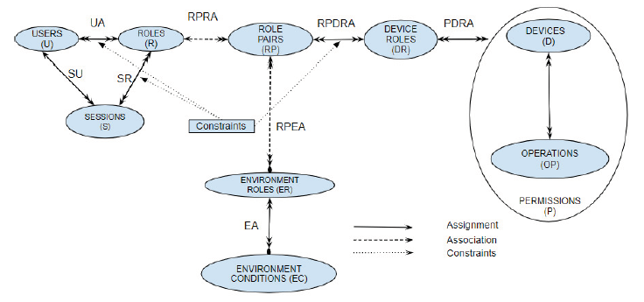


Constructing HABAC From EGRBAC
  The goal is to construct HABAC elements (U, UA, SA, ES, ESA, D, DA, OP, OPA) and the authorization policy function from EGRBAC policy in such a way that the authorizations are the same as those under EGRBAC.
Notes:
The purpose is to see whether we can fully express any EGRBAC configuration in HABAC model, and if not which model is more expressive, and in what terms.

Slide 21
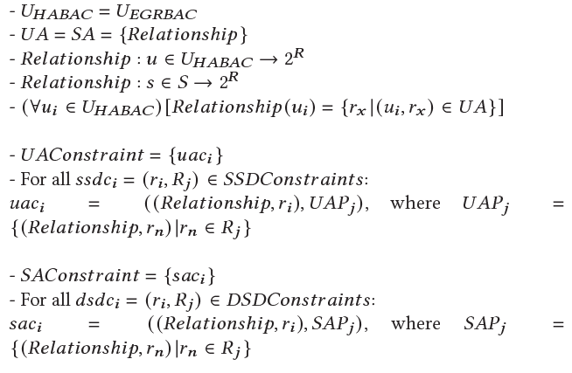
Constructing HABAC From EGRBAC
The set of users are the same in both systems.
Roles are expressed through the user attribute 𝑅𝑒𝑙𝑎𝑡𝑖𝑜𝑛𝑠ℎ𝑖𝑝 in HABAC.
𝑅𝑒𝑙𝑎𝑡𝑖𝑜𝑛𝑠ℎ𝑖𝑝 is a user and a session attribute that takes a user or a session as an input and returns the set of roles assigned to that user or that session
Static separation of duty constraints 𝑆𝑆𝐷𝐶𝑜𝑛𝑠𝑡𝑟𝑎𝑖𝑛𝑡𝑠 are translated into user attributes constraints in HABAC.
Dynamic separation of duty constraints 𝐷𝑆𝐷𝐶𝑜𝑛𝑠𝑡𝑟𝑎𝑖𝑛𝑡𝑠 are translated into subject attributes constraints in HABAC
Notes:
1- so for each user we assign the appropriate relationship attribute to it, where the value of that attribute is basically the roles assigned to it in the EGRBAC configuration.

Slide 22
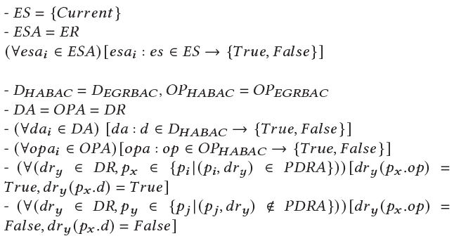
Constructing HABAC From EGRBAC
Environment roles are translated into atomic environment state attributes.
Device roles in EGRBAC are translated into atomic operation attributes and atomic device attributes with a range of values equal to {𝑇𝑟𝑢𝑒, 𝐹𝑎𝑙𝑠𝑒}.
Notes:
1- for example, if we have an EGRBAC environment role weekened, which is active during weekend. Then in HABAC it is represented as an attribute called weekend also, and that weekend attribute will be equal to true for the current state if it is currently weekend.
2- In EGRBAC device roles are ways of categorizing permissions. Since we do not have permission attributes in HABAC, and since a permission is mapping between a device and an operation, we translate device roles in EGRBAC into atomic operation attributes and atomic device attributes with a range of values equal to {𝑇𝑟𝑢𝑒, 𝐹𝑎𝑙𝑠𝑒}

Slide 23
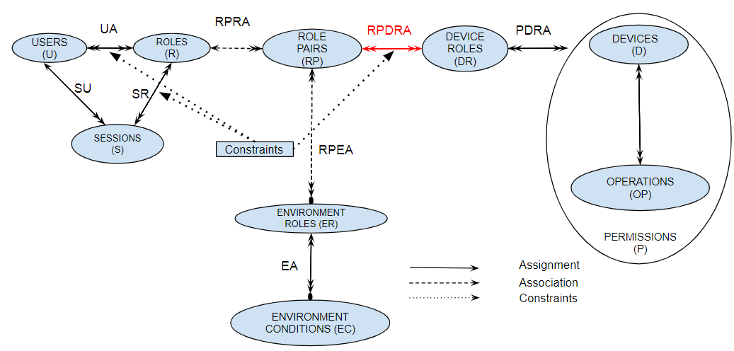
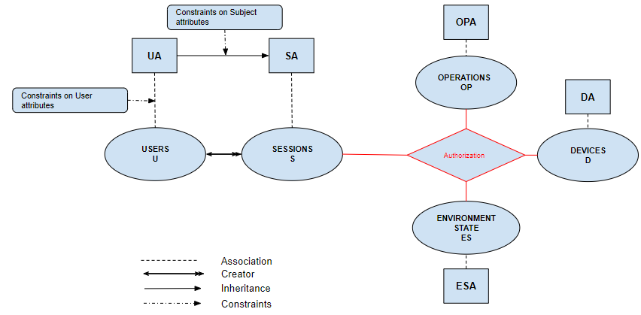
Constructing HABAC From EGRBAC
The final step is to construct the authorization policies.
In EGRBAC it is the 𝑅𝑃𝐷𝑅𝐴 that gives specific role pairs and hence users access to specific device roles and hence permissions.

Slide 24
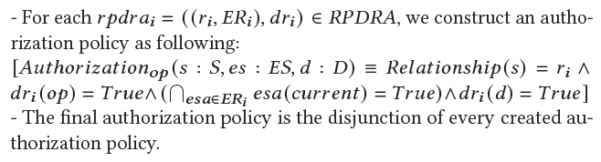
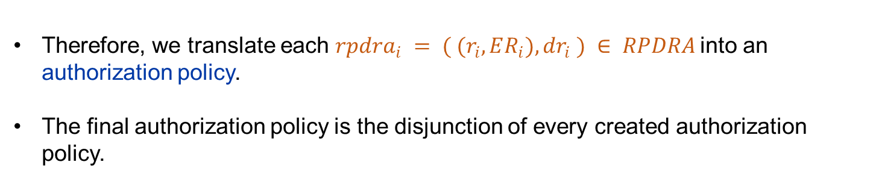
Constructing HABAC From EGRBAC
Therefore, we translate each $rpdra_{i} = ( (r_{i}, ER_{i}), dr_{i} ) ∈ RPDRA$into an authorization policy.
The final authorization policy is the disjunction of every created authorization policy.
Notes:
Here is our contribution.

Slide 25
Our Contribution
Design, formalize ABAC based access control model for smart home IoT (HABAC).
Analyze HABAC model relative to the previously published EGRBAC model [4]. Compare the theoretical expressive power of these models by:
  Introduce HABAC configuration that translates EGRBAC policies in a manner that they can be implemented by HABAC.
  Provide an algorithm to convert an HABAC specification to EGRBAC.
  Discuss the insights for practical deployment of these models resulting from these constructions.
Notes:
The second part of the comparison is doing the translation in the other direction.

Slide 26
Constructing EGRBAC From HABAC
  The goal is to construct EGRBAC elements (U, R, EC, ER, RP, D, OP, P, DR), assignments (UA, EA, PDRA, RPDRA), and associations (RPRA, RPEA) from HABAC policies in such a way that the authorizations are the same as those under HABAC.
Notes:
Here is our contribution.

Slide 27
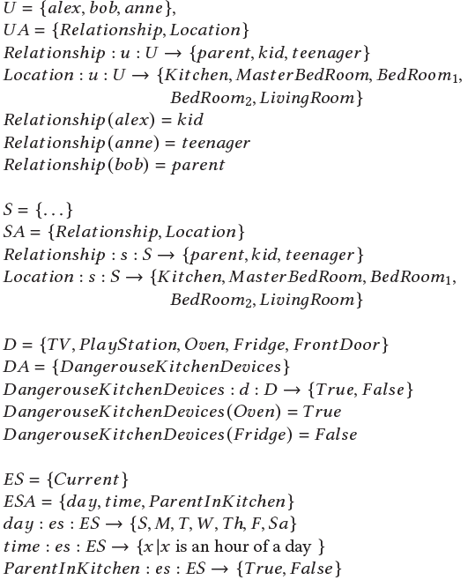
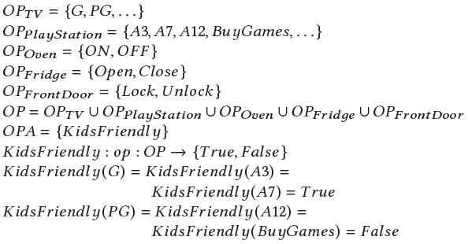
Constructing EGRBAC From HABAC
Notes:
Suppose we have this use case, where we have:
1- Three users. Assigned to different relationships.
2- we have sessions attributes similar to user attributes.
3- we have different devices.
4- we also have one device attribute…….
5- we have different operations for different devices, and we also have one operation attribute kids friendly, which is equal to True for kids friendly operations such as G contents, and equal to false for non kids friendly contents such as PG contents..

Slide 28
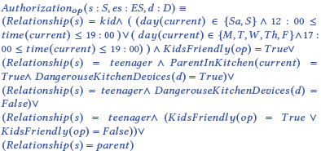
Constructing EGRBAC From HABAC
Notes:
The authorization function is a disjunction of five propositional statements.:
1- The first statement gives kids access to kids friendly operations during weekdays
evenings, or weekends afternoon and evenings.
2- The second statement gives teenagers access to dangerous kitchen devices only
when one of the parents is in the kitchen.
3- The third statement authorizes teenagers to use non dangerous kitchen devices unconditionally.
4- The fourth statement allows teenagers to access kids friendly operations, and non kids friendly operations unconditionally.
5- Finally, the fifth statement gives parents access to anything unconditionally.

Slide 29
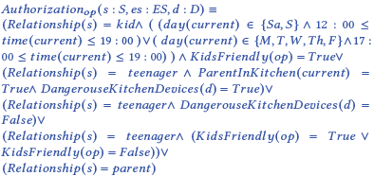
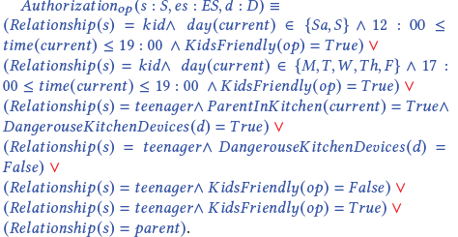
Constructing EGRBAC From HABAC
1. From Authorization Policy to Authorization Array
First, we convert the authorization policy into a disjunctive normal form (DNF)
Notes:
All logical formulas can be converted into an equivalent DNF form.
Here is the authorization policy in the DNF format after following the standard approach to convert it.
We call each conjuncted term a condition. We have different conditions. This one describe a session hence it is a session condition, this one describe an environment hence it is an environment condition, we also have device condition, and operation condition.
In this DNF authorization policy we have seven conjunctive clauses, each conjunctive clause represents one access authorization rule.
-------------------------------------------------------------------------

Slide 30
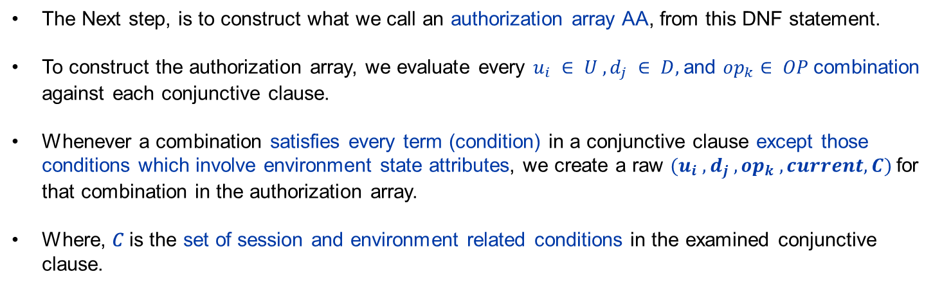
Constructing EGRBAC From HABAC
1. From Authorization Policy to Authorization Array
The Next step, is to construct what we call an authorization array AA, from this DNF statement.
To construct the authorization array, we evaluate every $u_{i} ∈ U , d_{j} ∈ D,$and $op_{k}∈ OP$combination against each conjunctive clause.
Whenever a combination satisfies every term (condition) in a conjunctive clause except those conditions which involve environment state attributes, we create a raw $(u_{i} ,d_{j} , op_{k} , current, C)$for that combination in the authorization array.
Where, 𝐶 is the set of session and environment related conditions in the examined conjunctive clause.

Slide 31
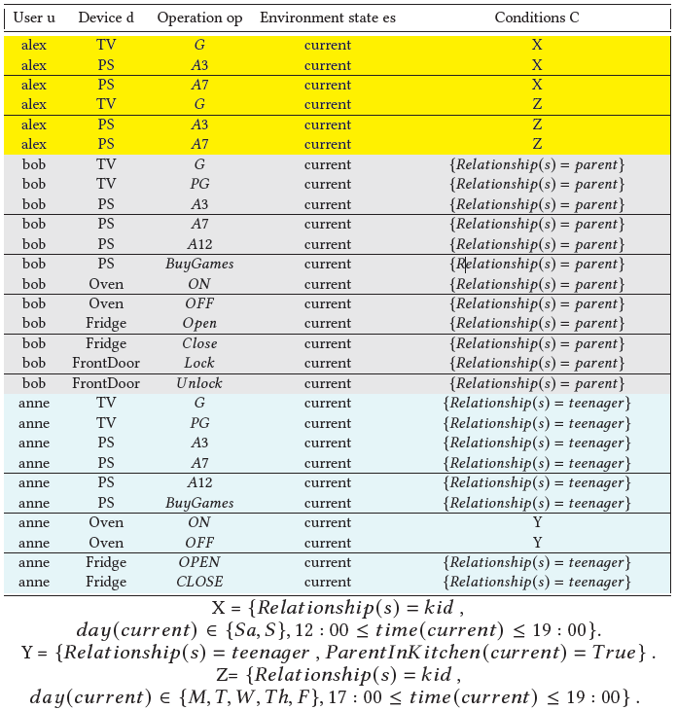
Constructing EGRBAC From HABAC
1. From Authorization Policy to Authorization Array
Notes:
So here is the resulted authorization array of our use case.
For example, the first raw means that alex is allowed to perform an operation G on the device TV during the current environment state, if and only if the condition X is satisfied.
And so on.

Slide 32
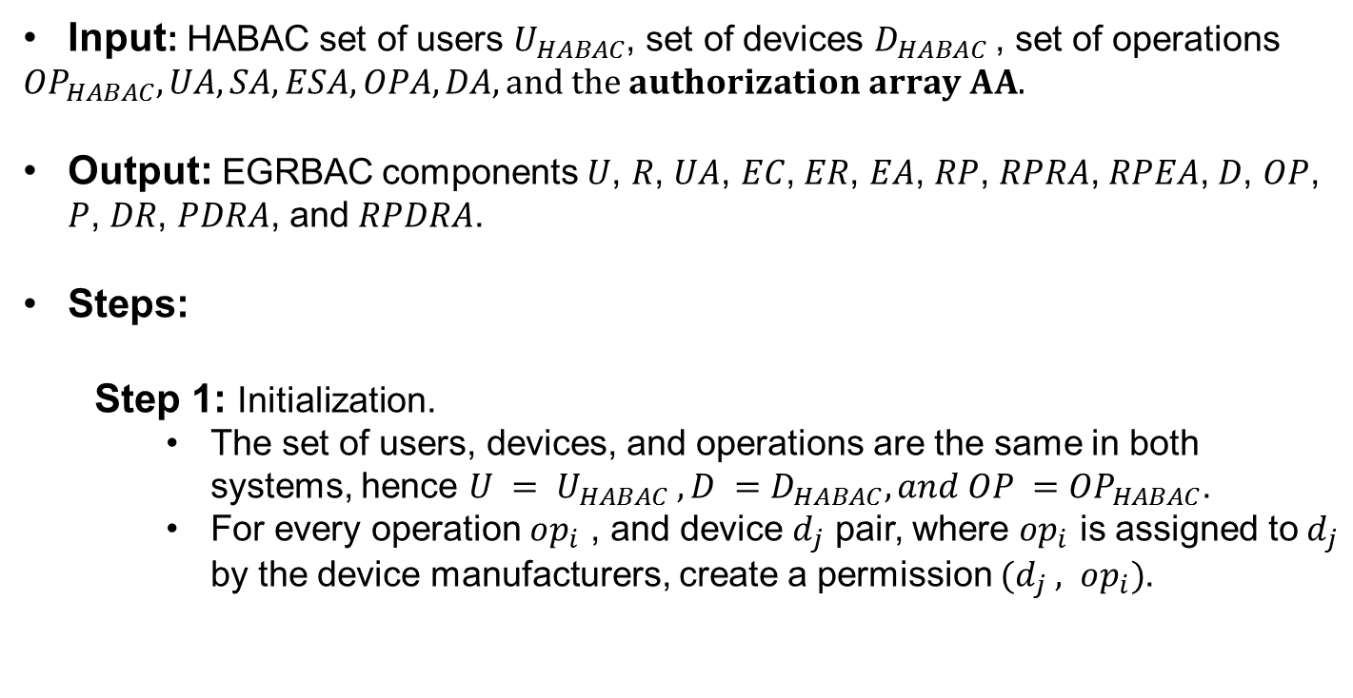
Constructing EGRBAC From HABAC
2. From Authorization Array to EGRBAC Approach
Input: HABAC set of users $U_{HABAC}$, set of devices $D_{HABAC}$, set of operations
$${OP}_{HABAC}, UA, SA, ESA, OPA, DA, and the authorization array AA.$$
Output: EGRBAC components 𝑈, 𝑅, 𝑈𝐴, 𝐸𝐶, 𝐸𝑅, 𝐸𝐴, 𝑅𝑃, 𝑅𝑃𝑅𝐴, 𝑅𝑃𝐸𝐴, 𝐷, 𝑂𝑃, 𝑃, 𝐷𝑅, 𝑃𝐷𝑅𝐴, and 𝑅𝑃𝐷𝑅𝐴.
Steps:
  Step 1: Initialization.
    The set of users, devices, and operations are the same in both systems, hence $U = U_{HABAC} , D =D_{HABAC}, and OP ={OP}_{HABAC}$.
    For every operation $op_{i}$ , and device $d_{j}$ pair, where $op_{i}$ is assigned to $d_{j}$ by the device manufacturers, create a permission $(d_{j} , op_{i})$.
Notes:
After constructing the authorization array, we follow this approach

Slide 33
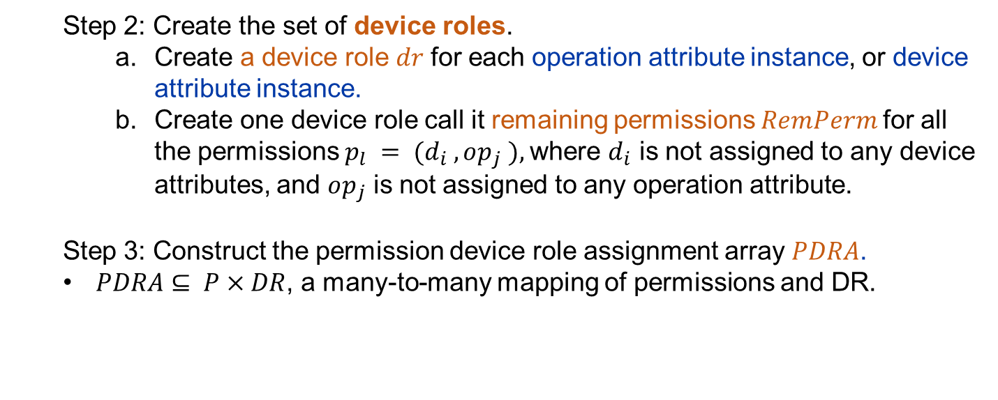
Constructing EGRBAC From HABAC
2. From Authorization Array to EGRBAC Approach
  Step 2: Create the set of device roles.
    Create a device role 𝑑𝑟 for each operation attribute instance, or device attribute instance.
    Create one device role call it remaining permissions 𝑅𝑒𝑚𝑃𝑒𝑟𝑚 for all the permissions $p_{l} = (d_{i} , op_{j} ),$where $d_{i}$ is not assigned to any device attributes, and $op_{j}$ is not assigned to any operation attribute.
  Step 3: Construct the permission device role assignment array 𝑃𝐷𝑅𝐴.
  $PDRA⊆ P×DR$, a many-to-many mapping of permissions and DR.
Notes:
1- this will capture different devices an operation attributes in term of device roles.
2- basically, this will capture the cases where some users have access to specific permissions directly without involving device’s or operation’s attributes.

Slide 34
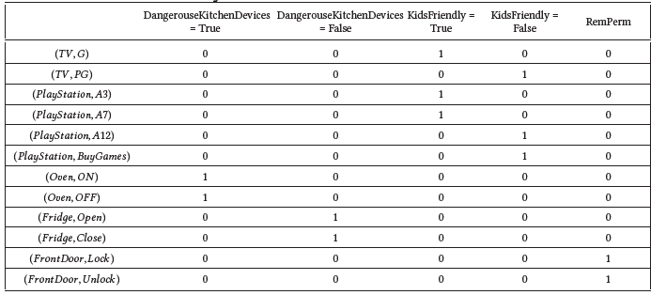
Constructing EGRBAC From HABAC
2. From Authorization Array to EGRBAC Approach
For every 𝑃𝐷𝑅𝐴[𝑖, 𝑗 ] = 1, add the pair $(p_{i}, dr_{j})$ to the set 𝑃𝐷𝑅𝐴 of EGRBAC.
Notes:
It is basically a mapping between different permissions constructed in the first step and different device role constructed in the second step.
To construct 𝑃𝐷𝑅𝐴 we first make a column for each 𝐷𝑅, and make a row for each permission 𝑝𝑥 . Then, we fill the array 𝑃𝐷𝑅𝐴, where 𝑃𝐷𝑅𝐴[𝑖, 𝑗 ] = 1 in two cases:
1- first if for the permission 𝑝𝑖 (corresponding to the row i) 𝑝𝑖 .𝑜𝑝 or 𝑝𝑖 .𝑑 satisfies the condition corresponding to the device role of the column j 𝑑𝑟 𝑗 .
2- if 𝑝𝑖 .𝑜𝑝 is not assigned to any operation attribute, and 𝑝𝑖 .𝑑 is not assigned to any device attribute, and the device role corresponding to this column is 𝑅𝑒𝑚𝑃𝑒𝑟𝑚.
Then from this data structure we extract the EGRBAC set PDRA .

Slide 35
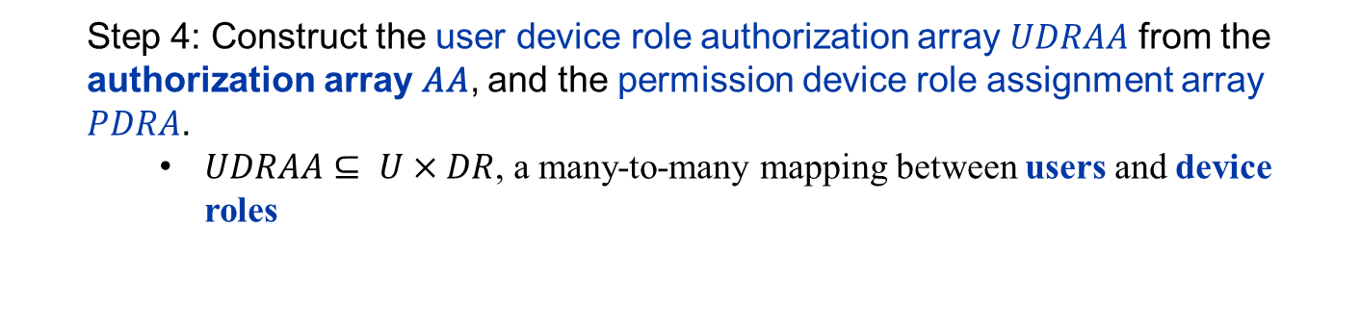
Constructing EGRBAC From HABAC
2. From Authorization Array to EGRBAC Approach
  Step 4: Construct the user device role authorization array 𝑈𝐷𝑅𝐴𝐴 from the authorization array 𝐴𝐴, and the permission device role assignment array 𝑃𝐷𝑅𝐴.
    $UDRAA⊆ U×DR$, a many-to-many mapping between users and device roles

Slide 36
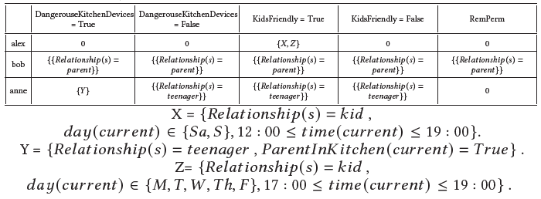

Constructing EGRBAC From HABAC
2. From Authorization Array to EGRBAC Approach
$PDRA$ $⊆$ $P×DR$
Notes:
So, from the previously created authorization array, and PDRA set. We create the UDRA array.
This array convey all the information that we need.
We have a raw for each user , and a column for each device role, and each entry basically tell us if a user have an authorization to access the corresponding device role or not. And if yes under which environment and session conditions.
----------------------------------------------------------------------------------------------------------------------------------
If they asked:
To construct 𝑈𝐷𝑅𝐴𝐴, we first make a raw for each user, and a column for each device
role.
Then, for every 𝑈𝐷𝑅𝐴𝐴[𝑖, 𝑗 ] ∈ 𝑈𝐷𝑅𝐴𝐴 we check the 𝐴𝐴 for every 𝑢𝑖 , and 𝑝𝑥 combination, where (𝑝𝑥, 𝑑𝑟 𝑗 ) ∈ 𝑃𝐷𝑅𝐴. Here, we have three cases:

Slide 37
Constructing EGRBAC From HABAC
2. From Authorization Array to EGRBAC Approach
  Step 5: Construct the rest of EGRBAC elements (𝑅, 𝐸𝐶, 𝐸𝑅, 𝑅𝑃),
  assignments (𝑈𝐴, 𝐸𝐴, 𝑅𝑃𝐷𝑅𝐴), and associations (𝑅𝑃𝑅𝐴, 𝑅𝑃𝐸𝐴) by
  following our proposed EGRBAC users and environment roles constructing
  Algorithm.
The main idea is to loop through the columns of UDRAA, each column is corresponding to different user's access rights to a specific device role.
Inside each columns loop through the fields of different rows to extract and construct different EGRBAC components.
Notes:
So now we already figured the device roles set, we also figured different permissions assignments to different device roles., and we also created this UDRAA.
We then feed these information into the …….
This algorithm…..
For example, lets take this entry …..

Slide 38
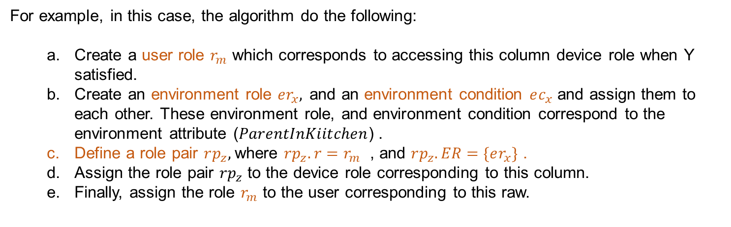
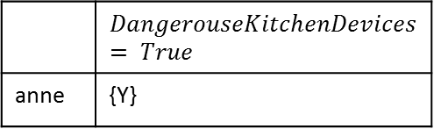
Constructing EGRBAC From HABAC
2. From Authorization Array to EGRBAC Approach
For example, in this case, the algorithm do the following:
  Create a user role $r_{m}$ which corresponds to accessing this column device role when Y satisfied.
  Create an environment role $er_{x},$and an environment condition $ec_{x}$ and assign them to each other. These environment role, and environment condition correspond to the environment attribute ($ParentInKiitchen$) .
  Define a role pair $rp_{z},$where $rp_{z}.r=r_{m}$ , and $rp_{z}.ER=\{er_{x}\}$ .
  Assign the role pair $rp_{z}$ to the device role corresponding to this column.
  Finally, assign the role $r_{m}$ to the user corresponding to this raw.
 | $$DangerouseKitchenDevices= True$$
anne | {Y}
Notes:
Here is our

Slide 39
Constructing EGRBAC From HABAC
2. From Authorization Array to EGRBAC Approach
  The algorithm do the same for all the entries in the UDRAA.
  By the end of this algorithm, all the EGRBAC elements (U, R, EC, ER, RP, D, OP, P, DR), assignments (UA, EA, PDRA, RPDRA), and associations (RPRA, RPEA) will be constructed.
  Step 6: Finally, we merge similar roles.

Slide 40
Our Contribution
Design, formalize ABAC based access control model for smart home IoT (HABAC).
Analyze HABAC model relative to the previously published EGRBAC model [4]. Compare the theoretical expressive power of these models by:
  Introduce HABAC configuration that translates EGRBAC policies in a manner that they can be implemented by HABAC.
  Provide an algorithm to convert an HABAC specification to EGRBAC.
  Discuss the insights for practical deployment of these models resulting from these constructions.
Notes:
Second, the problem statement.

Slide 41
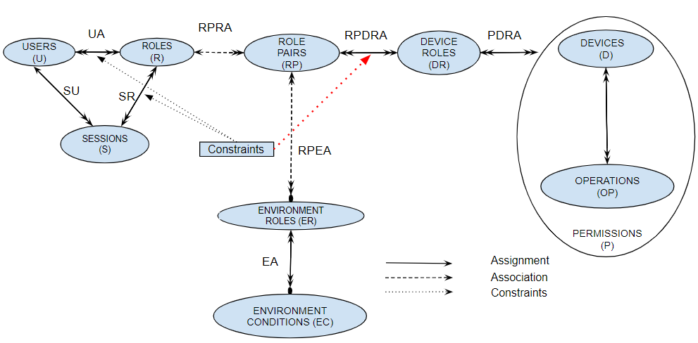
HABAC Vs EGRBAC
1- In HABAC we can not create something equivalent to EGRBAC PRConstraints.
Notes:
When we constructed HABAC from EGRBAC, we couldn’t create something equivalent to the PRConstraint.
This constraint basically prevent future assignments of specific roles to specific permissions.
The main reason is in EGRBAC, the way a user get access to specific set of permissions happens through a series of assignments, on one hand, we have users roles assignments, users roles and environment roles associations. On the other hand, we have permissions to device roles assignments. And finally, the 𝑅𝑃𝐷𝑅𝐴 relation brings all these components together by assigning role pairs to device roles.
There is no other way a user can get access to a specific permission. Hence, by controlling this attack point 𝑅𝑃𝐷𝑅𝐴 we can control which roles get access to which permissions.
In HABAC on the other hand, we don’t have an "attack point" similar to 𝑅𝑃𝐷𝑅𝐴 in EGRBAC that we can control to prevent specific access permission.
The only way to make sure that certain users can not get access to specific permissions is by checking each request to access these permissions and look for those prohibited users.
This is a significant advantage of EGRBAC which can enforce such constraints at assignment time whereas HABAC-like models would need to enforce these at enforcement time.

Slide 42
HABAC Vs EGRBAC
2- In EGRBAC it is easy to define who has what permissions, and who is not allowed to have a future access
to specific permissions.
1- In HABAC we can not create something equivalent to EGRBAC PRConstraints.
Notes:
Simply by checking users' roles, we can know which permissions assigned to which roles.
We cannot do that in HABAC.
---------------------------------------------------------------------------------------------------------------------
If they ask:
ABAC makes it easy to specify access rules, but to determine the permissions available to a particular user, a potentially large set of rules might need to be executed in exactly the same order in which the system applies them. This can make it impossible to determine risk exposure for a given user.

Slide 43
HABAC Vs EGRBAC
3- in EGRBAC, we can’t handle HABAC policies that involve
users, devices and operations dynamic attributes. Such handling may lead to role explosion
in EGRBAC.
2- In EGRBAC it is easy to define who has what permissions, and who is not allowed to have a future access
to specific permissions.
1- In HABAC we can not create something equivalent to EGRBAC PRConstraints.
Notes:
On the other hand, when we constructed EGRBAC from HABAC, we figured that we ….
Hence, in conclusion, a hybrid model combining HABAC and EGRBAC features may be the most suitable for smart home IoT, and likely more generally.
---------------------------------------------------------------------------------------------
If they asked:
In general, we have two types of attributes:
(a) Dynamic Attributes, this type is rapidly changing due to different conditions. For instance, user location,
weather, and device temperature.
(b) Static Attributes, this type is relatively static and need administrator action to be changed. For
example, user relationship, device level of danger, and so on
In our approach, we translate device, and permission attributes instances into device roles.
In EGRBAC, device roles are means of categorizing permissions of different devices according to relatively static characteristics. when a permission is assigned to a specific device role, then it is part of that device role until some administration change happens.
There is no way to neither dynamically activates and deactivates device roles, nor dynamically activates and deactivates assignment of permissions to different device roles.
For example: in HABAC we may have a device attribute 𝑑𝑒𝑣𝑖𝑐𝑒_𝑡𝑒𝑚𝑝𝑒𝑟𝑎𝑡𝑢𝑟𝑒 : 𝑑 : 𝐷 ←− {𝐿𝑜𝑤,𝐻𝑖𝑔ℎ}. Moreover, we may want to authorize some users to access a device 𝑑𝑥 only if 𝑑𝑒𝑣𝑖𝑐𝑒_𝑡𝑒𝑚𝑝𝑒𝑟𝑎𝑡𝑢𝑟𝑒 (𝑑𝑥 ) = 𝐿𝑜𝑤.
In order to accommodate this example in EGRBAC we have two options, the first one is by creating two device roles one for high temperature, and another for low temperature for each device. This will result in a role explosion. Furthermore, there is no mechanism in EGRBAC that can dynamically activates 𝑑𝑥 ’s high temperature device role while deactivating the low temperature device role when 𝑑𝑟𝑥 has high temperature and vice versa.
The second option is to create a device role for low temperature devices, if they have similar access conditions, and another device role for high temperature devices. However, there is no way to dynamically activates or deactivates devices membership in different device roles according to their temperatures.
The similar argument holds when we deal with dynamic operation, and user attributes.

Slide 44
Conclusion
We introduce HABAC access control model for smart home IoT.
It is a dynamic, fine grained ABAC based model that captures different attributes of users, environment, operations, and devices.
We provide a use case scenario demonstration. Moreover, we compare the theoretical expressive power of our model to EGRBAC which is a dynamic contextual aware RBAC based access control model. We do that by providing approaches for converting an HABAC specification to EGRBAC and vice versa.
In conclusion, we believe that a hybrid model retaining HABAC and EGRBAC features may be the most suitable for smart home IoT, and likely more generally.

Slide 45

Notes:
And finally, thank you for listening, and I guess I am are ready for questions.

Slide 46
Thank You

