Slide 1
Authorization Federation in IaaS Multi Cloud
Navid Pustchi, Ram Krishnan and Ravi Sandhu
SCC 2015
World-Leading Research with Real-World Impact!
1

Slide 2
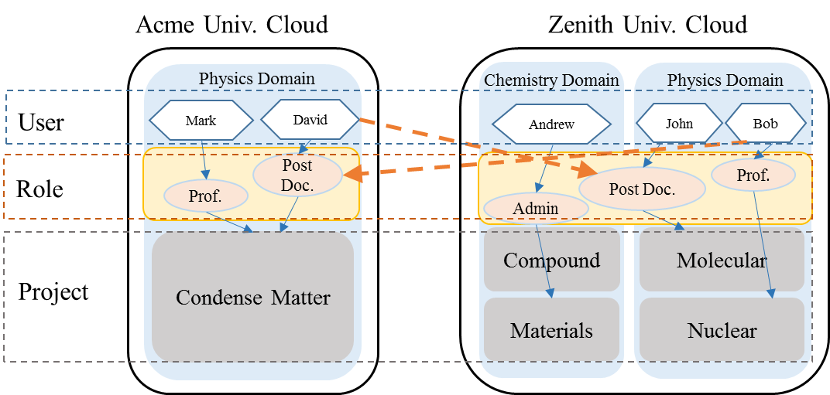
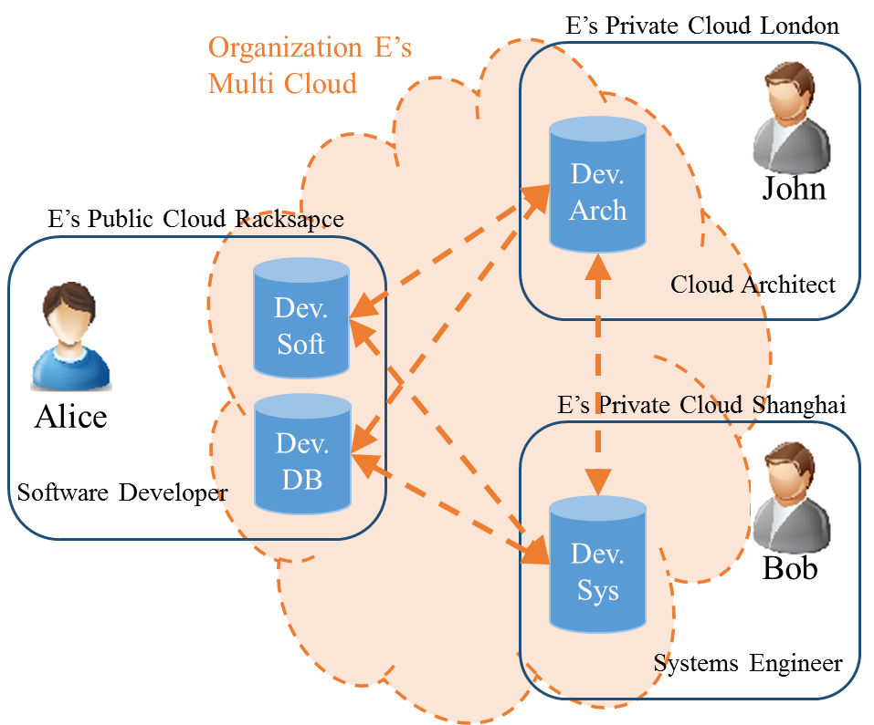
Why Multi Cloud?
Collaboration of organizations across clouds.
Organizations with resources across multiple clouds.
World-Leading Research with Real-World Impact!
2

Slide 3
Scope of Contribution
Cloud Federation
Service
SaaS
PaaS
IaaS
Platform
Homogenous
Heterogeneous
Trust
Circle-of-Trust
Peer-to-Peer
Coupling
Authentication Federation
Authorization Federation
World-Leading Research with Real-World Impact!
3

Slide 4
Multi Cloud Collaboration
Cloud Federation
Service (IaaS, PaaS, SaaS)
Heterogeneous: Google account (Open ID 2.0) Heterogeneous within google.
Homogenous: Eduroam federated network access.
Platform
Heterogeneous: OpenStack federation with AWS.
Homogenous: Keystone to Keystone federation.
Trust
Circle-of-Trust: Alliance of institutions for sharing scientific data such as CERN.
Peer-to-Peer: Best Buy federating with Rackspace.
Coupling
Identity Federation: SAML, OAuth, OpenID, SSO.
Authorization Federation: SAML, OAuth.
World-Leading Research with Real-World Impact!
4

Slide 5
Trust Framework
Trust
Coupling
Circle-of-Trust
Peer-to-Peer
Initiation
Bilateral
Unilateral
Direction
Bidirectional
Unidirectional
Transitivity
Non-Transitive
Transitive
World-Leading Research with Real-World Impact!
5

Slide 6
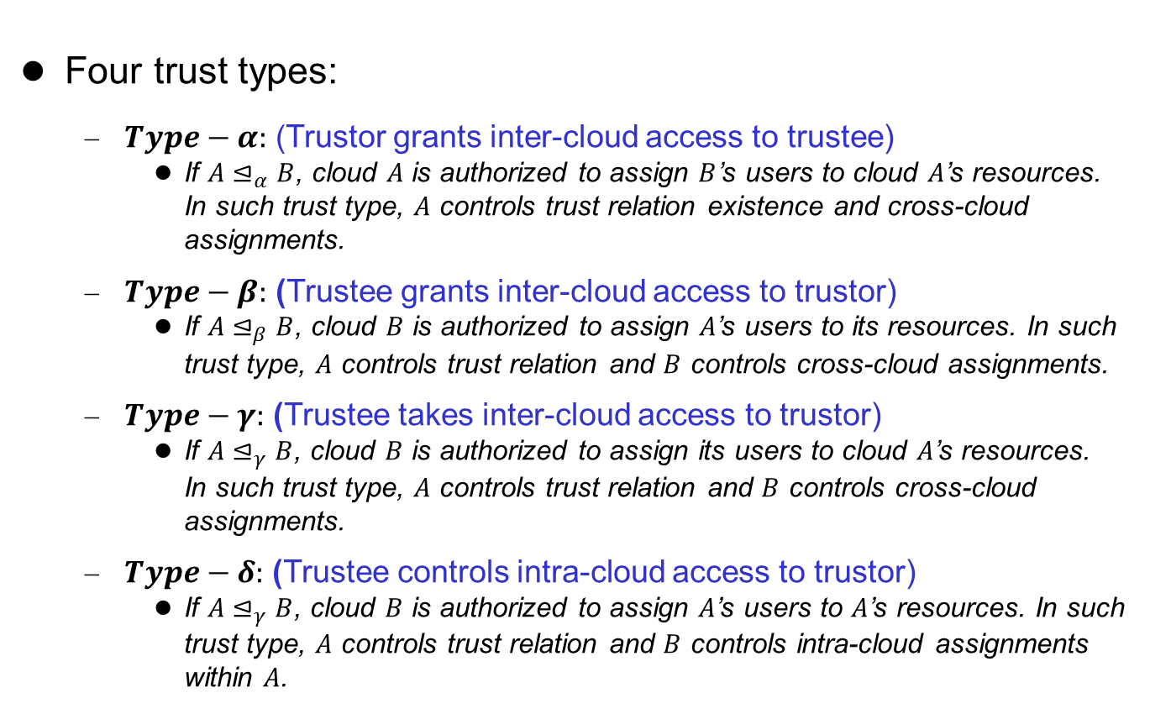
Concept of Trust
Four trust types:
$Type−α:$ (Trustor grants inter-cloud access to trustee)
If $A⊴_{α}B$, cloud $A$ is authorized to assign $B$’s users to cloud $A$’s resources. In such trust type, $A$ controls trust relation existence and cross-cloud assignments.
$Type−β:$ (Trustee grants inter-cloud access to trustor)
If $A⊴_{β}B$, cloud $B$ is authorized to assign $A$’s users to its resources. In such trust type, $A$ controls trust relation and $B$ controls cross-cloud assignments.
$Type−γ:$ (Trustee takes inter-cloud access to trustor)
If $A⊴_{γ}B$, cloud $B$ is authorized to assign its users to cloud $A$’s resources. In such trust type, $A$ controls trust relation and $B$ controls cross-cloud assignments.
$Type−δ:$ (Trustee controls intra-cloud access to trustor)
If $A⊴_{γ}B$, cloud $B$ is authorized to assign $A$’s users to $A$’s resources. In such trust type, $A$ controls trust relation and $B$ controls intra-cloud assignments within $A$.
World-Leading Research with Real-World Impact!
6

Slide 7
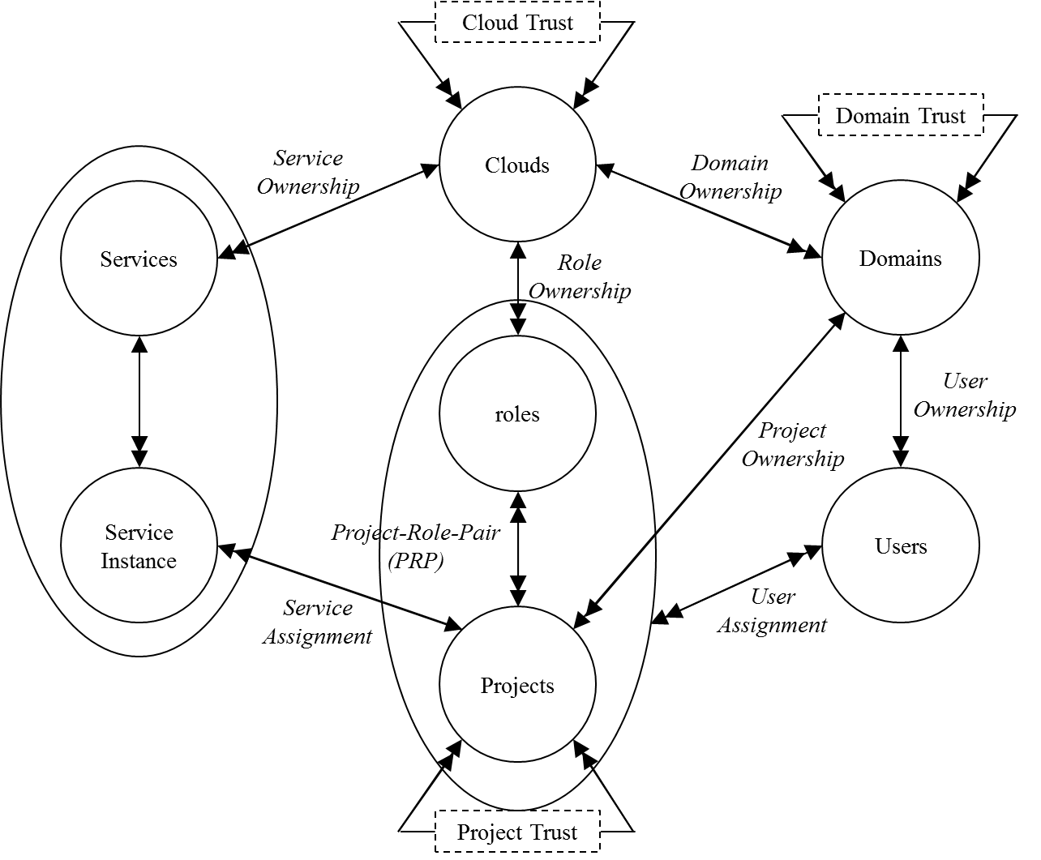
Administrative Realms
World-Leading Research with Real-World Impact!
7

Slide 8
Multi Cloud Trust
Three trust scopes based on administrative realms in cloud:
Cross Cloud Trust
Sharing cloud infrastructure resources, such as services.
Cross Domain Trust
Sharing domain resources such as projects.
Cross Project Trust
Sharing project resources such as VMs.
World-Leading Research with Real-World Impact!
8

Slide 9
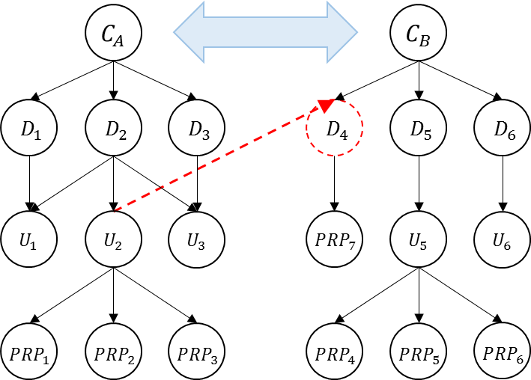
Cloud Trust
Enables sharing cloud resources, services and domains.
Set of domains shared between clouds with trust type (for domain trust).
Sharing services by creating private domains for service allocation.
Trust relation in Cloud Trust is Peer-to-Peer, bilateral, bidirectional, non-transitive.
World-Leading Research with Real-World Impact!
9

Slide 10















Domain Trust
Enabling cross cloud access by assigning users to PRPs between trusted domains.
Trust relations are Peer-to-Peer, unilateral, unidirectional, non-transitive.
$$D_{A}$$
$$D_{A} ⊴_{β}D_{B}$$
$$D_{B}$$
$$U_{1}$$
$$U_{2}$$
$$U_{3}$$
$$U_{4}$$
$$U_{5}$$
$$U_{6}$$
$${PRP}_{1}$$
$${PRP}_{2}$$
$${PRP}_{3}$$
$${PRP}_{4}$$
$${PRP}_{5}$$
$${PRP}_{6}$$
World-Leading Research with Real-World Impact!
10

Slide 11



















Project Trust
Enabling cross cloud access to service instances by assigning users to PRPs between trusted projects.
Trust relations are Peer-to-Peer, unilateral, unidirectional, non-transitive.
$$D_{A}$$
$${PRP}_{2} ⊴_{γ}{PRP}_{5}$$
$$D_{B}$$
$$U_{1}$$
$$U_{2}$$
$$U_{3}$$
$$U_{4}$$
$$U_{5}$$
$$U_{6}$$
$${PRP}_{1}$$
$${PRP}_{2}$$
$${PRP}_{3}$$
$${PRP}_{4}$$
$${PRP}_{5}$$
$${PRP}_{6}$$
$${VM}_{1}$$
$${VM}_{2}$$
$${VM}_{3}$$
$${VM}_{4}$$
$${VM}_{5}$$
$${VM}_{6}$$
World-Leading Research with Real-World Impact!
11

Slide 12
Related Work
RBAC extensions
ROBAC (collaboration ins not supported).
GB-RBAC (group does own users).
Role Based delegation models
Delegation chains lacks dynamicity of trust in cloud federation environments.
Multi-tenant trust models in single cloud.
MT-RBAC (Multi-Tenant RBAC).
CTTM (Cross Tenant Trust model).
OSAC-DT (OpenStack Access Control with Domain Trust).
World-Leading Research with Real-World Impact!
12

Slide 13
Conclusion & Future Work
Multi-cloud trust model
Cloud trust.
Domain trust.
Project trust.
Trust framework & trust types
Four types of trust applicable to administrative realms in cloud.
Implementation in single cloud
Partial implementation of domain-trust in single cloud OpenStack.
Future Work
Cloud trust implementation.
Implementation in federated OpenStack clouds.
Project trust implementation.
Hierarchical multi-domain model.
Attribute based models.
World-Leading Research with Real-World Impact!
13

