Slide 1
Institute for Cyber Security
A Group-Centric Model for Collaboration with
Expedient Insiders in Multilevel Systems
Khalid Zaman Bijon, Ravi Sandhu, Ram Krishnan
Institute for Cyber Security
University of Texas at San Antonio
May 22, 2012
International Symposium on Security in Collaboration Technologies and Systems
World-Leading Research with Real-World Impact!
1

Slide 2
Expedient Insiders
Who are expedient insiders?
Any outside Collaborators, i.e. Domain specialists, cyber-security experts, etc.
Difference with respect to true insiders
Transient rather than persistent
Information sharing is based on need-to-consult basis
Less commitment than long time employees
What are the Challenges?
Information selection for collaboration
Restrict unnecessary access
3. Import results
World-Leading Research with Real-World Impact!
2

Slide 3
Collaboration Process #1
Assign to a place in existing organizational structure
Top Secret
Secret
Classified
Outside Collaborators
Sharing more information than necessary
Open to more true-insiders than necessary
Unclassified
World-Leading Research with Real-World Impact!

Slide 4
Collaboration Process #2
Top Secret
Secret
Classified
Outside Collaborators
Scalability is the main Issue!
Unclassified
World-Leading Research with Real-World Impact!
4
Individual Sharing Collaboration

Slide 5
Group Centric Collaboration
Outside Collaborators
Just Right Sharing
Scalable
Organization
Collaboration Group
with Expedient Insider
World-Leading Research with Real-World Impact!
5
5
Notes:
5

Slide 6
Group Centric Collab. (cont.)
Operational aspect
User-Subject Model
User: human in the system
Subject: Programs/processes on behalf of user
Object-Version Model
write creates a new version
Security classification of versions (same?)
Subject Model
Read-Only Subject (can not write object but read from multiple groups)
Read-Write Subject (can write but limited read capability)
Administrative aspect
Membership Management
True Insider: Regular employee
Expedient Insider: Collaborators, Consultants
Group Lifecycle
Objects Management
Lattice Structure
G-SIS specification
World-Leading Research with Real-World Impact!
6

Slide 7
True Insiders Vs Expedient Insiders
True Insiders | Expedient Insiders
1. Simultaneously hold membership in multiple groups and organization | 1. Can get membership to multiple groups but not in organization
2. Retain the same organization clearance when joining a new group | 2. Assigned a single clearance for every group they join
3. Can access all objects that - Satisfy dominance relation - in organization or joined groups | 3. Can access all objects that - Satisfy dominance relation - in joined groups only
World-Leading Research with Real-World Impact!
7

Slide 8
Operational Semantics
CreateRWInCG Subject
CreateRWInOrg Subject
CreateRO Subject
Create Object
Read Version
Update Version
Kill Subject
CreateRWInCG Subject
CreateRWInOrg Subject
CreateRO Subject
Create Object
Read Version
Update Version
Kill Subject
Administrative Model
Operational Model
Establish/Disband Group
TS
TS
TS
TS
TS
TS
TS
TS
Join Insider
TS
S
Leave Insider
Join Outsider
S
S
S
S
S
S
S
S
S
S
S
Add Version
C
Remove Version
C
C
C
C
C
C
C
C
C
Leave Expedient
Insider
Merge Version
U
U
U
U
U
U
U
U
Import Version
U
Organization
Collaboration Group
Outside Consultants
World-Leading Research with Real-World Impact!
8

Slide 9
Read-Only Vs Read-Write Subject
Read Only | Read Write
1. Can not write, read is restricted by BLP simple security property | 1. Can read and write, however, write is restricted by BLP strict * property
2. User determines the security clearance (<= user’s clearance)
3. Can read objects across groups | 3. restricted within the same group it was created
4. Can not create new object | 4. Can create new object and object inherits its clearance
5. Read operation does not create new object versions | 5. Only a write operation always create a new version of the respective object, however, does not change the classification of the version
World-Leading Research with Real-World Impact!
9

Slide 10
Merge Vs Import Operation
Merge | Import
1. Can applicable only to previously added version | 1. Only to the newly created versions
2. Does not create new objects | 2. Always creates a new object
3. Does not change the object classification | 3. New object inherits classification from importing one
Collaboration Group
Merge
Add
Import
Organization
New object
World-Leading Research with Real-World Impact!
10

Slide 11
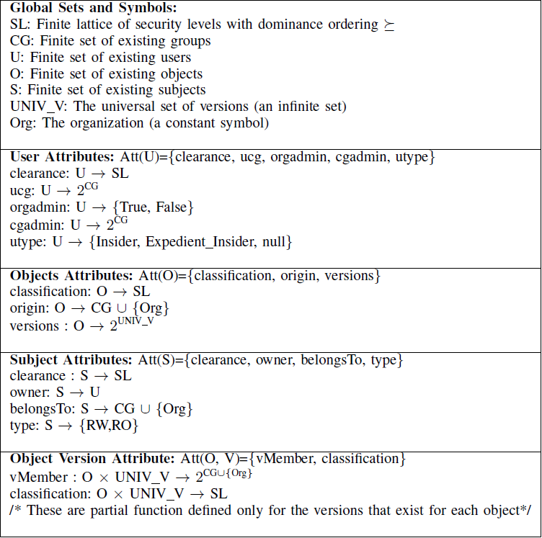
Attribute Specification
World-Leading Research with Real-World Impact!
11

Slide 12
Possible Enhancement
Join Insider operation could modify clearance
A manager of the organization could be a group director, etc.
Add object operation could modify classification
A secret object might get top secret classification in collaboration group
Add object could sanitize information
Organization might not want to share actual object
World-Leading Research with Real-World Impact!
12

Slide 13
Conclusion & Future Work
A novel method to manage expedient-insider
collaboration in multi level systems
Advantage of Group Centric Collaboration Model
Selective information sharing
Controlled flow back of results
Does not interfere with the main lattice structure
Easier to manage collaborations
Future Work
Collaboration group with multiple organizations, expedient insiders, etc.
Merging different organization’s structures
World-Leading Research with Real-World Impact!
13

Slide 14
Thank You ☺

