Slide 1


Slide 2

Cyber Attacks on Smart Farming Infrastructure
Authors: Sina Sontowski, Maanak Gupta, Sai Sree Laya Chukkapalli, Mahmoud Abdelsalam, Sudip Mittal, Anupam Joshi, Ravi Sandhu
Presenter: Sina Sontowski
ssontowsk42@tntech.edu
Notes:
Good afternoon, my name is Sina Sontowski and I’m an undergraduate student at Tennessee Tech. I’m going to be presenting about my paper Cyber Attacks on Smart Farming Infrastructure that I researched together with Dr. Gupta, Sai Chukkapalli, Abdelsalam, Dr. Mittal, Dr. Joshi, and Dr. Sandhu.

Slide 3

Outline
Background
Network Attacks
Deauthentication Attack
Implications of Deauthentication Attack
Notes:
I’ll be providing some general information about Smart-Farming and why it is of interest to the research community. Then I’ll be talking about some network attacks that we researched. And after that I’ll be describing the Denial of Service attack that I carried out and the implications of that attack.

Slide 4
Background
Smart-Farming
Fulfill global food demand and supply
Boost productivity and maintain product quality
A Smart-Farm, an attack vector
Target for foreign competitors
Limited investment in cybersecurity
Lack of resources
Notes:
So why do we care about smart-farming? First off, a lot of progress has been made in recent years in the agricultural sector to develop smart farming and precision agriculture technologies. And the agricultural sector is an important and big part of the economy. To put this into numbers, agriculture, food, and related industries contributed $1.053 trillion to the US gross domestic product. We can just imagine what kind of impact it would have on the economy if more investments in smart farming are to be made, especially because our population is at an rapid growth and there is therefore a higher demand for food products. To meet that food demand, agriculture and food sector has been integrating data driven and internet of things technologies to increase the quantity and quality of agricultural products. That means smart farming can be a possible solution to boost productivity and maintain product quality.
However the integration of such technologies does have its downsides. Incorporating IoT systems into the agricultural amplifies various cyber risks. These risks are currently not sufficiently addressed because of limited investments in cybersecurity by domain specific companies. There is also a lack of resources and know-how among the farming community. Which increses the threat of foreign competitiors and other interested parties to attack the smart-farm. That’s why we decided to investigate smart farming technologies further and create a simple test case architecture and see how easy it would be for an attacker to create problems.

Slide 5
Research Objectives
Explore different Cyberattacks
Demonstrate a Cyberattack on a Smart Farming Architecture
Analyze the attack and why it was possible so that it can be fixed
Notes:
Our goal with this research was to explore different cyber attacks that can be carried out on a smart farming architecture to gain an oversight of what an attacker could possibly do. Then we also specifically performed a cyber attack on that architecture, as an example of an actual attack that can be carried out by an attacker. We then analyzed the attack that we carried out to see why it was possible and what can be done to fix that vulnerability.

Slide 6
Network Attacks
Possible due to use of 802.11 protocol, not limited to Smart-Farm domain:
Password Cracking
Evil Twin Access Point
Key Reinstallation Attack
Kr00k - CVE-2019-15126
ARP Spoofing Attack
DNS Spoofing Attack
Notes:
The attacks that we deemed possible on a smart farming architecture, do not only apply to that specific domain. These network attacks apply to the general IoT domain. However because it is predicted that attacks on smart farming ecosystems are heavily dependent on the architecture and protocols used in deploying the connected environment, we chose to go with attacks that can be applied on a broader level and are very likely to be applicable to most smart farming architectures. For example, a smart farm that uses sensors that work with Zigbee protocol for example, can have additional attacks such as a replay attack that might be difficult to implement on other protocols. These following attacks that are listed here can be orchestrated in smart farms that use the IEEE 802.11 protocol. I won't ne going into the details of these attacks because it would just take too long and I do want to get to the more interesting things in this paper.

Slide 7
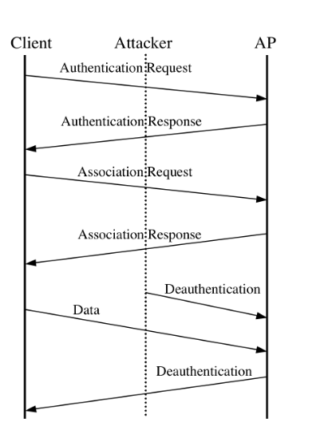
Deauthentication Attack
Notes:
An example of an attack that can be carried out on a smart farm that uses IEEE 802.11 is a Deauthentication Attack and we chose this attack as the attack that we carried out on our smart farming architecture. This attack is done by an adversary who sends spoofed deauthentication frames with spoofed MAC address of the access point once data or association response frame is found. To make this easier to understand, deauthentication frames are sent by a station or access point when all communications are terminated. Deauthentication is not a request but a notification. That means that if a stations wants to deauthenticate from an AP or an AP wants deauthenticate from stations, either device can send the deauthentication frame and it cannot be refused by either party except when management frame protection is involved. A deauthentication automatically causes disassociation because authentications is a prerequisitiy for association. The sending of spoofed deauthentication frames forces the targeted station to become unauthenticated and therefore is disconnected from the network. The attacked station then tries to reconnect and to prevent that reconnection the attacker contiuously keeps sending the deauthentication frames. To be able to reconnect the attacked client is forced to repeat IEEE 802.11 authentication and association process. The station is unable to connect to the network through prolonged sustaining of the spoofed frames [55]. This repeating transmission of frames is considered a DoS attack against the target MAC address which is then prevented to access the network. This kind of attack is difficult to detect because the frames are sent directly to the client without any detection or logging by the access point (AP) or Intrusion Detection System (IDS). In addition, MAC filtering process is unable to prevent this attack [56]. Often such attacks are used to prevent unauthorized stations from connecting to access points by wireless IDS vendors [55]. A prime reason this attack is possible is due the fact that management frames are not encrypted in IEEE 802.11 protocol. However, the protocol 802.11w prevents Wi-Fi deauthentication attacks by including cryptographic protection to deauthentication and dissociation frames. Therefore, those frames are very hard to be spoofed in a DoS attack [57]. An important reason for successful demonstration of this attack is because many vendors have not updated their hardware and software to 802.11w.

Slide 8
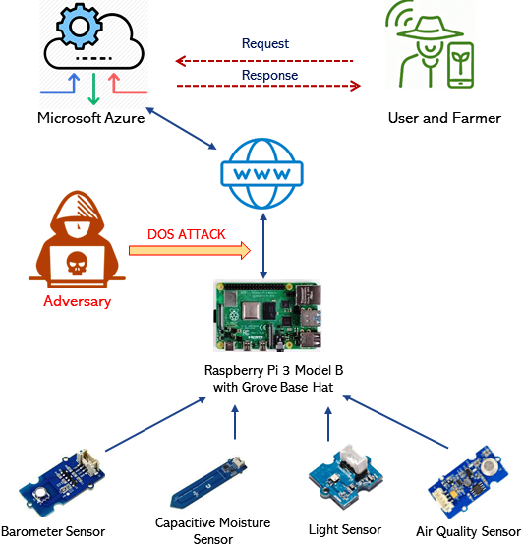
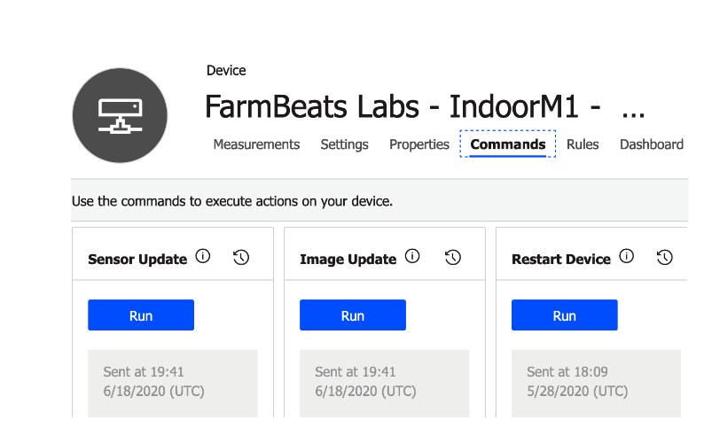
Set-up of the Architecture
Notes:
The architecture of deployed single smart farm is based upon Microsoft FarmBeats Student Kit11 for precision agri- culture. In our setup, we have made some modifications, which include an additional sensor. The Microsoft FarmBeats Student Kit includes Microsoft Azure12 cloud services and a Raspberry Pi with soil moisture, light, ambient temperature, and humidity sensors to collect data to improve productivity, increase yield, and save resources, together with data driven [38] applications. The kit was chosen as the architecture because of its comparable cheap cost, ease of installation, and set-up. In addition, all the data from the Microsoft FarmBeats Student Kit is collected to get a broad picture of precision agriculture deployment and allow researchers to use it as a testbed to deploy proof of concepts smart farming solutions.
The architecture used in this case is used to monitor an indoor plant over an extended period of time. The setup of the architecture which monitors the indoor plant can be seen in Figure 2. where the Raspberry Pi and its sensors are mounted on an indoor plant to monitor its metrics. the network communication between Raspberry Pi and cloud (Microsoft Azure) will be intercepted and interrupted by a DoS attack, which prevents the Raspberry Pi from connecting to the network. The four sensors that were used to monitor indoor plant are listed below (specifications in Table I):
A barometer sensor to detect atmospheric pressure, alti- tude, temperature, and humidity.
A grove light sensor has light dependent resistor to detect the intensity of the indoor light.
An air quality sensor to detect harmful gases such as carbon monoxide, acetone, and alcohol.
A capacitive moisture sensor measures soil moisture sensor based on capacitance changes.
These sensors were chosen because of their helpful applica- tion in monitoring in smart farm.
These sensors are made by Grove13, and require a Grove Base Hat14 for them to be attachable to the Raspberry Pi 3 Model B. The Grove Base Hat is mounted on a Raspberry Pi 3 Model B. The Raspberry Pi runs Windows 10 IoT Core15 which is optimized for smaller devices that have a display or no display.]. The Raspberry Pi 3 Model B is connected to a personal 2.4 GHz Wi-Fi network. Since a 2.4 GHz network provides coverage at a longer range compared to 5 GHz network, it is applicable to a smart farm environment since the architecture can be farther away from the wireless access point. For this architecture, the transmission time of data was not of critical
importance, therefore 2.4 GHz network was used. Alternate protocols that could have been used include Bluetooth and Zig- bee. However, in our deployed case only the 802.11 protocol was used to emphasize simplicity and cost-effectiveness. In addition, the Raspberry Pi 3 Model B is connected to Microsoft Azure Cloud Service, more specifically the Azure IoT Central16. The connected sensors send updated data to the cloud as displayed by Figure 4. The cloud allows the sensor data to be manually updated and the Raspberry Pi to be rebooted. Data analytic can be accessed by logging into the Azure IoT Central Cloud which provides a template that includes graphs and other visualizations as can be seen in Figure 5

Slide 9
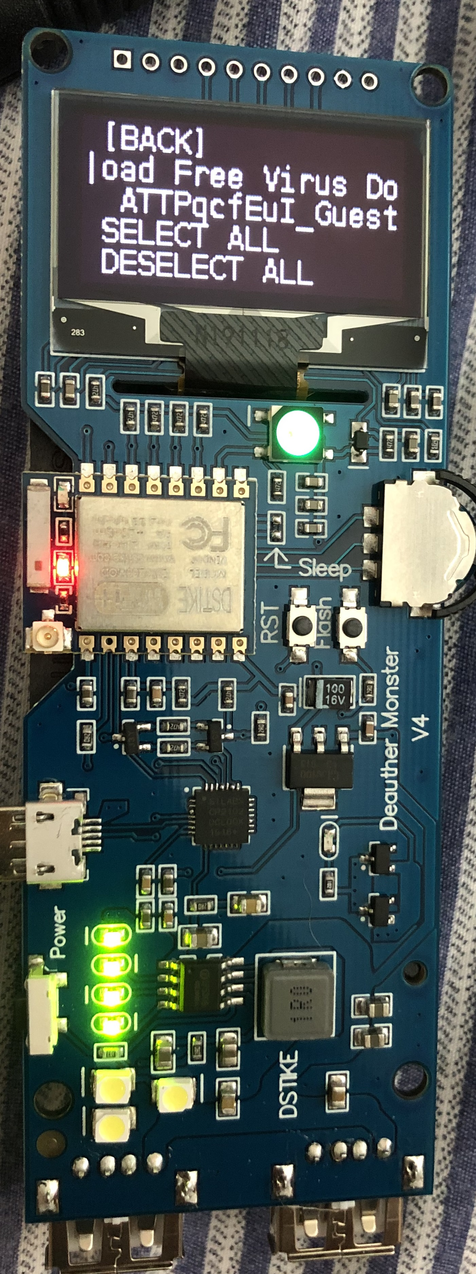
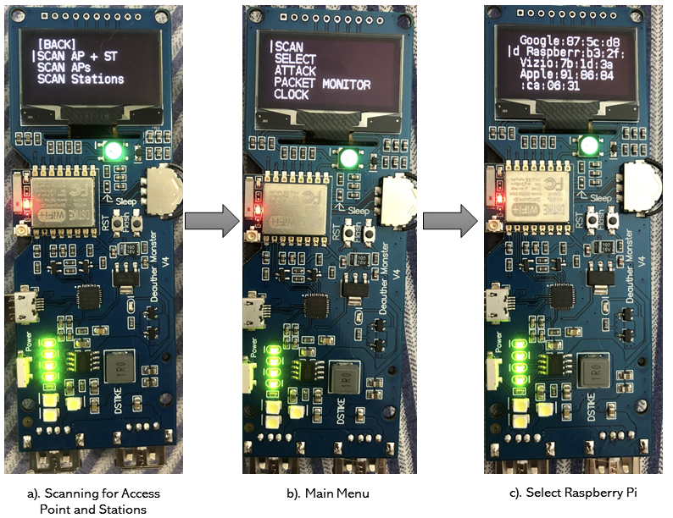
Steps of the Attack
Notes:
In order to organize a DoS attack, first, packets were sniffed to ensure the connectivity of Raspberry Pi and to see whether the packets are encrypted. Wireless Diagnostics in Mac OSX was used to sniff the packets, as shown in Figure 7. The built in Wi-Fi stumbler tool was used to identify channels and widths to use for packet sniffing, as illustrated in. After the channel was identified, the sniffer on Mac OSX was used to trace network traffic on that channel. The packet capture was opened with WireShark17. In our case, the source of these packets is attacked Raspberry Pi which is transmitting packets to the router (ARRISGro) and using IP multicast (IPv4mcast) to send packets to multiple sources in one transmission. The device is sending null data to the connected router to establish that it is in active state and that the transmission of frames from the AP to Raspberry Pi should be as expected. After the packets were sniffed, the Wi-Fi deauthentication attack was started. These packets are encrypted in WPA2 which prevents similar attack possibilities.
To successfully implement a Wi-Fi deauthentication attack, the Wi-Fi deauther tool needs to be in range of the network. The MakerFocus ESP8266 Development Board WiFi Deauther Monster comes with an antenna to improve its ability to catch the signal, which makes an adversary located at a Wi- Fi enabled smart farm to perform such attack. Note that this attack only works on a 2.4 GHz network. Steps of completing the attack are listed below (shown in Figure 10). These steps may be different in case another deauther tool is used.
1) The first step is to scan for access points and stations, as can be seen in Figure 10 (a). This is the most important step because if the desired station or access point cannot be found, the attack cannot happen. Depending on the .
signal strength, the antenna can be attached to the Deauther tool. Stations and access points found during this step will be needed for step 2.
2) When trying to deauther the Raspberry Pi, we need to go back to the main menu as seen in Figure 10 (b), and select the Raspberry Pi under stations as displayed in Figure 10 (c). Since we scanned for stations and access points in step 1, the Raspberry Pi was found and appears under stations now. With this step, we selected the Raspberry Pi as the station that we want to attack.
3) The last step is to organize the attack, which means going back to the main menu and under attack, selecting the deauther attack. A deauthentication frame is now sent to the Raspberry Pi and therefore disconnecting it from the network. The attacked Raspberry Pi is not connected to the network anymore, and the cloud cannot receive any sensor update. Figure 11 shows that when trying to update the sensors during the attack, no updates were received.
Attacking the Entire Network: This attack is possible on our architecture because only one AP is used. If more than one AP is used, they need to be in reach of the deauther tool. The deauther tool includes a 8 dbi antenna, which has a range of about 1500 ft. A different antenna can be purchased to increase the signal if needed to reach all of the APs. The attacked Raspberry Pi is connected to the Wi-Fi network named ’Free Virus Download’. This network is selected in the deauther tool to attack the complete network as shown in Figure 12. The steps for implementing the expanded network attack are similar as for disabling an individual station. First, access points and stations need to be scanned, then the network needs to be selected under APs. And finally, the deauther attack needs to be selected in the main menu. The Wi- Fi deauther attack was done on the whole network which resulted in the disconnection of all devices connected to the network including the Raspberry Pi. router sending deauthentication frames to the stations on the network.

Slide 10
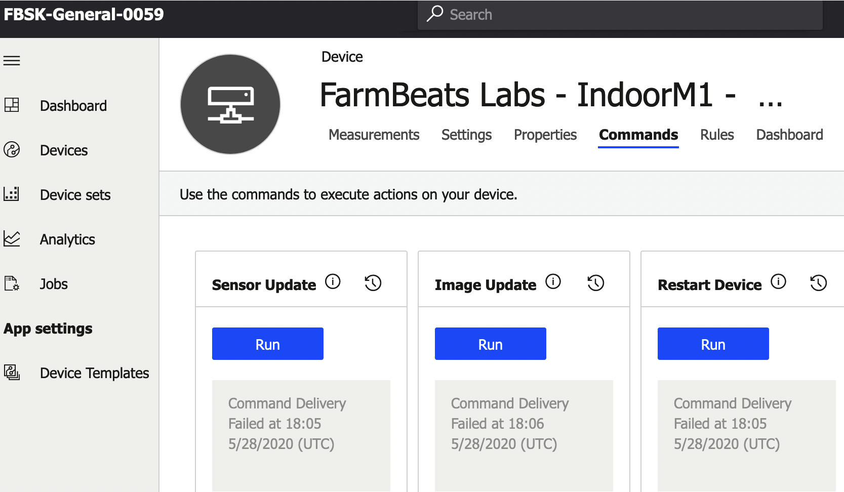
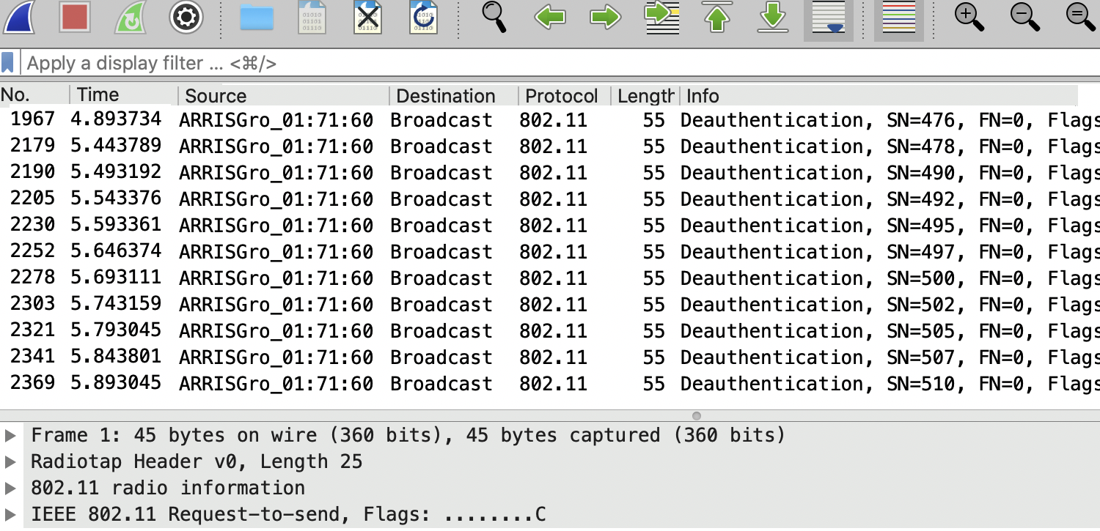
Completion of the Attack
Notes:
This packet capture is filtered by packet info and is therefore not in order. This filtering by packet info was done to show that a large number of deauthentication frames have been sent repeatedly to prevent stations from connecting to the network. This proves that the Wi-Fi deauthentication attack was a success due to the inability of the Raspberry Pi to connect to the network and sending sensor updates.
Our demonstration of the Wi-Fi deauthentication attack exposes the weakness of the IEEE 802.11 protocol (2.4 GHz), which requires attention and especially relevant not only in smart farming but also other IoT domains. By using 802.11w, management frames are encrypted and will make deauthenti- cation attack much more difficult to implement. However, our deployed Wi-Fi network and numerous other similar networks do not have 802.11w implemented.

Slide 11
Implications of Deauthentication Attacks
Sensor Data Obstruction
Obstruct real-time communication
Disrupt irrigation system’s decision
Damage crops, negatively affecting harvest
Controlling Connected Devices
Gains access to entire smart-farm through evil twin access point or password cracking
Controlling agricultural drones to spray excessive fertilizers over the plants
Notes:
Wi-Fi Deauthentication attack is one of the major avail- ability attacks [58] which disrupts communication networks and equipment availability, and negatively impacts the smart farms productivity. In our experiments, the Raspberry Pi can be considered an online connected equipment (e.g, smart sensor or drone). Wi-Fi Deauthentication attack targets the Raspberry
Pi and detaches it from the network. This attack impacts smart farms in multiple scenarios. A few are discussed below.
Sensor data obstruction: Data acquired from various sen- sors is the foundation of a smart farm, where most decisions are automated based on the data. For instance, the smart farm’s irrigation system activates and deactivates based on the soil water level measured by the moisture sensors. Typically, it is based on a simple certain threshold; however, modern smart irrigation systems consider more dynamic factors that require real-time data analytics and AI technologies. Real-time AI services can be used to determine how environmental factors influence the crops being irrigated as well as how soil moisture responds to irrigation for different crops, soils, and environ- mental conditions. As such, Deauthentication attacks, which prevent moisture sensors from connecting to the network, obstruct real-time communication and disrupt the irrigation system’s decision. This leads to crops over or under-watering, and eventually damage crops, negatively affecting a successful harvest. The potential damage of this particular scenario is also valid for livestock, where sensors monitoring their food, water, and health status are unavailable.
Controlling connected devices: As stated in section III, a deauthentication attack can be the basis for a subsequent evil twin access point or a password cracking attack. The attacker fetches the authentication details of the farmer by redirecting the farmer to a similar fake network. After that, the attacker gains access to the entire smart farm where he can control various devices to intentionally cause damage. For example, the attacker can damage the crops by controlling agricultural drones to spray excessive fertilizers over the plants. This would result in damaging crops at an early stage and bring huge loss.
It is important to recover from DoS attacks and communi- cation disruptions quickly before any substantial damage takes place.. Such attacks, if launched on a large scale, can cause dramatic economic loss to an entire country.

Slide 12
Defense against Deauthentication Attacks
Enabling IEEE 802.11w by encrypting management frames
Reasonable priced 802.11w routers common in big companies
Production cost: encryption capability issues
802.11w requires vendor to update code/firmware on both Aps and client side
Raspberry Pi 3 Model B’s network interface card does not support encryption protocol required for protected management frames; however, Model B+ does
Notes:
Enabling IEEE 802.11w-2009 prevents and detects deau- thentication attacks by protecting the management frames due to encryption. IEEE 802.11w is required by WPA3. For deauthentication and dissociation frames that are sent after key establishment, pair-related one-time keys are used: one for the access point and one for the client, where then the client determines if the deauthentication is valid. Reasonable priced 802.11w-2009 routers are common in big companies like Cisco or Aruba. One possible reason for that might be production costs. An encryption capability issue that involves a missing cipher can cause routers not to be 802.11w capable which can cause issues in the production cycle. 802.11w requires Robust Security Networks (RSN) that use, for ex- ample, AES/CCMP encryption. 802.11w requires the vendor to update their code/firmware on both APs and client side. Also, on some routers, IEEE 802.11w needs to be enabled and is not automatically enabled. The Raspberry Pi 3 Model B in this architecture does not support 802.11w because the network interface card does not support the encryption proto- col required for the protected management frames. However, the Raspberry Pi 3 model B+ has protected management frames capabilities. Therefore, updated hardware with in-built encrypted management frame functionality can protect against such attacks.

Slide 13
Conclusion
Smart Farming has become popular and widely adopted
Exposes new attack surfaces
DoS attack on Smart-Farming Infrastructure
Deauthentication Attack
Weakness of IEEE 802.11 protocol
Successful attack has serious implications
Future work, expand on other attacks and use other protocols
Notes:
In the last few years, smart farming has become popular and widely adopted. This transition has been accelerated further because of crop productivity and quality benefits while lowering the overall cost. However, this shift towards a con- nected ecosystem, exposes new attack surfaces, and provides opportunities for attackers to exploit vulnerabilities.
In this paper, we demonstrate a Denial of Service (DoS) attack on a smart farm ecosystem. We implemented a Wi-Fi deauthentication attack on the smart farm Wi-Fi network with a MakerFocus ESP8266 Development Board WiFiDeauther Monster, which obstructed a deployed sensor from connect- ing to the network. In addition, the attack was expanded to the entire network which prevented any smart device from connecting to a central cloud. This inability to not receive real-time sensor updates can negatively impact the data driven applications and overall functionality of a farm. The demonstration of the Wi-Fi deauthentication attack exposes a weakness of the IEEE 802.11 protocol (2.4 GHz). The ability and ease of carrying out a DoS attack in the precision agriculture ecosystem can have serious implications and a large scale coordinated attack can disrupt national economies.
For future work, we plan to expand on other attacks on smart farming infrastructure including evil twin access point and password cracking. In addition, we will extend these attack to include protocols such as zigbee and bluetooth to launch attacks such as man-in-the-middle and replay.

