Slide 1
Institute for Cyber Security
A Role Based Administration Model
For Attribute
Xin Jin, Ram Krishnan, Ravi Sandhu
SRAS, Sep 19, 2012
World-Leading Research with Real-World Impact!

Slide 2
Outline
Motivation
Background
Proposed Approach
Discussion and Future Work
World-Leading Research with Real-World Impact!
2

Slide 3
Motivation
Attribute Based Access Control provide flexibility and scalabilities for distributed access control
Role based trust management (RT)[Oakland02]
Unified ABAC model (ABAC-alpha) [DBSEC12]
Attribute based Encryption (ABE) [CCS06]
Usage control model (UCON) [TISSEC]
Logical based framework for ABAC [FMSE04], etc.
What is user attribute(credential, certificate , etc.)?
Name, address, country…
ID, clearance…
World-Leading Research with Real-World Impact!
3

Slide 4
Motivation
Much effort in how to use and store user attributes.
Authorization policy evaluate attribute of subject and object in the request ( s, o ) (ABAC-ALPHA,UCON, Logical based framework for ABAC)
Attribute Encryption (ABE,PKI)
Industry Implementation Standard (XACML, SAML, etc.)
Not enough on user attribute management
Who is authorized to assign user attributes?
Who is authorized to assign value for Salary(Alice)?
Can Bob say that Salary(Alice)=3000?
How should permissions be assigned to administrators?
Manually one by one? No!
World-Leading Research with Real-World Impact!
4

Slide 5
Motivation
Effective user attribute administration model needed
Ease of Administration one of desired features
Role based Access Control
Good candidate for user attribute Administration
Proved ease of administration
Efficient safety analysis
Sizable literature, etc.
Users
ROLES
Permissions
E.g. ProgramManager
E.g. Assign Alice’s salary to 3000, 6000 9000
World-Leading Research with Real-World Impact!
5

Slide 6
Background
User role assignment model (URA97)
Can_assign( administration role, prerequisite role, role range notation )
Can_revoke(administration role, role range notation )
User attributes
Atomic: User can only have one value for this kind of attribute. E.g. user id, clearance, etc.
Set: User can be assigned multiple values. E.g. role, phonenumber, etc.
Range(ua), attType(ua)
World-Leading Research with Real-World Impact!
6

Slide 7
Proposed Approach
Generalize Role as one of user attributes
Difference between role and user attribute
Role represents permissions while attributes do not
(Alice’s role is Program Chair VS Alice’s age is 23)
Role has hierarchy while attribute may not
(Role: CEO is senior role of employee. Attribute: Address)
Difference between atomic user attributes and set-valued user attributes
Assign new value to atomic user attribute automatically remove old value
Add new values to set-valued attribute does not guarantee permissions to delete existing attribute values.
World-Leading Research with Real-World Impact!
7

Slide 8
Proposed Approach
Permissions to each administrative role
Add value to set-valued user attributes
Delete value from set-valued attributes
Assign value to atomic-valued attributes
Specify the three permission sets for each role
Add value to set-valued user attributes
Delete value from set-valued attributes
Assign value to atomic-valued attributes
World-Leading Research with Real-World Impact!
8

Slide 9
Proposed Approach(GURA0)
Add values to set-valued user attributes:
AR： set of administrative roles
SUA: set of set-valued user attributes
EXPR(sua): logical expression composed of user attribute sua
World-Leading Research with Real-World Impact!
9

Slide 10
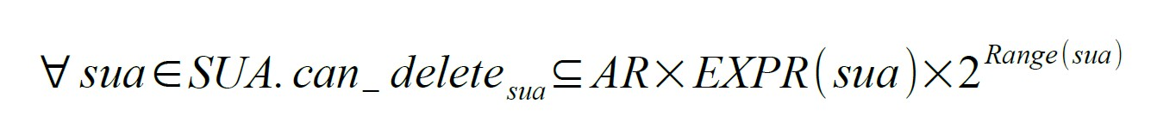
Proposed Approach(GURA0)
Delete values from set-valued user attributes:
AR: set of administrative roles
SUA: set of set-valued user attribute
EXPR(sua): logical expression composed of user attribute sua
World-Leading Research with Real-World Impact!
10

Slide 11
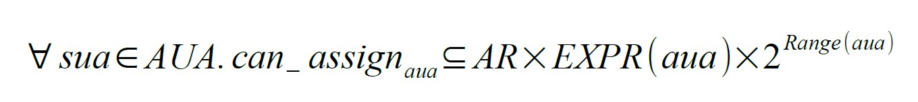
Proposed Approach(GURA0)
Assign value to atomic-valued user attributes:
AR： set of administrative roles
AUA: set of atomic-valued user attributes
EXPR(aua): logical expression composed of user attribute aua
World-Leading Research with Real-World Impact!
11

Slide 12
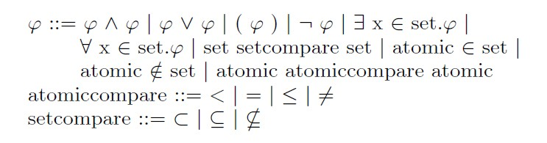

Language
Common Expression Language
Example: set-valued attributes in GURA0 EXPR(SUA) is specified using an instance of the above language where
World-Leading Research with Real-World Impact!
12

Slide 13
Example
Users And User Attributes
Administrative Roles
Add Employee to prj1 and prj2 but not both
PrjManager
InvolvedProject
Add Employee who is not involved in prj2 to prj1
Employee
PrjLeader1
PrjLeader2
Add Employee who is not involved in prj1 to prj2
Salary
Promote the salary of employee whose salary is less than 2000 to 3000, 6000 or 9000
HumanResourceManager
World-Leading Research with Real-World Impact!
13

Slide 14
Example
Users And User Attribute
Administrative Roles
PrjManager
InvolvedProject
Add Employee who is not involved in prj2 to prj1
Employee
PrjLeader1
PrjLeader2
Add Employee who is not involved in prj1 to prj2
Salary
Promote the salary of employee whose salary is less than 2000 to 3000, 6000 or 9000
HumanResourceManager
World-Leading Research with Real-World Impact!
14

Slide 15
Example
Users And User Attribute
Administrative Roles
PrjManager
InvolvedProject
Employee
PrjLeader1
PrjLeader2
Add Employee who is not involved in prj1 to prj2
Salary
Promote the salary of employee whose salary is less than 2000 to 3000, 6000 or 9000
HumanResourceManager
World-Leading Research with Real-World Impact!
15

Slide 16
Example
Users And User Attribute
Administrative Roles
PrjManager
InvolvedProject
Employee
PrjLeader1
PrjLeader2
Salary
Promote the salary of employee whose salary is less than 2000 to 3000, 6000 or 9000
HumanResourceManager
World-Leading Research with Real-World Impact!
16

Slide 17
Example
Users And User Attribute
Administrative Roles
PrjManager
InvolvedProject
Employee
PrjLeader1
PrjLeader2
Salary
HumanResourceManager
World-Leading Research with Real-World Impact!
17

Slide 18
Proposed Approach(GURA1)
Limited Expressive Power
Expression(ua) ONLY composed using the user attribute in context is not enough.
Example: PrjLeader1 is only authorized to add employee whose
experience with Java is more than 3 years and whose skills include
C++.
Least Privilege is not achieved
Expression(ua) CAN NOT restrict users to the least set. Need other user attributes to compose the expression.
World-Leading Research with Real-World Impact!
18

Slide 19
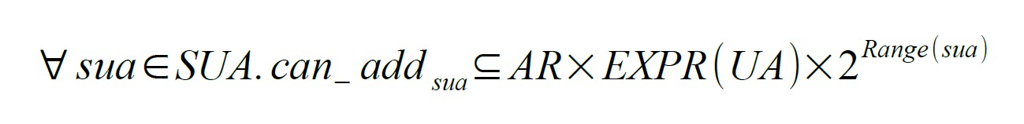
Proposed Approach(GURA1)
Further Generalization
EXPR(UA): logical expression composed of all
user attribute ua in UA
World-Leading Research with Real-World Impact!
19

Slide 20
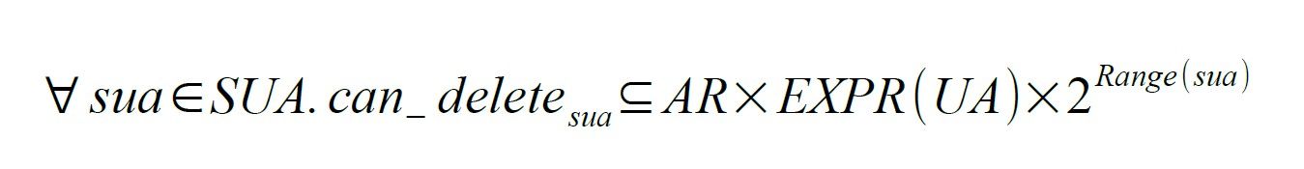
Proposed Approach(GURA1)
Further Generalization for GURA1:

Slide 21
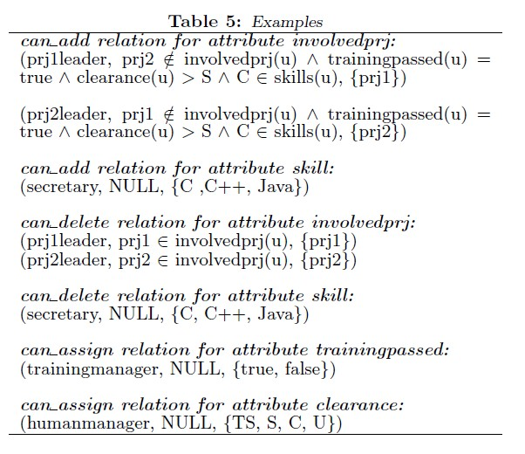
Example
Example using GURA1
World-Leading Research with Real-World Impact!
21

Slide 22
Discussions and Future Work
Advantages
Advantages of RBAC inherited
Limitations
Awkward for distributed administration of user attributes
For fine-grained user attribute administration, many roles with slight different set of permissions need to defined.
Future Work
Delegation
Attribute based user attribute management
World-Leading Research with Real-World Impact!
22

Slide 23
Institute for Cyber Security
Any Questions?
World-Leading Research with Real-World Impact!
23

