Slide 1
Institute for Cyber Security
Towards Provenance and Risk-Awareness in Social Computing
Yuan Cheng, Dang Nguyen, Khalid Bijon, Ram Krishnan, Jaehong Park and Ravi Sandhu
Institute for Cyber Security
University of Texas at San Antonio
September 19, 2012
SRAS 2012, Minneapolis, MN
World-Leading Research with Real-World Impact!
1

Slide 2
Access Control in Social Computing
Content is almost contributed by users
Access control policies are specified by users rather than the system alone
Policies are expressed in terms of attributes
In terms of relationships in online social networks
BUT, all of them are pre-defined static policies that always give the same outcome
Unfortunately, social computing environment is dynamically changing over time
World-Leading Research with Real-World Impact!

Slide 3
Motivating Example
A user starts an event to discuss on the upcoming US election outcome. Anyone registered in the social network can join the discussion group. However, joining the group requires to vote on an election poll. In order to vote, one must demonstrate his knowledge of the candidate through an action such as to like the candidate’s fan page. Furthermore, each candidate might want users to share their page before liking.
How to place control on the dependency of these actions?
How to place control on the occurrence and frequency of these actions?
World-Leading Research with Real-World Impact!

Slide 4
Risk-Aware Access Control
Risk is the possibility of future loss or damage
Future needs and user behaviors are essentially unpredictable by static access control policies
Risk-aware Access Control grants or denies an access dynamically based on estimated risk instead of some predefined policies
Two key issues to assess risk:
Estimate the cost of permission being misused (sensitivity)
Determine the likelihood of misusing permissions (trustworthiness)
World-Leading Research with Real-World Impact!

Slide 5
Provenance-Aware System
Provenance of a digital data object is defined as the documentation of its origin and all the processes that influence and lead to its current state.
In a provenance-aware system, related provenance information of system transactions/events are captured, stored, and maintained.
Provenance potentially provides many enhanced benefits: usage tracking, workflow control, versioning, trustworthiness, repeatability, access control, etc..
Can we use provenance for dynamic risk assessment?
World-Leading Research with Real-World Impact!

Slide 6
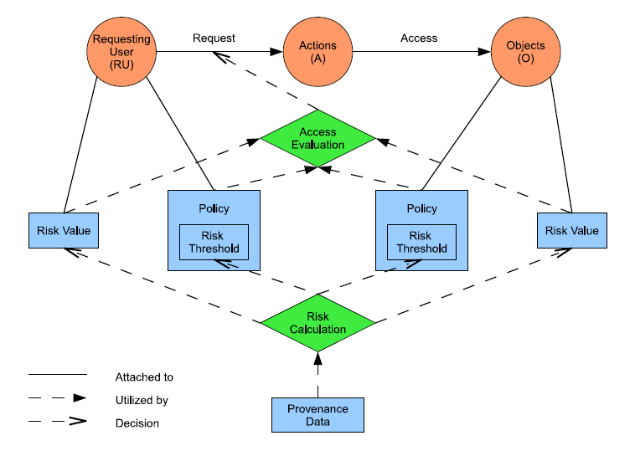
Risk Aware Access Control for SC
World-Leading Research with Real-World Impact!

Slide 7
Risk Aware Access Control for SC (cont.)
Risk value represents the level of misuse granting requester access would result in
Risk threshold denotes the level of sensitivity of performing the permission
Fluctuation of risk serves as the basis for dynamic access control
User’s risk value may increase or decrease as a result of her activities and behavior in the system.
Similarly, risk value of a resource may change depending on the past interactions on the resource.
Requester user and resource owner can specify a risk threshold associated with each permission
World-Leading Research with Real-World Impact!

Slide 8
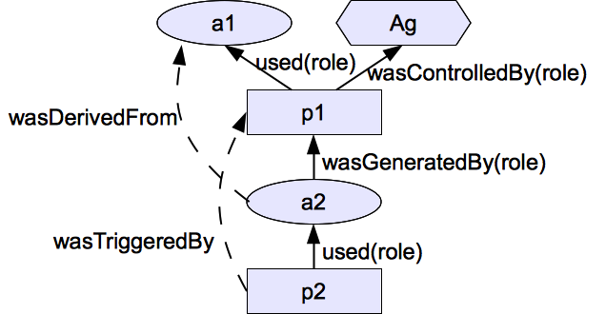
Modeling Provenance Data in SC
Open Provenance Model (OPM) as the data model for provenance information
Captures information associated with a transaction and expresses the relations between them in causality dependencies
3 Nodes
Artifact (ellipse)
Process (Rectangle)
Agent (Octagon)
5 Causality dependency edges (not dataflow)

Slide 9
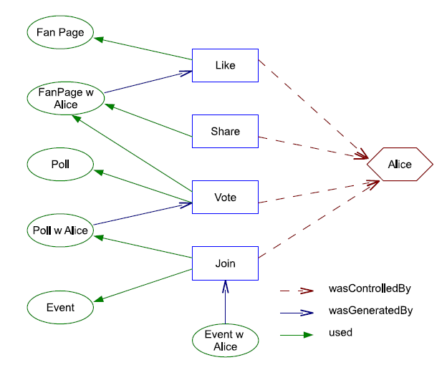
OPM Scenario
World-Leading Research with Real-World Impact!

Slide 10
Modeling Provenance Data in SC (cont.)
Alice requests to join an event:
request(Alice, join, accountOf(Alice), event)
Associated transaction:
(Alice, join, accountOf(Alice), event, eventWithAcountOfAliceAdded)
The corresponding provenance information:
(join, wasControlledBy, Alice)
(join, used, event)
(join, used, accountOf(Alice))
(eventWithAccountOfAliceAdded, wasGeneratedBy, join)
World-Leading Research with Real-World Impact!

Slide 11
CONCLUSION
Identify the necessity of incorporating Risk awareness and Provenance awareness in SC.
Demonstrate through an example scenario.
Present an approach for Provenance-based Risk Assessment.
Present the initial effort towards a conceptual model for Risk-based Access Control.
World-Leading Research with Real-World Impact!

Slide 12
World-Leading Research with Real-World Impact!
Questions or comments?
Thank You ☺

