Slide 1



Convergent Access Control to Enable Secure Smart Communities
Smriti Bhatt¹, Ravi Sandhu²
¹Department of Computing and Cyber Security, Texas A&M University-San Antonio
²Institute for Cyber Security (ICS), CREST-Center for Security and Privacy Enhanced Cloud Computing (C-SPECC)
Department of Computer Science, University of Texas at San Antonio
Email: sbhatt@tamusa.edu, Ravi.Sandhu@utsa.edu
The 2nd IEEE International Conference on Trust, Privacy and Security in Intelligent Systems, and Applications (TPS)
December 1-3, 2020

Slide 2
Outline
  Introduction
  Background
  Access Control Principles for Next-Generation Future Smart Communities
    Access Control Model Requirements
    Access Control Principles
  Convergent Access Control Framework
    A Smart Community Use Case
    Convergent Access Control for Smart Communities
  Discussion and Research Agenda
  Conclusion

Slide 3
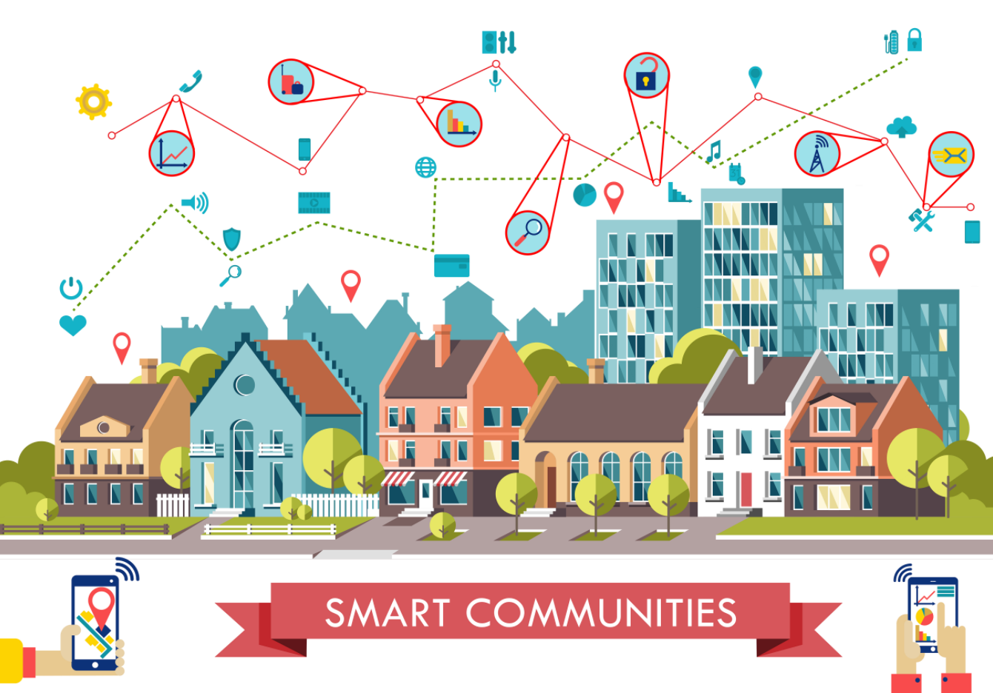
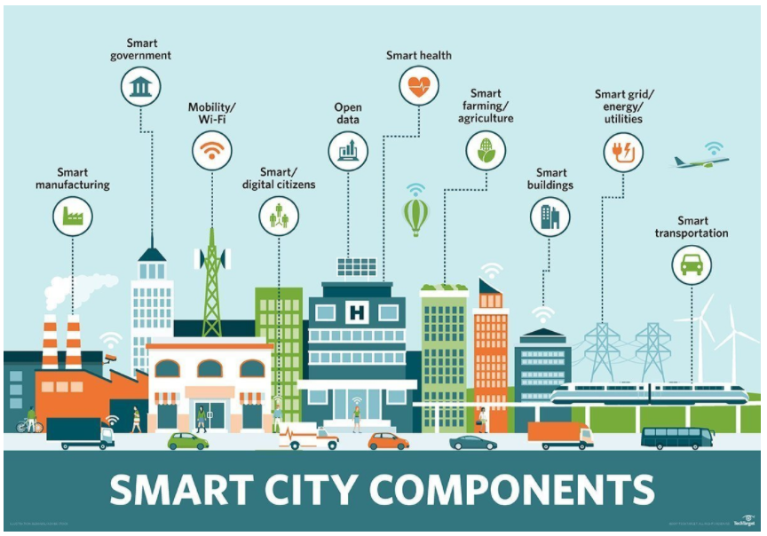
Introduction
  Smart Communities vs. Smart Cities
Image Credit: Graphic farm/Shutterstock.com
Source: https://www.nsf.gov/news/news_images.jsp?cntn_id=244863&org=NSF
Image Credit: internetofthingsagenda.techtarget.com
Source: https://johnenglander.net/will-smart-cities-save-us-from-rising-seas/
Notes:
With Internet of Things (IoT) devices and applications, and supporting technologies, such as cloud and edge computing, Artificial Intelligence (AI), Machine Learning and data analytics, we envision future connected smart communities (SC) where the users will be connected to the Internet along with their smart devices that utilize smart infrastructures, such as offices, buildings, homes, and hospitals.
The concept of smart cities has received significant attention in both academia and industry recently, whereby smart communities are sometimes considered as inclusive with smart cities.
Our vision of the smart communities expand beyond cities and nations to create a global connected ecosystem ranging across geographically distributed regions.
Such smart communities consist of multiple small connected communities that require a highly collaborative and interdisciplinary ecosystem including IoT, networking, AI, and distributed computing, and personnel such as researchers and subject experts with different skills, knowledge, and expertise.

Slide 4
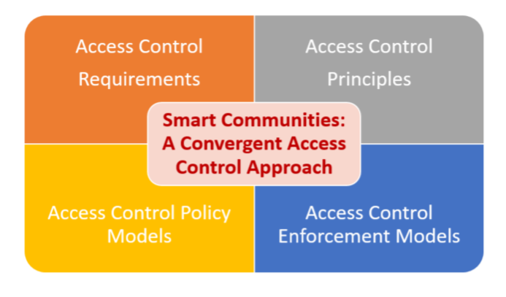
Future Smart Communities (SC) Access Control Aspects

Slide 5
Background
  Smart Communities –
    Smart Communities (SCs) are emerging today with the convergence of IoT, Cyber-Physical Systems (CPS), cloud and edge computing, and intelligent applications based on AI and ML (Machine Learning) technologies.
  Several smart application domains within SCs
    Smart Health
    Smart Energy
    Smart Transportation and Autonomous Vehicles
    Smart Farming and Infrastructure
    …
Notes:
A smart community can also be defined as a collection of connected human-cyber-physical systems enabled by IoT, cloud and edge computing technologies and services.
To enable future smart connected ecosystem, an essential component is active collaborations between these large cloud providers and academic researchers.

Slide 6
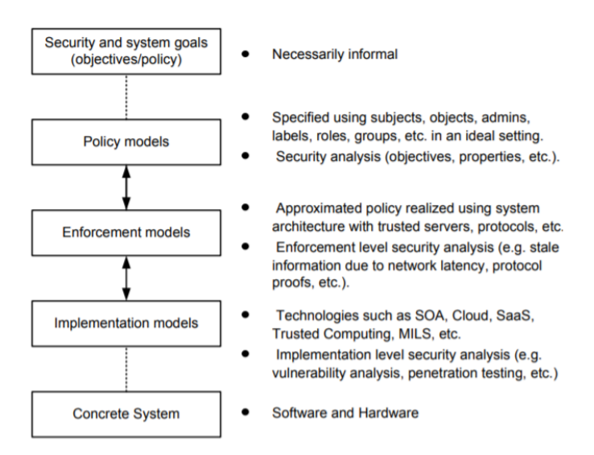
Background (contd.)
The PEI (Policy, Enforcement, and Implementation) Framework

Slide 7
ASCAA Principles
ASCAA Principles for Next-Generation Role-Based Access Control
  Abstraction: abstract privileges
  Separation: separation of operative and administrative functions
  Containment: least privilege and usage control
  Automation: automatic access control administration
  Accountability: hold users accountable of their actions in cyberspace

Slide 8
Access Control Model Requirements for SCs
Next-generation connected Smart Communities → high dynamic and distributed architectures with evolving access control requirements
Essential Requirements for Access Control models for Smart Communities
  Dynamic Authorization
  Flexibility
  Scalability
  Decentralization
  Compliance
  Light-Weight
  Privacy-Preserving

Slide 9
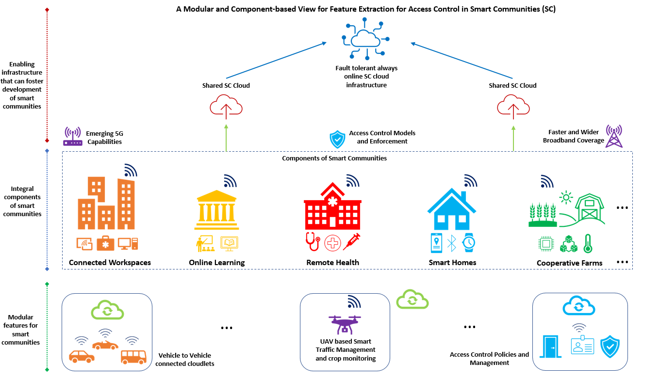
Connected Smart Communities Vision
Notes:
1. Based on modular and component-based view of SC, we can extract features for access control with a specific component (e.g., Remote Health, Smart Homes, etc.) which will facilitate to develop an access control model converging the required features (e.g., roles, attributes, relationships, etc.).

Slide 10
Access Control Principles for SCs
Access Control Principles for Next-generation connected Smart Communities
  Some of these principles are adopted from ASCAA principles and revised in the context of SCs
Abstraction: different types of entities access, and resources in various SC components
Dynamic Separation: dynamic separations of admin and operational permissions for users
Cooperation: trust and cooperation between several SC’s entities in managing access
Delegation: access delegation towards enabling autonomous environment
Containment: incorporates least privilege and need to know to ensure secure cooperation
Adaptability: allows to incorporate changes in different SC components, entities, and access
Autonomous: to enable fully autonomous access control models once defined and deployed
Accountability: similar to ASCAA, hold different parties accountable for their actions

Slide 11
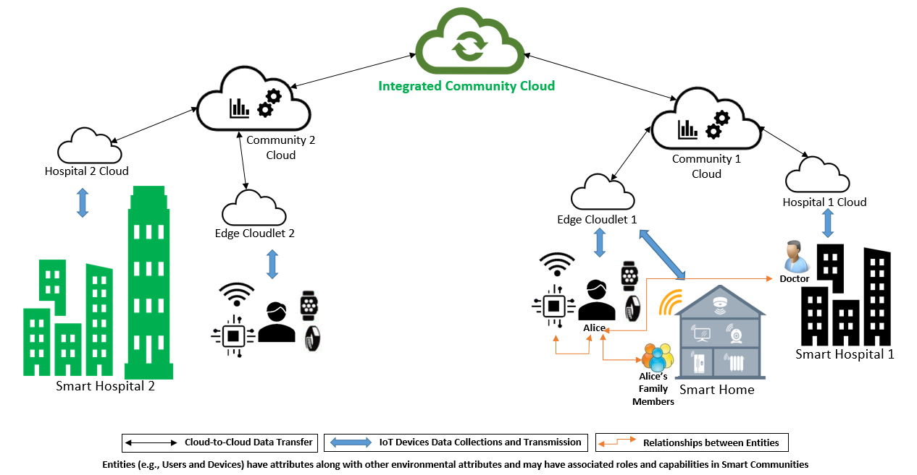
SC Use Case and Applicable Access Control Features

Slide 12
SC Use Case and Applicable Access Control Features (contd.)
SC Application Domain
SC Entities, Objects, …
…
Attributes
Relationships
Roles
How can we converge these access control features ?
How does access control requirements change as per different SC application domains?

Slide 13
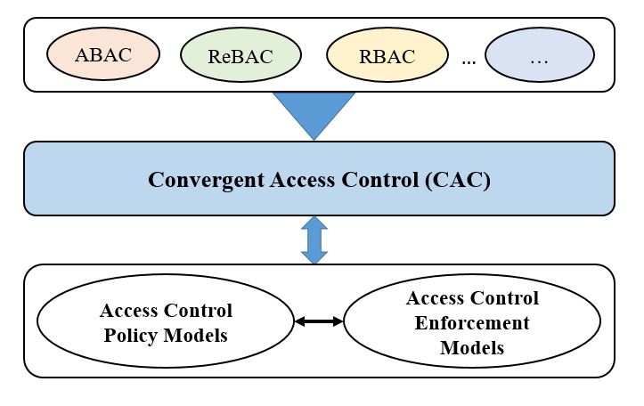
The Convergent Access Control (CAC) Framework

Slide 14
Summary and Future Research Agenda
Overarching Vision – Convergence of Access Control Models towards developing CAC Framework
Future collaborative and interdisciplinary research efforts from research community
  Some future research directions --
Suitability of Access Control Models and Systems
Hybrid Access Control Models
AI-Enabled Strategies for Access Control
Access Control Evaluation Frameworks

Slide 15
Thank You!
Questions?
Contact:
Smriti Bhatt: sbhatt@tamusa.edu
Ravi Sandhu: Ravi.Sandhu@utsa.edu
Acknowledgement:
This work is partially supported by NSF CREST Grant HRD1736209, and the Texas A&M System Chancellor Research Initiative (CRI) Grant.

