Slide 1
Edge Centric Secure Data Sharing with
Digital Twins in Smart Ecosystems
Glen Cathey¹, James Benson², Maanak Gupta¹, and Ravi Sandhu²
¹Dept. of Computer Science, Tennessee Technological University,
Cookeville, Tennessee 38505, USA
²Dept. of Computer Science and Institute for Cyber Security
University of Texas at San Antonio, TX 78249, USA
TPS 2021, Dec. 13, 2021
Notes:
Hello, my name is James Benson and I’ll be talking about edge centric secure data sharing with digital twins in smart ecosystems. This was a collaboration between Glen Cathey and Dr. Gupta from Tennessee Tech and Dr. Sandhu and myself from University of Texas at San Antonio.
1

Slide 2
Outline
IoT Background
ACO Architecture
Clustered Objects
Digital Twins and Current State of the Market
TBAC and our implementation
Results
Future Direction
A. Holst, “IoT connected devices worldwide 2019-2030,” Jan 2021. [Online].
Available: https://www.statista.com/statistics/1183457/iot-connected- devices-worldwide/

Slide 3
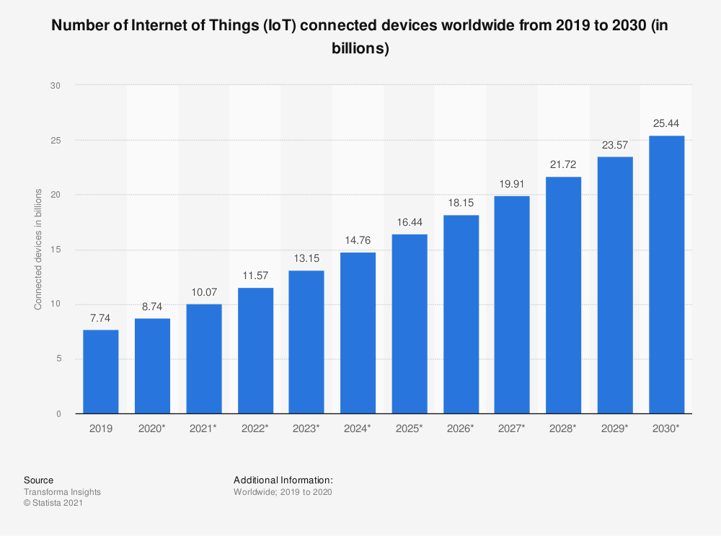
IoT Devices Prediction
A. Holst, “IoT connected devices worldwide 2019-2030,” Jan 2021. [Online].
Available: https://www.statista.com/statistics/1183457/iot-connected- devices-worldwide/
Notes:
IoT devices are growing rapidly worldwide, with more than 10 billion devices currently (2021) and an estimate of over 152,000 IoT devices connected to the internet per minute by 2025. This will lead the world to an estimate of over 25 billion devices and annual revenue worldwide of over $1T by 2030.

Slide 4
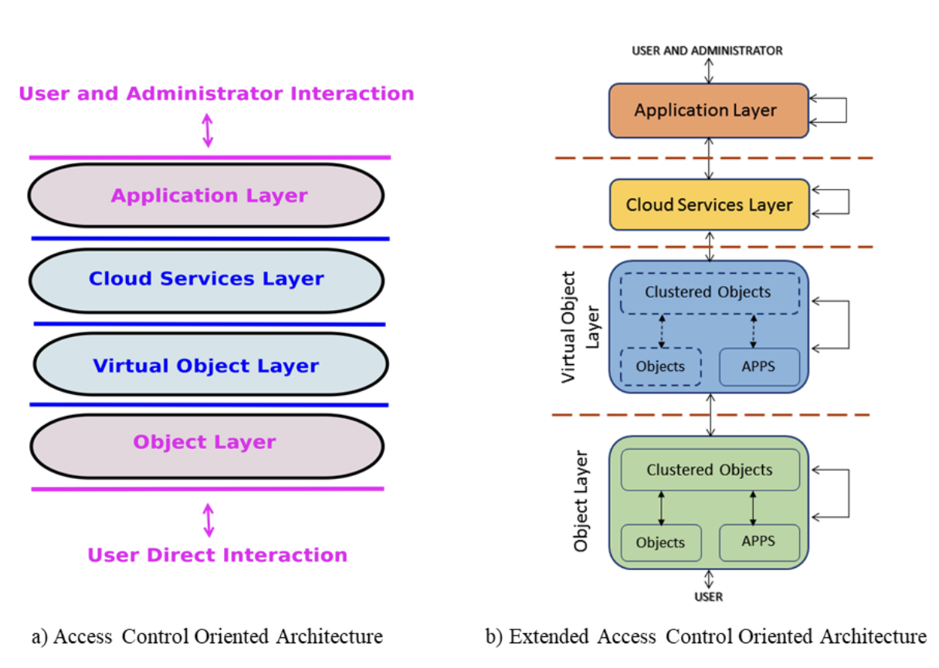
ACO Architecture
Notes:
When we think of the layers between a physical device and its digital counterpart, we can break up those layers into this architecture, the Access Control Oriented Architecture (ACO) with users and administrators interacting at object and application layers. Likewise, as an extension of ACO, communication can happen within a layer shown as the self-loops.
The object layer consists of physical devices which can sense or actuate the environment. These devices can be individual or clustered into larger objects. These clustered objects can be everyday objects like cell phones, as sophisticated as smart cars or complex as production lines which could contain many smart devices connected to a network.

Slide 5









Example of Clustered Obj.
Notes:
If we think about the 4 layers, we can apply them here in a clustered object like a car. We can see several clustered objects like the state of the car lights, the tire pressures, speed, temperature of the AC, oil, other fluids, battery capacity or levels, forward and rearview cameras, the list goes on.
In our example, we will use a car where we may physically manipulate the car on the object layer, turning on the blinker or changing the gear to “Reverse” might turn on a camera. The application layer may record the information from the cameras locally and display the image to your center console or perhaps perform object recognition which would both be on the application layer. If there is a collision, for example, that video may be uploaded to a cloud layer for long term storage and future download. Likewise, the car owner may opt into sharing video footage with the manufacturer on this cloud layer. But this layer is not necessarily mandatory. If the car detects an animal or this impending collision, the camera virtual object might communicate to the virtual braking system sensor, and which then tells the brakes to engage. So, as you can see, inside of each layer, there may be interactions between the same layers.
When different sensors communicate between themselves or different clustered objects, the communication should be from s1 (camera) to vs1, vs1 to vs2 (virtual brakes) where cloud/application layer for processing between these could occur, then finally vs2 to s2. The cloud layer can help with complex calculations like additional image processing to improve machine learning.

Slide 6
Current Security Measures
Two main common methods consist of:
Encryption security measures
Multifactor Authorization
Limits:
Encryption requires more powerful IoT devices
Multifactor only grants access, it does not limit how data is shared.
Notes:
Currently security measures in most technologies consist of encryption and multifactor authorization commonly referred to as 2FA. Unfortunately, IoT devices are often limited in power to do encryption and multifactor authentication only grants access, neither of these effectively limit data sharing.

Slide 7

Digital Twins
Digital twins are virtual counterparts to physical devices.
These twins help facilitate separation between objects and cloud services layer.
Page: 7
Notes:
Let’s talk about digital twins. A digital twin provides a digital representation of an objects physical twin. Like a car, IoT devices often have multiple state data such as user settings, manufacture configurations, operational status like RPM, temperatures, humidity, pressures, fluid levels, etc. These can all be mapped one-to-one to the digital twin.

Slide 8
Current State
Often, there is a one-to-one mapping between physical devices and virtual devices.
Limitations:
All users have access to the entire shadow
All users can read and update the state data.
All data may be exposed to unauthorized users/objects
Notes:
Currently, IoT technologies use various methods to communicate between devices, such as MQTT, ZigBee, 5G, or WiFi. But frequently, when they communicate it is doing so in a one-to-one mapping between the whole device and its digital counterpart. This has several limitations, the first being that if a user is granted access, the user will have access to the data for the complete device, and there is no filtering of the data. Similarly, once a user has access to the device, they can both read and write or update the state data. This also means that if there is a breach somewhere, all data may be exposed instead of a smaller subset of objects or data. Limiting permissions in IoT devices is often an afterthought.

Slide 9
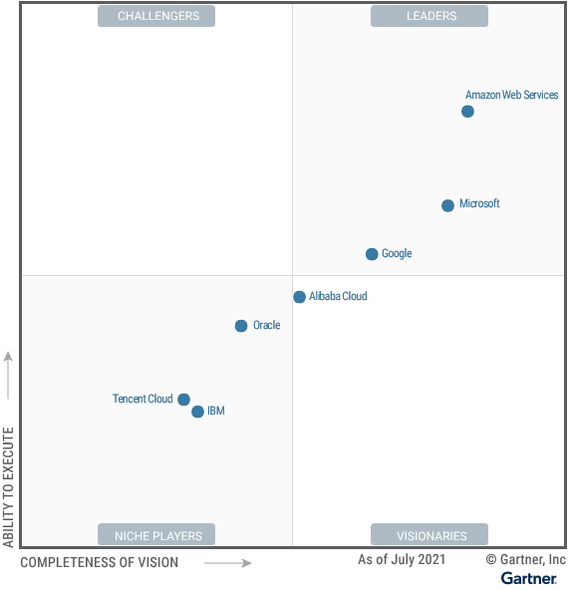
Cloud Providers
Notes:
In terms of industry usage, according to a Gartner report in July 2021, AWS is the leader in innovation and often sets the pace in the market for innovation which guides the roadmaps of other cloud providers.

Slide 10
Industry access control approaches
AWS supports a many-to-many digital twin-to-physical device relationship to a base unnamed shadow. Users can publish to named shadows for subsets of physical device data in order to minimize data exposure.
Azure offers tags which operate more as static attributes
Google offers tags which are more like device identifiers
Oracle offers tags which are more descriptive and have no security/access control features.
Notes:
As such, in terms of industry usage, AWS clearly offers a tremendous amount of services, however currently, there is no support for tagging discrete pieces of data or dynamically creating multiple shadows and separating the data in real time. Rules or lambda’s could be implemented to help distribute data to named shadows, however due to the lack of tag attachment to data these rules must work on data value, associated key, or other system information. This means data can be subdivided in the system, but like data can not be effectively grouped dynamically. Rules must be defined to sort individual data keys into named shadows resulting in a less scalable and more implementation specific system. Tagging data at this point would create some distance between the data and the tags applied to that data as well as the containers that the data will be placed in.
With regards to other cloud providers like Microsoft Azure, Google Cloud, Oracle and others, they offer IoT services, but none are as sophisticated as AWS's or offers the same advantages as our proposed solution to this problem.

Slide 11
Proposed Solution
The use of multiple shadows or digital twins for one physical object with the intent of separating data among different virtual objects based on tags assigned on the fly.
Attach tags directly to the device state information in order to reduce the “distance” between access control mechanisms and device itself.
Dynamic and on-to-fly subdivision of device state at the local edge according to attached tags.
Limit data exposure to authorized entities via subdivision of data in a many-to-one relationship between digital and physics devices.
Notes:
Going back to the title of this talk, how do we get edge centric secure data sharing with digital twins in smart ecosystems? Our solution and contribution focuses on using the tags to fragment one shadow into multiple shadows. These tags are already defined in the system but assigned on the fly based off of the values of the key/values pairs and are dynamic. What does this mean exactly? I’ll show you an example of this in just a couple of slides. We also focus on reducing the distance between when the data is created and the tag generation. This means that we will directly apply tags to the data and distribute it to the digital twins based on those tags. Again, each digital twin will have a set of tags defining what subset of data it will hold, and data will be distributed into each twin based on tags attached directly to that data.
This system doesn’t require any additional cryptographic security or authentication as the ‘edge’ in our case is akin to the data bus which is still inside of the clustered object. Regardless of the need of cloud services, this edge is still needed for sharing data between internal components. When cloud services are needed, this local edge would act as a data pass through.
That said, the security of the edge and the data it holds is of the utmost importance. There should be security there, but we are focusing on dynamically creating subsets of data by using tags to limit any data exposure. This should limit data exposure to authorized entities by using a many-to-one relationship between the digital and physical devices.

Slide 12
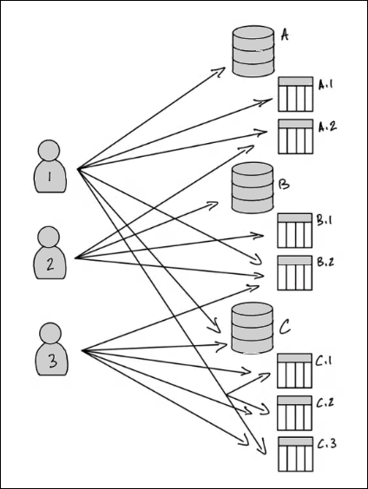
TBAC vs others
Tag Based Access Control is popular and coincides well with data lakes as well. Imagine streaming data into various DB’s and their corresponding Tables.
With TBAC, using five assignment operations and eight grant operations, the data lake administrator can specify 17 permissions.
https://docs.aws.amazon.com/lake-formation/latest/dg/tag-based-access-control.html
Notes:
In terms of access control, comparing TBAC to ABAC or other access control methods. TBAC coincides with data, and consequently, data lakes better than the traditional ABAC or other systems. AWS is beginning to get into more of a TBAC system for certain parts of their data as shown here in their example of users and databases with a few tables. In this example, with just a few assignments and operations they can specify 17 permissions. So you could imagine how this might be expanded upon with 10’s of databases and hundreds of tables, permissions and assignments of the data with tags could help simplify access control tremendously.
If we look at big data without IoT, we have Hadoop and Apache Ranger. So once the data is inside of Hadoop, Ranger allows the ability to manage data across the Hadoop platform as fine grain as column access because of tags. So, this form of tag-based access control is being used and adopted in industry, but nothing currently combines IoT at the level of data generation with immediate tagging and separation of data using TBAC.
TBAC could be joined with ABAC or RBAC to make the system more secure by assigning access to specific data specific users or during certain times of the day or with different roles.

Slide 13
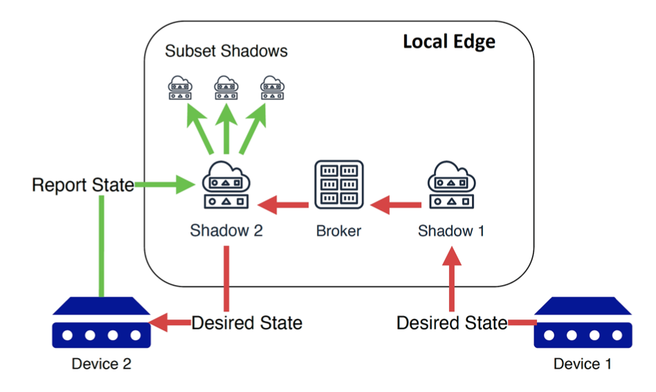
Proposed system architecture
Notes:
We conducted our experiment in a format similar to AWS Greengrass where we had our MQTT topics and our device state divided into three subgroups: reported, desired, and delta. That said, due to the nature of what we were trying to do, we didn’t use Greengrass or AWS Lambda. What we did is we deployed MQTT Mosquito Broker with pre-share key for authentication on a Raspberry Pi 4 for data collection. We simulated our devices and I think it’s important that throughout all our experiments, the raspberry pi was never stressed. We followed this architecture because AWS offers a large amount of scalability and integration into industrial environments with minimal modification of the current code base.
In our test architecture, we had two devices. The first device published a desired state to its shadow that it wants device2 to have. From there the shadow2 determines if there is a difference between reported and desired states. If there is a difference, the differing keys are added to the delta subgroup, the deltas are calculated and published to the physical device. Device 2 gets these keys and transition states and reports the new state. At this point the desired and reported state should match. It will remove the associated keys from both the desired and delta subgroups. The virtual shadow for device 2 with its tagged data are then divided based on attached tags and distributed to their associated base shadows in the local edge. This last stage of reporting the final state and publishing to the subset of shadows is what we are tracking.

Slide 14
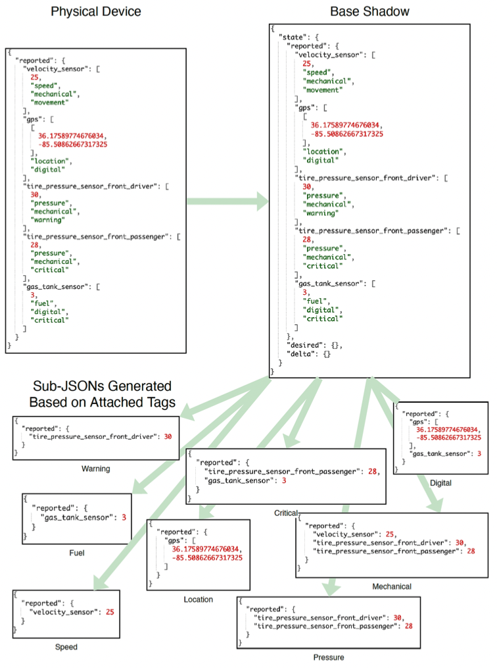
Notes:
So looking at that last stage, the physical device reports the data to its virtual shadow as shown here. In an ordinary device without tagging, you might just see a json without these tags shown.
These tags defines into which sub-json the data will propagate to. So here, we could also assign access to sub-json’s like warning or critical where data may go to several different sub-json’s using ABAC or RBAC.
Yesterday, I saw in a presentation that some cars can generate 20TB of data per day. Minimizing this data sharing within the architecture both increases security and decreases the burden on networking hardware by sharing only the data that is necessary. Access to the data would be given only to the authorized resources based off of the least privilege allowing for system malleability and a smaller attack surface area.
Since digital twins are the source of this subdivision as they can exist in a many-to-one relationship with their physical counterparts. Each shadow instance holds a subset of the data present and can independently grant access to resources. Other virtual devices may query the shadow for the current system state that they have access to or publish desired states to the system. The resulting architecture leads to a distribution of data and prevents a single MQTT client assuming all interaction with resources wishing to read or affect system state.
The implementation of physical devices is as straightforward in this architecture as it is in a one-to-one device-to-twin structure. Due to the centralized nature of MQTT, physical devices need only subscribe to topics following a pre-defined API structure to receive state change control signals. Authorization to publish to those topics may be handled by the broker, giving a central point at which access control can be done regarding all digital twins. This ensures security of the channels in which interaction takes while requiring few subscriptions from the physical device.

Slide 15
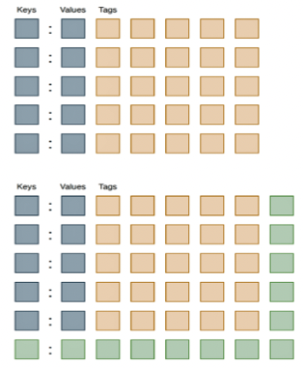
Transformation from 5 to 6 Key-Value Pairs
When there are five KV pairs in the system, there are 5 tags (upper diagram).
When we expand the testing to 6 KV pairs, we add additional tags (lower diagram).
Upon reception of a reported state from a simulated device, the shadow introduces a new k-v pair as well as increment the number of tags attached to all other pairs previously present.
Notes:
As we evaluated our code, we conducted two main tests, the first being an exponential increase of key-value pairs with tags, the other is more linear. So in this exponential increase, if we have for example, 5 key-value pairs we will have 5 tags. When we test 6 key-value pairs we will have 6 tags across each of the key value pairs.

Slide 16
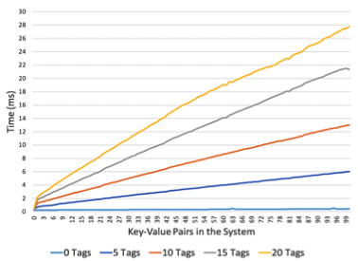
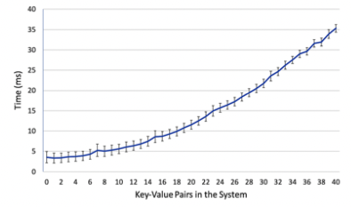
Results
Notes:
So, in our experiment we conducted 500 trials at each of these data points, we had some fixed number of tags from 0 tags as a baseline to 20 tags in intervals of 5. These fixed tags are more in line to what we would expect to happen in industry, but we also tested where we expand the number of tags with the key-value pairs as shown in the previous slide (the figure on the right).
In terms of what we tracked in these results, the time above is not reflective of any transmission times like transmitting the data to the broker or sending the message out again, it is only showing the time from when we received the messages on the broker, to calculate and resolve the messages, splitting them up into the respective sub-json’s to just before we send the messages back out to everyone else. This avoids introducing a lot of variances due to network delays and abstracts our evaluation away from physical devices or network specific implementations.
So, this first graph is where we had 3, 6, 9, up to 100 key-value pairs with a fixed number of tags associated with those pairs. This resulted in a linear trend based off the tags. Each data series represents an incrementation of number of key-value pairs from zero to one hundred with each additional pair containing specified number of tags, e.g. at data point 80 in the ‘5 Tags’ series there are 80 key-value pairs each of which has 5 attached tags resulting with 400 total tags present in the system. At the maximum of 100 key-value pairs and 20 tags on each, a total of 2000 tags, the processing time took under 28ms which is good in terms of real-time applications.
The next method is what we demonstrated in our previous slide, so if we had 5 key-value pairs, we also had 5 tags, when we tested for 6 pairs, we had 6 tags and so forth. Again, the processing time of the system averaged over 500 trials where each trial incremented the number of key-value pairs in the system from zero to forty and then emptied the system. Each point is the average performance time of the system associated with that many key-value pairs present. The attached error bars indicate a 99% confidence interval and show that with 1600 total tags present in the system (40 tags attached to 40 key-value pairs), the average processing time will rarely exceed 36 ms.
These times are promising for real time and edge centric industry applications as they show minimal increase in processing time at the digital twin level. The largest bottleneck in the system was a ‘parse tags’ function in the second graph, if the number of tags applied to each key-value pair is kept low the system remains scalable and suffers minor performance degradation.

Slide 17
Future Directions
Investigate additional ways of separating one shadow into multiple shadows
Potentially with the adoption for cloud scalability
How this could be applied to other smart environments
Evaluating the overhead of existing schemes without TBAC as a type of benchmark.
Combination of TBAC with ABAC or other forms of access control on the tagged shadows of creation of shadows and tags
Notes:
In the future we can investigate additional ways of separating one shadow into many with the potential of cloud scalability and how this could be applied to other smart environments.
We could look at how to evaluate the overhead of some existing schemes without TBAC as a type of benchmark.
We could also combine TBAC with ABAC or other access control models on the tagged shadow to help create a platform where we could limit data very precisely and determine how and where these types of models could be best applied to help limit access with the easiest administration possible.

Slide 18
Acknowledgements
This work is partially supported by:
  NSF CREST Grant HRD-1736209 at UTSA &
  Grant 2025682 at TTU
Question/ Feedback

