Slide 1
Cyber Incident Response Models for Information and Resource Sharing
Secure Information and Resource Sharing in Cloud Infrastructure as a Service
Amy(Yun) Zhang, Ram Krishnan, Ravi Sandhu
Institute for Cyber Security
University of Texas at San Antonio
San Antonio, TX 78249
Nov 03, 2014
Presented by: Amy(Yun) Zhang

Slide 2
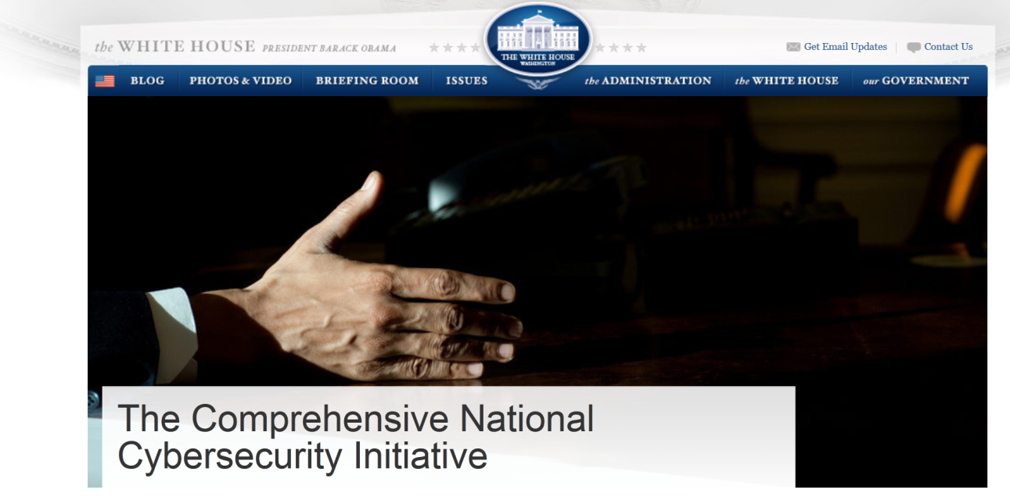
Information Sharing and Coordination Initiatives
collaboration and coordination to enhance situational awareness
Share malicious activities on federal systems
Technologies, tools, procedures, analytics
UTSA
Ref: http://www.whitehouse.gov/issues/foreign-policy/cybersecurity/national-initiative
Notes:
cybersecurity has been identified as one of the most serious economic and national security challenges. And the country and organizations are not prepared adequately to counter.
Gov is making federal efforts to defend the U.S. information and communications infrastructure and the development of a comprehensive approach to securing America’s digital infrastructure.
The CNCI consists of a number of mutually reinforcing initiatives with the following major goals:
• To establish a front line of defense against today’s immediate threats by creating or enhancing shared situational awareness of network vulnerabilities, threats, and events within the Federal Government
• To defend against the full spectrum of threats
• To strengthen the future cybersecurity environment by expanding cyber education; coordinating and redirecting research and development efforts across the Federal Government; and working to define and develop strategies to deter hostile or malicious activity in cyberspace.

Slide 3
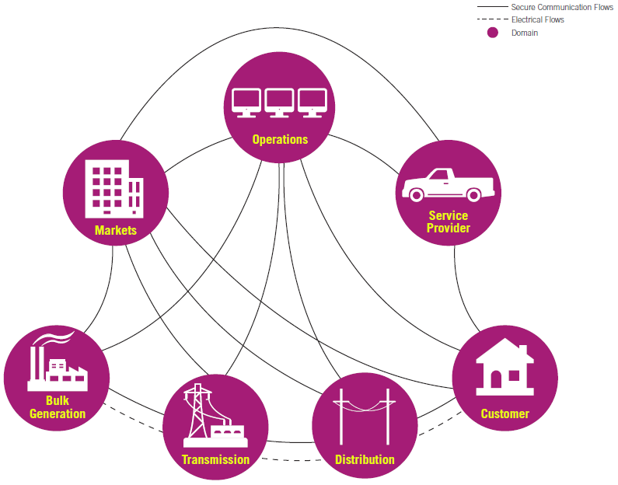
Electric Grid Scenario
Cyber incidents in electricity providers
Local utilities, regional, state, national operators
Need a standing platform that facilitates sharing
Controlled access
UTSA
Notes:
DHS has identified 16 critical infrastructure sectors. E.g.: Comm, Financial, IT, Transportation, etc.
Information Sharing and Analysis Center (ISACs) exist for several of these sectors

Slide 4
Scope
Focus on technical challenges
Sharing amongst a set of organizations
Information, infrastructure, tools, analytics, etc.
May want to share malicious or infected code/systems (e.g. virus, worms, etc.)
Sensitive
Often ad hoc
What are the effective ways to facilitate sharing in such circumstances?
Information sharing models
Infrastructure, technologies, platforms

Slide 5
Key Requirements for Information Sharing
Cyber infrastructure
Light-weight and agile
Rapid deployment and configuration
Secure isolated environment

Slide 6
Cyber Infrastructure for Sharing
Traditional platforms
Shared storage
SharePoint, Dropbox, Google Drive, etc.
Shared infrastructure
Grid computing
Modern platform
Cloud

Slide 7
Cloud IaaS Advantages for Cyber Incident Sharing
Virtualized resources
Theoretically, one can take a snapshot and mobilize
Operational efficiency
Light-weight and agile
Rapid deployment and configuration
Dynamic scaling
Self-service

Slide 8
Cloud IaaS Challenges for Cyber Incident Sharing
IaaS clouds lack secure sharing models
Storage
Compute
Networks
Need ability to snapshot tenant infrastructure, share, and control who can access
Share by copy

Slide 9

Sharing Model in Cloud IaaS
Add/Remove Data
Add/Remove Data
Secure Isolated Domain (SID)
View #1: Org C
View #1: Org A
Participant C
View #2: SID
View #2: SID
Participant A
Join/Leave Users
Join/Leave Users
Add/Remove Data
Join/Leave Users
Participant B
Can create multiple secure isolated projects (SIPs) within SID with different controls
View #1: Org B
View #2: SID

Slide 10
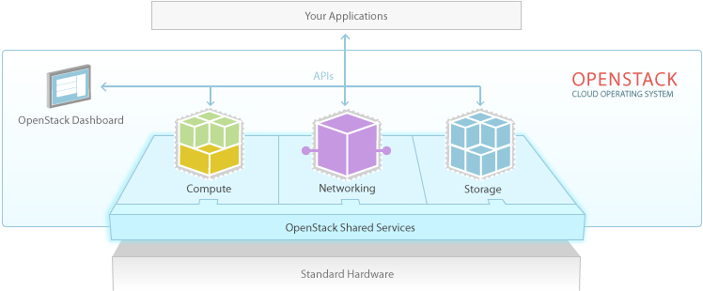
OpenStack
> 200 companies
~14000 developers
>130 countries
OpenStack
Dominant open-source cloud IaaS software
Ref: http://www.openstack.org
Notes:
OpenStack software controls large pools of compute, storage, and networking resources throughout a datacenter, managed through a dashboard or via the OpenStack API. OpenStack works with popular enterprise and open source technologies making it ideal for heterogeneous infrastructure.
Hundreds of the world’s largest brands rely on OpenStack to run their businesses every day, reducing costs and helping them move faster.

Slide 11
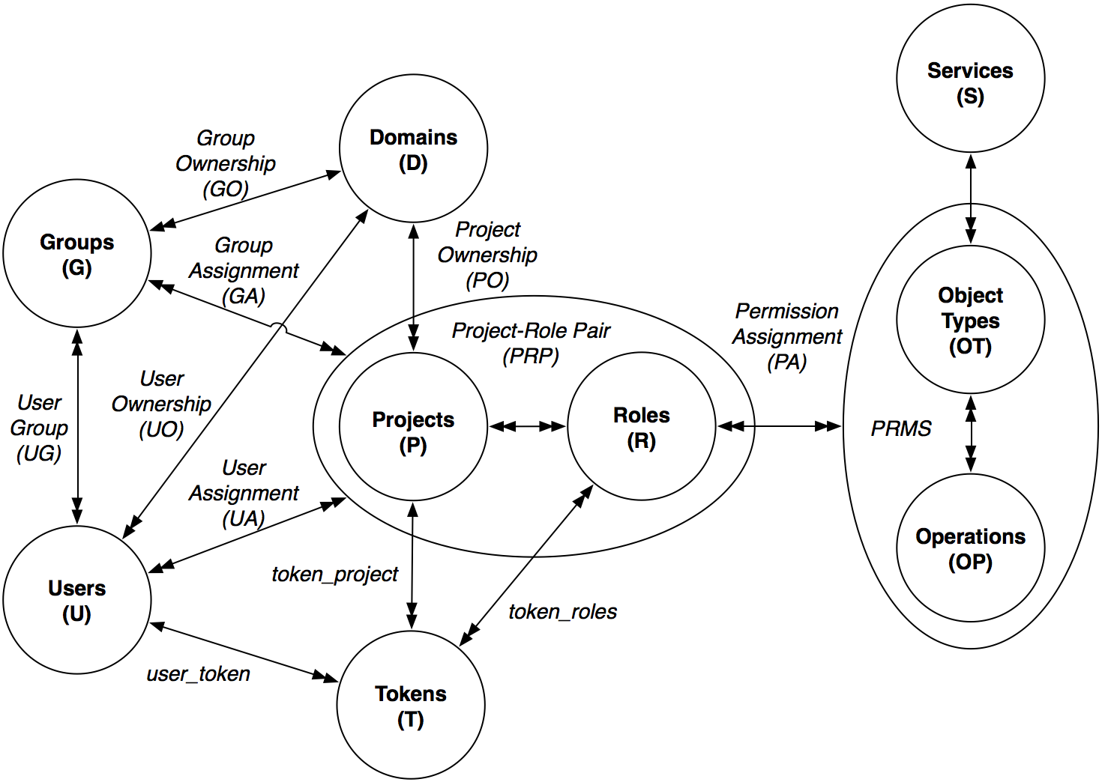
OpenStack Access Control (OSAC)
Notes:
Users represent people who are authenticated to access OpenStack cloud resources while a group is a set of users.
Projects define a boundary of cloud resources—a resource container in which users can get access to the services the cloud provides, such as virtual machines, storages, networks, and so on. Domain is a higher level concept that equates to a tenant of the CSP. The projects in a domain represents the administrative boundary of its users and groups. Projects allow tenants to segment their resources and to manage their users’ scope of access to those resources.
Roles are global, which are used to specify access levels of users to services in specific projects in a given do- main. Note that users are assigned to projects with a specific set of roles.
An object type and operation pair defines actions which can be performed by end users on cloud services and resources.
Users authenticate themselves to Keystone and obtain a token which they then use to access different services. The token contains various information including the domain the user belongs to, and the roles of the user in specific projects in that domain.

Slide 12
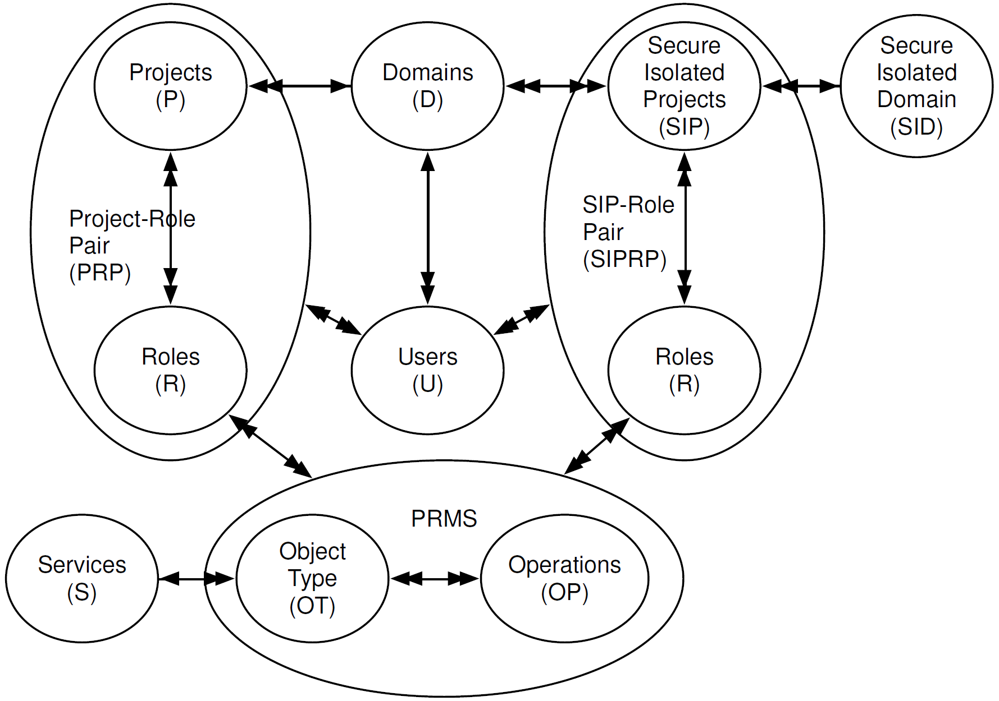
OSAC-SID

Slide 13
Conceptual Model
Administrative Model
Collaboration Group
Operational Model
Establish/Disband
Join User
Join User
Leave User
Create RO/RW Subject
Kill Subject
Create Object
Read/Update Version
Suspend/Resume
Version
Create RO/RW Subject
Kill Subject
Create Object
Read/Update Version
Suspend/Resume
Version
Leave User
ORG A
Add Version
Add Version
ORG B
Remove Version
Remove Version
Merge Version
Merge Version
Substitute User
Substitute User
Import Version

Slide 14
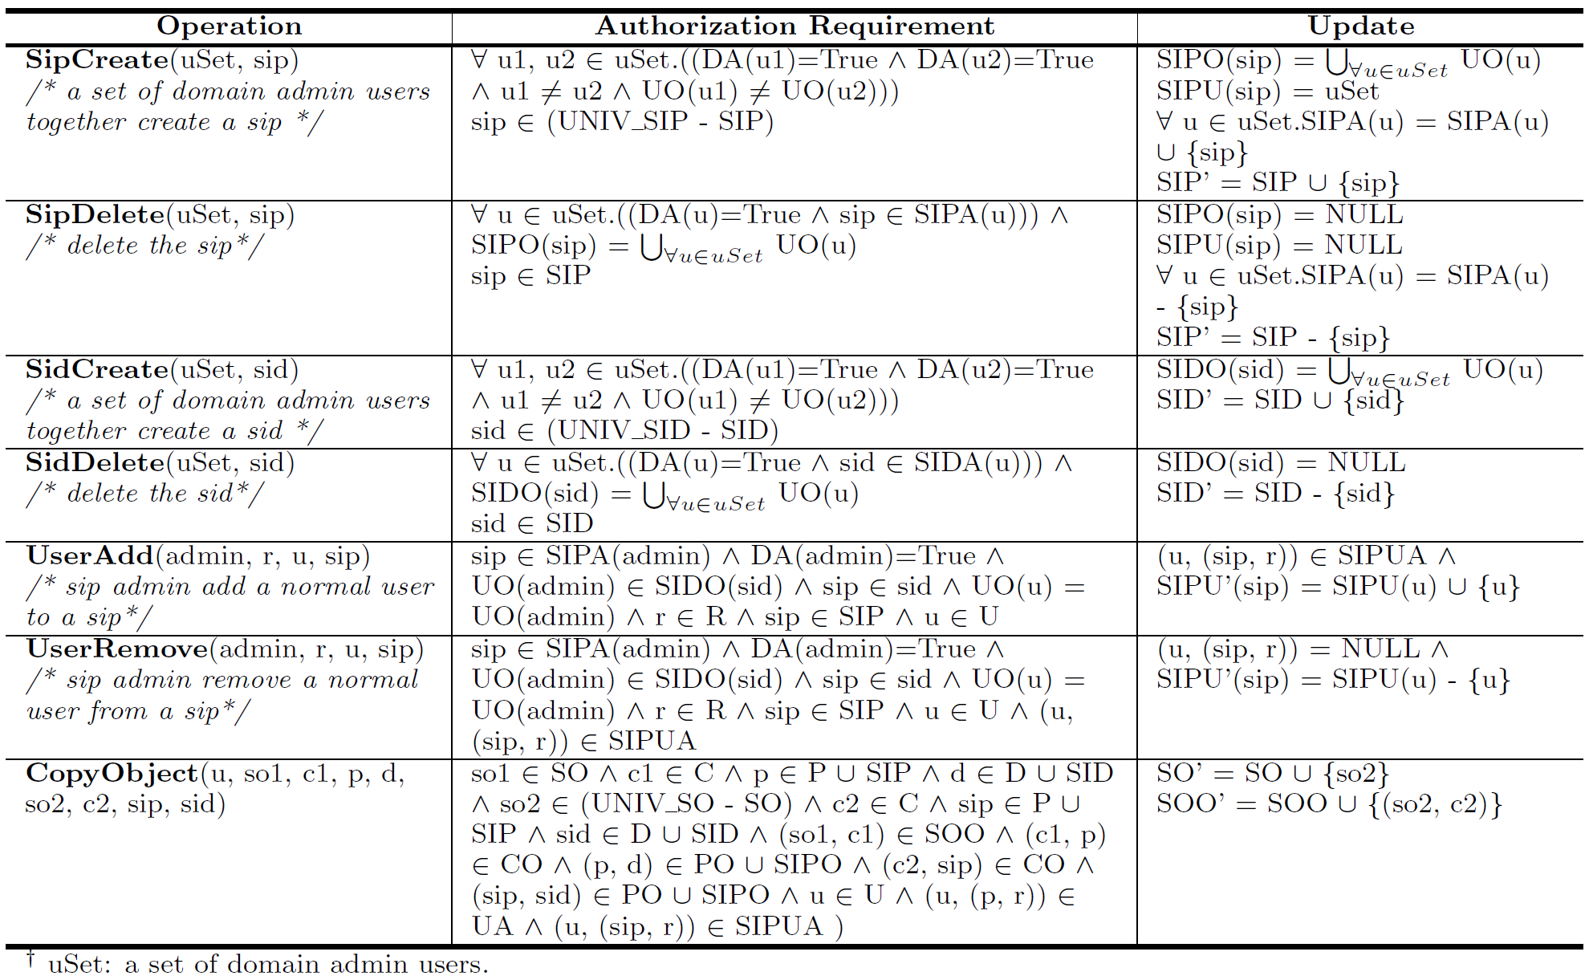
OSAC-SID Administrative Model

Slide 15
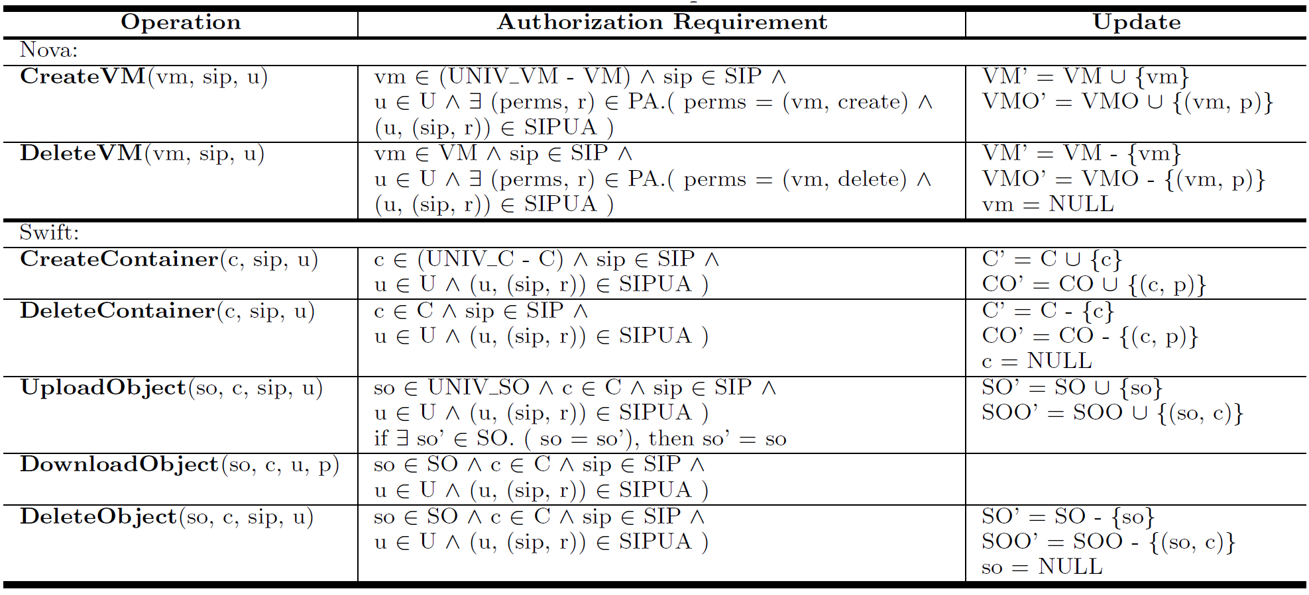
OSAC-SID Operational Model

Slide 16
SID and SIP in OpenStack
CPS
SID-Critical-Infrastructure
SAWS
Admin: CPSadmin
Admins:
CPSadmin, SAWSadmin
Admin: SAWSadmin
Users: Alice@CPS, Bob@CPS
Create
Join
Users: Harry@SAWS
Users: Alice@CPS, Harry@SAWS
member
member
SIP-PortScanning
IT-CPS
member
IT-SAWS
member
SIP-DOS
Share objects, VMs, etc.
Admin: SAPDadmin
Users: Martin@SAPD
member
IT-SAPD
SAPD

Slide 17
Conclusion and future work
Developed sharing models
Formal specification
Enhanced OpenStack with SID/SIP capabilities
Cyber incident response capabilities
Self-service
SID/SIP specific security
Share data, tools, etc. in an isolated environment
Ability to execute and analyze malicious code in an isolated environment
Practitioners can deploy a “cyber incident response” cloud
Potential blueprint for official OpenStack adoption
Future work
more fine grained access control within a SIP
harden the implementation to prevent overt information flow

Slide 18
Thanks
Q&A

