Slide 1
CS 5323
Anomaly Detection
Lecture 14
World-Leading Research with Real-World Impact!

Slide 2

Outline
Anomaly detection
Facts and figures
Application
Challenges
Classification
Anomaly in Wireless

Slide 3
Recent News
Hacking of Government Computers Exposed 21.5 Million People
Most persistent cybercriminals: Ransomware attackers 172% increase in the first half of 2016
Most expensive attacks in 2016: Leoni and Bangladesh Bank
Biggest attack vector in finance: SWIFT
Worst all-around troublemaker: Mirai
First successful cyber attack on an industrial facility: Ukrainian power grid
https://www.nytimes.com/2015/07/10/us/office-of-personnel-management-hackers-got-data-of-millions.html
https://www.trendmicro.com/vinfo/us/security/news/cyber-attacks/a-rundown-of-the-biggest-cybersecurity-incidents-of-2016

Slide 4
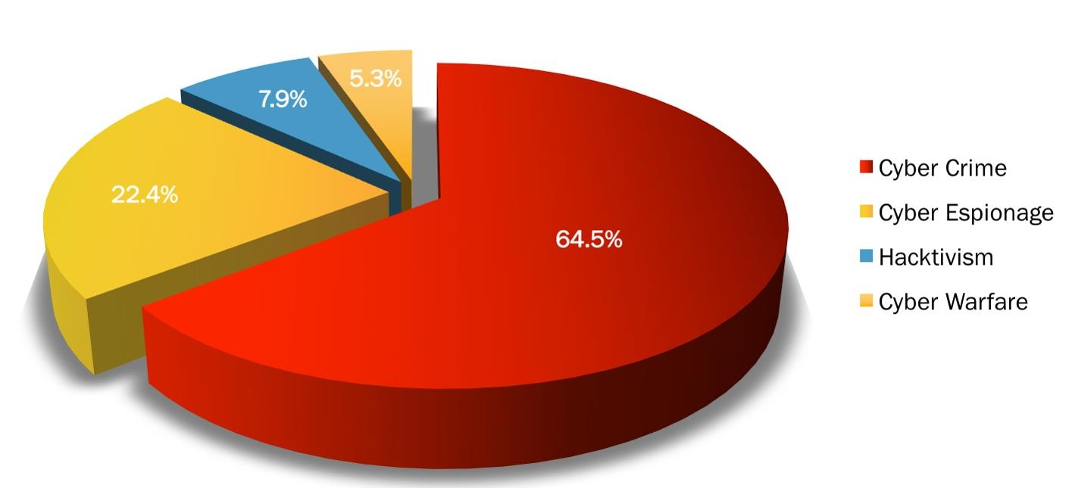
Attack in February, 2017
http://www.hackmageddon.com/2017/03/20/february-2017-cyber-attacks-statistics/ (Accessed March 31st 2017)

Slide 5
Investment
Invest over $19 billion for cyber security as part of the President’s Fiscal Year (FY) 2017 Budget.
Cyber security Ventures predicts global cyber security spending will exceed $1 trillion from 2017 to 2021!
Cybercrime continues to fuel cyber security market growth!!!!
https://obamawhitehouse.archives.gov/the-press-office/2016/02/09/fact-sheet-cybersecurity-national-action-plan
http://cybersecurityventures.com/cybersecurity-market-report/ (

Slide 6

Anomaly

Slide 7
Applications
Network intrusion detection
Insurance / Credit card fraud detection
Healthcare Informatics / Medical diagnostics
Industrial Damage Detection
Image Processing / Video surveillance
Novel Topic Detection in Text Mining
Lots more!

Slide 8


Intrusion Detection
Intrusion Detection
  Process of monitoring the events occurring in a computer system or network and analyzing them for intrusions
  Intrusions are defined as attempts to bypass the security mechanisms of a computer or network ‏
Challenges
  Traditional signature-based intrusion detection
  systems are based on signatures of known
  attacks and cannot detect emerging cyber threats
  Substantial latency in deployment of newly
  created signatures across the computer system
Anomaly detection can alleviate these
limitations

Slide 9
Fraud Detection
Fraud detection refers to detection of criminal activities occurring in commercial organizations
  Malicious users might be the actual customers of the organization or might be posing as a customer (also known as identity theft).
Types of fraud
  Credit card fraud
  Insurance claim fraud
  Mobile / cell phone fraud
  Insider trading
Challenges
  Fast and accurate real-time detection
  Misclassification cost is very high

Slide 10

Industrial Damage Detection
Industrial damage detection refers to detection of different faults and failures in complex industrial systems, structural damages, intrusions in electronic security systems, suspicious events in video surveillance, abnormal energy consumption, etc.
  Example: Aircraft Safety
    Anomalous Aircraft (Engine) / Fleet Usage
    Anomalies in engine combustion data
    Total aircraft health and usage management
Key Challenges
  Data is extremely huge, noisy and unlabelled
  Most of applications exhibit temporal behaviour
  Detecting anomalous events typically require immediate intervention

Slide 11
Key Challenges
Defining a normal region
The boundary between normal and outlying behaviour
The exact notion of an outlier is different for different application domains
Availability of labelled data for training/validation
Malicious adversaries
Data might contain noise
Normal behaviour keeps evolving

Slide 12
Anomaly Detection Strategies
Supervised Anomaly Detection
  Labels available for both normal data and anomalies
  Similar to rare class mining
Semi-supervised Anomaly Detection
  Labels available only for normal data
Unsupervised Anomaly Detection
  No labels assumed
  Based on the assumption that anomalies are very rare compared to normal data

Slide 13
Classification
Anomaly Detection
Classification Based
Point Anomaly Detection
Rule Based
Neural Networks Based
SVM Based
Nearest Neighbour Based
Density Based
Distance Based
Contextual Anomaly Detection
Clustering Based
Collective Anomaly Detection
Statistical
Parametric
Non-parametric
Online Anomaly Detection
Others
Distributed Anomaly Detection
Information Theory Based
Spectral Decomposition Based
Visualization Based
* Outlier Detection – A Survey, Varun Chandola, Arindam Banerjee, and Vipin Kumar, Technical Report TR07-17, University of Minnesota

Slide 14
Point Anomalies
An individual data instance is anomalous w.r.t. the data
Y
N₁
o₁
O₃
o₂
N₂
X
V. CHANDOLA, A. BANERJEE, and V. KUMAR, “Anomaly Detection: A Survey”, ACM computing surveys (CSUR), 41(3): 2009, pg 15:1-15:58.

Slide 15
Classification
Anomaly Detection
Classification Based
Point Anomaly Detection
Rule Based
Neural Networks Based
SVM Based
Nearest Neighbor Based
Density Based
Distance Based
Contextual Anomaly Detection
Clustering Based
Collective Anomaly Detection
Statistical
Parametric
Non-parametric
Online Anomaly Detection
Others
Distributed Anomaly Detection
Information Theory Based
Spectral Decomposition Based
Visualization Based
Outlier Detection – A Survey, Varun Chandola, Arindam Banerjee, and Vipin Kumar, Technical Report TR07-17, University of Minnesota

Slide 16
Classification Based Techniques
Build a classification model for normal (and anomalous (rare)) events based on labelled training data, and use it to classify each new unseen event
Classification models must be able to handle skewed (imbalanced) class distributions
Categories:
  Supervised classification techniques
    Require knowledge of both normal and anomaly class
    Build classifier to distinguish between normal and known anomalies
  Semi-supervised classification techniques
    Require knowledge of normal class only!
    Use modified classification model to learn the normal behavior and then detect any deviations from normal behavior as anomalous

Slide 17
Classification Based Techniques
Advantages:
  Supervised classification techniques
    Models that can be easily understood
    High accuracy in detecting many kinds of known anomalies
  Semi-supervised classification techniques
    Models that can be easily understood
    Normal behaviour can be accurately learned
Drawbacks:
  Supervised classification techniques
    Require both labels from both normal and anomaly class
    Cannot detect unknown and emerging anomalies
  Semi-supervised classification techniques
    Require labels from normal class and possible high false alarm rate

Slide 18
Rule Based Techniques
Involves an attempt to define a set of rules that can be used to decide that a given behavior is that of an intruder.
  Rules with support higher than pre specified threshold may characterize normal behaviour
  Anomalous data record occurs in fewer frequent item sets compared to normal data record
  Example : SNORT a powerful, flexible open source NIDS
    developed by Sourcefire.
    Combines the benefits of signature, protocol, and anomaly-based inspection
    Snort is the most widely deployed IDS/IPS technology worldwide
    With millions of downloads and nearly 400,000 registered users, Snort has become the de facto standard for IPS

Slide 19
SNORT Rule
    alert tcp $EXTERNAL_NET any -> 192.168.3.0/24 80 (msg:”Sample alert”;)
    alert icmp any any -> $HOME_NET any (msg:”ICMP test”; sid:1000001; rev:1; classtype:icmp-event;)

Slide 20
PN-rule Learning
P-phase:
    cover most of the positive examples with high support
    seek good recall
N-phase:
    remove FP from examples covered in P-phase
    N-rules give high accuracy and significant support
C
C
NC
NC
Existing techniques can possibly learn erroneous small signatures for absence of C
PN-rule can learn strong signatures for presence of NC in N-phase
M. Joshi, et al., PNrule, Mining Needles in a Haystack: Classifying Rare Classes via Two-Phase Rule Induction, ACM SIGMOD 2001

Slide 21
Using Neural Networks
  The ides here is to train neural network to predict a user’s next action or command, given the window of n previous actions.
Advantages:
  They cope with noisy data
  Their success does not depend on any statistical assumption about the nature of the underlying data
  They are easier to modify for new user communities
Problems:
  A small window will result in false positives, a large window will result in irrelevant data as well as increase the chance of false negatives.
  The net topology is only determined after considerable trail and error.
  The intruder can train the net during its learning phase.
Multi-layer Perceptrons
Auto-associative neural networks
  Replicator NNs

Slide 22
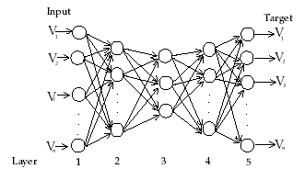
Using Replicator Neural Networks
Use a replicator 4-layer feed-forward neural network (RNN) with the same number of input and output nodes
Input variables are the output variables so that RNN forms a compressed model of the data during training
A measure of outlyingness is the reconstruction error of individual data points.
Input
Target variables
S. Hawkins, et al. Outlier detection using replicator neural networks, DaWaK02 2002.

Slide 23
Using Support Vector Machines
Converting into one class classification problem
  Separate the entire set of training data from the
  origin, i.e. to find a small region where most of the
  data lies and label data points in this region as one
  class
  Separate regions containing data
  from the regions containing no
  data.
origin
push the hyper plane away from origin as much as possible
M. Amer, M. Goldstein, “Enhancing One-class Support Vector Machines for Unsupervised Anomaly Detection”,
ODD’13, August 11th, 2013, Chicago, IL, USA.

Slide 24
Classification
Anomaly Detection
Classification Based
Point Anomaly Detection
Rule Based
Neural Networks Based
SVM Based
Nearest Neighbour Based
Density Based
Distance Based
Contextual Anomaly Detection
Clustering Based
Collective Anomaly Detection
Statistical
Parametric
Non-parametric
Online Anomaly Detection
Others
Distributed Anomaly Detection
Information Theory Based
Spectral Decomposition Based
Visualization Based
* Outlier Detection – A Survey, Varun Chandola, Arindam Banerjee, and Vipin Kumar, Technical Report TR07-17, University of Minnesota

Slide 25
Nearest Neighbour Based Techniques
Key assumption: normal points have close neighbours while anomalies are located far from other points
General two-step approach
  Compute neighbourhood for each data record
  Analyze the neighbourhood to determine whether data record is anomaly or not
Categories:
  Distance based methods
    Anomalies are data points most distant from other points
  Density based methods
    Anomalies are data points in low density regions

Slide 26
Nearest Neighbour Based Techniques
Advantage
  Can be used in unsupervised or semi-supervised setting (do not make any assumptions about data distribution)
Drawbacks
  If normal points do not have sufficient number of neighbours the techniques may fail
  Computationally expensive
  In high dimensional spaces, data is sparse and the concept of similarity may not be meaningful anymore. Due to the sparseness, distances between any two data records may become quite similar => Each data record may be considered as potential outlier!

Slide 27
Distance based Outlier Detection
Steps
  For each data point d compute the distance to the k-th nearest
  neighbor d_{k}
  Sort all data points according to the distance d_{k}
  Outliers are points that have the largest distance d_{k} and therefore are located in the more sparse neighbourhoods
  Usually data points that have top n% distance d_{k} are identified as outliers
    n – user parameter
  Not suitable for datasets that have modes with varying density
Knorr, Ng,Algorithms for Mining Distance-Based Outliers in Large Datasets, VLDB98
S. Ramaswamy, R. Rastogi, S. Kyuseok: Efficient Algorithms for Mining Outliers from Large Data Sets, ACM SIGMOD Conf. On Management of Data, 2000.

Slide 28
Density based Outlier Detection(LOF)
For each data point q compute the distance to the k-th nearest neighbor (k-distance)
Compute reachability distance (reach-dist) for each data example q with respect to data example p as:
  reach-dist(q, p) = max{k-distance(p), d(q,p)}
Compute local reachability density (lrd) of data example q as inverse of the average reachabaility distance based on the MinPts nearest neighbors of data example q
  lrd(q) =
Compaute LOF(q) as ratio of average local reachability density of q’s k-nearest neighbors and local reachability density of the data record q
  LOF(q) =
Breunig, et al, LOF: Identifying Density-Based Local Outliers, KDD 2000.

Slide 29
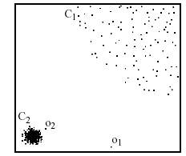
LOF Approach
Example:
Distance from p₃ to nearest neighbor
p₃
×
Breunig, et al, LOF: Identifying Density-Based Local Outliers, KDD 2000.

Slide 30
Classification
Anomaly Detection
Classification Based
Point Anomaly Detection
Rule Based
Neural Networks Based
SVM Based
Nearest Neighbor Based
Density Based
Distance Based
Contextual Anomaly Detection
Clustering Based
Collective Anomaly Detection
Statistical
Parametric
Non-parametric
Online Anomaly Detection
Others
Distributed Anomaly Detection
Information Theory Based
Spectral Decomposition Based
Visualization Based
Outlier Detection – A Survey, Varun Chandola, Arindam Banerjee, and Vipin Kumar, Technical Report TR07-17, University of Minnesota

Slide 31
Clustering Based Techniques
Key assumption: normal data records belong to large and dense clusters, while anomalies belong do not belong to any of the clusters or form very small clusters
Categorization according to labels
  Semi-supervised – cluster normal data to create modes of normal behavior. If a new instance does not belong to any of the clusters or it is not close to any cluster, is anomaly
  Unsupervised – post-processing is needed after a clustering step to determine the size of the clusters and the distance from the clusters is required for the point to be anomaly
Anomalies detected using clustering based methods can be:
  Data records that do not fit into any cluster (residuals from clustering)‏
  Small clusters
  Low density clusters or local anomalies (far from other points within the same cluster)

Slide 32
Clustering Based Techniques
Advantages:
  No need to be supervised
  Easily adaptable to on-line / incremental mode suitable for anomaly detection from temporal data
Drawbacks:
  Computationally expensive
    Using indexing structures (k-d tree, R* tree) may alleviate this problem
  If normal points do not create any clusters the techniques may fail
  In high dimensional spaces, data is sparse and distances between any two data records may become quite similar.
    Clustering algorithms may not give any meaningful clusters

Slide 33
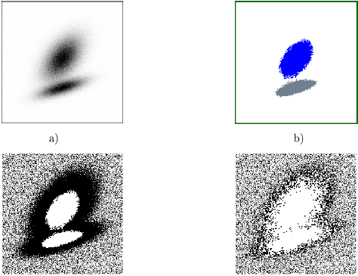
FindOut Algorithm
FindOut algorithm* by-product of WaveCluster
Main idea: Remove the clusters from original data and then identify the outliers
Transform data into multidimensional signals using wavelet transformation
  High frequency of the signals correspond to regions where is the rapid change of distribution – boundaries of the clusters
  Low frequency parts correspond to
  the regions where the data is
  concentrated
Remove these high and low
frequency parts and all remaining
points will be outliers
D. Yu, G. Sheikholeslami, A. Zhang, FindOut: Finding Outliers in Very Large Datasets, 1999.

Slide 34
Cluster Based Local Outlier Factor
Use squeezer clustering algorithm to perform clustering
Determine CBLOF for each data
record measured by both the size
of the cluster and the distance to
the cluster
  if the data record lies in a small cluster,
  CBLOF is measured as a product of
  the size of the cluster the data record
  belongs to and the distance to the
  closest larger cluster
  if the object belongs to a large cluster
  CBLOF is measured as a product of
  the size of the cluster that the data record belongs to and the distance between the data record and the cluster it belongs to (this provides importance of the local data behavior)
Z. He, X Xu, S. Deng, Discovering Cluster based Local Outlier,2003

Slide 35
Classification
Anomaly Detection
Classification Based
Point Anomaly Detection
Rule Based
Neural Networks Based
SVM Based
Nearest Neighbor Based
Density Based
Distance Based
Contextual Anomaly Detection
Clustering Based
Collective Anomaly Detection
Statistical
Parametric
Non-parametric
Online Anomaly Detection
Others
Distributed Anomaly Detection
Information Theory Based
Spectral Decomposition Based
Visualization Based
Outlier Detection – A Survey, Varun Chandola, Arindam Banerjee, and Vipin Kumar, Technical Report TR07-17, University of Minnesota

Slide 36
Statistics Based Techniques
Data points are modelled using stochastic distribution points are determined to be outliers depending on their relationship with this model
Advantage
  Utilize existing statistical modelling techniques to model various type of distributions
Challenges
  With high dimensions, difficult to estimate distributions
  Parametric assumptions often do not hold for real data sets

Slide 37
Types of Statistical Techniques
Parametric Techniques
  Assume that the normal (and possibly anomalous) data is generated from an underlying parametric distribution
  Learn the parameters from the normal sample
  Determine the likelihood of a test instance to be generated from this distribution to detect anomalies
Non-parametric Techniques
  Do not assume any knowledge of parameters
  Use non-parametric techniques to learn a distribution – e.g. parzen window estimation

Slide 38
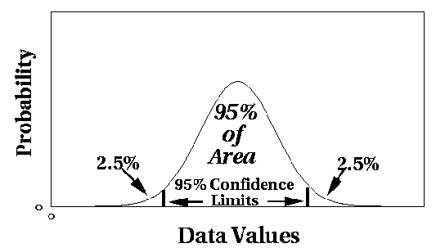
Model based Statistical Techniques
Assume a parametric model describing the distribution of the data (e.g., normal distribution)
Apply a statistical test that depends on
  Data distribution
  Parameter of distribution (e.g., mean, variance)
  Number of expected outliers (confidence limit)

Slide 39
Grubbs’ Test
Detect outliers in univariate data
Assume data comes from normal distribution
Detects one outlier at a time, remove the outlier, and repeat
  H₀: There is no outlier in data
  H_{A}: There is at least one outlier
Grubbs’ test statistic:
Reject H₀ if:

Slide 40
Classification
Anomaly Detection
Classification Based
Point Anomaly Detection
Rule Based
Neural Networks Based
SVM Based
Nearest Neighbor Based
Density Based
Distance Based
Contextual Anomaly Detection
Clustering Based
Collective Anomaly Detection
Statistical
Parametric
Non-parametric
Online Anomaly Detection
Others
Distributed Anomaly Detection
Information Theory Based
Spectral Decomposition Based
Visualization Based
* Outlier Detection – A Survey, Varun Chandola, Arindam Banerjee, and Vipin Kumar, Technical Report TR07-17, University of Minnesota

Slide 41
Information Theory Based Techniques
Compute information content in data using information theoretic measures, e.g., entropy, relative entropy, etc.
Key idea: Outliers significantly alter the information content in a dataset
Approach: Detect data instances that significantly alter the information content
  Require an information theoretic measure
Advantage
  Operate in an unsupervised mode
Challenges
  Require an information theoretic measure sensitive enough to detect irregularity induced by very few outliers

Slide 42
Information Theory Based Techniques
Using a variety of information theoretic measures
Kolmogorov complexity based approaches
  Detect smallest data subset whose removal leads to maximal reduction in Kolmogorov complexity
Entropy based approaches
  Find a k-sized subset whose removal leads to the maximal decrease in entropy

Slide 43
Spectral Techniques
Analysis based on eigen decomposition of data
Key Idea
  Find combination of attributes that capture bulk of variability
  Reduced set of attributes can explain normal data well, but not necessarily the outliers
Advantage
  Can operate in an unsupervised mode
Disadvantage
  Based on the assumption that anomalies and normal instances are distinguishable in the reduced space
Several methods use Principal Component Analysis
  Top few principal components capture variability in normal data
  Smallest principal component should have constant values
  Outliers have variability in the smallest component

Slide 44
Using Robust PCA
Variability analysis based on robust PCA
  Compute the principal components of the dataset
  For each test point, compute its projection on these components
  If y_{i} denotes the i^{th} component, then the following has a chi-squared distribution
  An observation is outlier if for a given significance level
  Have been applied to intrusion detection, outliers in space-craft components, etc.
Shyu, M.-L., Chen, S.-C., Sarinnapakorn, K., and Chang, L. 2003. A novel anomaly detection scheme based on principal component classifier, In Proceedings of the IEEE Foundations and New Directions of Data Mining Workshop.

Slide 45
Visualization Based Techniques
Use visualization tools to observe the data
Provide alternate views of data for manual inspection
Anomalies are detected visually
Advantage
  Keeps a human in the loop
Disadvantages
  Works well for low dimensional data
  Can provide only aggregated or partial views for high dimension data

Slide 46
Application of Dynamic Graphics
Apply dynamic graphics to the exploratory analysis of spatial data.
Visualization tools are used to examine local variability to detect anomalies
Manual inspection of plots of the data that display its marginal and multivariate distributions
* Haslett, J. et al. Dynamic graphics for exploring spatial data with application to locating global and local anomalies. The American Statistician

Slide 47
Classification
Anomaly Detection
Classification Based
Point Anomaly Detection
Rule Based
Neural Networks Based
SVM Based
Nearest Neighbor Based
Density Based
Distance Based
Contextual Anomaly Detection
Clustering Based
Collective Anomaly Detection
Statistical
Parametric
Non-parametric
Online Anomaly Detection
Others
Distributed Anomaly Detection
Information Theory Based
Spectral Decomposition Based
Visualization Based
* Outlier Detection – A Survey, Varun Chandola, Arindam Banerjee, and Vipin Kumar, Technical Report TR07-17, University of Minnesota

Slide 48
Contextual Anomalies
An individual data instance is anomalous within a context
Requires a notion of context
Also referred to as conditional anomalies*
Anomaly
Normal
* Xiuyao Song, Mingxi Wu, Christopher Jermaine, Sanjay Ranka, Conditional Anomaly Detection, IEEE Transactions on Data and Knowledge Engineering, 2006.

Slide 49
Contextual Anomaly Detection
Advantage
  Detect anomalies that are hard to detect when analyzed in the global perspective
Challenges
  Identifying a set of good contextual attributes
  Determining a context using the contextual attributes

Slide 50
Classification
Anomaly Detection
Classification Based
Point Anomaly Detection
Rule Based
Neural Networks Based
SVM Based
Nearest Neighbor Based
Density Based
Distance Based
Contextual Anomaly Detection
Clustering Based
Collective Anomaly Detection
Statistical
Parametric
Non-parametric
Online Anomaly Detection
Others
Distributed Anomaly Detection
Information Theory Based
Spectral Decomposition Based
Visualization Based
* Outlier Detection – A Survey, Varun Chandola, Arindam Banerjee, and Vipin Kumar, Technical Report TR07-17, University of Minnesota

Slide 51
Collective Anomalies
A collection of related data instances is anomalous
Requires a relationship among data instances
  Sequential Data
  Spatial Data
  Graph Data
The individual instances within a collective anomaly are not anomalous by themselves
Anomalous Subsequence

Slide 52
Classification
Anomaly Detection
Classification Based
Point Anomaly Detection
Rule Based
Neural Networks Based
SVM Based
Nearest Neighbor Based
Density Based
Distance Based
Contextual Anomaly Detection
Clustering Based
Collective Anomaly Detection
Statistical
Parametric
Non-parametric
Online Anomaly Detection
Others
Distributed Anomaly Detection
Information Theory Based
Spectral Decomposition Based
Visualization Based
* Outlier Detection – A Survey, Varun Chandola, Arindam Banerjee, and Vipin Kumar, Technical Report TR07-17, University of Minnesota

Slide 53

On-line Anomaly Detection
Data in many rare events applications arrives continuously at an enormous pace
There is a significant challenge to analyze such data
Examples of such rare events applications:
  Video analysis
  Network traffic monitoring
  Aircraft safety
  Credit card fraudulent transactions
* Outlier Detection – A Survey, Varun Chandola, Arindam Banerjee, and Vipin Kumar, Technical Report TR07-17, University of Minnesota

Slide 54
Simple Idea
The normal behaviour is changing through time
Need to update the “normal behaviour” profile dynamically
  Key idea: Update the normal profile with the data records that are “probably” normal, i.e. have very low anomaly score
  Time slot i – Data block D_{i} – model of normal behavior M_{i}
  Anomaly detection algorithm in time slot (i+1) is based on the profile computed in time slot i
Time slot 1
Time slot 2
Time slot i
Time slot (i+1)
Time slot t
…..
…..
D_{i}
D_{i+1}
Time
* Outlier Detection – A Survey, Varun Chandola, Arindam Banerjee, and Vipin Kumar, Technical Report TR07-17, University of Minnesota

Slide 55
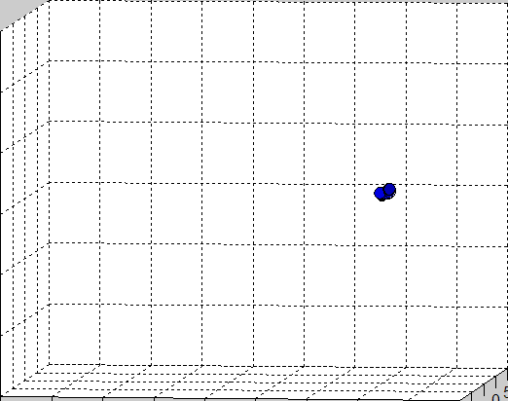
Drawbacks
If arriving data points start to create a new data cluster, this method will not be able to detect these points as outliers at the time when the change occurred
* Outlier Detection – A Survey, Varun Chandola, Arindam Banerjee, and Vipin Kumar, Technical Report TR07-17, University of Minnesota

Slide 56
Classification
Anomaly Detection
Classification Based
Point Anomaly Detection
Rule Based
Neural Networks Based
SVM Based
Nearest Neighbor Based
Density Based
Distance Based
Contextual Anomaly Detection
Clustering Based
Collective Anomaly Detection
Statistical
Parametric
Non-parametric
Online Anomaly Detection
Others
Distributed Anomaly Detection
Information Theory Based
Spectral Decomposition Based
Visualization Based
* Outlier Detection – A Survey, Varun Chandola, Arindam Banerjee, and Vipin Kumar, Technical Report TR07-17, University of Minnesota

Slide 57
Distributed Anomaly Detection
Data in many anomaly detection applications may come from many different sources
  Network intrusion detection
  Credit card fraud
  Aviation safety
Failures that occur at multiple locations simultaneously may be undetected by analyzing only data from a single location
  Detecting anomalies in such complex systems may require integration of information about detected anomalies from single locations in order to detect anomalies at the global level of a complex system
There is a need for the high performance and distributed algorithms for correlation and integration of anomalies

Slide 58
(Cont…)
Simple data exchange approaches
  Merging data at a single location
  Exchanging data between distributed locations
Distributed nearest neighbouring approaches
  Exchanging one data record per distance computation – computationally inefficient
  privacy preserving anomaly detection algorithms based on computing distances across the sites
Methods based on exchange of models
  explore exchange of appropriate statistical / data mining models that characterize normal / anomalous behaviour
    identifying modes of normal behaviour; describing these modes with statistical / data mining learning models; and
    exchanging models across multiple locations and combing them at each location in order to detect global anomalies

Slide 59
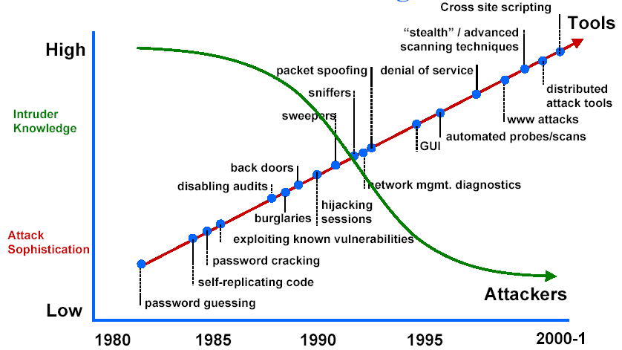
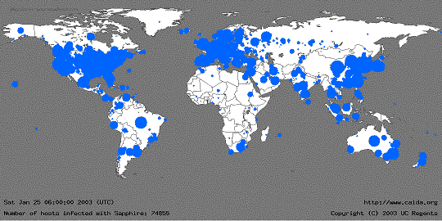
Case Study
Incidents Reported to Computer Emergency Response Team/Coordination Center (CERT/CC)
Due to the proliferation of Internet, more and more organizations are becoming vulnerable to cyber attacks
Sophistication of cyber attacks as well as their severity is also increasing*
Security mechanisms always have inevitable vulnerabilities
  Firewalls are not sufficient to ensure security in computer networks
  Insider attacks
1990 1991 1992 1993 1994 1995 1996 1997 1998 1999 2000 2001 2002 2003
The geographic spread of Sapphire/Slammer Worm 30 minutes after release (www.caida.org)
*Attack sophistication vs. Intruder technical knowledge, source: www.cert.org/archive/ppt/cyberterror.ppt

Slide 60
Data Mining Approach
Traditional intrusion detection system IDS tools (e.g. SNORT) are based on signatures of known attacks
Limitations
  Signature database has to be manually revised
  for each new type of discovered intrusion
  They cannot detect emerging cyber threats
  Substantial latency in deployment of newly created signatures across the computer system
Increased interest in data mining based IDS for detection
  Attacks for which it is difficult to build signatures
  Unforeseen/Unknown attacks
  MINDS(Learning from rare class – Building rare
  class prediction models)

Slide 61
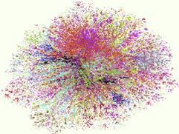
Graph Based Approach
Why should we care?
Internet Map [lumeta.com]

Slide 62
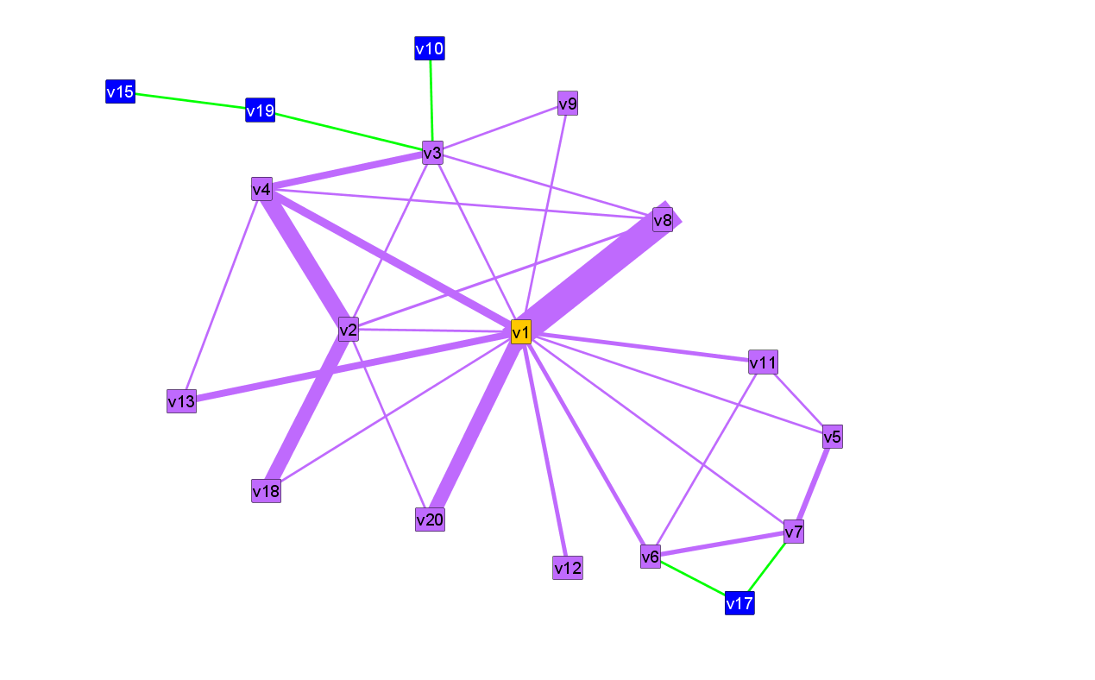
OddBall Approach
egonet
ego
L. Akoglu, M. McGlohan, C. Faloutsos, “OddBall: Spotting Anomalies in Weighted Graphs”, PAKDD,2010

Slide 63
Anomaly Detection
In
Mobile Ad-Hoc Network

Slide 64
Vulnerabilities in MAN
The very advantage of its mobility leads to its disadvantage.
Possible attacks ranging from passive eavesdropping to active interference.
Communication infrastructure and communication topology different from wired communications.
Damages include loss of privacy, confidentiality, security etc...

Slide 65
(Cont…)
Autonomous nature, roaming independence.
Unprotected physical medium.
Node tracking is difficult.
Decentralized network infrastructure and decision making. Mostly rely on cooperative participation.
Susceptible to attacks designed to break the cooperative algorithms.

Slide 66
(Cont…)
Bandwidth and power constraints make conventional security measures inept to attacks that exploit applications relying on them.
Wireless networks involving base node communications (ex. access points) are vulnerable to DoS attacks like dis-association and de-authentication attacks.
No clear line of defense.

Slide 67
Key design issues
Build Intrusion detection and response system that fits the features of mobile ad-hoc networks. Should be both distributed and cooperative.
Choose appropriate data audit sources. Local audit data versus global audit data.
Separate normalcy from anomaly.

Slide 68
Possible Aspect
Intrusion detection and response should be both distributed and cooperative to suite the needs of mobile adhoc networks.
Every node participates in intrusion detection and response.
Each node is responsible for detection and reporting of intrusions independently. All nodes can investigate into an intrusion event.

Slide 69
Problems
cannot conduct investigations of attacks without human intervention
cannot intuit the contents of your organizational security policy
cannot compensate for weaknesses in network protocols
cannot compensate for weak identification and authentication mechanisms
capable of monitoring network traffic but to a certain extent of traffic level

Slide 70
Conclusion
Anomaly detection can detect critical information in data
Highly applicable in various application domains
Nature of anomaly detection problem is dependent on the application domain
Need different approaches to solve a particular problem formulation
This is not the end …

Slide 71
Reference
V. CHANDOLA, A. BANERJEE, and V. KUMAR, “Anomaly Detection: A Survey”, ACM computing surveys (CSUR), 41(3): 2009, pg 15:1-15:58.

Slide 72

Thank You Very Much

