Slide 1
Security Challenges in Software Defined Networks (SDN)
Lecture 18

Slide 2
Outline
Market and SDN
Conventional Networks v.s SDN
OpenFlow-enabled SDN devices
SDN Security Applications
SDN Security Challenges
Community Debate regarding Security in SDN

Slide 3
Market and SDN
In 2016, the market research firm IDC predicted that the market for SDN network applications would reach US$3.5 billion by 2020.
Leading IT companies such as Nokia, Cisco, Dell, HP, Juniper, IBM, and VMware have developed their own SDN strategies.
In 2015, AT&T reduced provisioning cycle by 95% with SDN.
Marc C. Dacier, Hartmut Cwalinski , Frank Kargl , Sven Dietrich, Security Challenges and Opportunities of Software-Defined Networking, Apr 3, 2017
“We have taken a process from low automation and weeks to complete to high automation and minutes to complete. We’re turning the industry on its head in an unprecedented way.” John Donovan
AT&T’s analyst conference in August 2015, John Donovan
Notes:
International Data Corporation (IDC), an American market research, analysis and advisory firm, specializes in information technology,
AT&T reduces provisioning cycle by 95% with SDN
reduction in the time spent ordering, managing and changing services by up up to 95%.
“We have taken a process from low automation and weeks to complete to high automation and minutes to complete. We’re turning the industry on its head in an unprecedented way.” John Donovan
John Donovan : senior executive vice president of technology and network operations

Slide 4
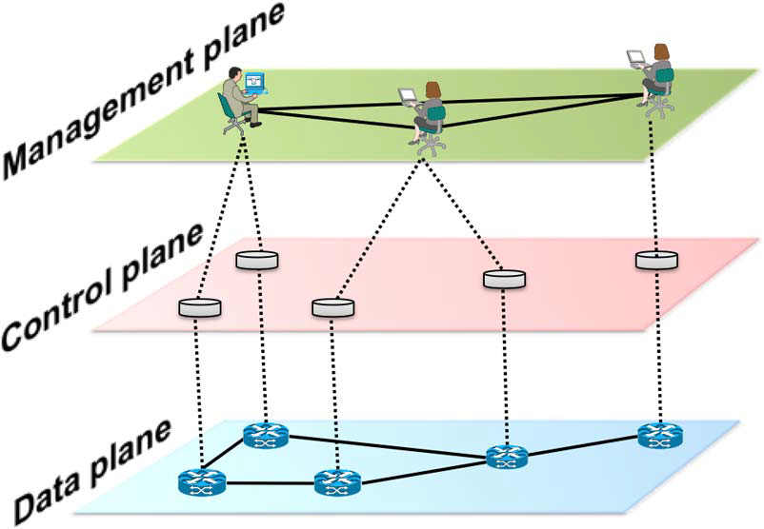
Conventional Networks vs. SDN
Control Plane
Smart
Network
Applications
Traffic mngmnt,QoS
Policy Imp.
Security services
Decoupling
Control Plane
Open
North-bound API
Abstract
view
Data Plane
Data Plane
Dumb, fast
Control Plane
Policy mngmnt
Limited visibility
Vendor-specfic
Missconfiguration
Poor responses
Policy conflicts
Security breaches
Decentralized.
Complex
Static architecture
Innovation is difficult
Costly
Yes costly
OpenFlow
South-bound API
Global
view
Decentralized Control
S
S
S
S
Data Plane
Customization
Programmability
*
Conventional Networks
Software Defined Networks
*Figure: Kreutz, Diego, et al. "Software-defined networking: A comprehensive survey." Proceedings of the IEEE 103.1 (2015): 14-76.

Slide 5
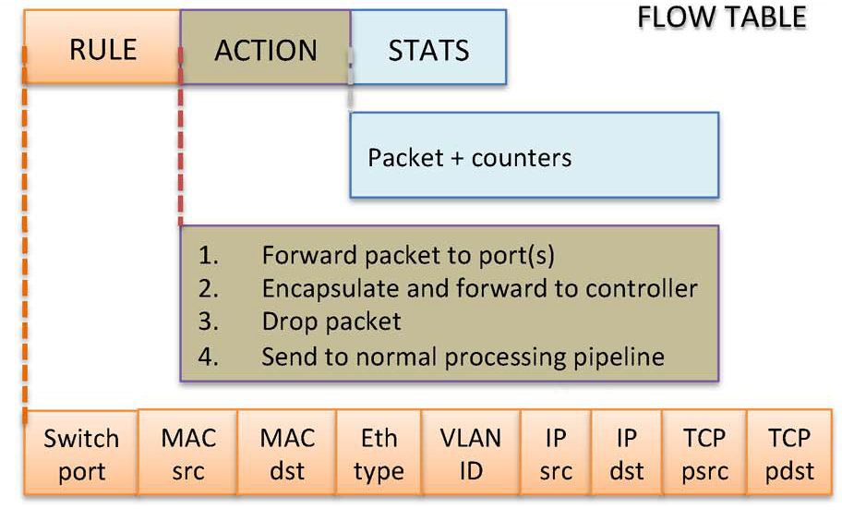
OpenFlow-enabled SDN devices
OpenFlow is: Enabler of SDN
Protocol between the control plan and data plane
Describes how controller and a network forwarding device should communicate
Packet+ byte Counters
Match Fields
Switching
*
00:2E
*
*
*
*
*
*
*
port3
300
Routing
*
*
*
*
*
4.5.6.7
*
*
*
port5
250
Firewall
*
*
*
*
*
*
*
*
10
drop
500

Slide 6
SDN security applications
examples
Load Balancer: send each HTTP request over lightly loaded path to lightly loaded server.
Firewall: inform Central Controller about malware’s packets, controller pushes new rules to drop packets.
Application plane
Routing, Load Balancer,
Access Control, monitoring, firewall, DDoS Mitigation, IDS/IPS
Abstract Network View
Network Virtualization
Up-to-date Global Network View
Control Plane
Server
A→B drop
S
S
S
S
Incoming packets
S
S
S
S
S
R
6

Slide 7
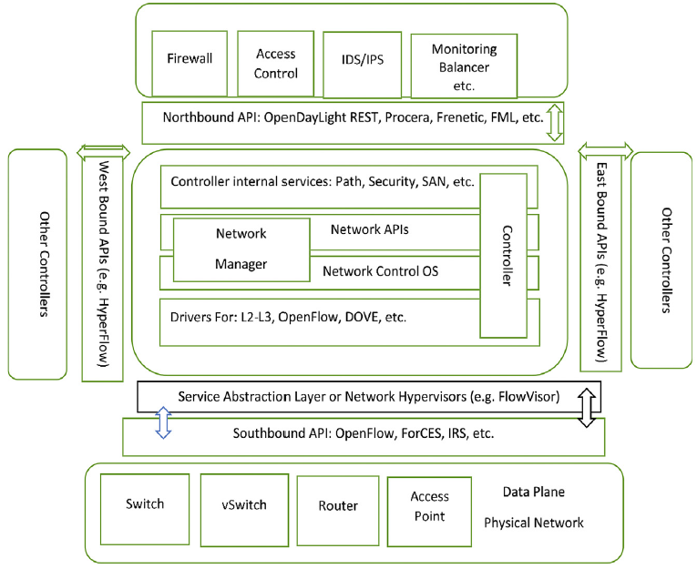
The big Picture SDN Archetucture
Alsmadi, Izzat, and Dianxiang Xu. "Security of software defined networks: A survey." Computers & security 53 (2015): 79-108.

Slide 8
SDN Security Challenges

Slide 9
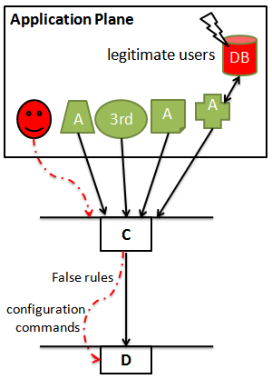
Application Plane Security Challenges
Lack of Authentication and Authorization
Lack of Access Control and Accountability
Fraudulent flow rule insertion
SDN aware & SDN unaware apps
Nested applications
Apps classes
Service apps
sensitive apps
Path characteristics
Access ports
Monitor traffic
Reject/Accept flows

Slide 10
Application Plane Targeted Threat/Proposed Solution
Threats within/from apps
Security policy violation
flow rules contradiction
Access control breach
Framework for security apps development
(FRESCO Scripting language)
Security policy
verification framework
-Flover:
on controller
new/old rules conflict
-ndb: root cause
-OFRewind : trace anomalies
Assertion-based language
-catch bugs before deployed
- forwarding loops
- black holes
Permission system (PermOF ):
least privilege on apps

Slide 11
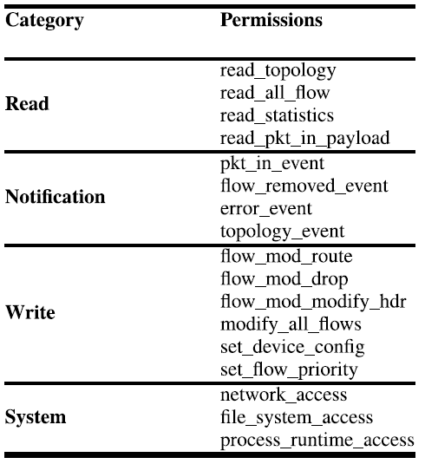
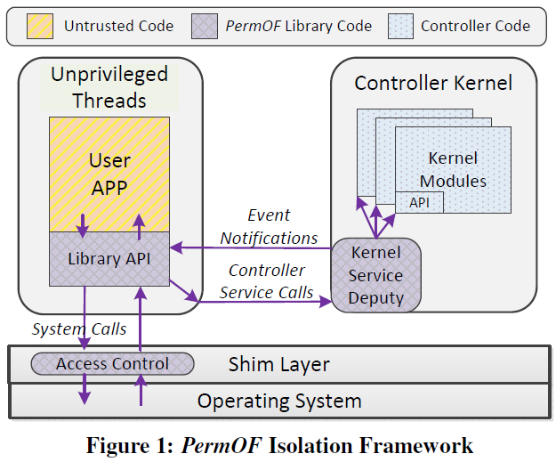
PermOF
The design is based on a Set of permissions & Isolation mechanisms
Ensures controller superiority over applications
Isolates control flow and data flow
controller should be able to mediate all the apps’ activity
Availability of sensitive info
real time
dynamic
execute
controlled by the controller kernel
Wen, Xitao, et al. "Towards a secure controller platform for openflow applications." Proceedings of the second ACM SIGCOMM workshop on Hot topics in software defined networking. ACM, 2013.

Slide 12
Control Plane Security Challenges
Threats due to Scalability
DoS Attacks
Challenges in Distributed Control Plane
-SDN response times
-IP packets with random headers
-Huge # flow rules
-saturation

Slide 13
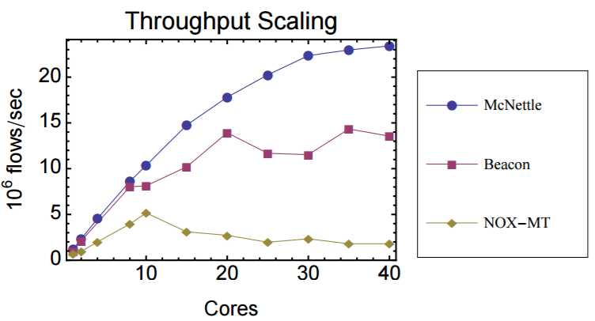

Control Plane Targeted Threat/Proposed Solution
Controller scalability
DDoS Attack
Challenges in distributed control plane
1. Wildcards mechanism
-Load balancing: direct an aggregate of client requests to replicas
2. Increase the processing power (McNettle controller) parallelism
3. Hybrid reactively/Proactive controller
Detection Framework
SDN DDoSDetection
intra-domain & inter-domain
(DISO)
NOX-MT scales to 5m f/s at 10 CPU cores
Beacon → 13m f/s at 20 CPU cores
McNettle →20m f/s at 46 CPU cores
McNettle
http://haskell.cs.yale.edu/wp-content/uploads/2013/04/thesis-singlespace.pdf

Slide 14
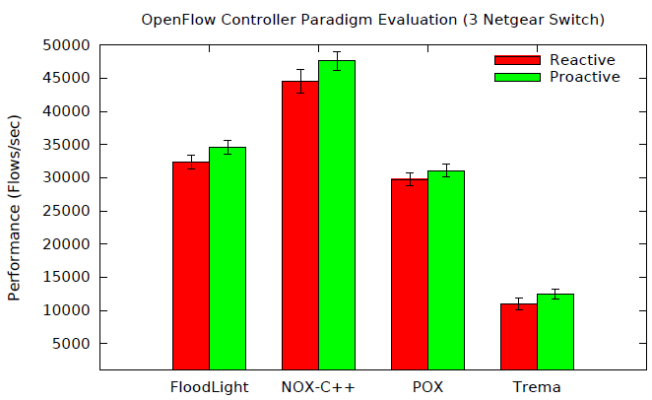
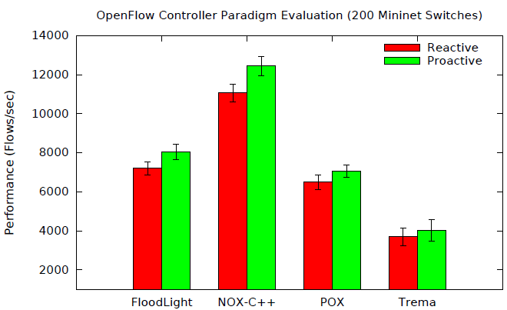
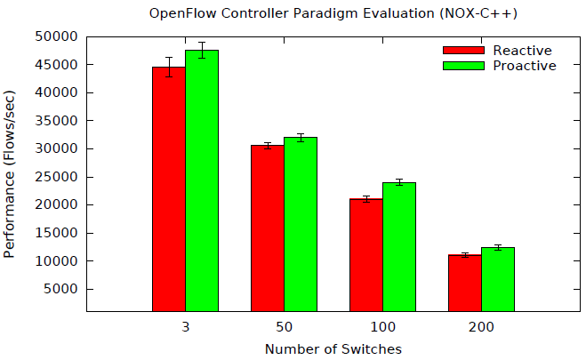
Reactively vs. Proactive Controller
Marcial P. Fernandez, Evaluating OpenFlow Controller Paradigms, 2013

Slide 15
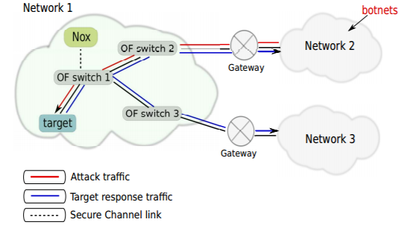
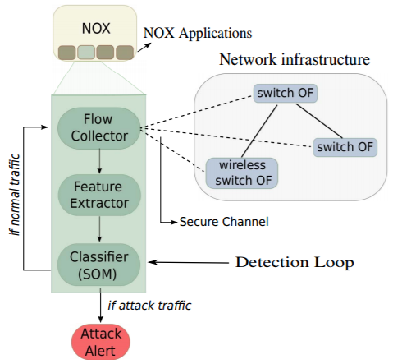
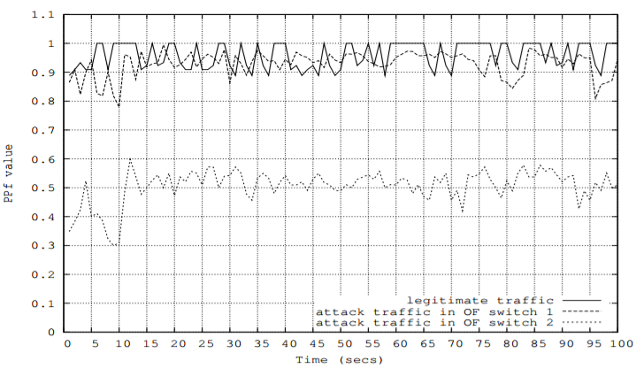
SDN DDoSDetection
Flow collector module: gathers flow entries within intervals.
Feature extractor: Avg. packets/f, Avg. Bytes /f, avg duration/f, growth of single-flows, and growth of different ports.
Classifier: Analyzes → Alarm?
R. Braga, E. Mota, and A. Passito, “Lightweight DDoS flooding attack detection using NOX/OpenFlow,” in Proc. IEEE 35th Conf. LCN, Oct. 2010, pp. 408–415.

Slide 16
intra-domain & inter-domain (DISO)
intra-domain : manages its own network domain
compute the paths of flows
dynamically react to network issues (broken line, high latency, bandwidth cap exceeded)
redirecting and/or stopping traffic
inter-domain:
discovers neighboring controllers and manages communication among controllers
exchange aggregated network-wide information with others
Traffic Optimization...
A
Topology!
Link information!
C1
C2
C3
SubD1
SubD2
SubD3

Slide 17
Data Plane Security Challenges
Flow rules installation
Switch-Controller link
Genuine vs. malicious rules
Limited table entries
Limited switch buffer
#switches per controller
path Length

Slide 18
Data Plane Targeted Threat/Proposed Solution
flow rule contradiction
man-in-the-middle attacks
Real-time contradiction check
FortNox

Slide 19
High level points
-- Debate

Slide 20
Centralization in SDN
The Good:
Fast responsiveness
Easy to removing policy inconsistencies
centralized routing algorithms
Firewalls
network-monitoring
The Bad:
Single point of failure may be exploited by an internal or external attacker
Regarding DDoS
Bad: centralization added a new type of denial-of-service (DoS) vector.
Good: Effective management of existing DoS attack types
Using Global view
Traffic analysis
New security challenges but benefits appear to be predominant!!!
Marc C. Dacier, Hartmut Cwalinski , Frank Kargl , Sven Dietrich, Security Challenges and Opportunities of Software-Defined Networking, Apr 3, 2017

Slide 21
Attack Surface vs. Defense Opportunities
Good:
In SDN defenders can create customized security solutions
e.g Anomaly detection systems
Global view
Open hardware interfaces
Centralized control
Bad:
Benefit the attackers (zero day attacks)
The centralized architecture
Lack of defender expertise
Still immature technology
Marc C. Dacier, Hartmut Cwalinski , Frank Kargl , Sven Dietrich, Security Challenges and Opportunities of Software-Defined Networking, Apr 3, 2017

Slide 22
Centralized vs. Distributed Approach
Good:
Reduced complexity by splitting into planes.
Easier testable
E.g, routing algorithms simpler than the distributed approach in conventional networks.
Bad:
Stressed by two aspects that strongly call for the use of a distributed approach.
The need for scalability
Operational requirements (fault tolerance)
Marc C. Dacier, Hartmut Cwalinski , Frank Kargl , Sven Dietrich, Security Challenges and Opportunities of Software-Defined Networking, Apr 3, 2017

Slide 23
Is SDN More Complex?, or Is It Simpler?
Implementing the control plane completely in software
Good :
Programmability
Bad:
Opposes simplicity : raises issues about algorithmic complexity.
Why: additional requirements that weren’t imposed on classical networks but are now thinkable in SDN.
Simplicity is a key design principle in building secure systems.
SDN has the potential to be simple—but making it simple is quite complex.
Marc C. Dacier, Hartmut Cwalinski , Frank Kargl , Sven Dietrich, Security Challenges and Opportunities of Software-Defined Networking, Apr 3, 2017

Slide 24
Open problems & research directions
How to implement authentication and authorization to certify SDN applications.
How to implement access control and accountability in SDN.
How to implement customized security procedures based on the type or categories of applications.
How can we find automated derivation of Secure SDN Configurations.
How can we secure the controller-switches communication?
How can we perform efficient intrusion detection and anomaly detection in SDNs?
How can we operate SDN in presence of untrusted HW components?
How can we protect the controller itself?
Without security, SDN will not succeed!

Slide 25
Thank you

